Slide 1

NHS
Healthcare: Appointments,
Utilisation & Capacity Analysis
A Data Analysis
By
Andrew Willacy
August 2025
Notes:
Hello and welcome to my presentation about the NHS. We will firstly be looking at the context and background of the situation, the problem we are looking to solve and how the analysis was carried out. WE will then look at some of the interesting insights and trends before moving onto recommendations and conclusions.

Slide 2
Context & background
NHS England has a problem. A problem of limited capacity and resource utilisation
Or does it?
Missed appointments cost £30 each, a financial and social burden
15M missed GP appointments*
The NHS have posed two questions:
Has there been adequate staff & capacity in the networks?
What was the actual utilisation of resources?
*https://www.england.nhs.uk/2019/01/missed-gp-appointments-costing-nhs-millions/
Notes:
NHS England has a problem? A problem of limited capacity and resources. Or does it? Well that’s what we hope to discover
Each missed appointment has a financial and social burden on the NHS (UK tax payer) and patients (enable to get an appointment). Can this be addressed through a data informed approach. Can we predict whether an appointment is likely to be missed.
Initial analysis suggests that there may indeed not be sufficient resources to deal with an ever increasing population demand.
The NHS have posed to questions. Has there been adequate staff and capacity in the networks?
What was the actual utilisation of resources?
Lets set about looking into this

Slide 3
Initial Insights
106 locations across 7 regions
Face to face appointments most common, followed by telephone
Covid changed how appointments are delivered
91% of all appointments attended
Most GP appointments are same day
Most appointments are 6-10 minutes in duration
Unmapped, inconsistent mapping and data quality issues
Notes:
Sp, some initial insights.
There are 106 locations across 7 regions
Face to face is the most common delivery method for appointments, followed by telephone and the covid pandemic played a big part in this change as we’ll see later on,
91% of all appointments are attended. But that still leaves 96,000 missed appointments a day, using a 1,2 million a day guide figure.
Most GP appointments are same day
But, crucially, one regularly occurring theme has been with unmapped, inconsistent mapped and data quality issues,

Slide 4
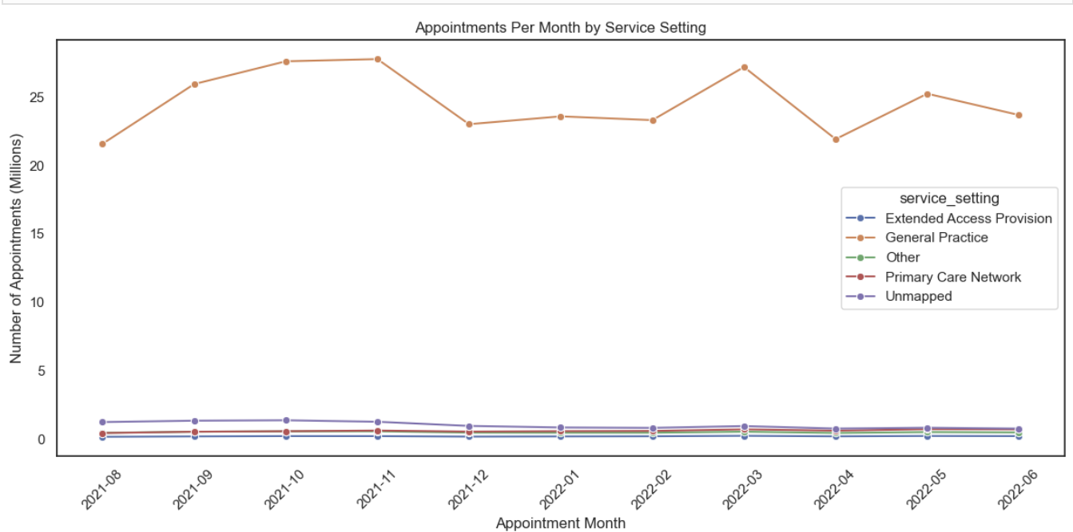
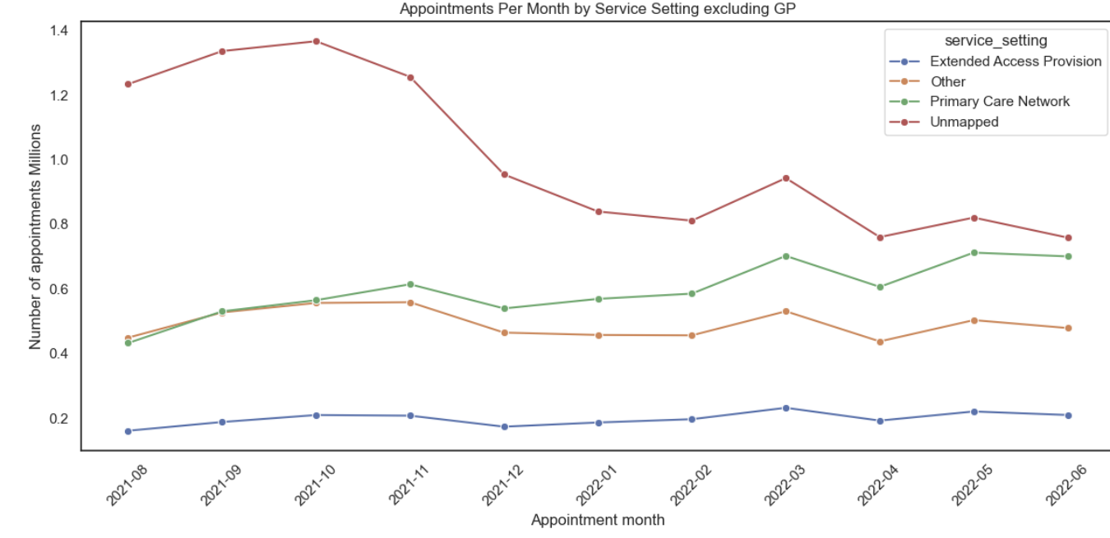
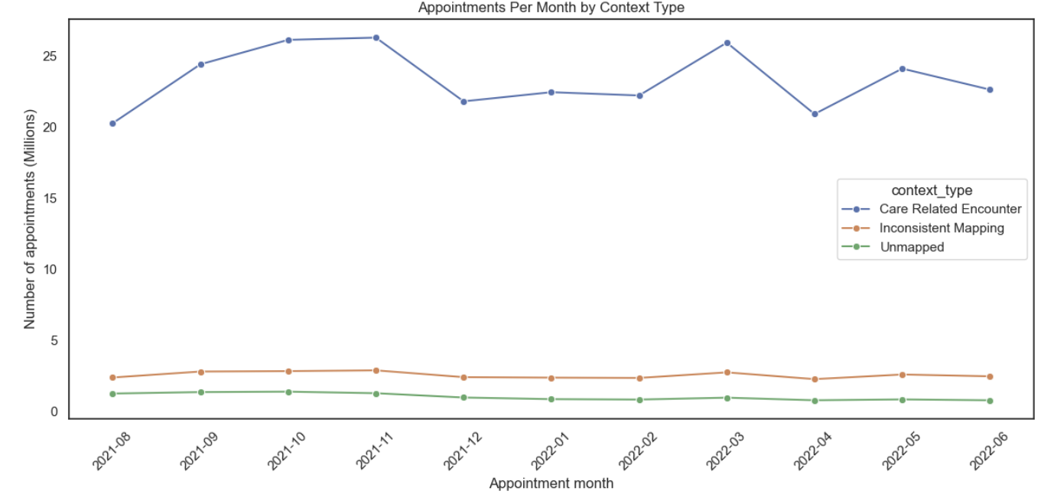
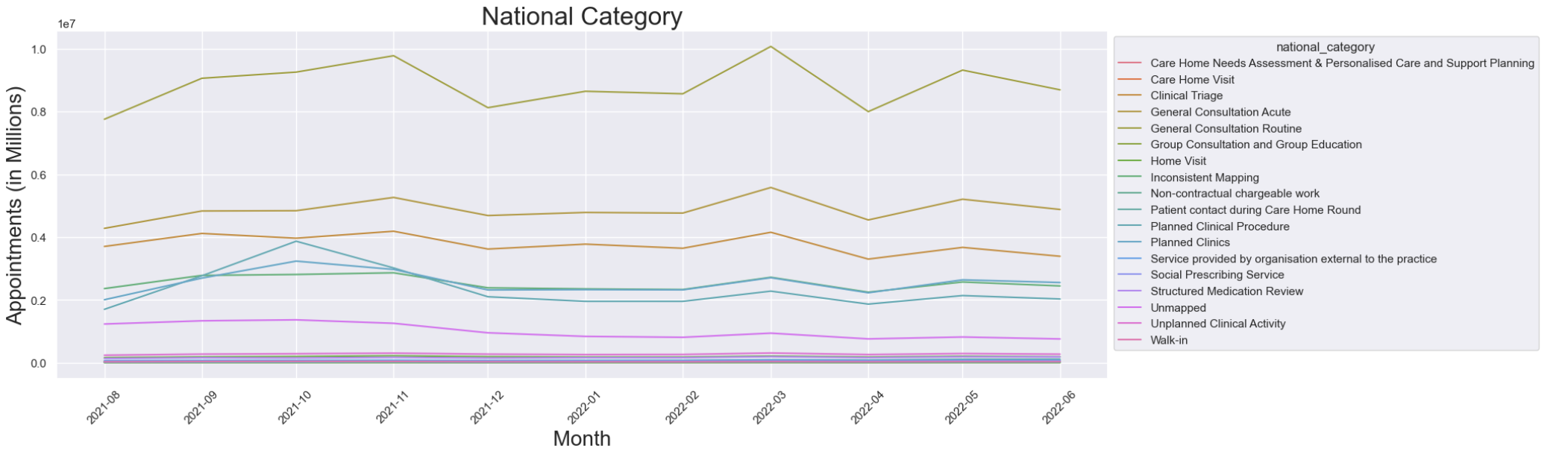
Service settings & context types 08/2021-06-2022
Notes:
Service setting and context type.
GP is by far the most popular service setting and dominates the chart to the extent everything else is barely, so to the right we have the same chart without the GP service setting. Now we can see that the unmapped category (red line) makes up the biggest chunk. This is an issue for data collection. Howeverm a significant drop started in October 2021 presumably due to a new mapping system introduced in August of that year.
Also slight increase in primary care (green) during this period.
In terms of context type, Primary care dominates. But again we see the issue of Unmapped and inconsistent mapping.
In the National categories Routine general consultation makes up ther highest number of appointments.
In each graph we can see we are facing an issue with data quality

Slide 5
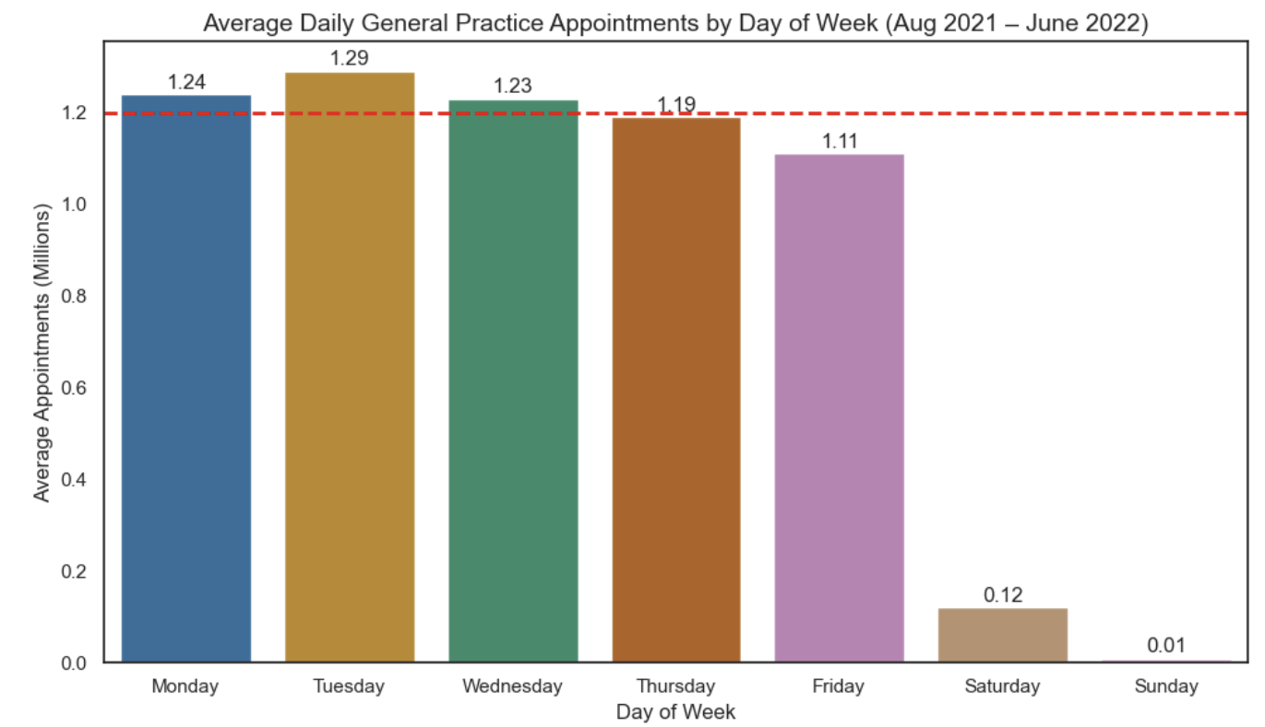
Average daily appointments by day
Notes:
So, turning to appointments now, we can see an average week. The red horizontal line marks 1.2 million daily appointments considered to be the maximum capacity of the NHS
The graph shows this was breached on Monday, Tuesday and Wednesday. Weekends barely register yet are included in the 1.2 million caoacity figures which will skew the data.
Indeed the graph suggests that Tuesday was the busiest day on average. But maybe not all is at it seems.

Slide 6
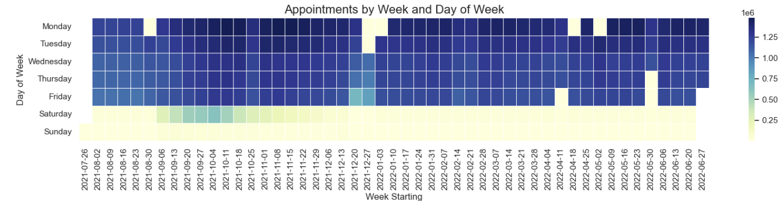
Which days are busiest (getting to the truth)
Notes:
This heatmap shows which days are the busiest for the period August 2021 to June 2022
Each square represents a day and each week flows from left to right.
The darker the square the higher the number of appointments on that day. So yellow is low, and dark blue high.
Now we can see some Mondays’s had very few appointments, these look like bank holidays when GP surgeries were likely closed. But as we saw previously the capacity figure doesn’t take this into account
The same situation arises with weekends, where there are very few appointments. There was an increase in Saturday appointments between September and December of 20221.
So using a capacity figure of 1.2 Million for every day simply doesn’t work and skews the data
It’s also likely that the actual number of appointments is actually higher than the data may at first suggest, Indeed Monday is likely the busiest day as could be expected after two days when appointments were unavailable.

Slide 7
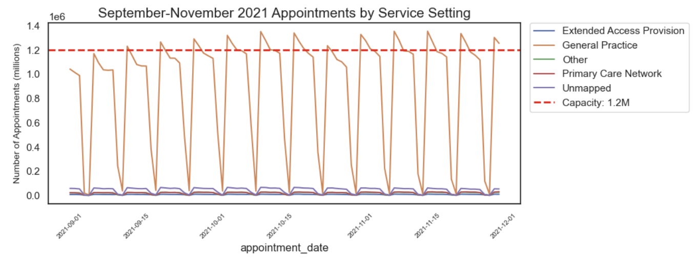
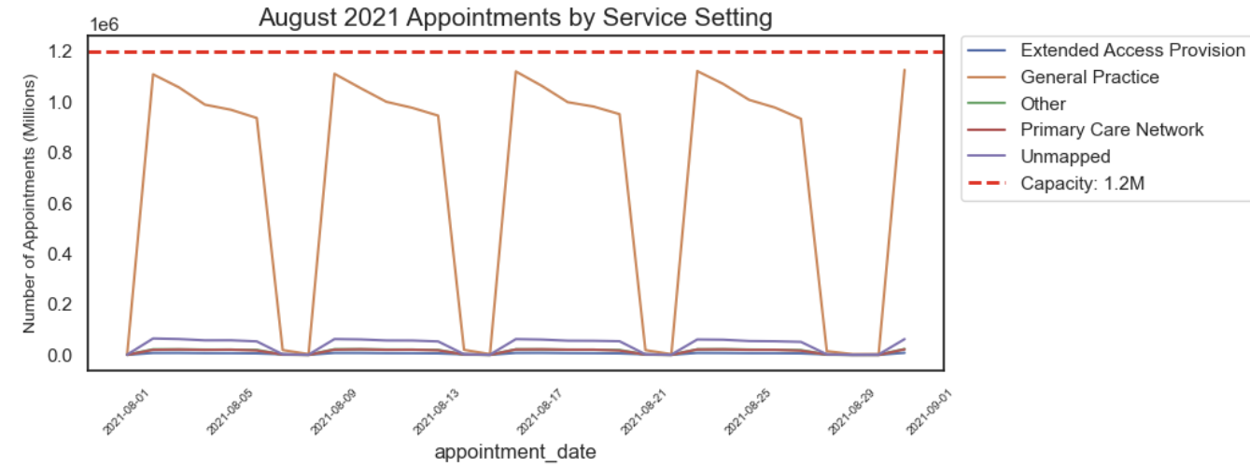
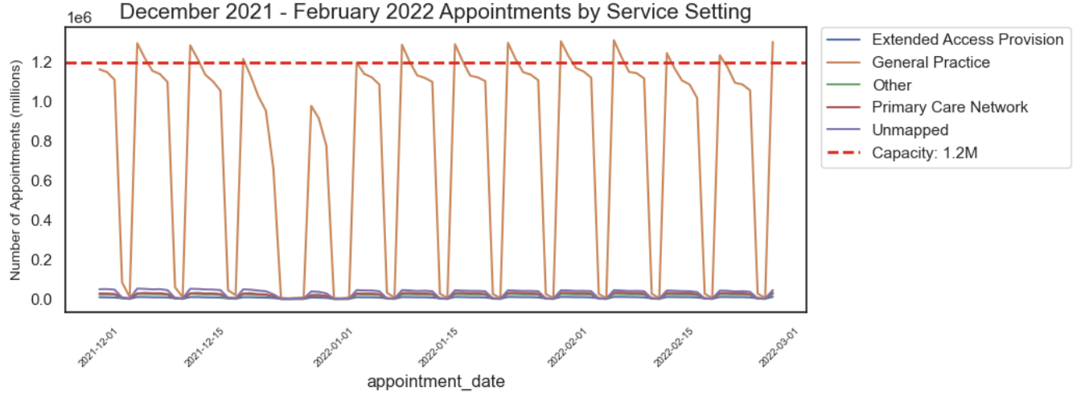
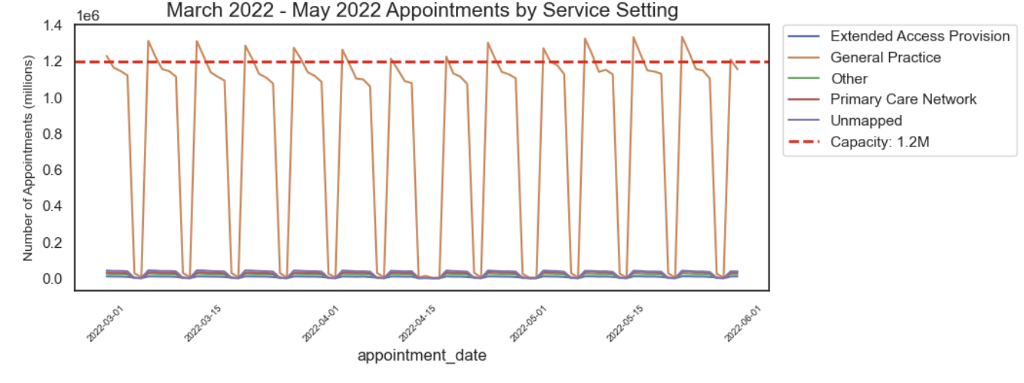
Appointments by season (August 2021-June 2022)
Notes:
So turning to seasonal trends. The red horizontal line represents the 1.2 million capacity.
We can see how each weeks starts off with high demand then tends to drop off a bit later in the week. The orange lines represent demand for GP appointments.
The summer season (August) is very similar and indeed suggests capacity is above demand.
Moving onto the Autumn months (September to November), the situation changes, with a greater demand on services.
We can see that capacity is starting to be breached, particularly in the first half of the week, although demand does increase later in the week as we move into October/November.
A Similar picture with the winter months of December to February, although Thursday and Friday seem less in demand.
Note the dip around Christmas and New Year, which is to be expected as GPs are closed.
Into Spring and the months of March to May, its again a similar picture with a slight dip in demand during April, this was around Easter.

Slide 8
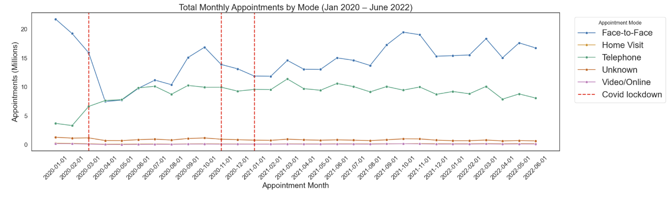
How where appointments delivered (mode)
Significant and sharp decrease in the number of face to face appointments when the first Covid lockdown came into force,
An increase in telephone appointments at the same time
Notes:
Now we turn to how appointments were delivered over time.
We’re going back in time for this looking at the period January 2020 – June 2022
Now there’s a good reason for this. This is the Covid period which caused massive upheaval particularly to the NHS
The red vertical line represent the start of covid lockdowns
We can see a sharp drop in face to face appointments (blue line) and at the same time a smaller increase in telephone based appointments (green line)
By May face to face appointments are increasing again, interestingly so are telephone appointments.
For the second lockdown telephone appointments remain steady but face to face once again sharply decline
After the lockdowns, face to face appointments have been up and down while the numbers of telephone appointments has remained relatively steady.

Slide 9
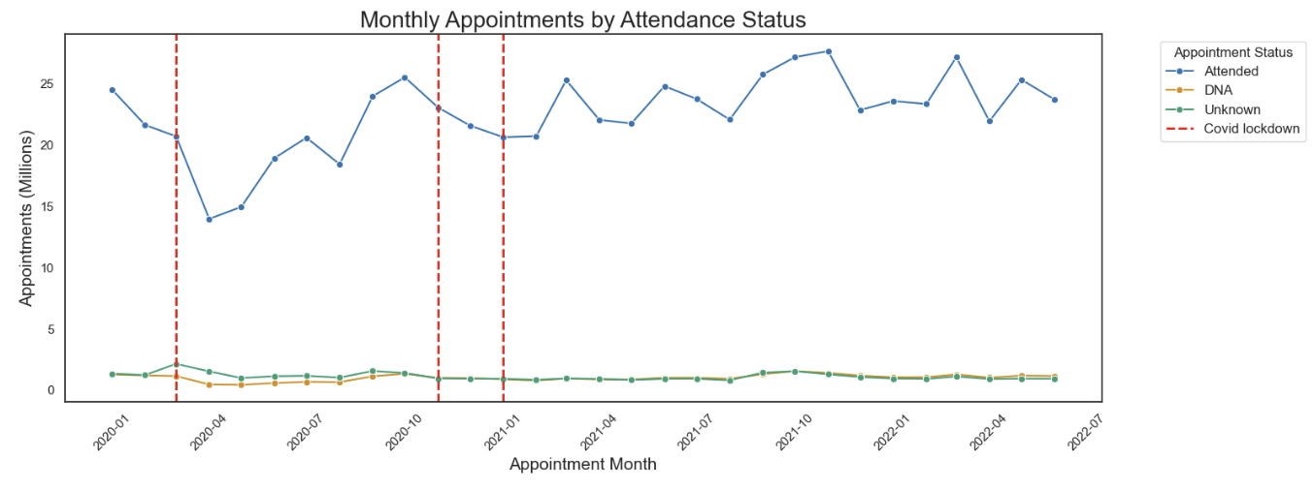
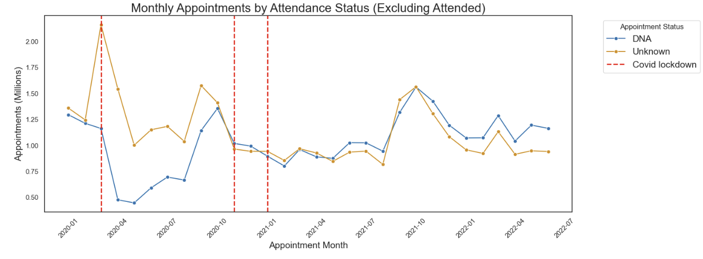
Appointments by attendance (Jan 2020 – June 2022)
Notes:
For the same period looking at attendance. The categories are ‘Attended’ , ‘Unknown’ and ‘Did not attended after appointment was made’ Attendance dropped during the first covid lockdown (red vertical lines) suggesting less appointments were made. At the same time there is an increase in the ‘Unknown’ category
Looking at the bottom graph, the ‘attended’ status has been removed to gain a clearer understanding
‘Unknown’ increases by 1 million, so we see an issue with data recording again. At the same time DNA (Did Not Attended) fallssharply, although quickly increased again during the following months
There is a significant increase in both ‘Unknown’ and ‘DNA’ during October 2021 which seems to coincide with the covid vaccine rollout.

Slide 10
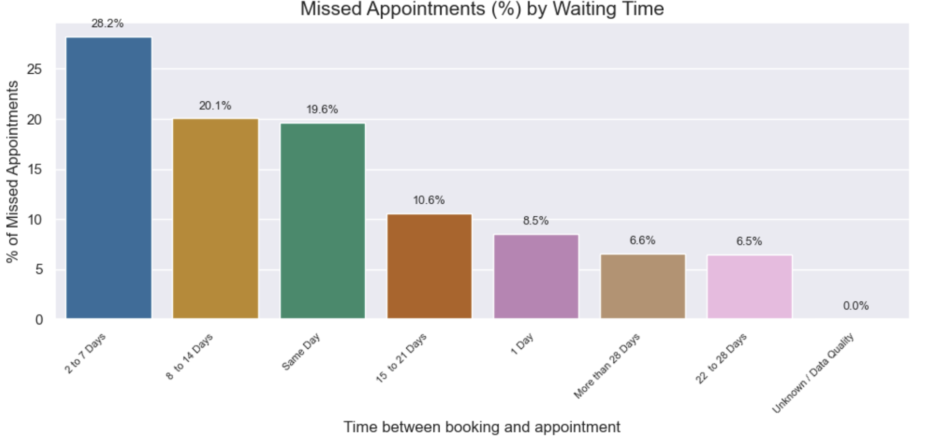
Missed appointments by wait time
Notes:
To ascertain whether it could be predicted when patients were most likely to not attend appointments it’s worth looking at how the number of missed appointments corresponds to the wait time between making and appointment and attending.
In this case it seems that 2-7 days is the most likely to not be attended. WE could assume that patients felt better during that time and didn’t bother attending. Interestingly 22-28 days, and more than 28 days, were the least likely to be missed. These may be appointments that are for continuing treatment or situations where there is no immediate rush to be seen.

Slide 11
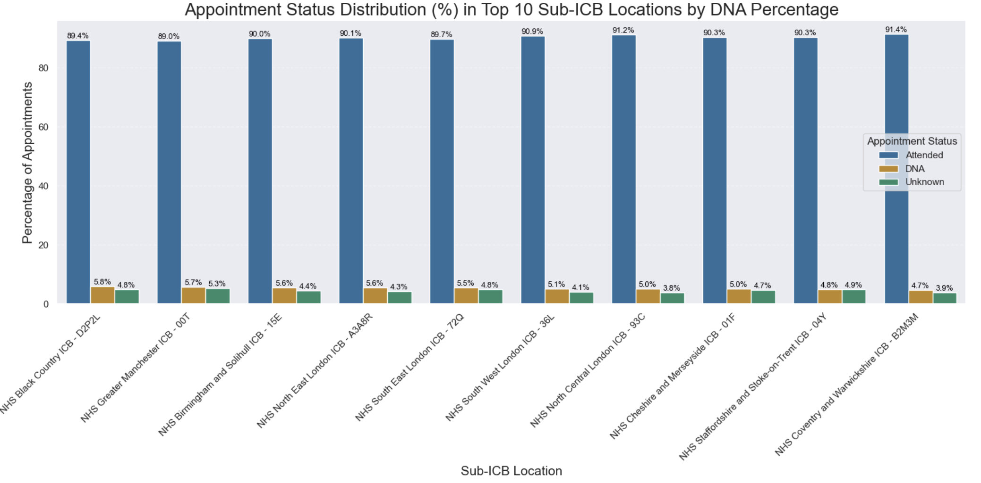
Appointment attendance status (Sub ICB)
91% of appointments are attended
3.5-4.3% are not attended
4.4%-5.5% are unknown
Notes:
So here we can see the attendance status across the top sub icb locations by DNA
Most appointments are attended as scheduled
However it can be seen that up to 5.8% are not in the nwrost performing locations, that equates to nearly 70,000 missed appointments a day at a cost of £2 Million
3.9%-4.8% are unknown, so the situation could be worse and better

Slide 12
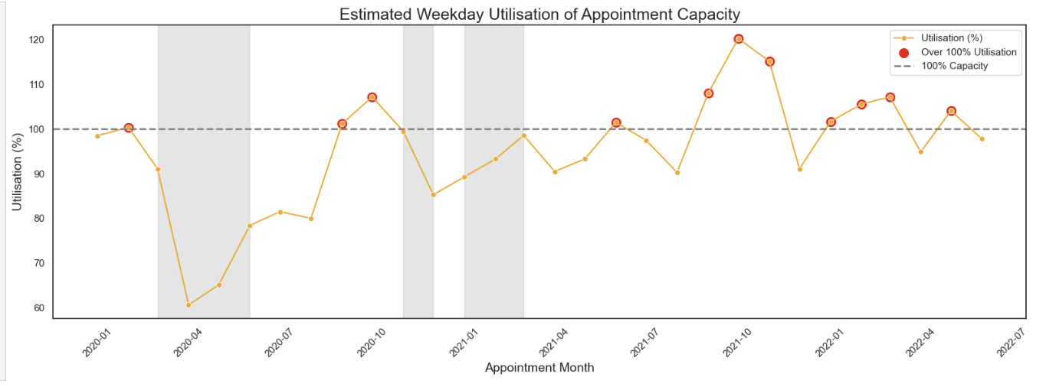
Utilisation (January 2020-June 2022)
Notes:
Utilisation of resources
The grey blocks signify the covid lockdowns. Each red dot represents over 100% utilisation.
During the first lockdown utilisation was very low, but as we’ve seen less appointments were made during this period, so that’s hardly surprising.
Over utilisation does vary, but it appears to occur during the Autumn predominately. Indeed the months of September, October and November show over utilisation for both 2020 and 2021.
There is also a smaller peak in winter to Spring of 2022
So it looks like we may be able to predict those periods where utilisation will be a problem.

Slide 13
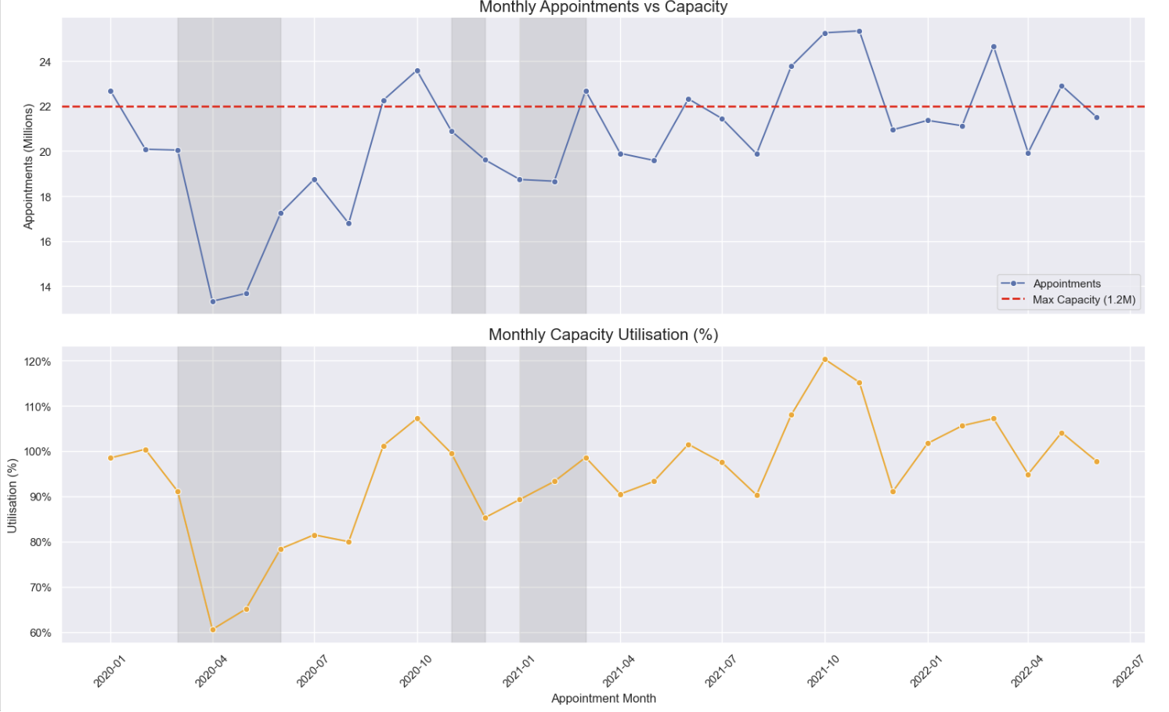

Slide 14
Key Insights & Trends
NHS England is experiencing an ever increasing demand on services fueled by an increasing population, particularly the elderly
Daily capacity of 1.2 Million
Capacity is an issue during the autumn and winter months but under capacity the rest of the year
Patients not attending booked appointments is costly both financially and socially
Data quality and mapping a big issue
Notes:
The key insights and trends discovered
It’s evident that the NHS does indeed have an issue with capacity and resource management. Using the figure of 1.2 Million appointments as capacity for each day makes no sense. It should be demand driven. Weekends are always going to be well under this capacity figure, so resources should be utilised to those days, weeks or months of high demand and reduced when demand is lower.
It may not be a case of lack of resources but more the resources aren’t available at the right times.
Patients not attending appointments is a big issue and creates a problem with availability of appointments, not to mention the financial burden.
Across the whole analysis data quality or lack of data has been an issue. It is vital have reliable and consistent data collection in place to be able to have a clear picture of the situation.

Slide 15
Recommendations
More reliable and efficient data collection is needed
Adjust capacity levels and utilisation as required according to demand
Use historical trends to plan for the future
The problem of DNA needs to be sorted – target in particular those areas where DNA is particularly high
Review how patients make, reschedule and cancel appointments
Increase social media integration
Collect more demographic and social economic data, adhering to laws and ethical standards
Notes:
So to the recommendations
First and foremost, improve the administration of data, Ensure all staff are recording data accurately and in a timely fashion.
The capacity levels should be based on demand, and resources utilised as necessary for the peaks and troughs in demand. It may not be a question of more staff, but more a question of how they are utilised.
With that historical trends could be used to plan ahead. Having said that the data from the time period here probably doesn’t represent typical years, a pandemic isn’t a yearly occurrence, so some caution should be used.
The issue of non attendance needs addressing. Maybe the use of technology through text or email reminders. However not everyone is tech savy particulaly the elderly.
In the same vein, maybe review how appointments are made, rescheduled and even cancelled. Would the use of an app or patient portal help make this an easy and quick process.
The collection of demographic data may also help ascertain if it’s certain groups who are non attendance

Slide 16
Conclusion
Notes:
So conclude, the analysis suggests the system is under strain during busy periods. The NHS should look at reviewing capacity and utilisation to meet demands as and when needed.
Data quality remains an issue and the non attendance situation needs to be addressed.
Social media is under utillised, patients are more than likely to have mobile phones and use social media. Now while such systems may already exist through websites, it’s a question of ensuring they are easy to use and functioning., so here is an opportunity to bring the NHS into the 21st century

