Slide 1
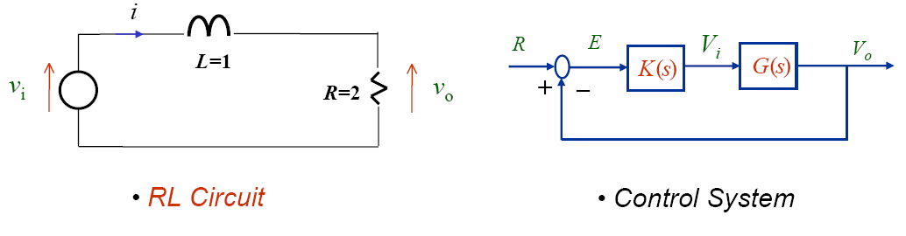
EGR431 Project 1
(100 points. Please submit softcopy report and simulation files to Blackboard.)
Consider a simple RL circuit below. Design a PI controller (see the second figure) such that when it is applied to the circuit, the resulting settling time due to a unit step input is less than 1 second with a 10% overshoot.

