Slide 1
Spatial Mapping of Air Quality
Andrew Willis
CSC-423 Datamining
11/18/2025
With Regards to Energy efficiency providing a predictive model

Slide 2
Air pollution remains one of the leading environmental health risks in the United States, with regional disparities linked to differences in energy production and policy. As states transition toward renewable energy, it is important to quantify how clean energy adoption influences air quality outcomes over time.

Slide 3
Results
Andrew Willis
11/18/2025
1. Acquired Data
2. Technique
3. Post Processing

Slide 4
Data: https://www.epa.gov/outdoor-air-quality-data
PyPy: plotly, matplotlib, scikit, tqdm, pandas, numpy
Built-in: dataclasses, pathlib, typing, json, logging, webbrowser, argparse
Acquired Data
1

Slide 5
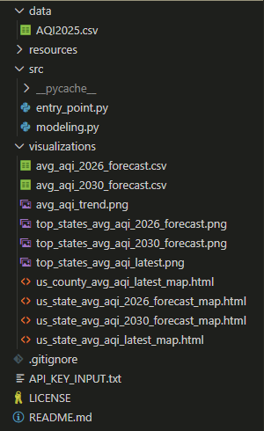
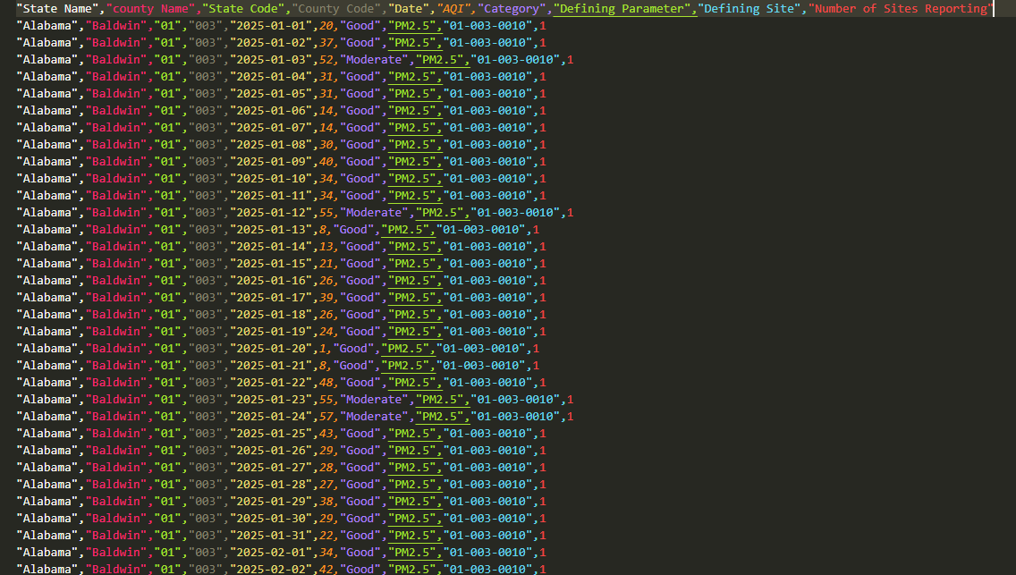
Technique
2
Notes:
Automatic Feature Creation, Linear Regression, CSV Parsing

Slide 6
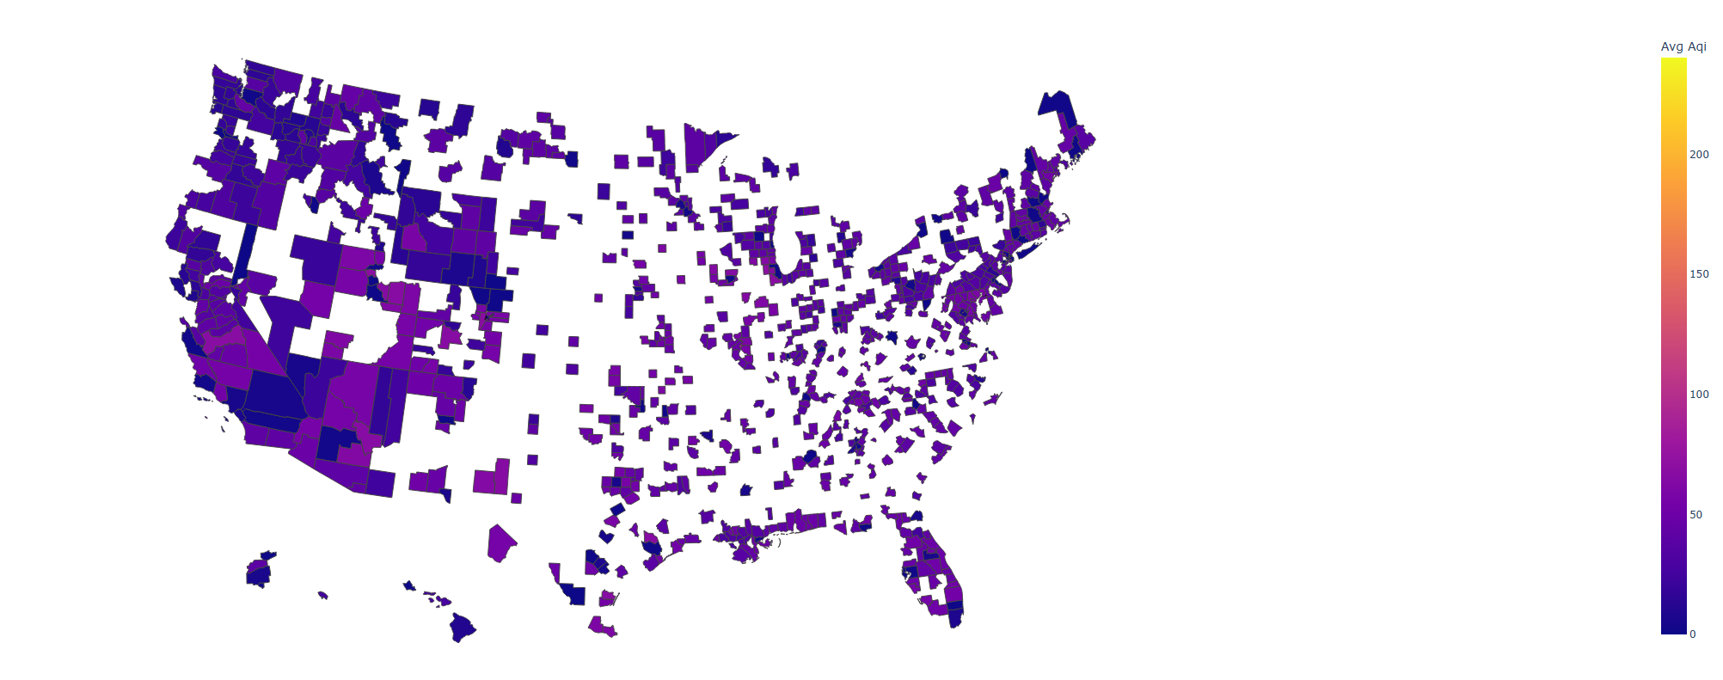
County Level AQI - 2025 Raw Data
Post Processing
3a
Notes:
Automatic Feature Creation, Linear Regression, CSV Parsing

Slide 7
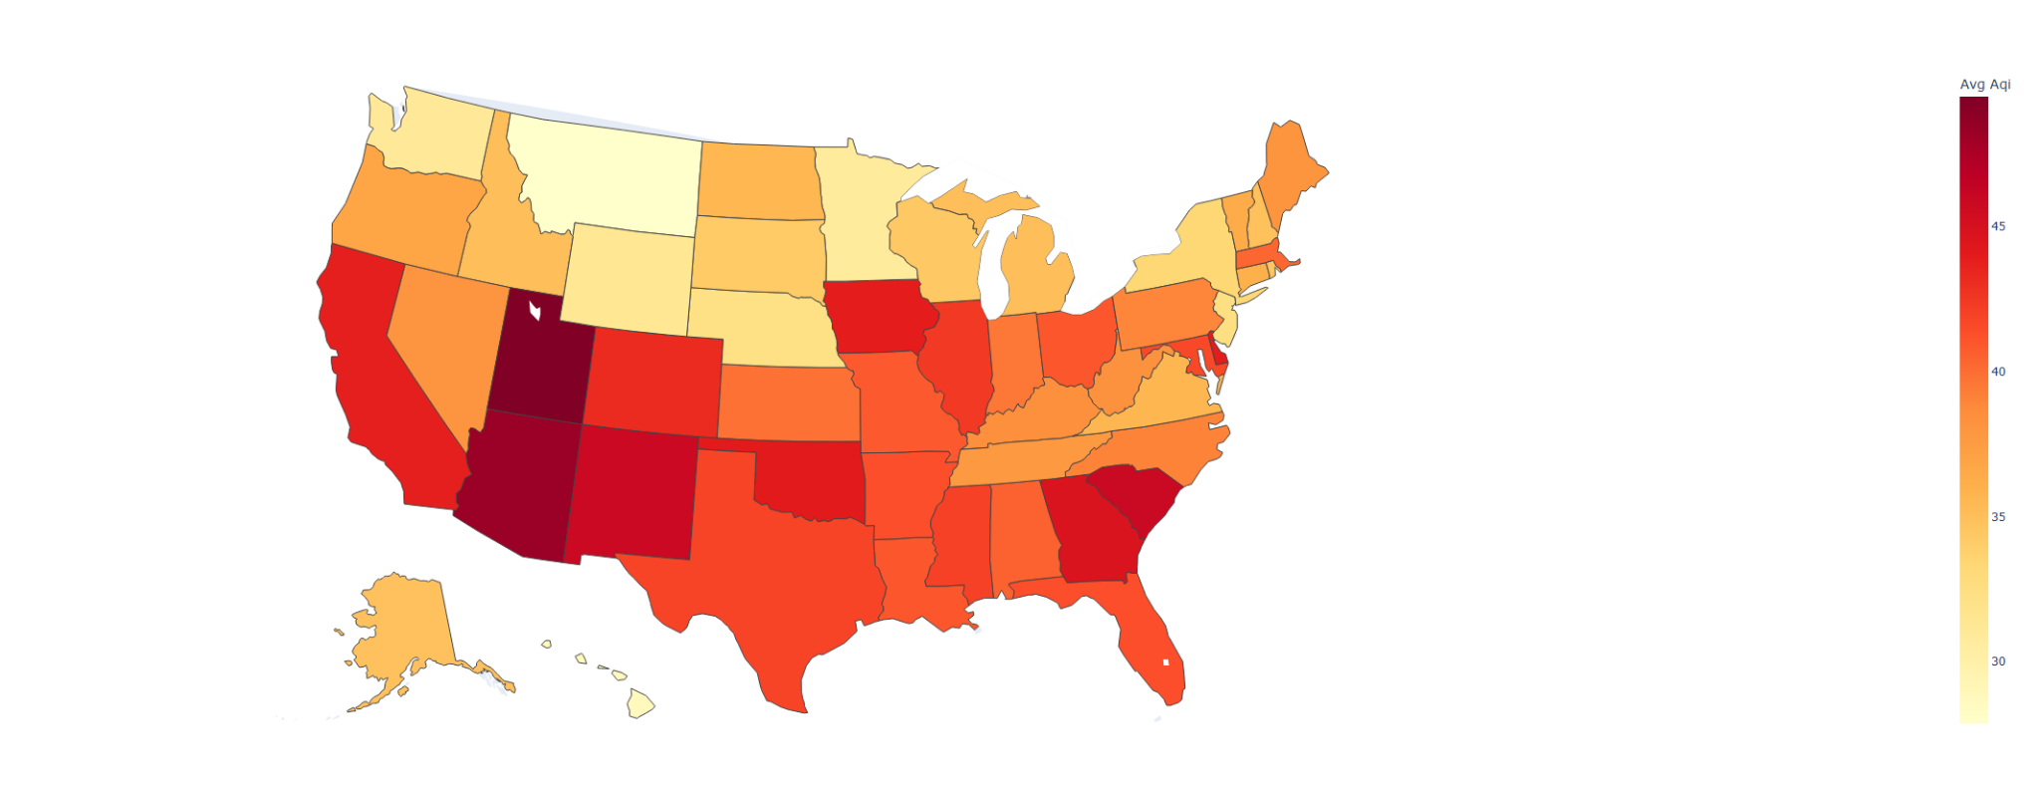
State Level AQI - 2025 Raw Data
Post Processing
3b
Notes:
Automatic Feature Creation, Linear Regression, CSV Parsing

Slide 8
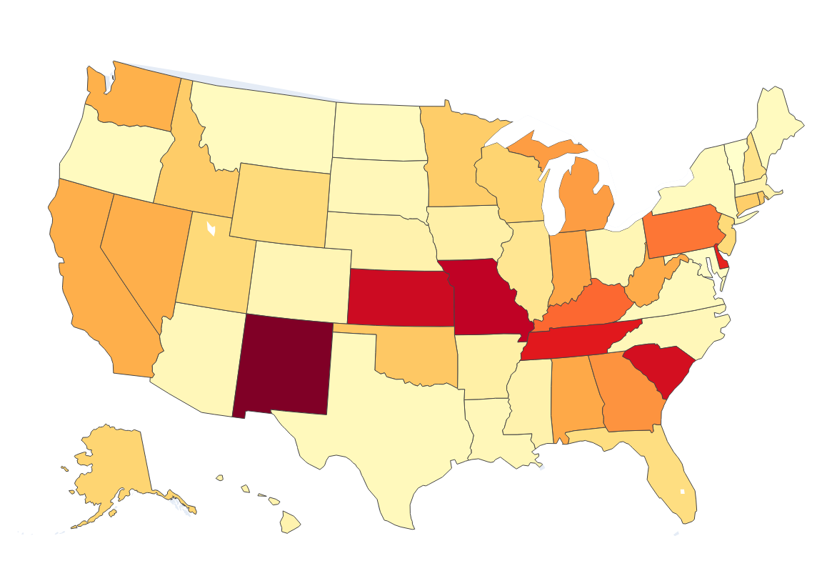
State Level AQI - 2026 Predicted
Post Processing
3c
Notes:
Automatic Feature Creation, Linear Regression, CSV Parsing

Slide 9
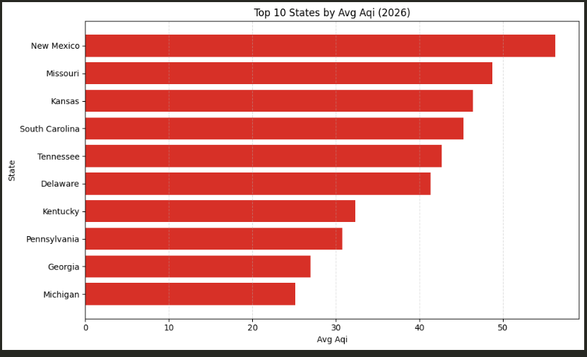
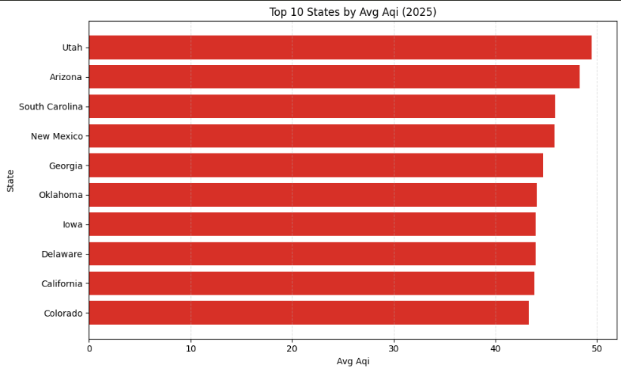
Post Processing
3d
Notes:
Automatic Feature Creation, Linear Regression, CSV Parsing

Slide 10
When given positive energy outlooks, the Air quality will improve generally as seen by the model.

Slide 11

Instructions for use are on the README.md on my Github: https://github.com/AndrewWillis7/Energy-Vs-Air-Quality-Heatmaps
Data: https://www.epa.gov/outdoor-air-quality-data
PyPy: plotly, matplotlib, scikit, tqdm, pandas, numpy
Built-in: dataclasses, pathlib, typing, json, logging, webbrowser, argparse
Resources
Thank you!

