Slide 1
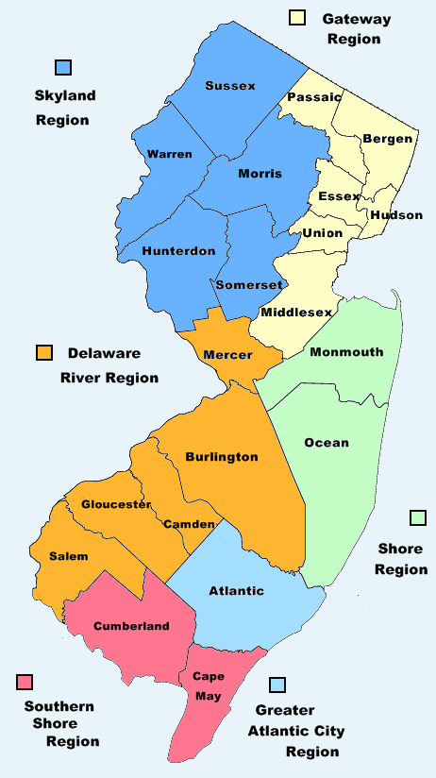
2016 NJ Election Forecast
Andrew Wang, Robert Fullem

Slide 2
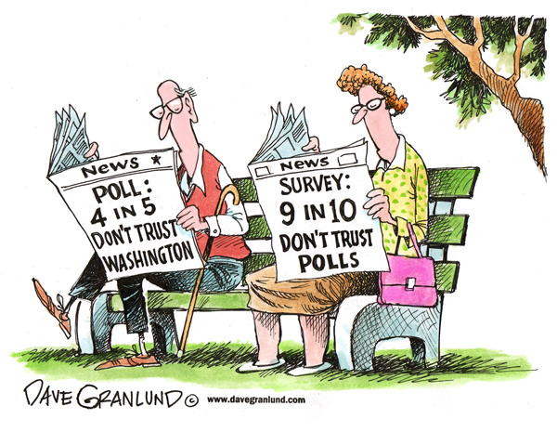
Polling is often inaccurate of election results
Demographic changes can help us to predict how NJ counties will vote in 2016.
Use census data concerning changes in population and income per capita
Linear regression models will tell us what to predict for 2016 election results

Slide 3
2016 Election is Over!
Ways to use database
Compare our projected voting results to actual county voting results
Which counties we got right?
Which counties we got wrong? (3)
See correlation of changes in per capita income to voting trends
See which counties populations are growing the fastest/slowest and how they voted in 2016

Slide 4
For the following people
Political Scientists: Use as a tool to forecast future elections
Political party affiliates: See how demographic changes will impact your parties viability in different counties
Hobbyist/Enthusiast: See plots that show how the county you reside in will be voting in the future!

Slide 5
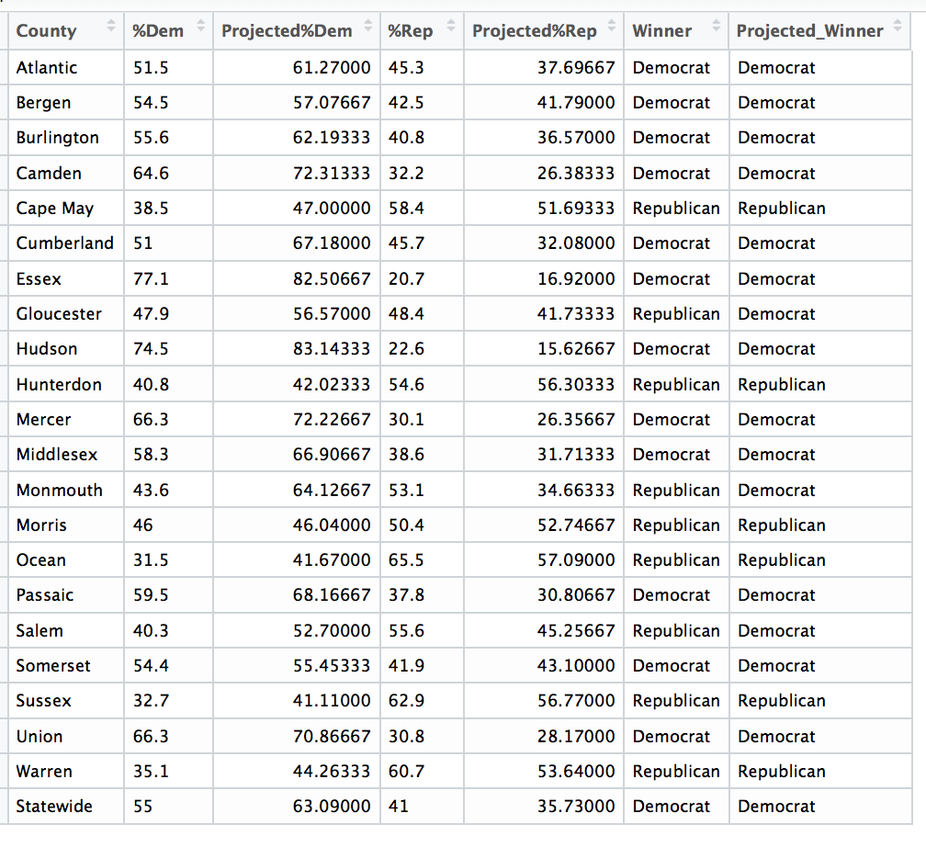
18/21 counties correctly predicted!

Slide 6
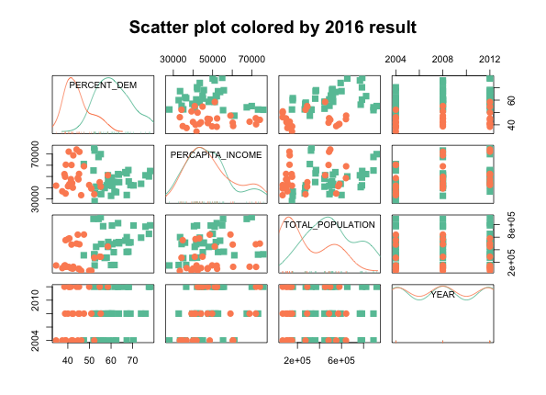
Scatter plots of variables being analyzed
Orange: Republican Voters
Green: Democrat Voters
Plots made from:
% Democrat votes
% Republican votes
Total population
Percapita income
Year
2016 winner

