Slide 1
Introduction to Electrical and Computer Engineering
ECE-3 Fall 2021
LAB 6

Slide 2
Outline
Examples, Matrix-Vector Multiplication (Notebook)
Discrete Convolution via Toeplitz Matrix

Slide 3
Toeplitz Matrix
a b c d e f
g a b c d e
h g a b c d
k h g a b c
M_{(i,j)} = M _{(i+1,j+1)}
1 3 0 4 3
7 1 3 0 4
1 7 1 3 0
*not necessarily square

Slide 4
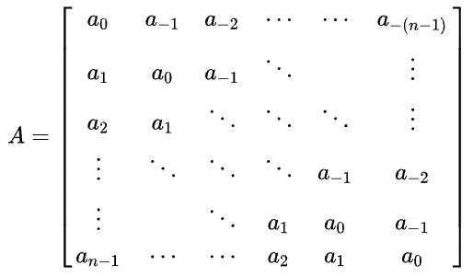
Toeplitz Matrix
General Form:
Source: https://en.wikipedia.org/wiki/Toeplitz_matrix

Slide 5
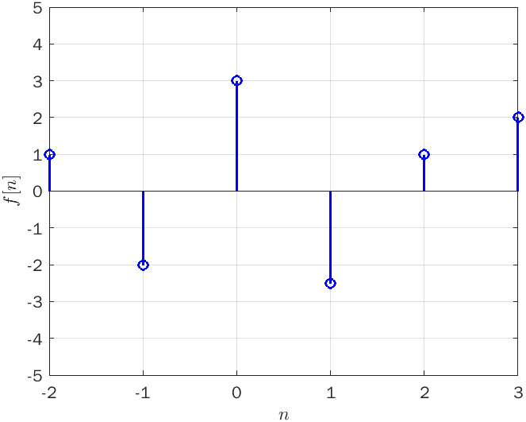
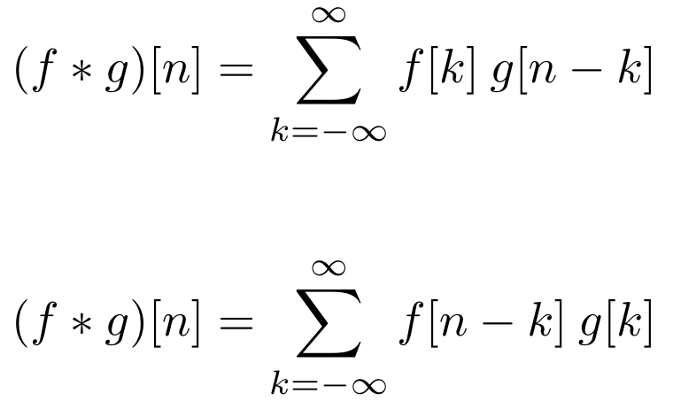
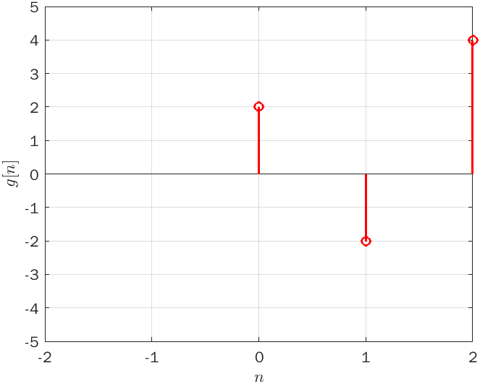
Discrete Time Convolution
Definition

Slide 6
Discrete Time Convolution

Slide 7
Demonstration (Continuous Time)
Source: https://en.wikipedia.org/wiki/Convolution

Slide 8
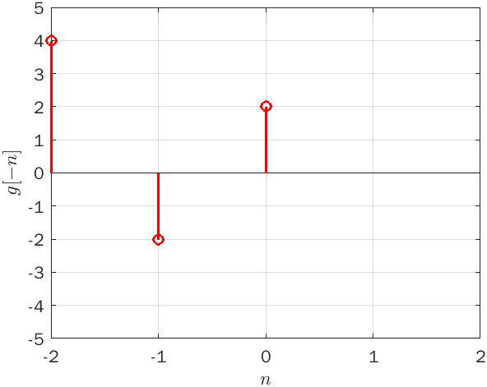
Discrete Time Convolution
g[n]
g[1-n]

Slide 9
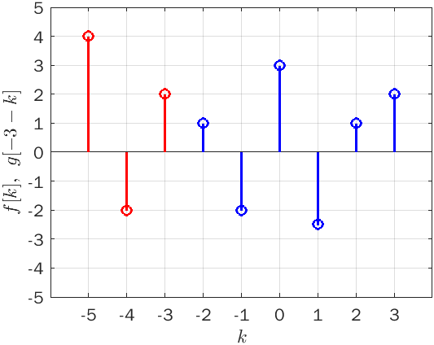
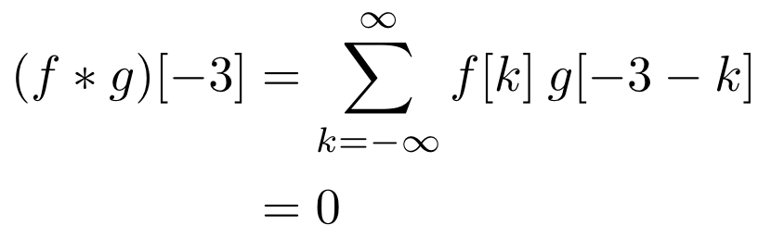
Discrete Time Convolution

Slide 10
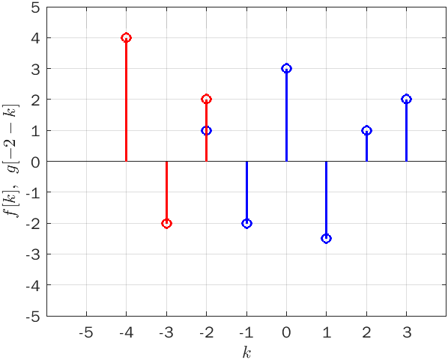
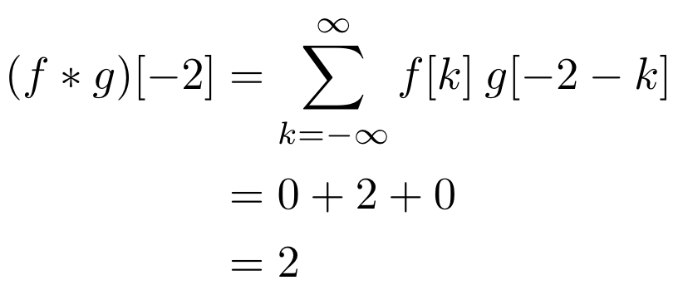
Discrete Time Convolution

Slide 11
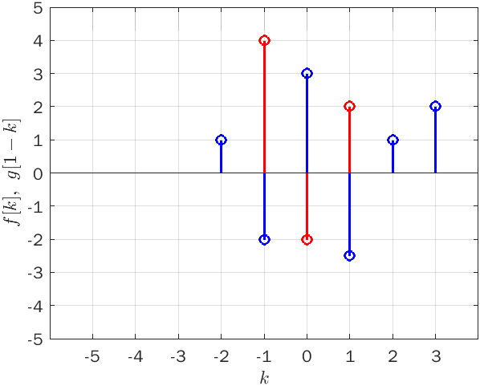
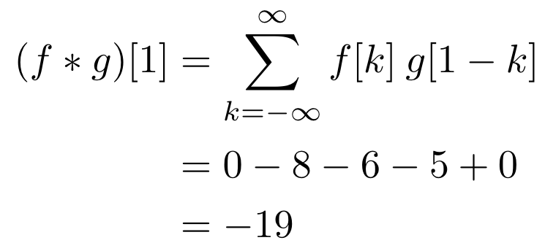
Discrete Time Convolution

Slide 12

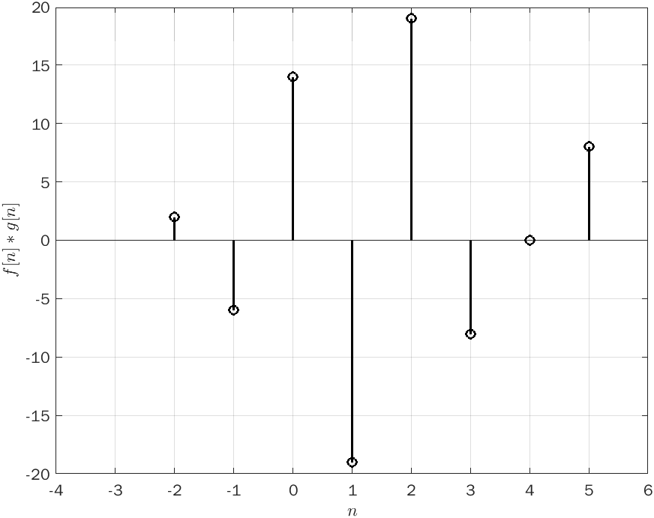
Discrete Time Convolution

Slide 13
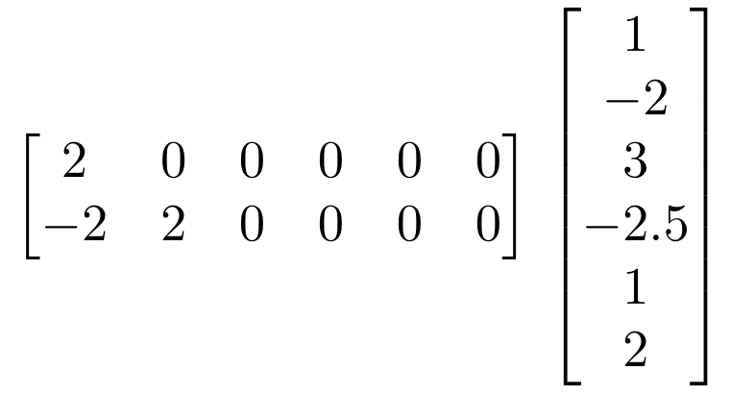
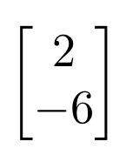
Discrete Time Convolution
g(k) * f(k)
f(k)
g(-k)

Slide 14
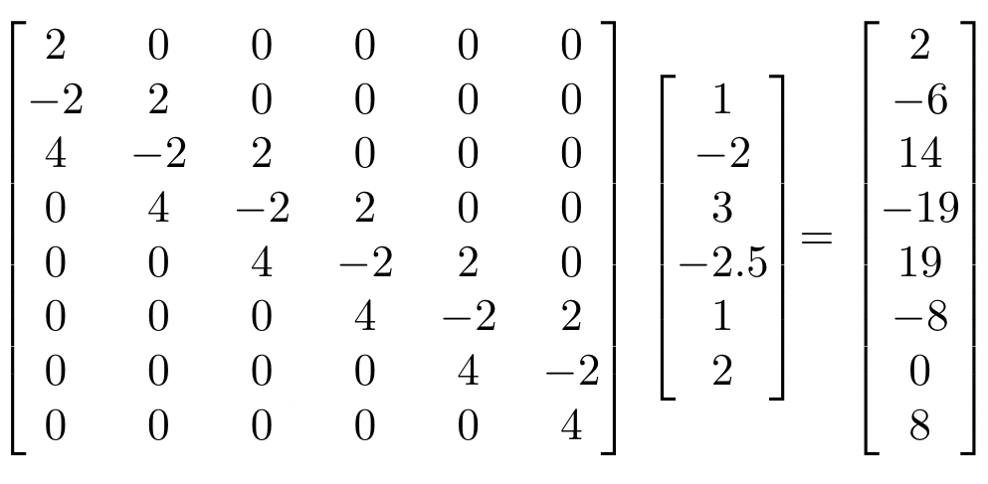
Discrete Time Convolution
Toeplitz Matrix

Slide 15
bit.ly/ece3-lab6

