Slide 1
Introduction to Electrical and Computer Engineering
ECE-3 Fall 2021
LAB 5

Slide 2
bit.ly/ece3-lab5

Slide 3
Outline
Matrix, Vector Relationships
Special Matrices (See ipynb)
Matrix Norm (See ipynb)
Matrix Vector Multiplication

Slide 4
Matrices and Vectors
If you are studying a system with n pieces of data, you can represent the data with a n-dimensional vector
Transformations (how these n pieces of data change) in your system can be represented with a matrix
a₁₁ | a₁₂ | a₁₃
a₂₁ | a₂₂ | a₂₃
a₃₁ | a₃₂ | a₃₃
x_{i}
y_{i}
z_{i}
Ex:
Transformation Matrix: A =
Initial Vector: v_{i} =
a₁₁ | a₁₂ | a₁₃
a₂₁ | a₂₂ | a₂₃
a₃₁ | a₃₂ | a₃₃
x_{i}
y_{i}
z_{i}
x_{f}
y_{f}
z_{f}
Final Vector: v_{f} = A v_{i} =
=
Notes:
Axis in np.sum()

Slide 5
Matrices and Vectors
Matrices can also describe functions that take a vector as input and output another vector. Nonlinear and high order functions can similarly be approximated with matrix/vector multiplication.
a₁₁ | a₁₂ | a₁₃
a₂₁ | a₂₂ | a₂₃
a₃₁ | a₃₂ | a₃₃
x_{i}
y_{i}
z_{i}
x_{f}
y_{f}
z_{f}
Function of vector v: f(v)= A v =
=
v
f(v)

Slide 6
Matrices Vector Multiplication
A v = b
m x 1
m x n
n x 1
Notes:
Axis in np.sum()

Slide 7
Example #1:
Change of Basis
y
We are given standard basis (x y z)
1
0
0
0
1
0
0
0
1
x =
y =
z =
c
a
We now want to make a transformation matrix to switch to the new basis, (a b c)
x
√(2) / 2
√(2) / 2
0
√(2) / 2
0
√(2) / 2
0
√(2) / 2
√(2) / 2
b
a =
b =
c =
z

Slide 8
Example #1 (cont.):
Write each (a b c) with respect to (x y z)
a = [√(2) / 2] x + [√(2) / 2] y + 0 z
b = [√(2) / 2] x + 0 y + [√(2) / 2] z
c = 0 x + [√(2) / 2] y + [√(2) / 2] z
We can now write the transformation matrix from (x y z) to (a b c)
√(2) / 2 | √(2) / 2 | 0
√(2) / 2 | 0 | √(2) / 2
0 | √(2) / 2 | √(2) / 2
A =

Slide 9
Example #1 (cont.):
We can now take some point p from (x y z) and express it with respect to (a b c)
p₁
p₂
p₃
p_{(xyz)} =
in (x y z)
√(2) / 2 | √(2) / 2 | 0
√(2) / 2 | 0 | √(2) / 2
0 | √(2) / 2 | √(2) / 2
p₁
p₂
p₃
p_{(abc)} = A p_{(xyz)} =
in (a b c)

Slide 10
Example #1 (cont.):
√(2) / 2 | √(2) / 2 | 0
√(2) / 2 | 0 | √(2) / 2
0 | √(2) / 2 | √(2) / 2
p₁
p₂
p₃
p_{(abc)} = A p_{(xyz)} =
[√(2) / 2]p₁ + [√(2) / 2]p₂
[√(2) / 2]p₁ + [√(2) / 2]p₃
[√(2) / 2]p₂ + [√(2) / 2]p₃
=
with respect to the basis vectors (a b c)

Slide 11
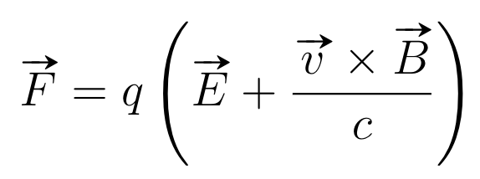
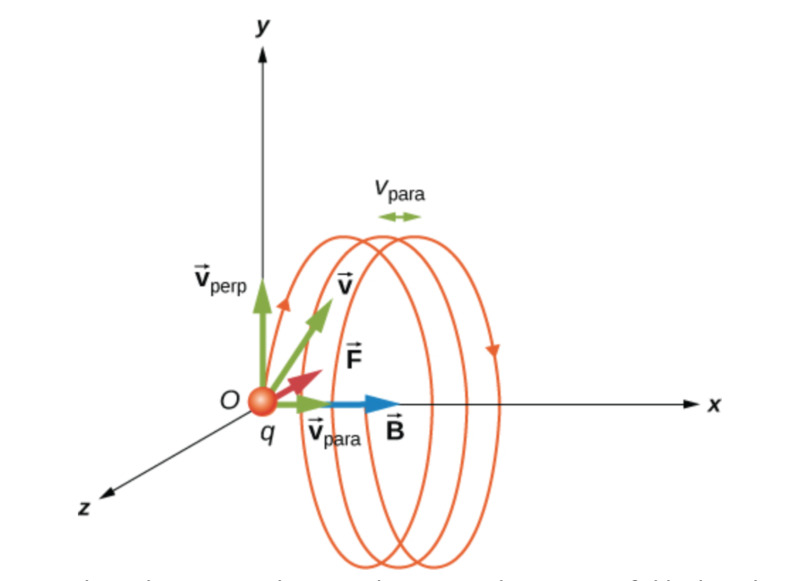
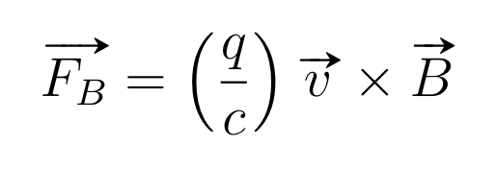
Example #0:
Motion of an electron in a Magnetic Field
The force on a charged particle in electric and magnetic fields is given by the Lorentz Force Law:
Let’s now consider just a magnetic field:
This term indicates any velocity perpendicular to the field produces a corresponding force

Slide 12
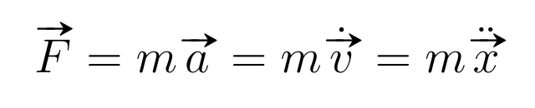
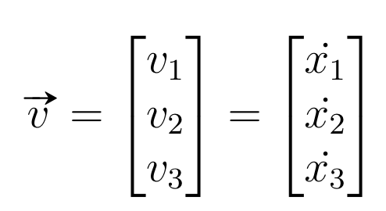
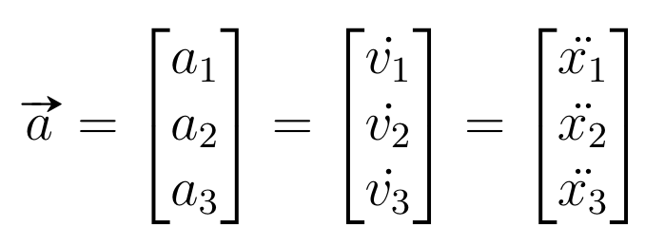
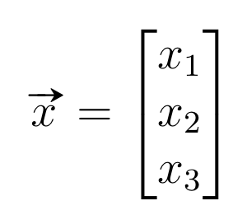
Example #0: (cont.)
We can use this to predict the motion of the electron in 3D through its changing 3-vector representation. This is done via standard calculus and equations of motion. (You are not expected to know this - beyond the scope of this class at the present)
Newton’s 2nd Law!

Slide 13

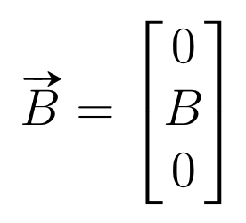



Example #0: (cont.)
For this example, we assume the magnetic field is oriented along the e₂-axis. We can compute the magnetic force via the cross product to find the acceleration of the electron.

Slide 14
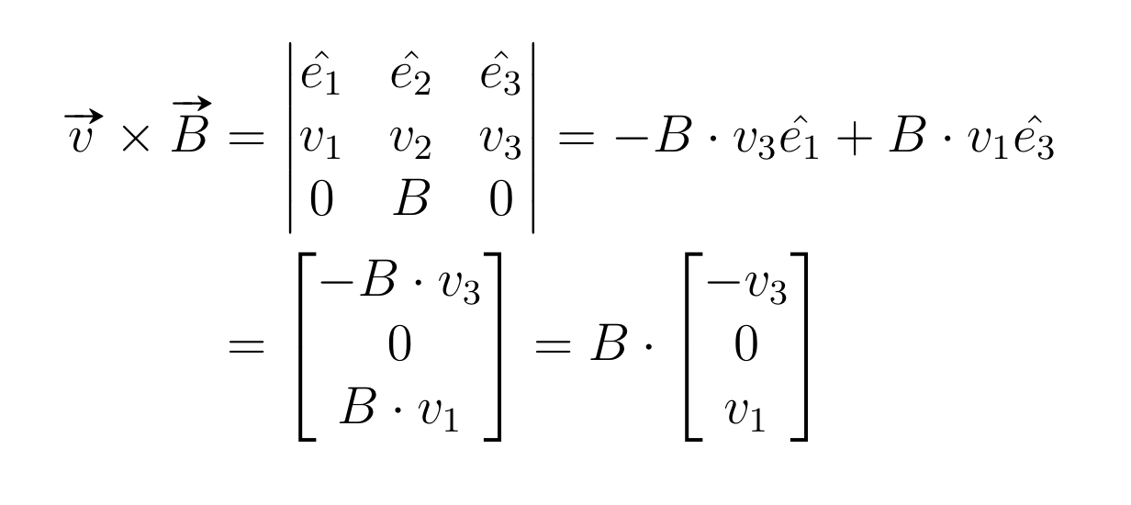
Example #0: (cont.) - Cross Product

Slide 15
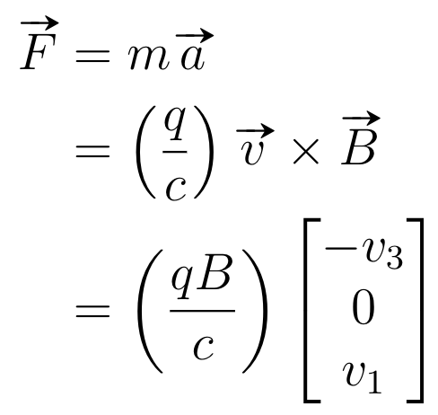
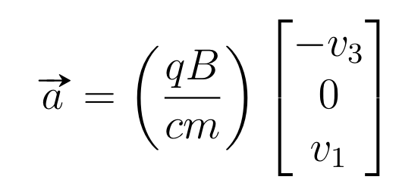
Example #0: (cont.)
The magnetic force is now known. We can then derive acceleration.

Slide 16
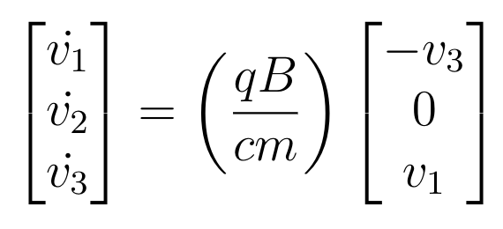
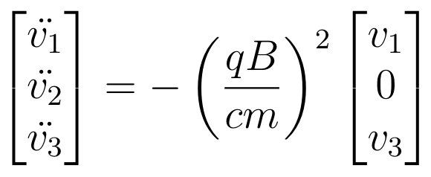
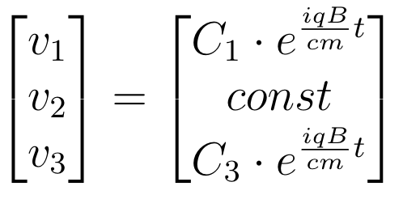
Motion forms helical path
Example #0: (cont.)
After some basic calculus we find the vector representations of the velocity of the charge from the acceleration. With further integration we can find the position vector as well.
Derive again to solve
Describes rotations in the complex plane
Notes:
Point out rotations in specific dimensions - combining oscillations in 2D traces a circle

