Slide 1
Introduction to Electrical and Computer Engineering
ECE-3 Fall 2021
LAB 7

Slide 2
Outline
Matrix Multiplication
Linear Equations (in Notebook)
Linear Dynamical Systems (in Notebook)

Slide 3
Matrix Multiplication
Two matrices A and B can be multiplied together if their dimensions match such that the matrix operating from the left has the same number of columns as the matrix on the right (which it is acting upon) has numbers of rows.
The matrix product AB is computable if A is an n x m matrix (n rows, m columns) and B is an m x k matrix (m rows, k columns). The resulting matrix C = AB will be an n x k matrix (n rows, k columns).
A_{nxm} B_{mxk}= C_{nxk}

Slide 4
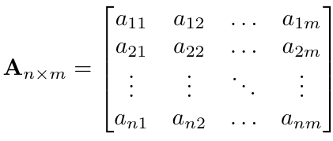
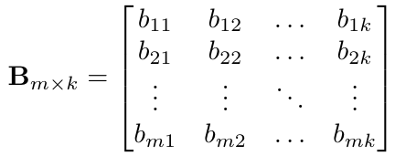
Example 1: General Matrix Multiplication
A_{nxm} B_{mxk}= (AB)_{nxk} = C_{nxk}

Slide 5
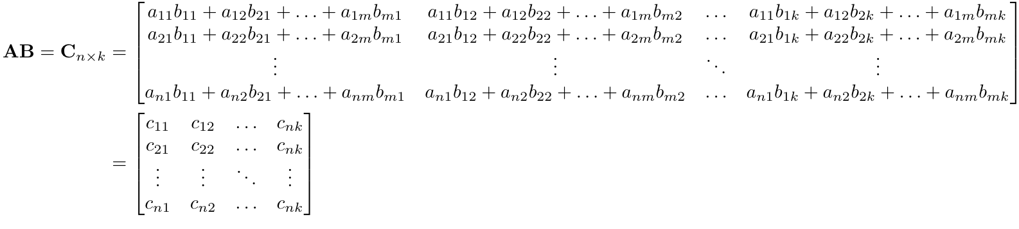
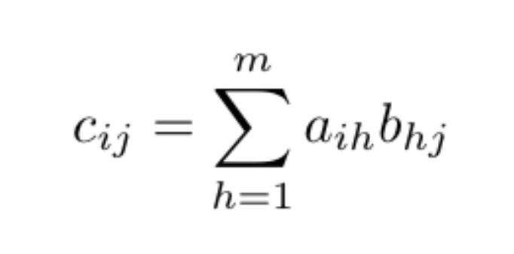
Example 1 (cont.)
Each coefficient c_{ij} is calculated as the sum of the products of row elements a_{ih} and b_{hj}, with h ranging from 1 to m (the number of columns in A and rows in B):

Slide 6
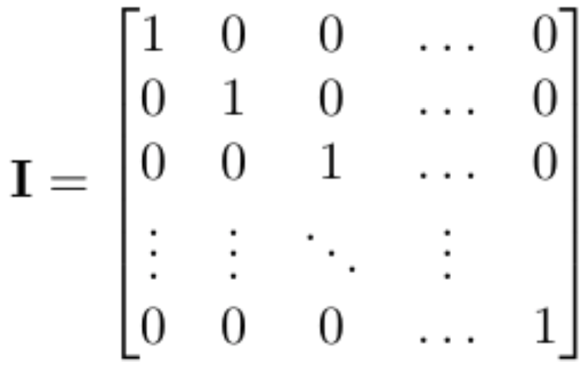
Matrix Operation Properties
The identity matrix I is an n x n (square) diagonal matrix in which the diagonal entries are all populated with 1’s.
For some n x m matrix A, the product of A with the identity matrix will reproduce A. The number of columns of the matrix operating from the left must always match the number of rows of the matrix on the left.
I_{nxn} A_{nxm} = A_{nxm} I_{mxm} = A_{nxm}

Slide 7
Matrix Operation Properties
For matrices A, B, and C, the following properties hold (assuming the dimensions of the matrices are such that all the operations are computable):
Associativity: ABC = (AB)C = A(BC)
Dimensions A_{nxm}, B_{mxk}, C_{kxj} so that it is computable
Distributivity: A(B + C) = AB + AC
Dimensions A_{nxm}, B_{mxk}, C_{mxk} (B and C the same size) so that it is computable
(AB)^{T} = B^{T}A^{T}
Dimensions A_{nxm} and B_{mxk} so (AB)_{nxk} and (AB)^{T}_{kxn}
Dimensions B^{T}_{kxm} and A^{T}_{mxn}, so (B^{T}A^{T})_{kxn}

Slide 8
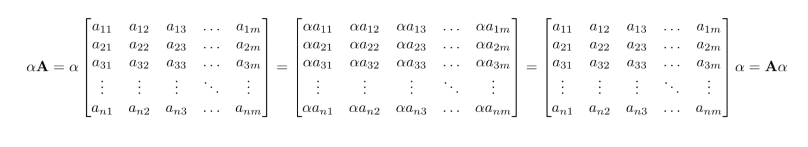
Matrix Operation Properties
Consider the matrix A and the scalar ɑ. The scalar-matrix multiplication then follows similar to scalar-vector and vector-scalar multiplication:
For matrix A_{nxm} and scalar ɑ, the following property holds: ɑA_{nxm}= A_{nxm}ɑ

Slide 9
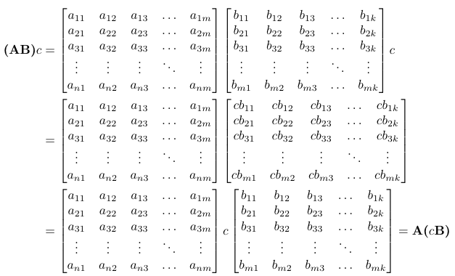
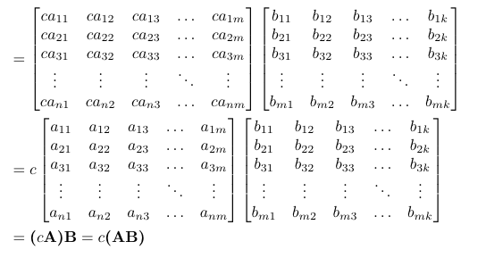
Matrix Operation Properties
Now consider the matrices A_{nxm} and B_{mxk}, and the scalar c. Then:
(A_{nxm}B_{mxk})c = A_{nxm}(cB_{mxk}) = (cA_{nxm})B_{mxk}= c(A_{nxm}B_{mxk})

Slide 10
bit.ly/ece3-lab7

