Slide 1
Introduction to Electrical and Computer Engineering
ECE-3 Fall 2021
LAB 8

Slide 2
Left Inverse
𝖷A = I
Properties:
The left inverse of a matrix is not unique, except when A is a 1x1 matrix i.e A is a number.
The dimensions of the left inverse of A_{mxn} is X_{nxm} i.e same as A^{T}.

Slide 3
Left Inverse
Necessary and sufficient condition
𝖷A = I
Existence:
A has a left inverse when columns of A are linearly independent.
1 2 3 4
4 6 2 1
8 9 1 1
1 2 3
4 6 2
8 9 1
NO
MAYBE ?
Wide matrix

Slide 4
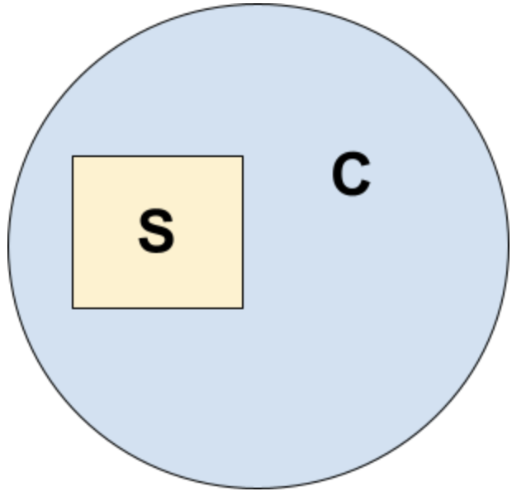
Sufficient Condition
Aside
S: The number is divisible by 4.
B: The number is divisible by 2.
C: The number is even.
S is a sufficient condition for C.
B is a necessary and sufficient condition for C.
B

Slide 5
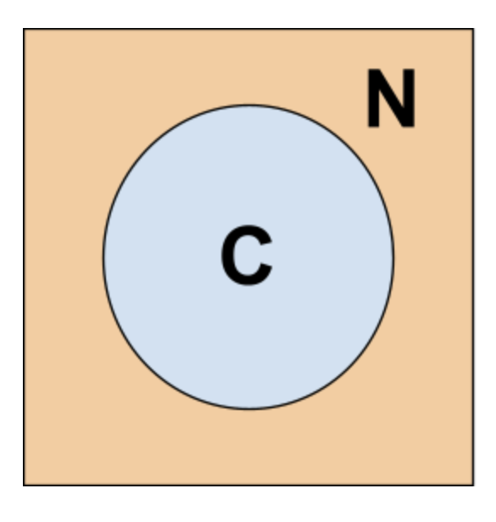
Necessary Condition
Aside
N: The number is divisible by 2.
B: The number is divisible both by 2 & 3
C: The number is divisible by 6
N is a necessary condition for C.
B is a necessary and sufficient condition for C.
B

Slide 6
Examples
Aside
#1: x being less than 12 is a sufficient condition for x being less than 15
#2: x being a rectangle is a necessary condition for x being a square.
True/False
True/False
Notes:
T

Slide 7
Left Inverse
Necessary and sufficient condition
𝖷A = I
Existence:
A has a left inverse when columns of A are linearly independent.
1 2 3 4
4 6 2 1
8 9 1 1
1 2 3
4 6 2
8 9 1
NO
MAYBE ?
Wide matrix

Slide 8
Right Inverse
A𝖷 = I
Properties:
The right inverse of a matrix is not unique, except when A is a 1x1 matrix i.e A is a number.
The dimensions of the right inverse of A_{mxn} is X_{nxm} i.e same as A^{T}.

Slide 9
Right Inverse
Necessary and sufficient condition
A𝖷 = I
Existence:
A has a right inverse when rows of A are linearly independent.
1 2
4 6
8 9
NO
Tall matrix

Slide 10
Inverse
𝖷A = A𝖷 = I
Properties:
The inverse of a matrix is unique. (equal to left and right inverse)
The dimensions of the inverse of A_{mxm} is X_{mxm}.

Slide 11
Inverse
Necessary but not sufficient condition
𝖷A = A𝖷 = I
Existence:
If a matrix A is invertible, it has to be square. (Not tall or wide)
0 0 0
0 0 0
0 0 0
NO
Square matrix

Slide 12
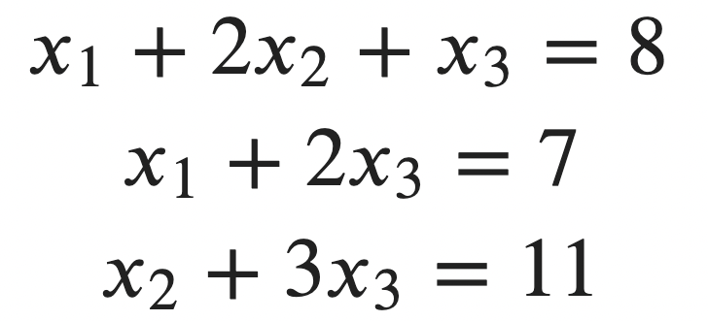
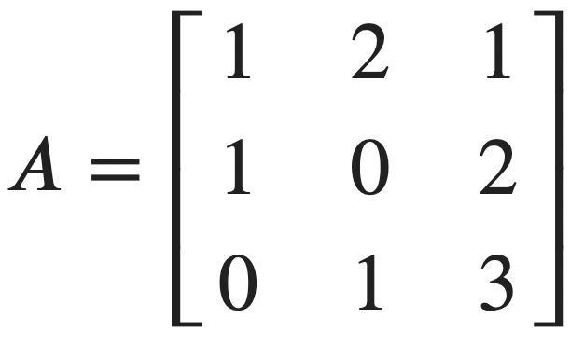
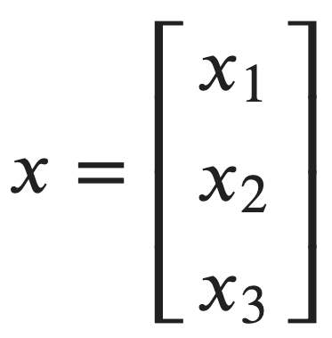
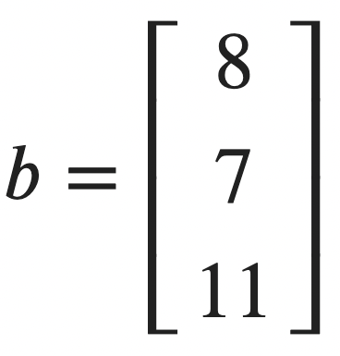
Using numpy.linalg.solve

Slide 13
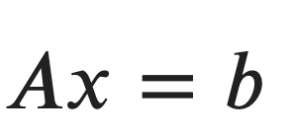
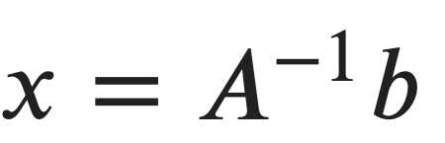
Using numpy.linalg.solve
x=np.linalg.solve(A,b)
x=np.linalg.inv(A) @ b

Slide 14
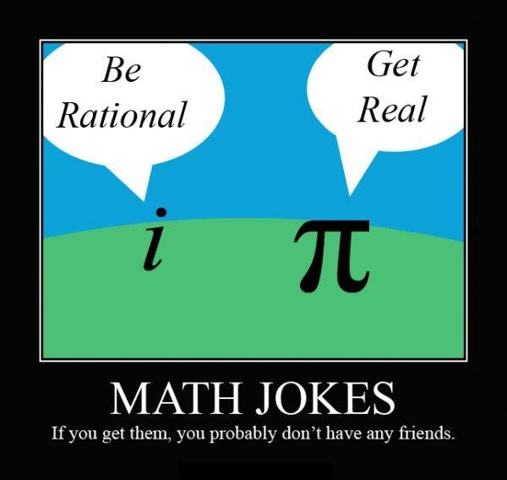
If,
1 = 3
2 = 3
3 = 5
4 = 4
6 = ?

Slide 15
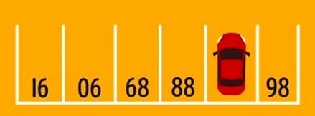
?

Slide 16
bit.ly/ece3-lab8

