Slide 1
Jaguar ride
A ride sharing android APPLICATION

Slide 2
introduction
The application can be separated into two parts - the driver side and the rider side. When a user logs into the app, he can choose to become a driver or a rider by choosing which side he wants to proceed to. On the rider side, the user can see his location on the map and request for a ride, while on the driver side, the driver can see a list of all nearby riders and choose one request to accept. Once the driver accepts a request, Jaguar Ride will navigate him to the rider through Google Maps. In this way, Jaguar Ride allows both people who drive and who does not drive to find their “car buddies” efficiently.

Slide 3
Technical background
Wi-Fi (Wireless Network Connection)
Java GPS Module
Google Maps API
AWS Parse Server

Slide 4
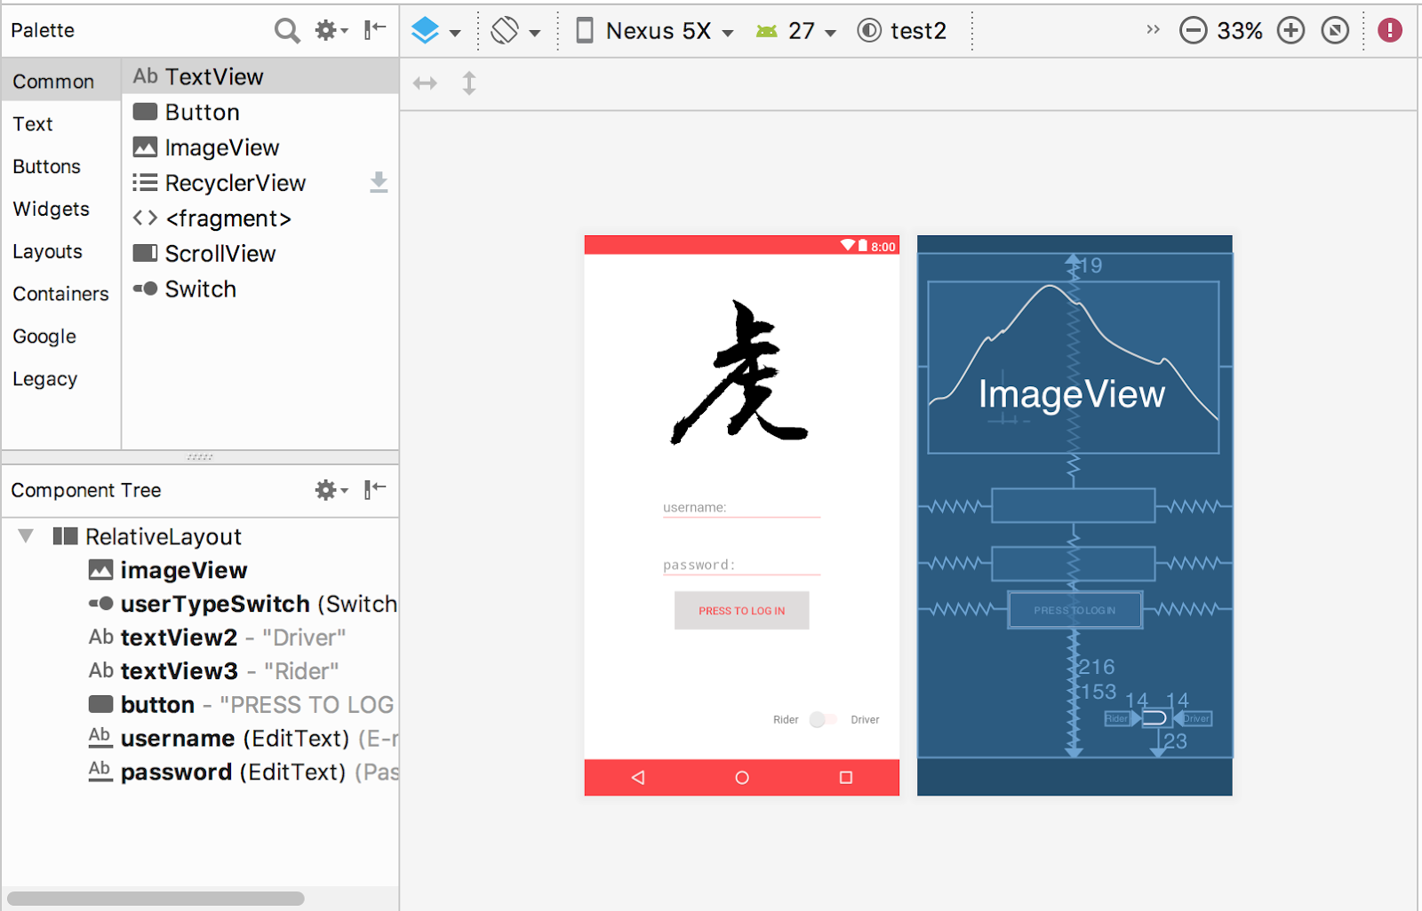
Frontend IMPLEMENTATION
The design of front end for this application can mainly be divided into four parts:
user login page (home page),
rider-view page
driver-view page
Google Map navigation page
Utilizes Android Studio’s Theme Editor to visualize the critical UI elements.

Slide 5
Backend implementation
AWS Parse Server
Mongo DB database
ParseObject
Store and Query
Database Schemas
|-- User -> username -> RiderOrDriver ->location
|-- Request -> Ridername -> location -> Drivername

Slide 6
Rider activities
Login
Request a Ride
Wait for a Driver to Accept
Wait for the Driver to Arrive

Slide 7
Driver Activities
Login
View the Request List
Pick a Request to Accept
Navigate to the Rider

Slide 8
Discussion
Challenges We Have Encountered
Emulator Google Play API Outdated
Emulator Real-time GPS Location not Supported
What We Have Learnt
Explored How to Use Google Maps API
Explored How to Use the Location Manager and ParseGeoPoint() Module to achieve real-time location functions.

Slide 9
Q&A

Slide 10
THANK YOU !!!
Team Jaguar

