Slide 1




Uncertainty-aware Self-ensembling Model for Semi-supervised 3D Left Atrium Segmentation
School of Electronic Information and Communications
Huazhong University of Science and Technology
Presenter: Zhanke Zhou
Date: 2020.12.13
Notes:
Hello everyone, I’m Zhanke Zhou
from Huazhong University of Science and Technology.
Today I’m very glad to talk about
Dr. Yu’s work in last year, twenty nineteen
The title of the paper is
Uncertainty-aware Self-ensembling Model for
Semi-supervised 3D Left Atrium Segmentation

Slide 2
Outline
Background
Introduction to WSL
Introduction to UA-MT
UA-MT
Experiments
Case Study
Improvement
Conclusion
Discussion
Q&A
Notes:
This Is the outline for today’s presentation
Let’s go to the first part, Background

Slide 3
Background
Information
Paper-1: A Brief Introduction to Weakly Supervised Learning
Authors: Zhi-Hua Zhou
Publish: National Science Review
Url: https://academic.oup.com/nsr/article/5/1/44/4093912
Paper-2: Uncertainty-aware Self-ensembling Model for Semi-supervised 3D Left Atrium Segmentation
Authors: Lequan Yu, Shujun Wang, Xiaomeng Li, Chi-Wing Fu, Pheng-Ann Heng
Publish: MICCAI 2019
Url: https://arxiv.org/abs/1907.07034
Code: https://github.com/yulequan/UA-MT
Notes:
Here is some information about the paper
It was published in MICCAI 2019,
which is a top-tier conference in the medical image analysis field.
Its relevant URL of arxiv and open-source code on github
are available here

Slide 4
Outline
Background
Introduction to WSL
Introduction to UA-MT
UA-MT
Experiments
Case Study
Improvement
Conclusion
Discussion
Q&A
Notes:
This Is the outline for today’s presentation
Let’s go to the first part, Background

Slide 5
Introduction to WSL
Weakly Supervised Learning (WSL)
Motivation
In many tasks, it is difficult to get strong supervision information
like fully ground-truth labels
due to the high cost of data labeling process.
Taxonomy of WSL
Incomplete Supervision 不完全监督
Lack of annotations (i.e., existing plenty of unlabeled data)
Inexact Supervision 不确切监督
Only coarse annotations available
Inaccurate Supervision 不准确监督
Learning with label noise
Notes:
Automated segmentation of left atrium
in MR images
is of great importance
in promoting the treatment of atrial fibrillation,
which is the most common type of cardiac arrhythmia.
The poor performance of current treatment
is due to a lack of understanding of the
structure of the human atria.
In this task,
We have a 3D clinical dataset,
and we need to propose a model
to do 3D Left Atrium Segmentation automatically.

Slide 6
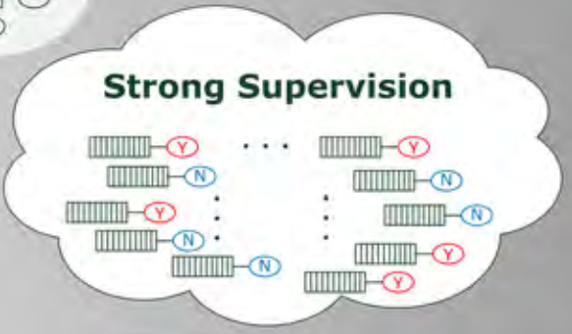
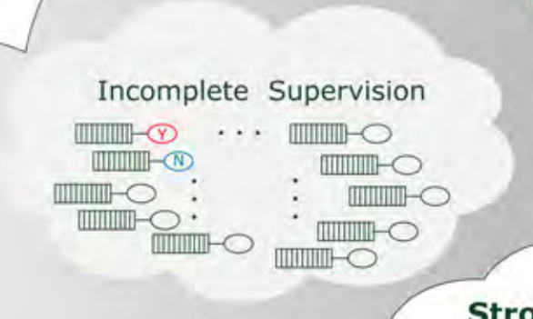
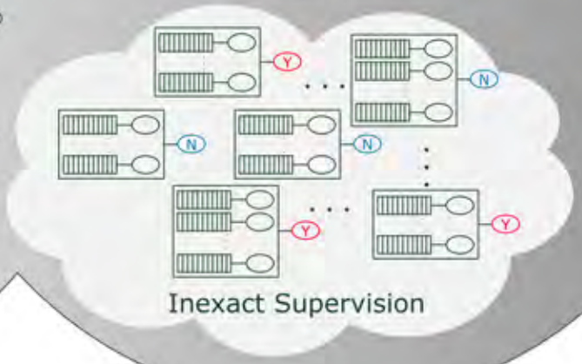
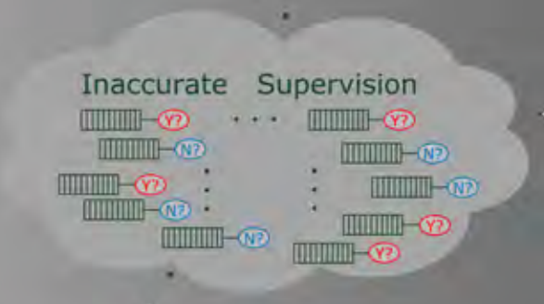
Introduction to WSL
Weakly Supervised Learning (WSL)
Taxonomy of WSL
Incomplete Supervision 不完全监督
Inexact Supervision 不确切监督
Inaccurate Supervision 不准确监督
Notes:
Automated segmentation of left atrium
in MR images
is of great importance
in promoting the treatment of atrial fibrillation,
which is the most common type of cardiac arrhythmia.
The poor performance of current treatment
is due to a lack of understanding of the
structure of the human atria.
In this task,
We have a 3D clinical dataset,
and we need to propose a model
to do 3D Left Atrium Segmentation automatically.

Slide 7
Outline
Background
Introduction to WSL
Introduction to UA-MT
UA-MT
Experiments
Case Study
Improvement
Conclusion
Discussion
Q&A
Notes:
This Is the outline for today’s presentation
Let’s go to the first part, Background

Slide 8
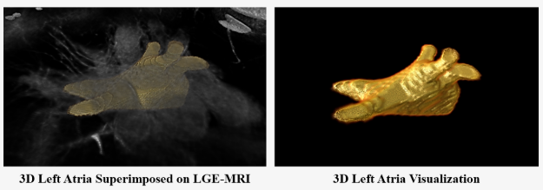
Introduction to UA-MT
3D Left Atrium(LA) Segmentation
Pathology: Atrial Fibrillation
Images: 3D Gadolinium-Enhanced Magnetic Resonance (MR) Imaging
Labels : 3D Binary Masks of the Left Atrial Cavity
2018 Atrial Segmentation Challenge
Notes:
Automated segmentation of left atrium
in MR images
is of great importance
in promoting the treatment of atrial fibrillation,
which is the most common type of cardiac arrhythmia.
The poor performance of current treatment
is due to a lack of understanding of the
structure of the human atria.
In this task,
We have a 3D clinical dataset,
and we need to propose a model
to do 3D Left Atrium Segmentation automatically.

Slide 9
Introduction to UA-MT
Challenges
Lack of labeled data
Why? High cost in collecting and annotating
Motivation
UA-MT: Uncertainty-Aware Mean Teacher Framework
Three Key Points
Semi-supervised Learning
Leveraging abundant unlabeled data
Uncertainty-aware (UA)
Considering the reliability of the targets
Mean Teacher (MT)
To overcome the limitations of Temporal Ensembling
Notes:
the main challenges of this task
is lack of labeled data
and the reason for that is
high cost in collecting and annotating data
In this paper,
The author propose a novel Uncertainty-Aware Mean Teacher Framework,
called UA-MT for short,
to handle the left atrium segmentation from 3D MR images.
Here are three keywords of UA-MT
The first one is Semi-supervised,
The propose UA-MT effectively Leverage not only the limited labeled data
but also The abundant unlabeled data.
And Second, Uncertainty-aware,
UA-MT consider the reliability of the targets
and apply uncertainty estimation strategy to do quantization for the reliability.
Finally, Mean Teacher
Mean Teacher is a kind of self-ensembling approach
in order to overcome the limitations of Temporal Ensembling
In the next slides I am going to talk about these keywords in details

Slide 10
Outline
Background
Introduction to WSL
Introduction to UA-MT
UA-MT
Experiments
Case Study
Improvement
Conclusion
Discussion
Q&A
Notes:
So what is UA-MT?
How it utilize unlabeled data?

Slide 11


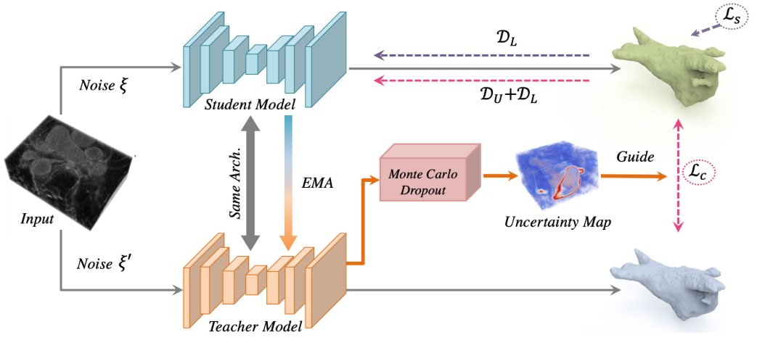
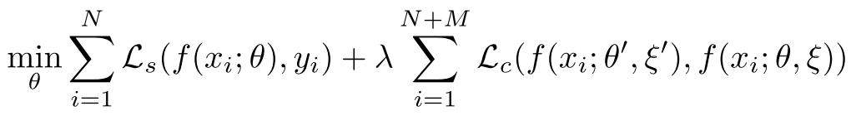

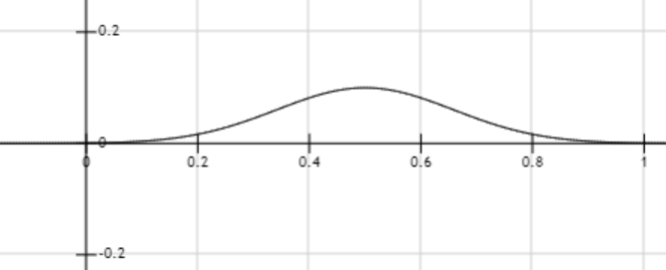
UA-MT
Network Structure
Consisting of a student model and a teacher model
Teacher model
Generates targets for the student model to learn from
Estimates the uncertainty of the targets
Student model
optimized by minimizing two kinds of loss
Ls : supervised loss on labeled data
Lc : consistency loss on both labeled and unlabeled data
Labeled Data:
Unlabeled Data:
Objective function:
Notes:
So let’s take an overview of UA-MT.
As shown in the picture below,
The network of UA-MT consists of a student model and a teacher model.
These two models have different jobs to do,
and play diverse role in the whole framework.
The two main tasks for teacher model is
Generating the targets for the student model to learn from
And
Estimating the uncertainty of the targets.
For student model,
Its objective function is shown in the right,
As you see, there are two terms in this mathematical expression
Which means
The student model is optimized by minimizing two kinds of loss function
The first one is Ls, a supervised loss on labeled data
And the another is Lc, which is a consistency loss
on both labeled and unlabeled data.
And it's worth to mention that,
There is a λ coefficient in the expression of objective function,
λ is an ramp-up weighting coefficient that
controls the trade-off between the supervised and unsupervised loss.
The author use a time-dependent Gaussian warming up function λ(t)
to control the balance
between the supervised loss and unsupervised loss
Such design can ensure that at the beginning,
the objective function is dominated by the supervised loss term
It can avoid the network get stuck in a degenerate solution
where no meaningful target prediction
of unlabeled data is obtained

Slide 12
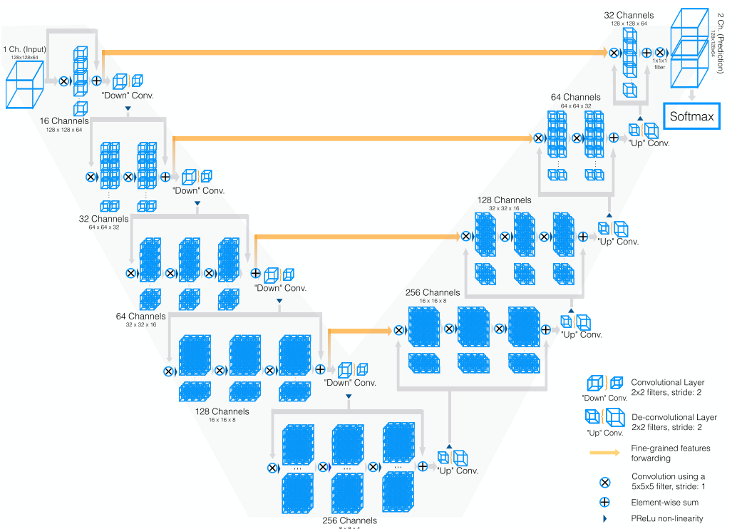
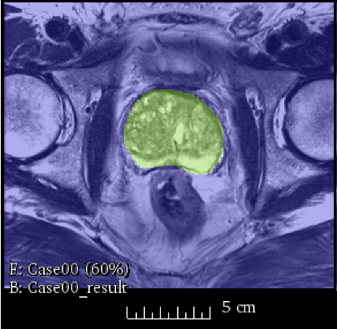
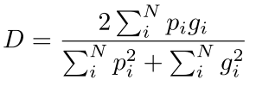
UA-MT
Backbone
V-Net: a volumetric, fully convolutional
neural network for 3D image segmentation
Input shape: 128×128×64
Output shape: 2×128×128×64
2 Classes : Background (0) / Foreground (1)
Supervised Loss
Cross entropy loss + Dice loss
Why dice loss?
Foreground occupies only a small region
Give more importance to foreground
Dice loss = 1 - D (dice coefficient)
Objective function:
Supervised Loss
Notes:
When it comes to the network backbone,
the author employ V-net,
Which is a volumetric, fully convolutional neural network
especially for 3D image segmentation.
The Input shape of V-net is (one hundred and twenty eight) square by sixty four,
And the three number represent the height, width and depth of the voxel input.
As you see, the output is dimension raising because
The backbone is required to do binary classification.
In related python code, the author use zero and one to represent
Background and Foreground respectively.
Recall that I mention supervised loss in last slide,
Actually, the supervised loss includes
cross entropy loss and Dice loss.
So why we need The Dice loss?
Why only using cross entropy as supervised loss is not enough?
That is because the foreground,
Which representing the anatomy of interest,
occupies only a small region. [click -> pic]
This often causes the learning process to get trapped in local minima of the loss function yielding a network whose predictions are strongly biased towards background.
So we should give more importance to foreground
In order to handle to problem of data imbalance.
Dice loss equal 1 minus dice coefficient
The dice coefficient D can be written as the mathematical expression below.
It estimates the extent of overlap for foreground between two binary volumes.
The more they overlap, the bigger dice coefficient,
And the less dice loss
So, that is the Supervised Loss
Located at the first term of objective function

Slide 13
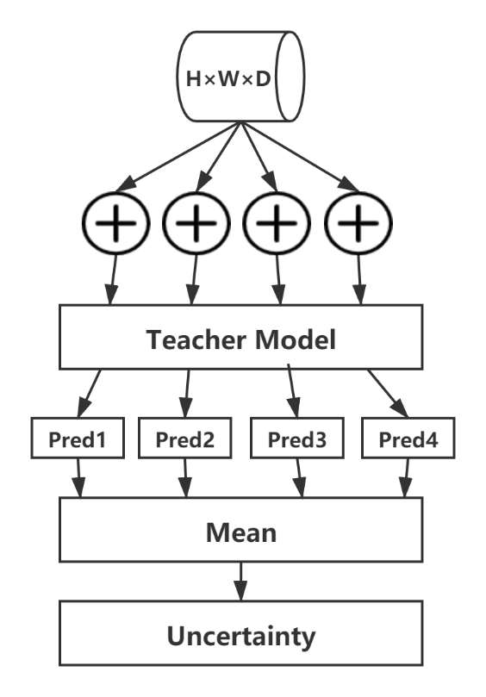


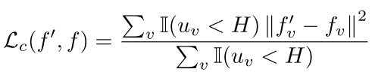
UA-MT
Objective function:
Consistency Loss
Uncertainty Estimation
Why?
The predicted targets from the teacher model may be unreliable and noisy
Previous works do not consider the reliability of the targets
Estimate the uncertainty with
Monte Carlo Sampling
Test Data Augmentation
Predictive Entropy
The metric to approximate the uncertainty
obtain a set of softmax probability vector:
Uncertainty-Aware Consistency Loss
voxel-level mean squared error (MSE) loss
T=4 | Fore | Back
Sample 1 | 0.9 | 0.1
Sample 2 | 0.91 | 0.09
Sample 3 | 0.92 | 0.08
Sample 4 | 0.89 | 0.11
Mean | 0.905 | 0.095
Uncertainty | 0.453
T=4 | Fore | Back
Sample 1 | 0.9 | 0.1
Sample 2 | 0.8 | 0.2
Sample 3 | 0.95 | 0.05
Sample 4 | 0.75 | 0.25
Mean | 0.85 | 0.15
Uncertainty | 0.609
Notes:
In this slide, I am going to talk about the Uncertainty Estimation.
So WHY we need to estimate the uncertainty?
That is because
The predicted targets from the teacher model may be
unreliable and noisy,
However, previous works do not consider the reliability of the targets.
In UA-MT, it estimates the uncertainty with
Monte Carlo Sampling and
Test Data Augmentation.
[click]
In detail, UA-MT perform T stochastic forward
passes on the teacher model
under random dropout
and input Gaussian noise for each input volume.
Therefore, for each voxel in the input,
we obtain a set of softmax probability vector pt.
[click]
We choose the predictive entropy as the metric to
approximate the uncertainty
Formally, the predictive entropy can be summarized as below
[click]
Let me show it in concrete cases [click]
Suppose T equals 4,
For an specific and individual voxel in the input,
We resample it four times and get the final scores after SoftMax.
For simplicity's sake, here I only consider one point
but not a three-dimensional vector as output.
In case one, After four times of adding gaussian noise,
the results differ little and the mean score of Foreground is
Zeros point nine zero five, which is close to 1.
However, in case two,
The results vary greatly
and bring decrease in score of Foreground,
And finally get a greater uncertainty compared with case one.
That is how UA-MT estimates the uncertainty of each target prediction
with Monte Carlo sampling.
By exploiting the uncertainty information of the teacher model,
we can select meaningful and reliable targets whose uncertainty is under threshold H.
Then the student model is optimized by the Uncertainty-Aware consistency loss
as the voxel-level MSE loss of
the teacher and student models
only for the reliable targets.
So, that is the Consistency Loss
Located at the second term of objective function.

Slide 14
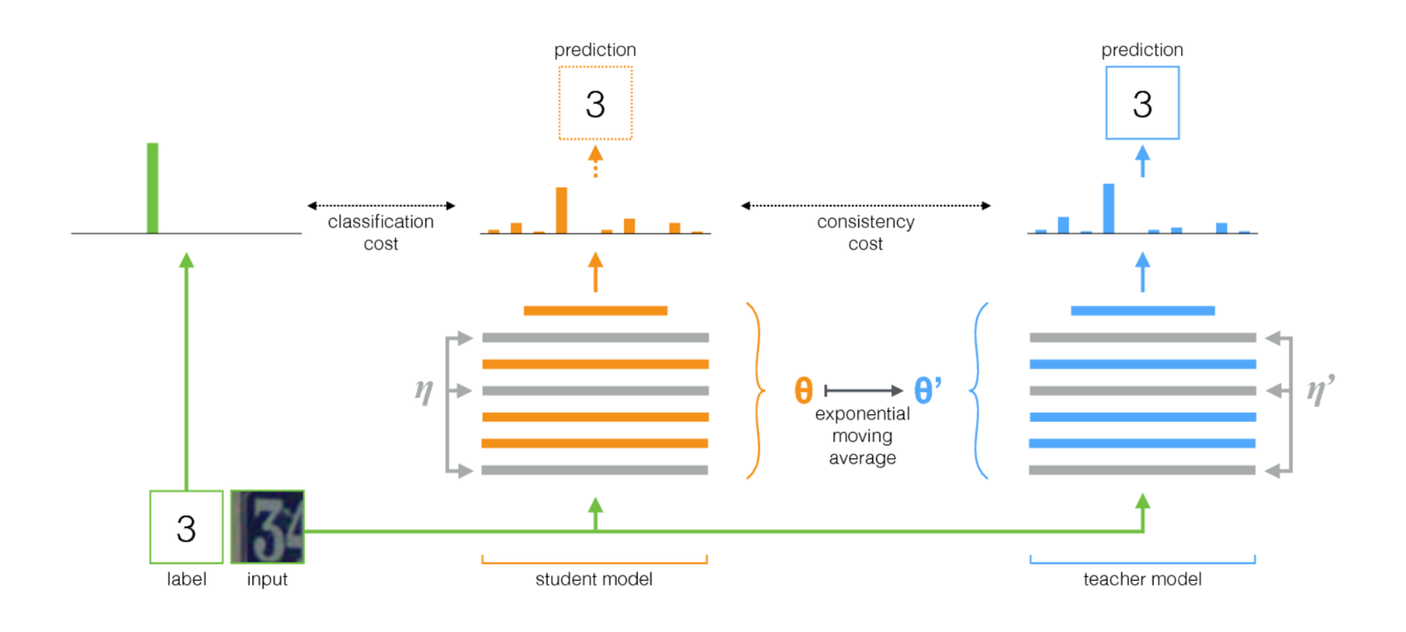


UA-MT
Mean Teacher (MT)
Why called Mean Teacher?
The teacher model is an average of consecutive student models
Why using Mean Teacher?
To overcome the limitations of Temporal Ensembling
Ensemble predictions of the network at different training process
can improve the quality of the predictions
Exponential Moving Average (EMA)
Updating the teacher’s weights
at training step t as:
α = min(1 - 1 / (t + 1), α)
Consistency Cost
Minibatch
Two Models
Notes:
Let we take a close look at the Mean Teacher.
Mean Teacher is a simple method for semi-supervised learning.
It is called Mean Teacher
because The teacher model is an average of consecutive student models.
Why using Mean Teacher?
To overcome the limitations of Temporal Ensembling
Limitations
Ensemble predictions of the network at different training process can improve the quality of the predictions
The Mean Teacher consists of the following steps:
Click
1. Take a supervised architecture and make a copy of it. Let's call the original model the student and the new one the teacher.
Click
2. At each training step, use the same minibatch as inputs to both the student and the teacher but add random noise to the inputs separately.
Click
3. Add an additional consistency cost between the student and teacher outputs. And Let the optimizer update the student weight.
Click
4. Let the teacher weights be an exponential moving average (EMA) of the student weights. That is, after each training step, update the teacher weights a little bit toward the student weights.

Slide 15
Outline
Background
Introduction to WSL
Introduction to UA-MT
UA-MT
Experiments
Case Study
Improvement
Conclusion
Discussion
Q&A
Notes:
After introducing the algorithm
Let’s take a look at the experiment

Slide 16
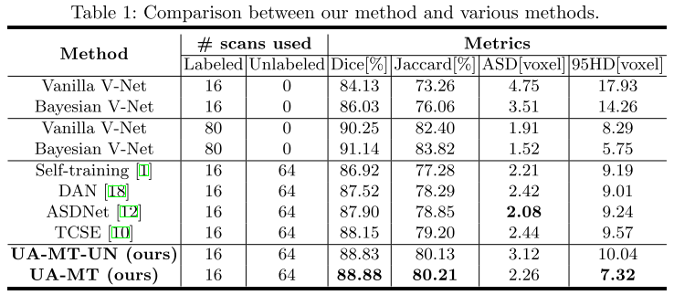
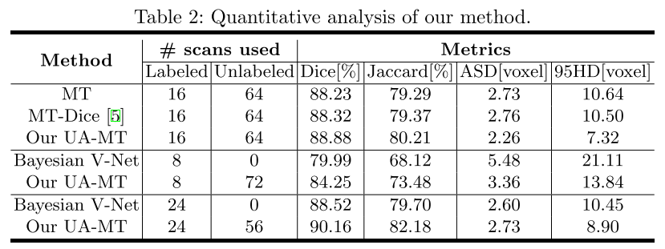
Experiments
Atrial Segmentation Challenge dataset
Distribution
100 scans in total
80 for training
20 for evaluation
Evaluation
Metrics
Dice
Jaccard
Average Surface Distance (ASD)
95% Hausdorff Distance (95HD)
Outperforms the state-of-the-art
semi-supervised methods
Notes:
In Atrial Segmentation Challenge dataset,
We have 100 labeled scans in total,
and the author split it to
80 scans for training and 20 for evaluation.
Four metrics are applied to proceed evaluation.
The comparison in the table shows that
UA-MT outperforms the state-of-the-art semi-supervised methods

Slide 17
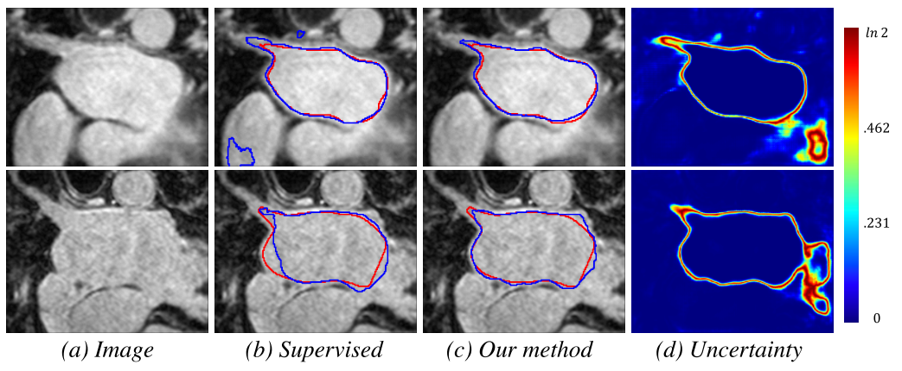
Case Study
Segmentation examples
Compared with the supervised method, UA-MT
have higher overlap ratio with the ground truth
produce less false positives
The network estimates high uncertainty
near the boundary
ambiguous regions of great vessels
Notes:
Let’s use some examples to
get an intuitive feeling for the effect of the model.
Compared with the supervised method, UA-MT
have higher overlap ratio with the ground truth and produce less false positives.
As shown in Figure below,
The network estimates high uncertainty near the boundary and ambiguous regions of great vessels.

Slide 18
Outline
Background
Introduction to WSL
Introduction to UA-MT
UA-MT
Experiments
Case Study
Improvement
Conclusion
Discussion
Q&A
Notes:
This this section
I am going to talk about
my personal point of view for improvement of UA-MT

Slide 19
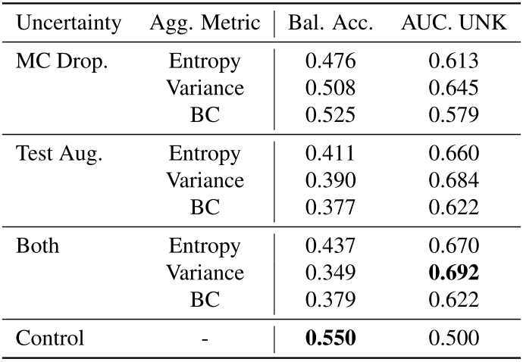


Improvement
Better Uncertainty Estimation Module (UEM)
Uncertainty Estimation Matters
The key of success lies in the quality of targets
Effect
Identify difficult cases
Detect out-of-distribution samples
Weakness of UEM in UA-MT
Only concerning single type of noise
Only one metric
Improvement (of Presentation Level)
More metrics to quantify the uncertainty [1]
Variance
Bhattacharyya Coefficient (BC)
Design an uncertainty-Aware attention module [2]
Notes:
Firstly, we may need a Better Uncertainty Estimation Module.
I think the key of success lies in the quality of targets
And that’s why Uncertainty Estimation Module is so important.
It’s capable to Identify difficult and out-of-distribution samples in dataset.
What about the Weakness of Uncertainty Estimation Module in UA-MT
The Weaknesses of are
Only concerning single type of noise which is gaussian noise.
Only one metric, the predictive entropy, is applied to do estimation.
So I think the Improvement of Presentation Level
Is that
Besides Entropy, we can attempt more metrics to quantify the uncertainty,
for example the Variance or
the 巴特查里亚 Bhattacharyya Coefficient (BC for short)
In a recent paper which was published in CVPR this year,
Its experiments show that the different kinds of metrics
to quantify the uncertainty
influence the performance of network.
What’s more,
We can refer to this another recent paper through this hyperlink here,
To Design an uncertainty-Aware attention module
Attention mechanism is an effective means
of guiding the model to
focus on a partial set of most relevant features
for each input instance.
Inspired by UA-MT
I think we can
allow the attention module to
output uncertainty on each input feature
and further leverage them when making final predictions.

Slide 20
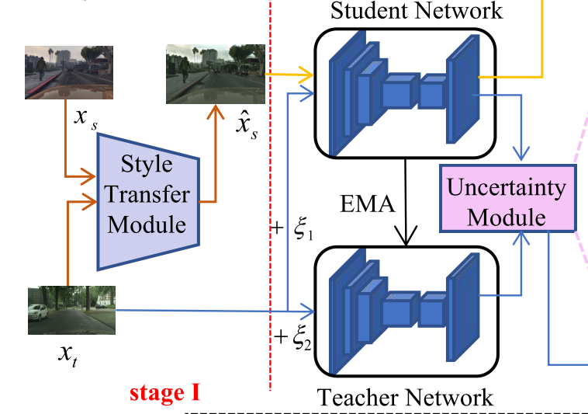
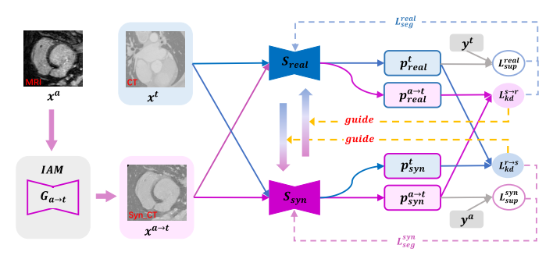
Improvement
Transferable Prior Knowledge
To make up annotation scarcity
Weakness of UA-MT
Only using single small-scale dataset
No enough knowledge
Improvement
Exploit the prior knowledge (e.g. shape priors)
learned from assistant modality
to improve the performance on target modality
Style Transfer Module [3]
Produce translated images
to address the domain gap
Image Alignment Module [4]
To narrow the appearance gap
between assistant and target modality data
Notes:
Another improvement
I think
is Transferable Prior Knowledge
in order to make up annotation scarcity.
The Weakness of UA-MT is
Only using single small-scale dataset
No enough knowledge can be exploited.
So the Improvement is to
Exploit the prior knowledge
For example, shape priors
learned from assistant modality
to improve the performance on target modality
This approach need to consider the gap between different domains
We can refer to the Style Transfer Module in this paper to
Produce translated images.
Or
The Image Alignment Module
To narrow the appearance gap.
In addition, This paper is also co-authored by Dr. Yu
I am going to read it carefully in following days.

Slide 21
Outline
Background
Introduction to WSL
Introduction to UA-MT
UA-MT
Experiments
Case Study
Improvement
Conclusion
Discussion
Q&A
Notes:
So
Let’s go to the final section of
Today’s presentation
The conclusion

Slide 22
Conclusion
UA-MT
A novel uncertainty-aware semi-supervised learning method
for left atrium segmentation from 3D MR images
Encourages the segmentation to be consistent
For the same input under different perturbations
Explore the model uncertainty to improve the quality of the target
Outperforms the state-of-the-art semi-supervised methods
Notes:
In this paper, The author propose
UAMT, A novel uncertainty-aware semi-supervised learning method
for left atrium segmentation from 3D MR images
UAMT Encourages the segmentation to be consistent
For the same input under different perturbations
To better leverage the unlabeled data
UAMT explore the model uncertainty to improve the quality of the target
The method outperforms the state-of-the-art semi-supervised methods,
demonstrating the potential of the framework
for the challenging semi-supervised problems

Slide 23
Discussion
Use UA-MT for reference (in our project)
Better Performance
Utilize abundant unlabeled data
Higher Stability
Uncertainty estimation
Improving training process
Explore new ideas
Weakly supervised Learning
Semi-supervised learning
Label-noise representation learning
Transfer learning
Notes:
智慧医疗？
Yaohai 暑研？

Slide 24
Reference
1. Bai, W., Oktay, O., Sinclair, M.e.a.: Semi-supervised learning for network-based cardiac mr image segmentation. In: MICCAI. pp. 253–260 (2017)
2. Baur, C., Albarqouni, S., Navab, N.: Semi-supervised deep learning for fully con- volutional networks. In: MICCAI. pp. 311–319 (2017)
3. Chartsias, A., Joyce, T., Papanastasiou, G., Semple, S., Williams, M., Newby, D., Dharmakumar, R., Tsaftaris, S.A.: Factorised spatial representation learning: ap- plication in semi-supervised myocardial segmentation. MICCAI pp. 490–498 (2018)
4. Chen, C., Bai, W., Rueckert, D.: Multi-task learning for left atrial segmentation on ge-mri. arXiv preprint arXiv:1810.13205 (2018)
5. Cui, W., Liu, Y., Li, Y., Guo, M., Li, Y., Li, X., Wang, T., Zeng, X., Ye, C.: Semi-supervised brain lesion segmentation with an adapted mean teacher model. In: IPMI. pp. 554–565 (2019)
6. Dong, N., Kampffmeyer, M., Liang, X., Wang, Z., Dai, W., Xing, E.: Unsupervised domain adaptation for automatic estimation of cardiothoracic ratio. In: MICCAI. pp. 544–552 (2018)
7. Ganaye, P.A., Sdika, M., Benoit-Cattin, H.: Semi-supervised learning for segmen- tation under semantic constraint. In: MICCAI. pp. 595–602 (2018)
8. Kendall, A., Gal, Y.: What uncertainties do we need in bayesian deep learning for computer vision? In: NIPS. pp. 5574–5584 (2017)
9. Laine, S., Aila, T.: Temporal ensembling for semi-supervised learning. arXiv preprint (2016)
10. Li, X., Yu, L., Chen, H., Fu, C.W., Heng, P.A.: Semi-supervised skin lesion seg- mentation via transformation consistent self-ensembling model. BMVC (2018)
11. Milletari, F., Navab, N., Ahmadi, S.A.: V-net: Fully convolutional neural networks for volumetric medical image segmentation. In: 3DV. pp. 565–571 (2016)
12. Nie, D., Gao, Y., Wang, L., Shen, D.: Asdnet: Attention based semi-supervised deep networks for medical image segmentation. In: MICCAI. pp. 370–378 (2018)
13. Perone, C.S., Cohen-Adad, J.: Deep semi-supervised segmentation with weight- averaged consistency targets. In: DLMIA workshop (2018)
14. Tarvainen, A., Valpola, H.: Mean teachers are better role models: Weight-averaged consistency targets improve semi-supervised deep learning results. In: NIPS (2017)
15. Xiong, Z., Fedorov, V.V., Fu, X., Cheng, E., Macleod, R., Zhao, J.: Fully automatic left atrium segmentation from late gadolinium enhanced magnetic resonance imag- ing using a dual fully convolutional neural network. TMI 38(2), 515–524 (2019)
16. Yang, X., Bian, C., Yu, L., Ni, D., Heng, P.A.: Hybrid loss guided convolutional networks for whole heart parsing. In: International Workshop on STACOM (2017)
17. Yu, L., Cheng, J.Z., Dou, Q., Yang, X., Chen, H., Qin, J., Heng, P.A.: Automatic 3d cardiovascular mr segmentation with densely-connected volumetric convnets. In: MICCAI. pp. 287–295. Springer (2017)
18. Zhang, Y., Yang, L., Chen, J., Fredericksen, M., Hughes, D.P., Chen, D.Z.: Deep adversarial networks for biomedical image segmentation utilizing unannotated im- ages. In: MICCAI. pp. 408–416 (2017)
19. Zhou, Y., Wang, Y., Tang, P., Bai, S., Shen, W., Fishman, E.K., Yuille, A.L.: Semi- supervised multi-organ segmentation via multi-planar co-training. arXiv preprint arXiv:1804.02586 (2018)

Slide 25
Q&A Thanks for your attention!
Outline
Background
Introduction
UA-MT
Experiments
Case Study
Improvement
Conclusion
Notes:
Thank you for your attention
and please feel free to ask me questions.
Thank you.

