Slide 1
Interpretable and Generalizable Graph Learning via Stochastic Attention Mechanism
Presenter: Zhanke Zhou
^{2022. 06. 30}

Slide 2
About the paper
Interpretable and Generalizable Graph Learning via Stochastic Attention Mechanism
Authors: ﻿﻿Siqi Miao, Miaoyuan Liu, Pan Li
Conference: ICML 2022
Affiliation: ﻿Department of Computer Science, Purdue University
Paper: https://arxiv.org/pdf/2201.12987.pdf
Code: https://github.com/Graph-COM/GSAT

Slide 3
Outline
Background
The existing methods
The proposed method
Experiment
Summary and discussion

Slide 4
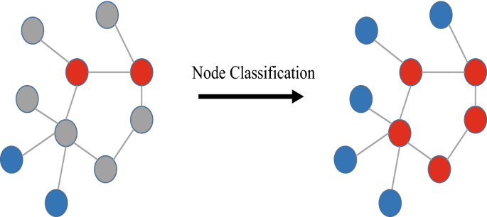
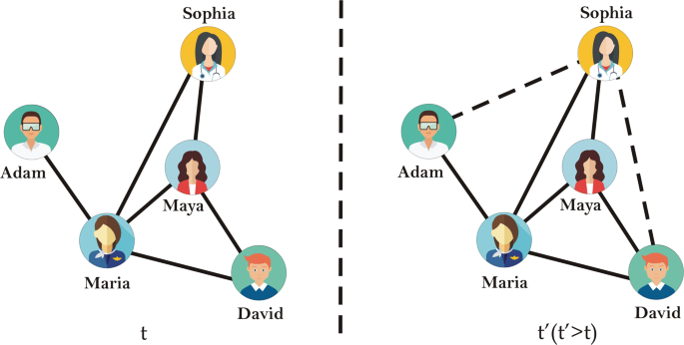
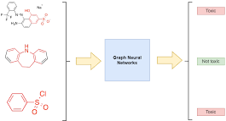
Background | graph learning
node-level
link-level
graph-level

Slide 5

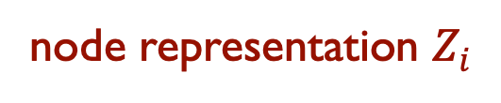

Background | graph learning
$$Graph data D→{GNN f}_{ }→representation Z→ \tilde{Y}⟷Y$$
node
vector
encode
i
$$f:i→ℝ^{d}$$
$$ℝ^{d}$$
node representation $Z_{i}$
However, only powerful is not enough

Slide 6
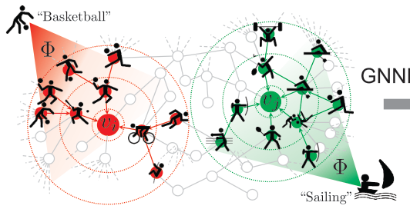

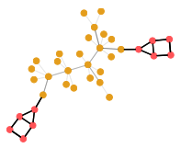
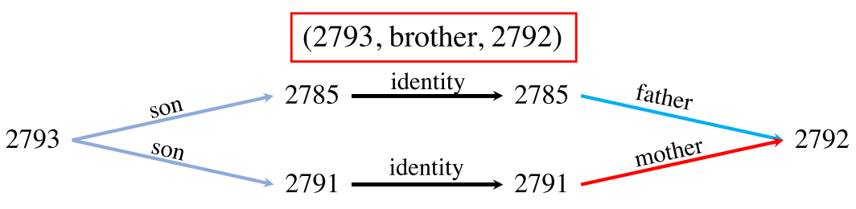
Background | motivation
node-level task: requires relevant nodes
e.g., node classification
graph-level task: requires relevant subgraphs
e.g., graph classification
link-level task: requires relevant paths
e.g., link prediction

Slide 7


Background | motivation
$$Graph data D→{GNN f}_{ }→representation Z→ \tilde{Y}⟷Y$$
Powerful
Interpretable
i.e., to approximate $Y$ by $\tilde{Y}$
i.e., which parts in $D$contribute to $\tilde{Y}$
the learned representation and graph data are usually highly entangled
an important property to trustworthy ML
e.g. ﻿identifying the functional groups in a molecule
Core problem:
how to provide more accurate interpretation without sacrificing the accuracy?

Slide 8
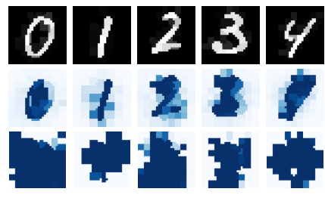
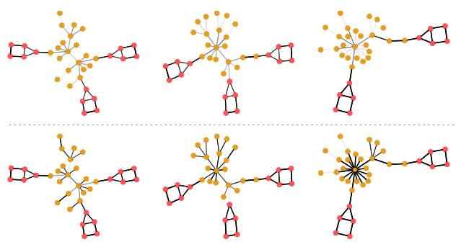
Background | motivation
Graph classification
Image classification
Proposed
Baseline
The proposed method can provide the more accurate interpretation
at the same time, it is not harmful to the performance, and even boost it

Slide 9
Outline
Background
The existing methods
The proposed method
Experiment
Summary and discussion

Slide 10
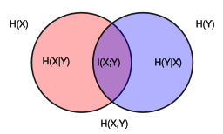
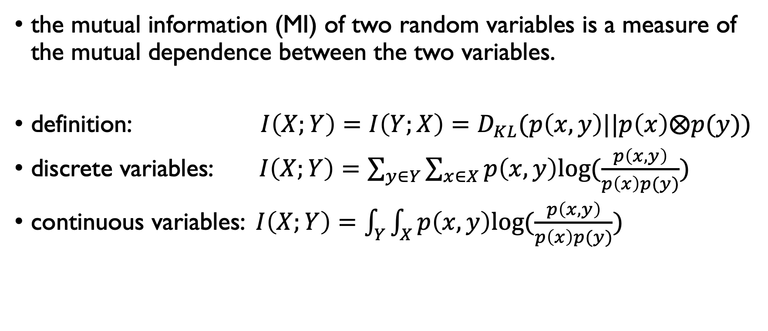
﻿Preliminaries | ﻿mutual information
the mutual information (MI) of two random variables is a measure of the mutual dependence between the two variables.
definition: $I\left(X;Y\right)=I\left(Y;X\right)=D_{KL}(p\left(x,y\right)||p\left(x\right)⨂p(y))$
discrete variables: $I\left(X;Y\right)=\sum_{y∈Y}{\sum_{x∈X}{p\left(x,y\right)log⁡(\frac{p\left(x,y\right)}{p\left(x\right)p(y)})}}$
continuous variables: $I\left(X;Y\right)=\int_{Y}^{ }{\int_{X}^{ }{p\left(x,y\right)log⁡(\frac{p\left(x,y\right)}{p\left(x\right)p(y)}})}$
https://en.wikipedia.org/wiki/Mutual_information

Slide 11
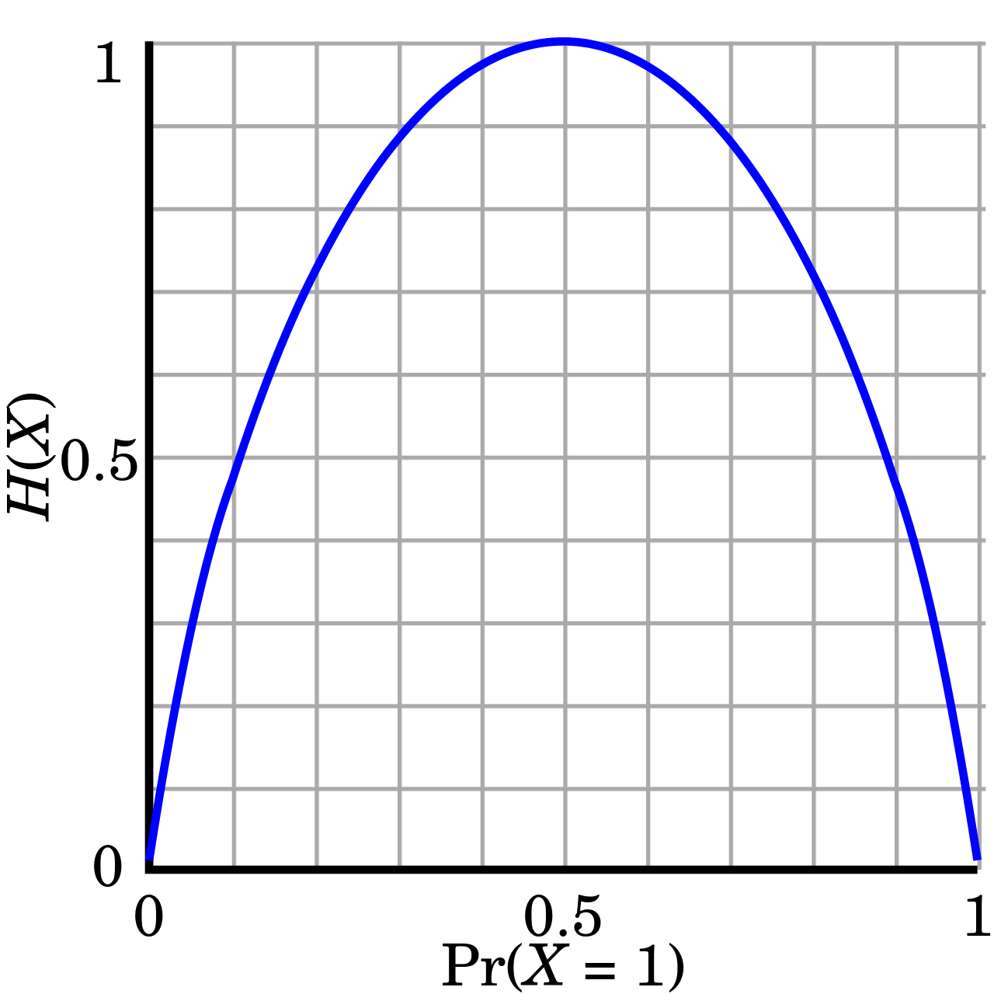


﻿Preliminaries | ﻿mutual information
$I\left(X;Y\right)=H\left(X\right)−H\left(X | Y\right)$
$I\left(X;Y\right)=H\left(Y\right)−H\left(Y | X\right)$
$I\left(X;Y\right)=H\left(X\right)+H\left(Y\right)−H(X,Y)$
$$H\left(x\right)=−xlog_{2}(x)$$

Slide 12


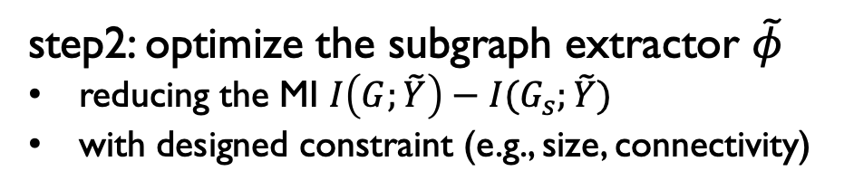


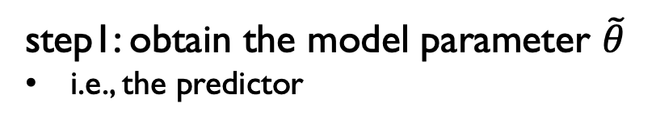







The existing post-hoc methods
For example:
$$f_{\tilde{θ}}$$
step1: ﻿obtain the model parameter $\tilde{θ}$
i.e., the predictor
$$G$$
$$\tilde{Y}$$
$$Y$$
fixed
step2: ﻿optimize the subgraph extractor $\tilde{φ}$
reducing the MI $I\left(G;\tilde{Y}\right)−I(G_{s};\tilde{Y})$
with designed constraint (e.g., size, connectivity)
$$g_{\tilde{φ}}$$
$$f_{\tilde{θ}}$$
$$G$$
$$G_{s}$$
$$\tilde{Y}$$
$$Y$$
$$f_{\tilde{θ}}∘g_{\tilde{φ}}$$
the interpretating system

Slide 13



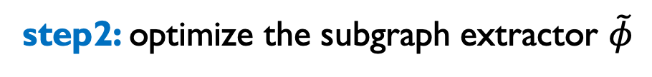
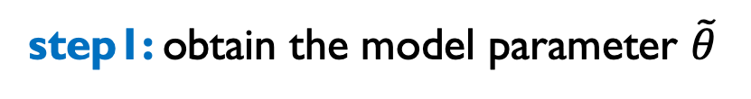
The existing post-hoc methods
step1: ﻿obtain the model parameter $\tilde{θ}$
$$f_{\tilde{θ}}∘g_{\tilde{φ}}$$
step2: ﻿optimize the subgraph extractor $\tilde{φ}$
the interpretating system

Slide 14
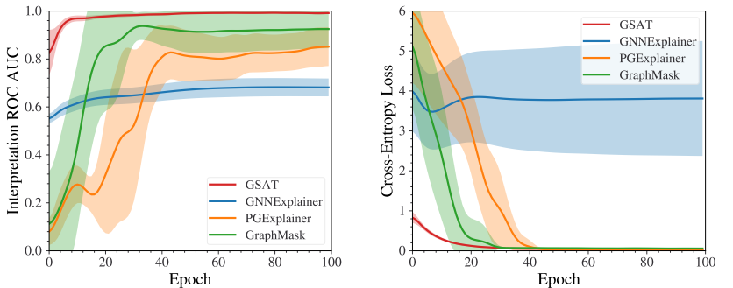
The existing post-hoc methods | problems
interpretation performance training loss
Observation: (under-fitting)
the interpretation is sub-optimal and the training loss keeps high

Slide 15
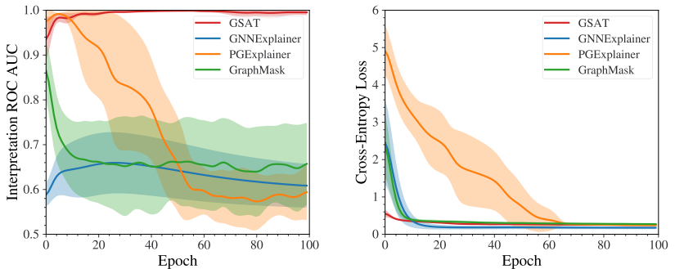
The existing post-hoc methods | problems
interpretation performance training loss
Observation: (over-fitting)
﻿The overfitting problems are severe and common
﻿However, it is hard to have the ground truth interpretation labels in practice 🤔

Slide 16
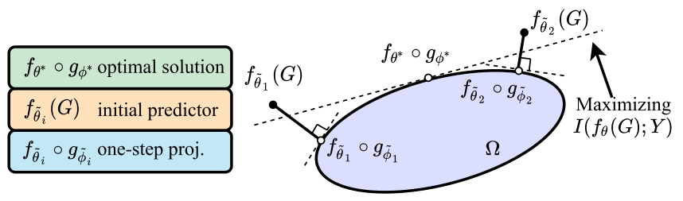
The existing post-hoc methods | problems
﻿Post-hoc methods just perform one-step projection
to the information-constrained space (Ω)
cons
always suboptimal (low accuracy)
sensitive to the pre-trained model (high variance)
the pretrain model
the learned projection

Slide 17



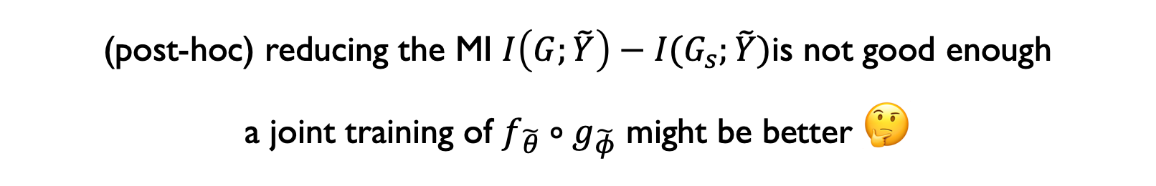




The existing post-hoc methods | problems
$$f_{\tilde{θ}}∘g_{\tilde{φ}}$$
$$g_{\tilde{φ}}$$
$$f_{\tilde{θ}}$$
$$G$$
$$G_{s}$$
$$\tilde{Y}$$
$$Y$$
(post-hoc) reducing the MI $I\left(G;\tilde{Y}\right)−I(G_{s};\tilde{Y})$is not good enough
a joint training of $f_{\tilde{θ}}∘g_{\tilde{φ}}$ might be better 🤔

Slide 18
Outline
Background
The existing methods
The proposed method
Experiment
Summary and discussion

Slide 19
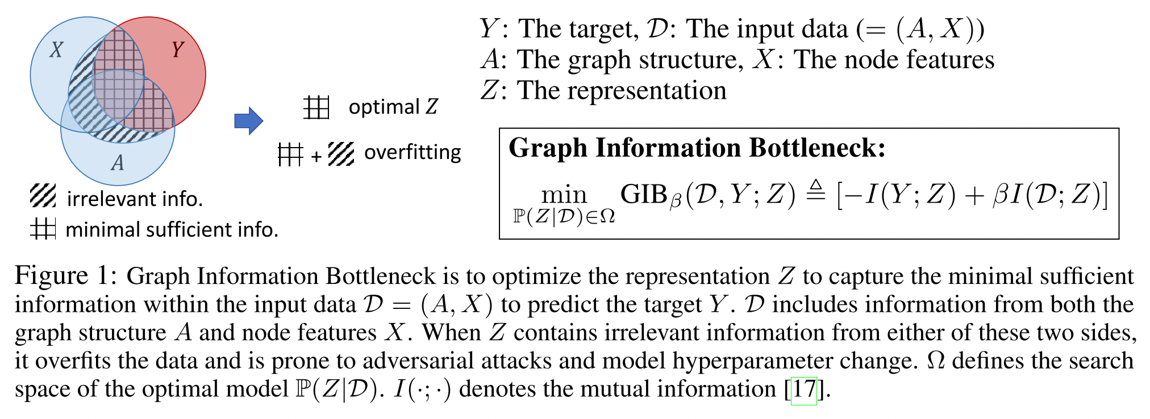
Graph information bottleneck (GIB)
D=(X,A) → (GNN) → Z ↔ Y
Graph Information Bottleneck. NeurIPS 2020.

Slide 20







Graph information bottleneck (GIB)
inspired by the GIB, this work uses
information constraint to select label-relevant subgraph
$$G$$
$$G_{s}$$
$$\tilde{Y}$$
$$Y$$
$$I(G_{s};G)↓$$
$$I(G_{s};Y)↑$$
﻿not impose any potentially biased constraints
e.g., graph size or connectivity (adopted by other works)

Slide 21
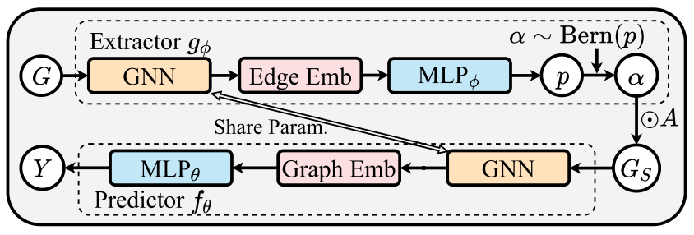











The proposed method
$$G$$
$$g_{φ}$$
joint training
$$g_{φ}$$
$$f_{θ}$$
$$G$$
$$G_{s}$$
$$\tilde{Y}$$
$$Y$$
$$\tilde{Y}$$
$$f_{θ}$$
$$G_{s}$$

Slide 22



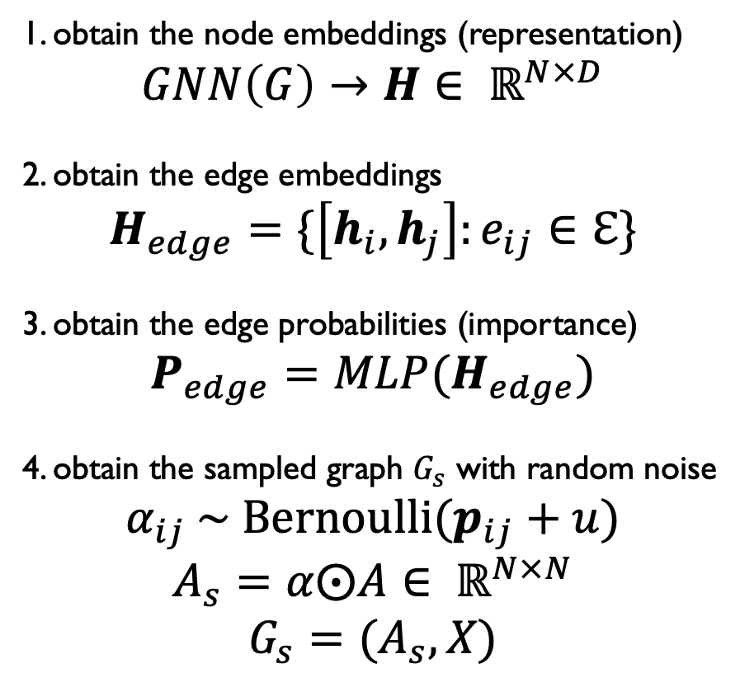






The proposed method | extractor
$$G$$
$$g_{φ}$$
1. obtain the node embeddings (representation)
$$GNN\left(G\right)→H∈ ℝ^{N×D}$$
2. obtain the edge embeddings
$$H_{edge}=\{\left[h_{i},h_{j}\right]:e_{ij}∈ℇ\}$$
3. obtain the edge probabilities (importance)
$$P_{edge}=MLP(H_{edge})$$
4. obtain the sampled graph $G_{s}$ with random noise
$$α_{ij} \sim {\text{Bernoulli}(p}_{ij}+u)$$
$$A_{s}=α⨀A∈ ℝ^{N×N}$$
$$G_{s}=(A_{s},X)$$
$$G_{s}$$
$$g_{φ}$$
$$f_{θ}$$
$$G$$
$$G_{s}$$
$$\tilde{Y}$$
$$Y$$

Slide 23
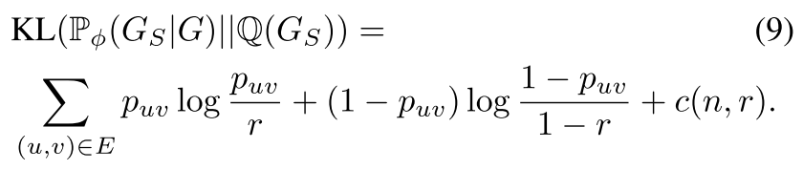






The proposed method | extractor
$$G$$
$$g_{φ}$$
$$G_{s}$$
$$g_{φ}$$
$$f_{θ}$$
$$G$$
$$G_{s}$$
$$\tilde{Y}$$
$$Y$$

Slide 24







The proposed method | predictor
$$G$$
$$g_{φ}$$
$$\tilde{Y}$$
$$f_{θ}$$
$$G_{s}$$
classification loss, e.g., cross entropy
$$g_{φ}$$
$$f_{θ}$$
$$G$$
$$G_{s}$$
$$\tilde{Y}$$
$$Y$$

Slide 25
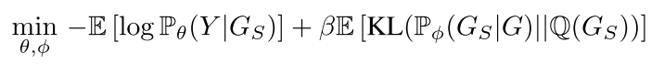








Full learning objective
joint training
$$g_{φ}$$
$$f_{θ}$$
$$G$$
$$G_{s}$$
$$\tilde{Y}$$
$$Y$$
$$\left(g_{\tilde{φ}}\right)$$
$$\left(f_{\tilde{θ}}\right)$$

Slide 26
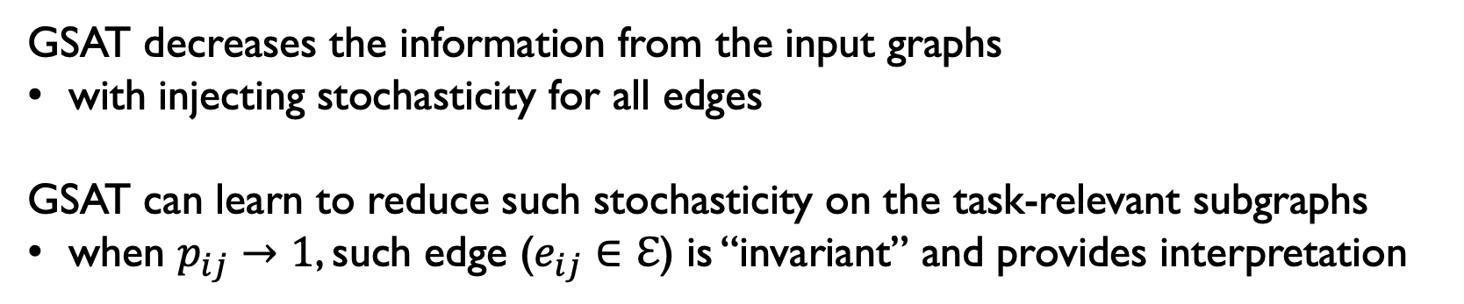



Further interpretation
$$G$$
$$G_{s}$$
$$Y$$
﻿GSAT decreases the information from the input graphs
with injecting stochasticity for all edges
GSAT can learn to reduce such stochasticity on the task-relevant subgraphs
when $p_{ij}→1$, such edge ($e_{ij}∈ℇ$) is “invariant” and provides interpretation

Slide 27
Outline
Background
The existing methods
The proposed method
Experiment
Summary and discussion

Slide 28
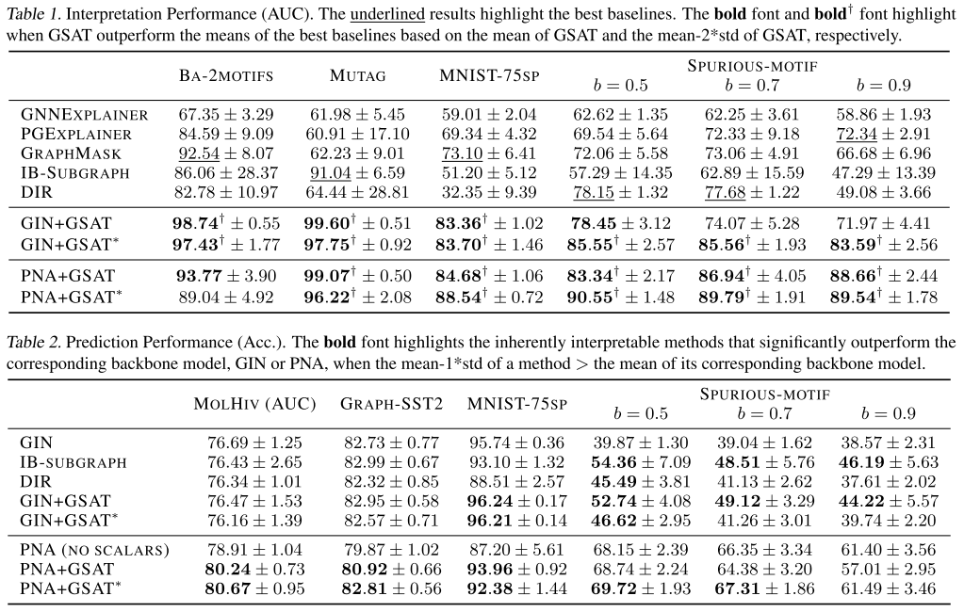
Experiment
Interpretation 👍🏻
Prediction 👍🏻

Slide 29
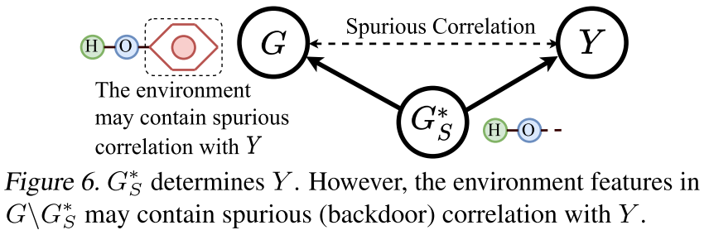
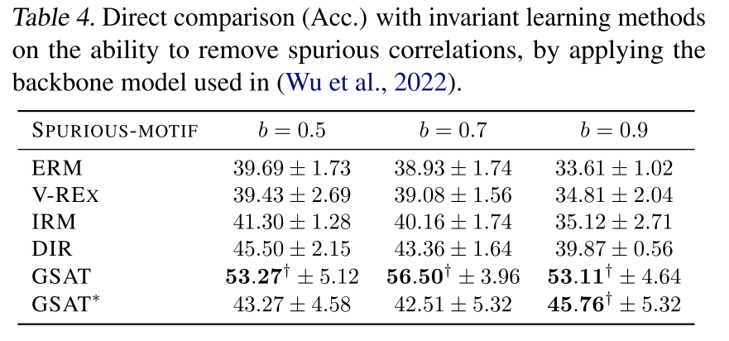
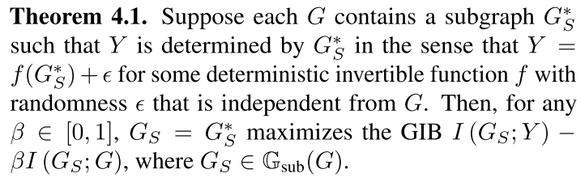
Experiment
﻿GSAT can remove spurious correlations in the training data 👍🏻
mainly due to the injecting stochasticity

Slide 30
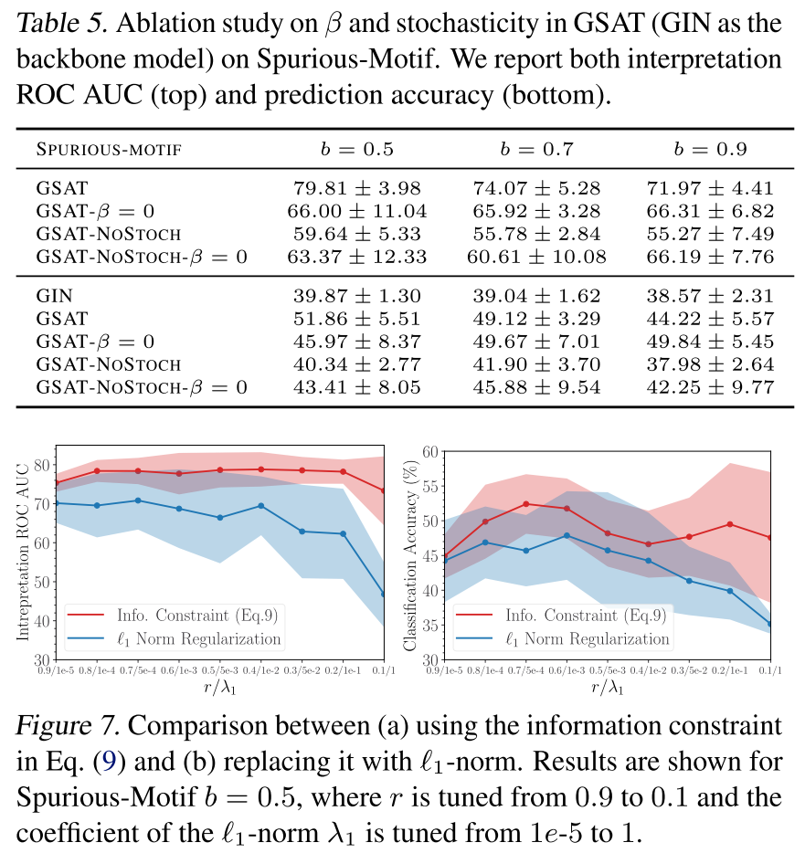
Experiment
graph information bottleneck (GIB) 👍🏻
stochasticity (gumbel trick) 👍🏻

Slide 31
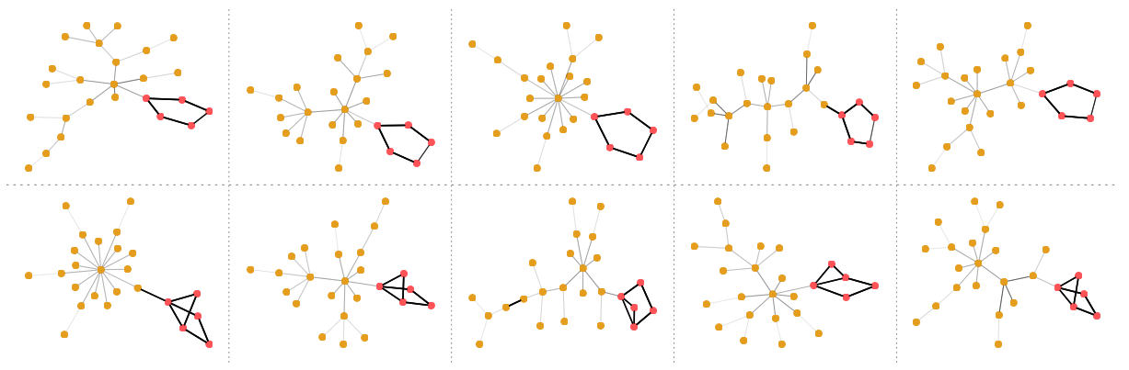
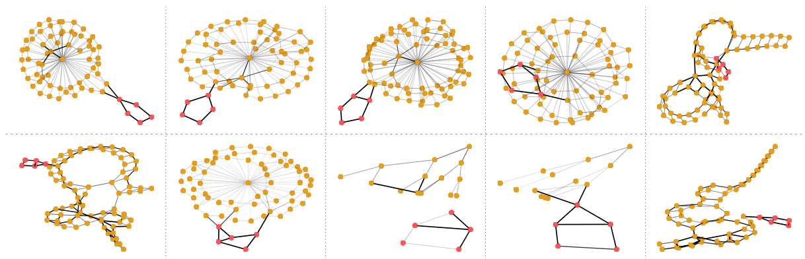
Experiment
since the GSAT dose not make any assumptions on the selected subgraphs,
the improvement of GSAT can be even more
if the true subgraph are dis-connected or vary in sizes.

Slide 32
Outline
Background
The existing methods
The proposed method
Experiment
Summary and discussion

Slide 33
Summary
﻿First, the GIB frees GSAT from any potentially biased assumptions
which are adopted in previous methods
Second, GSAT can provably remove spurious correlations in the training data
by reducing the information from the input graph
Third, GSAT can cooperate with the pre-trained model if provided
GSAT may further improve both of its interpretation and prediction accuracy

Slide 34
Related works
GNNExplainer: Generating Explanations for Graph Neural Networks. NeurIPS 2019.
Graph Information Bottleneck. NeurIPS 2020.
Parameterized Explainer for Graph Neural Network. NeurIPS 2020.
INTERPRETING GRAPH NEURAL NETWORKS FOR NLP WITH DIFFERENTIABLE EDGE MASKING. ICLR 2021.
GRAPH INFORMATION BOTTLENECK FOR SUBGRAPH RECOGNITION. ICLR 2021
DISCOVERING INVARIANT RATIONALES FOR GRAPH NEURAL NETWORKS. ICLR 2022.

Slide 35
Q&A
Thanks for your attention!

