Slide 1
Some Personal Suggestions
on Doing Research
Zhanke Zhou
2024 / 03 / 27

Slide 2
Biography
Research Career
2018.3 – 2021.1 Member @Dian Group
supervised by Dr. Yayu Gao and Dr. Xiaojun Hei
2021.1 - present Research Intern @LARS Group
supervised by Dr. Quanming Yao and Dr. Yongqi Zhang
2022.2 - present RA/PhD @TMLR Group
supervised by Dr. Bo Han
Research Interest
Trustworthy Machine Reasoning for Scientific Discoveries
Personal Homepage: https://andrewzhou924.github.io/
Biography
bachelor
Why research
How research
Suggestions
phd

Slide 3
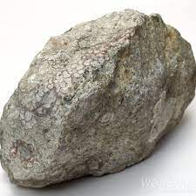
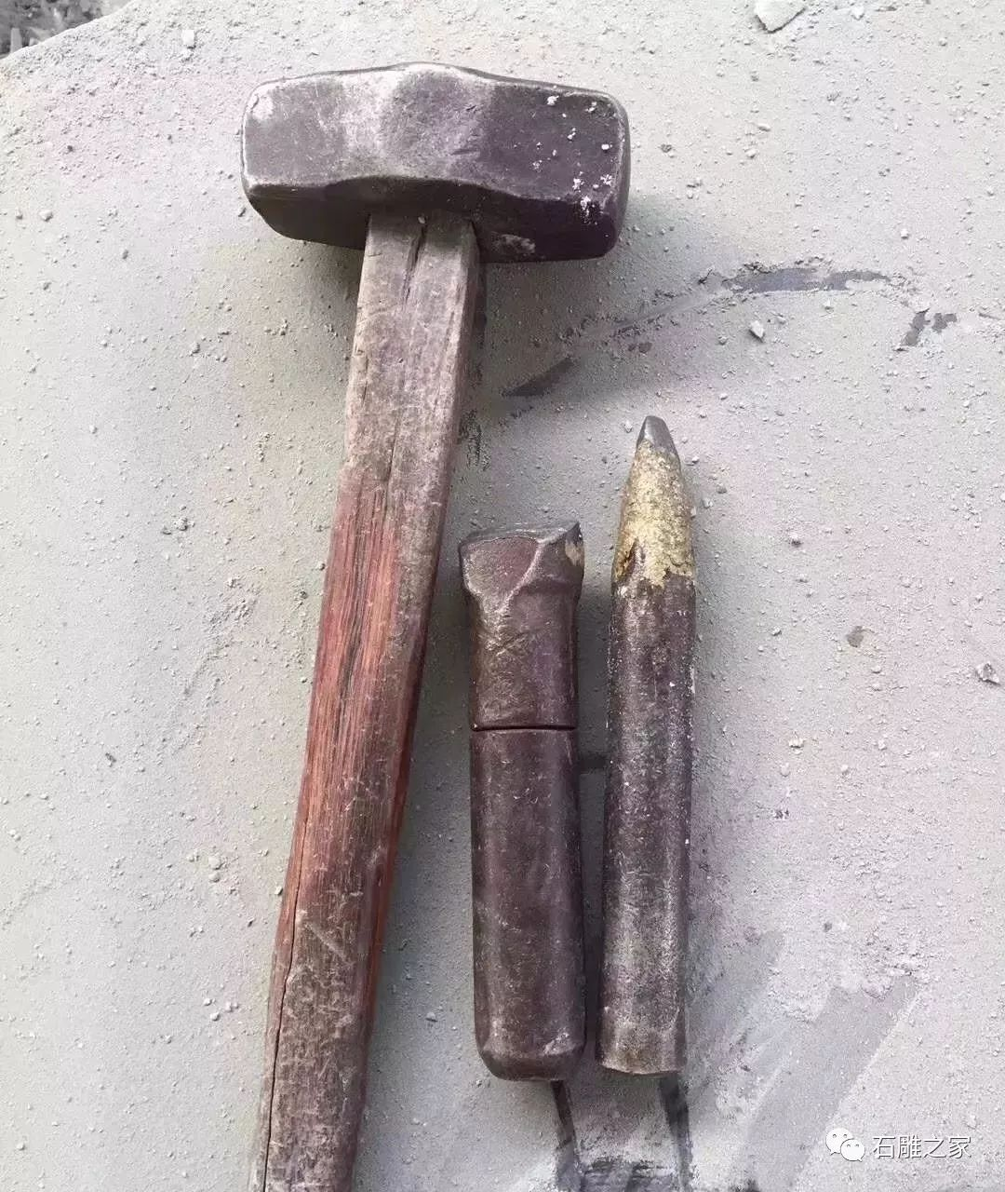
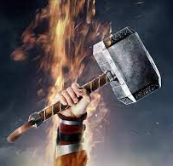
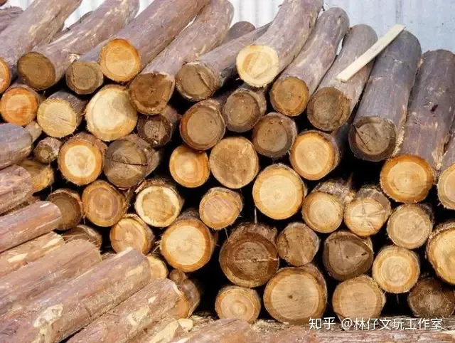


Why research?
Your motivation matters: Make a thing works
Biography
Why research
How research
Suggestions
0
1
100
$→$Research
create new knowledge
$→$Engineering
improve and apply

Slide 4


Why research?
Your motivation matters: Make a thing works
Biography
fundamental research
a prototype
real-world application
Why research
How research
Suggestions
0
1
100
How to make it works
fundamentally and mathematically
How to make it works
effectively and efficiently
$→$Research
$→$Engineering
➔ do something hardcore attracts me

Slide 5
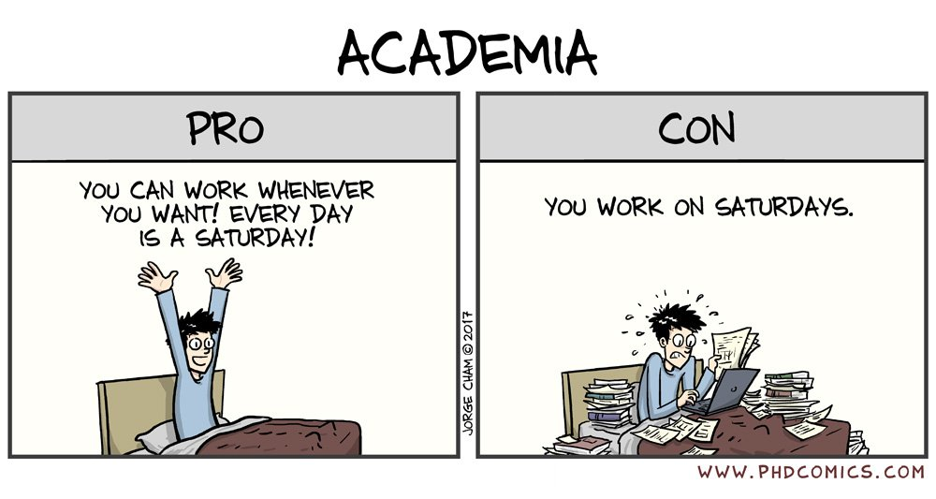
Why research?
Research is with great uncertainty (that is, the cost)
Biography
Why research
How research
Suggestions
Why I choose to do research?
a title? a PhD diploma? a kind of life!
https://phdcomics.com/

Slide 6


How research?
My Working Flow:
update
Biography
you
Why research
Papers
Codes
Talks
inputs
outputs
Drafts
Codes
Slides
Submissions
Codes
Presentations
a problem
How research
Suggestions
“explore”
“exploit”
communicate
your alumni
new
collaborator
Output, get feedback, and update

Slide 7
How research?
My research life
doing research (70%)
take courses & teaching assistant (15%)
sports and travel (10%)
other stuff in my lab (5%)
Biography
Why research
How research
Suggestions
Everyday can be a Saturday
But, we work on Saturday…

Slide 8
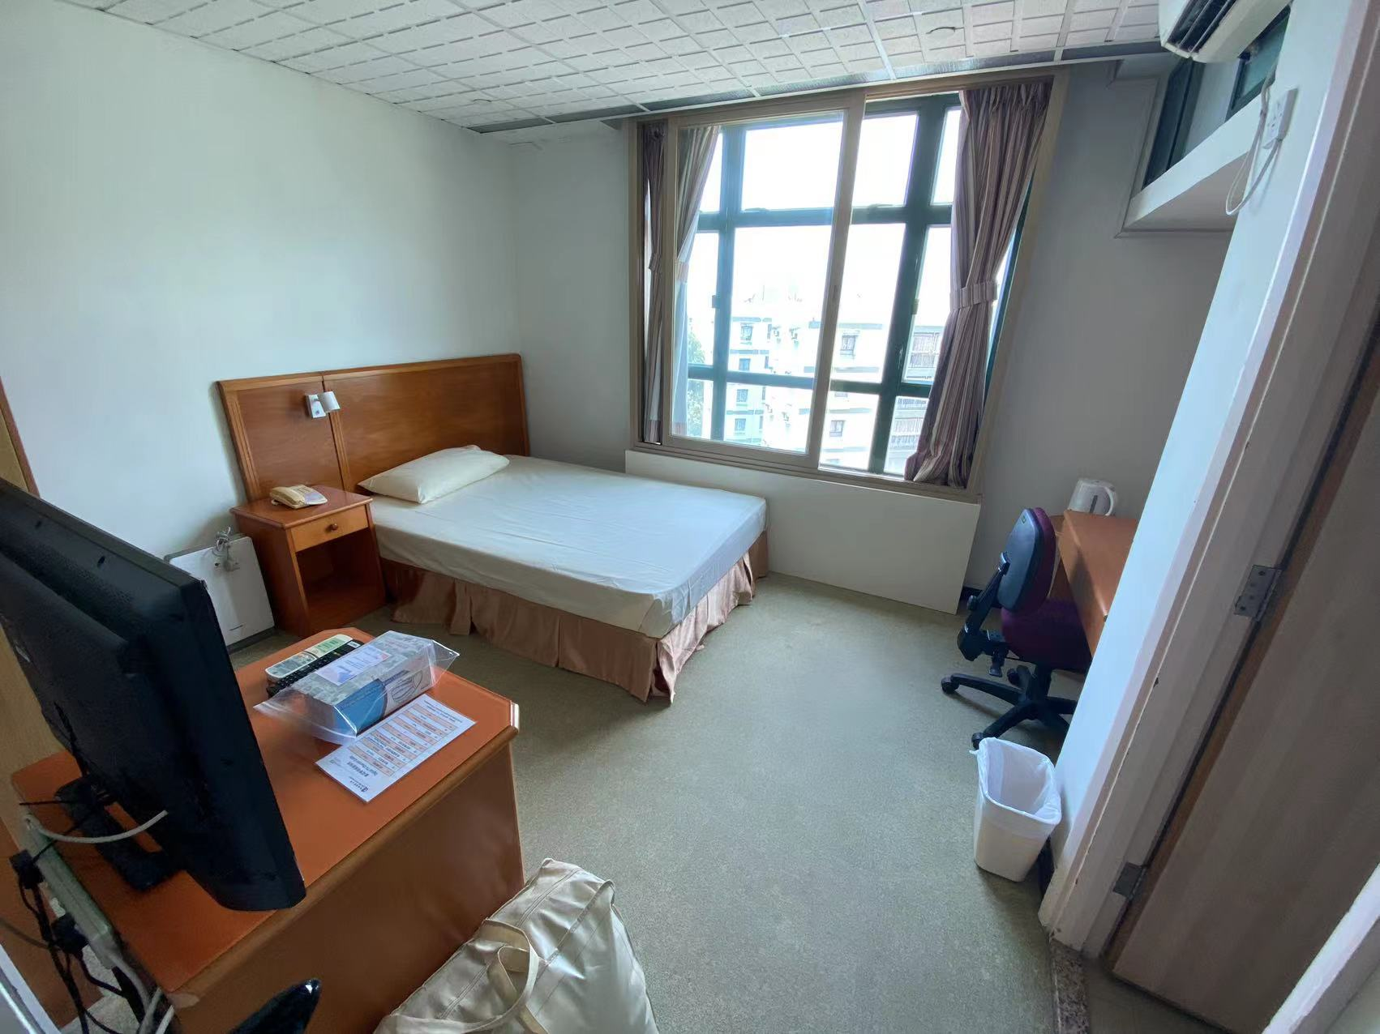
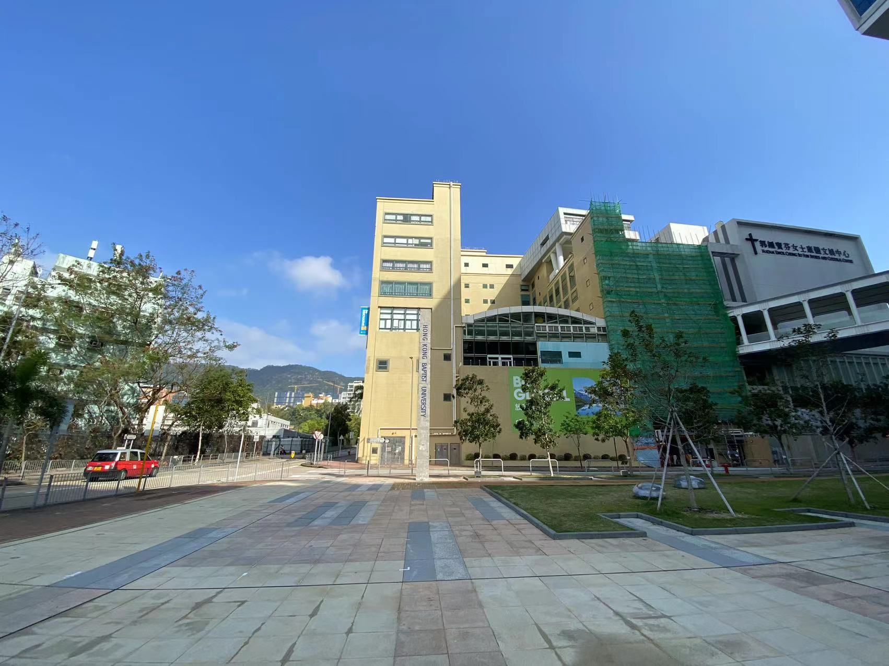
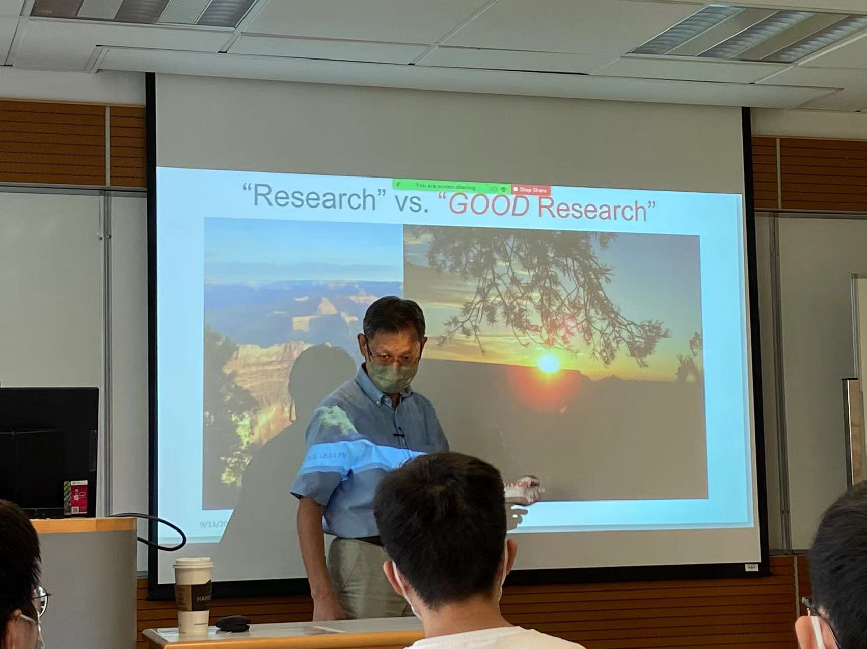
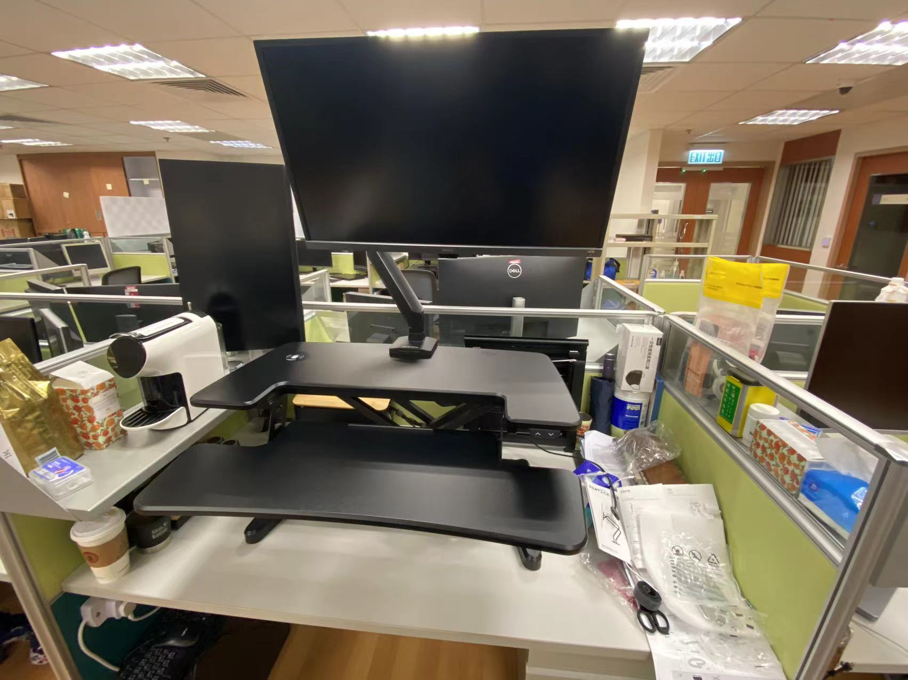
How research?
My research life | “work hard”
Biography
Why research
How research
Suggestions

Slide 9
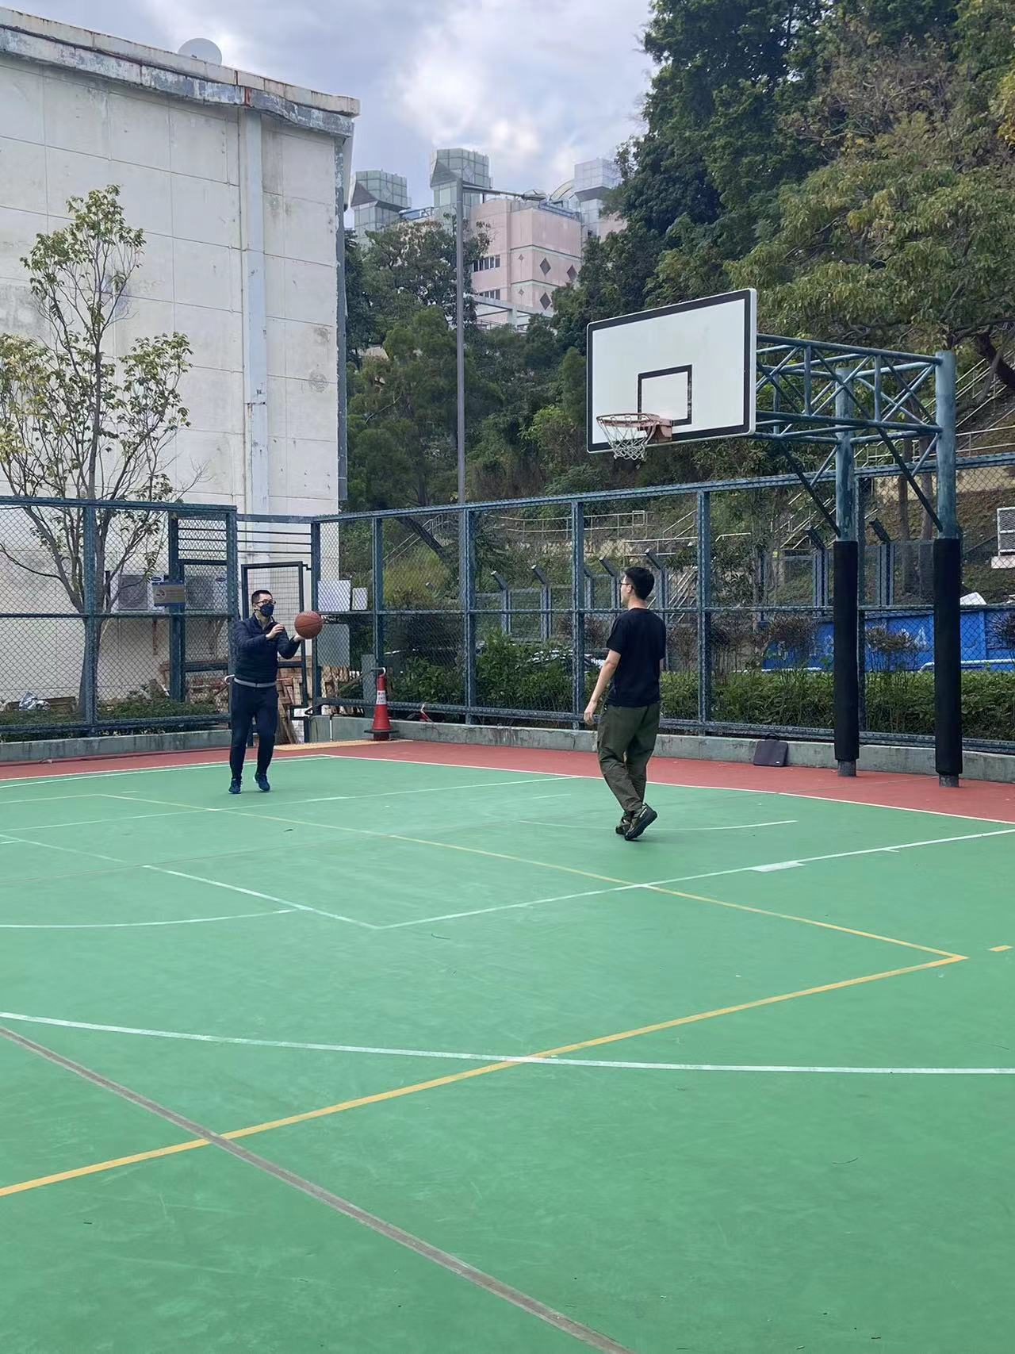
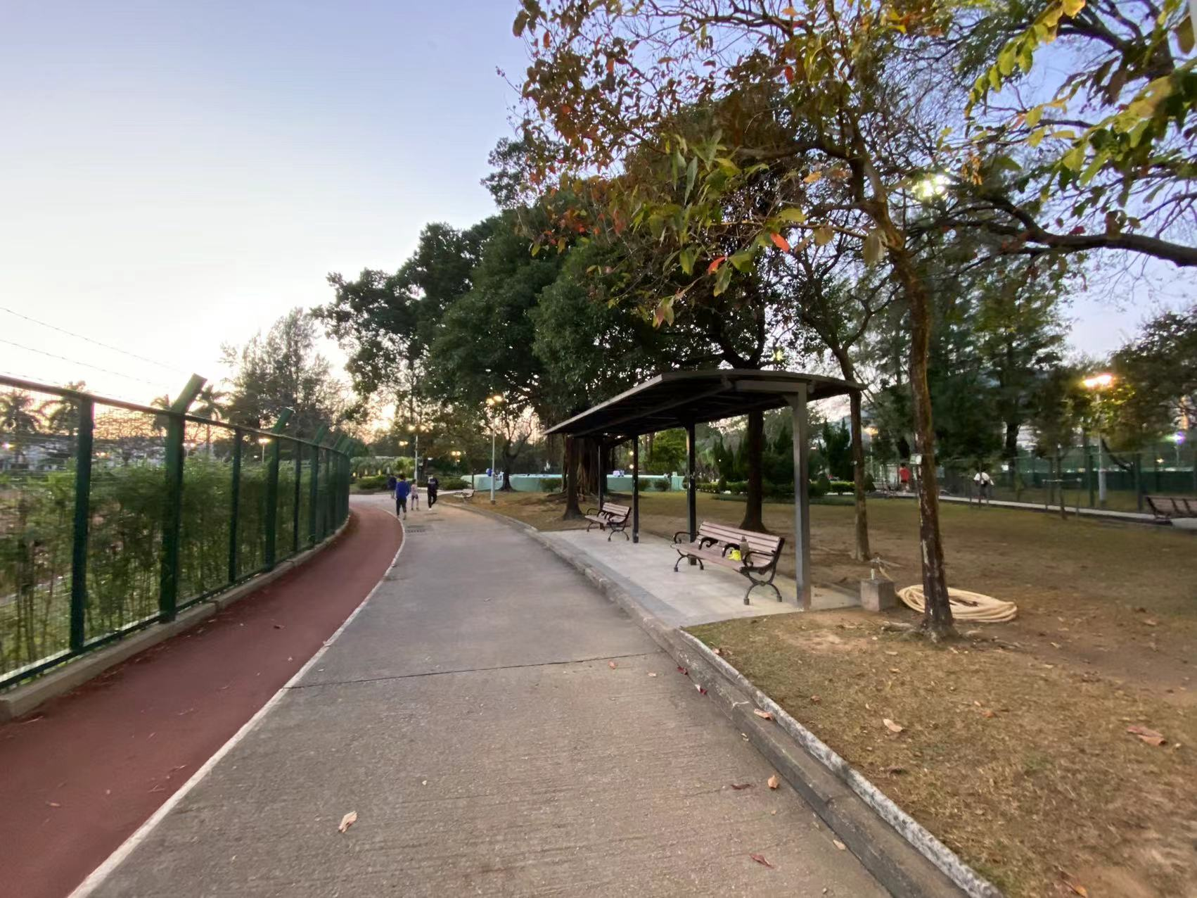
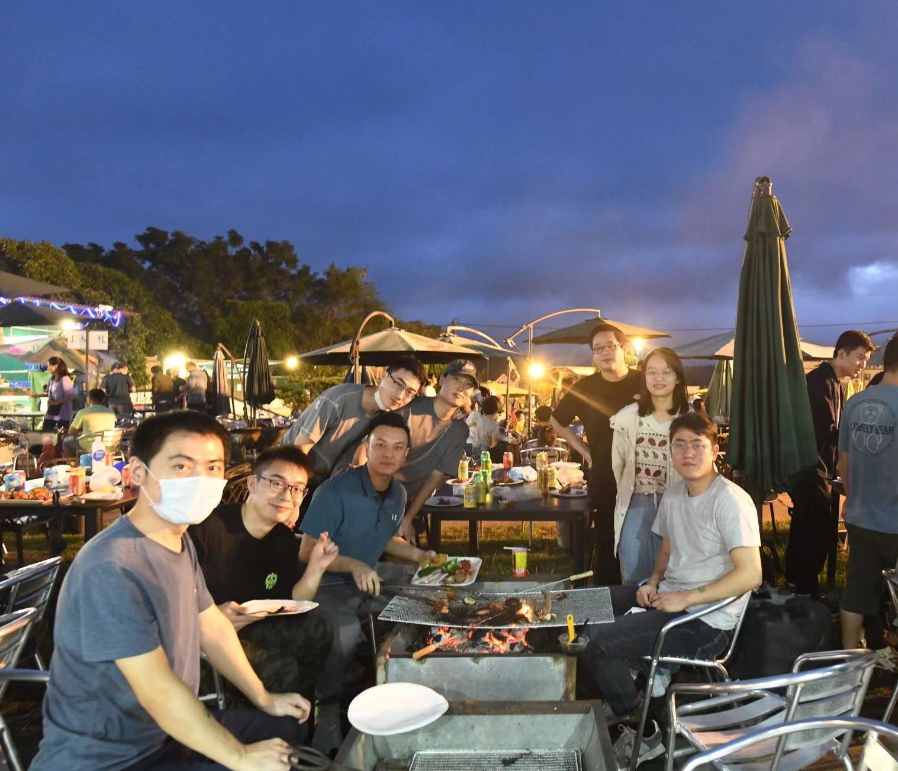
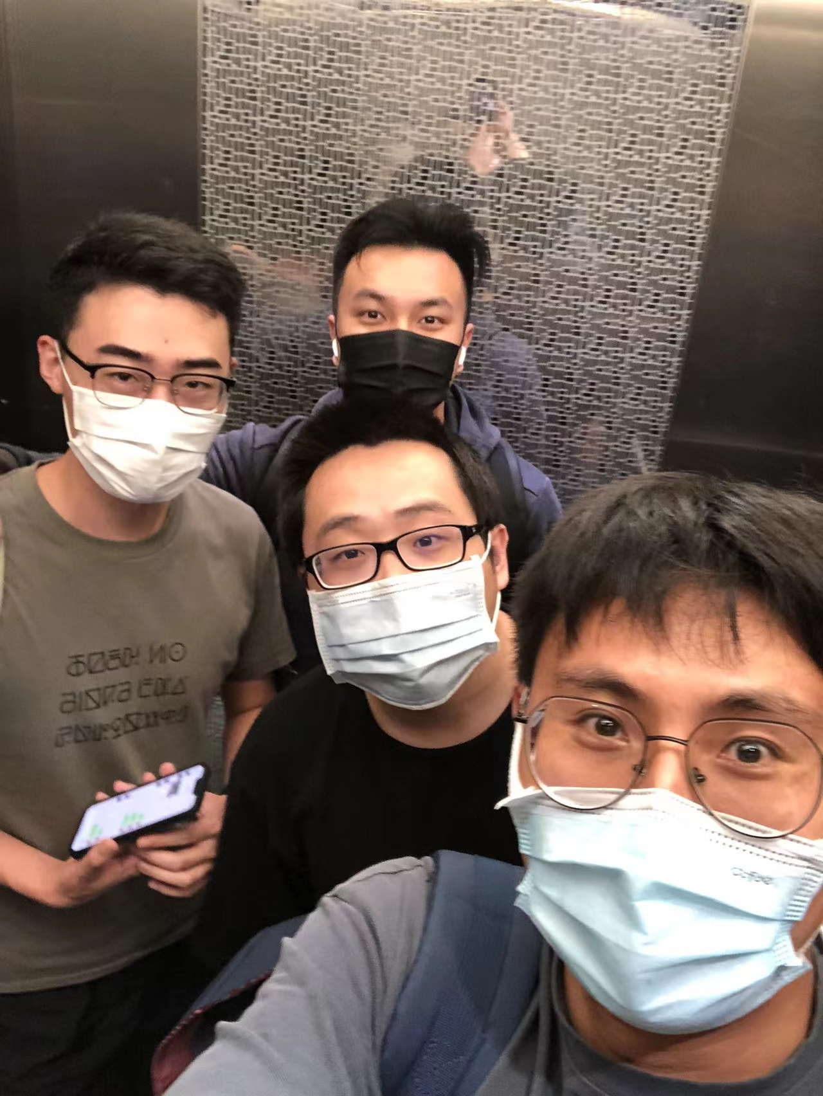
How research?
My research life | “play hard”
Biography
Why research
How research
Suggestions

Slide 10
Suggestions
In addition to Strong Self Motivation,
The three (most) important things are:
Novelty
➔ know what problem to solve
➔ know which direction to delve into
Depth
➔ read & think & do in depth and hardcore
➔ if it doesn’t challenge you, if won’t change you
Delivery
➔ share your discovery with other researchers
➔ e.g. Group Meetings / Offline Conference / Online seminars / … (international-wise)
Biography
Why research
How research
Suggestions

Slide 11
Suggestions
Ask yourself: which kind of thing you want to do?
If you want to do research, just try now
try to read a paper written in English
try to analyze and improve an existing method
try to summarize you findings and share
…
“learning by doing”（干中学）
Biography
Why research
How research
Suggestions

Slide 12
Q & A
Email: cszkzhou@comp.hkbu.edu.hk

