Slide 1


Softmax Classifier on CIFAR-10 dataset
主讲人：周展科 组员：唐彬 杨澍生 杨阳
华中科技大学
电子信息与通信学院

Slide 2
提纲
Softmax Classifier
Implementation Details
Loss Function
Gradient Checking
Weight Visulization
Discuss
Summary
Reference

Slide 3
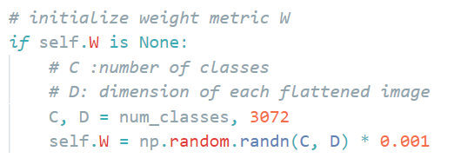
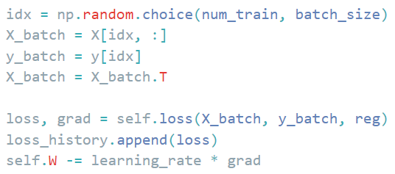
1.Softmax Classifier
Implementation Details
Weight Initialization
Mini-Batch Gradient Descent

Slide 4
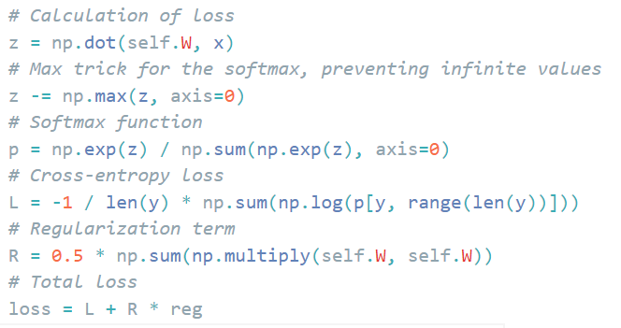
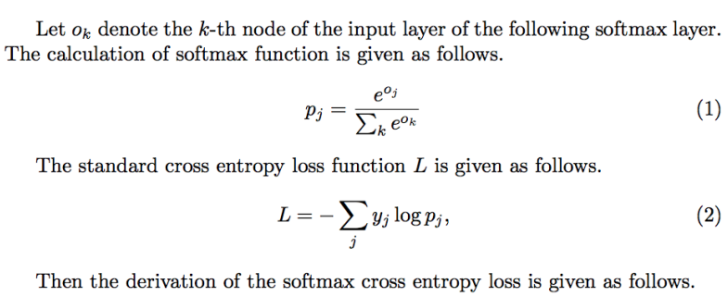
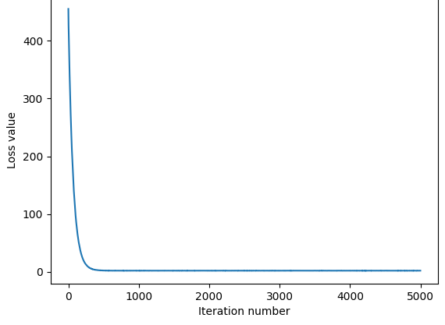
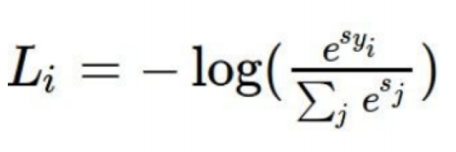
1.Softmax Classifier
Loss Function
Muti-Class Cross-entropy

Slide 5
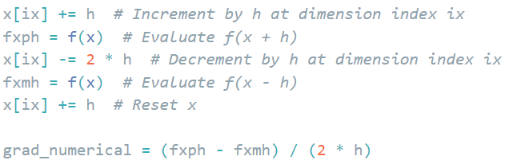
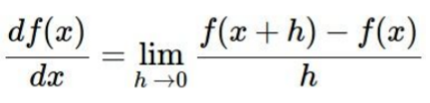
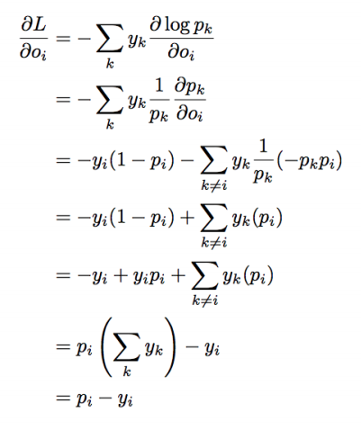
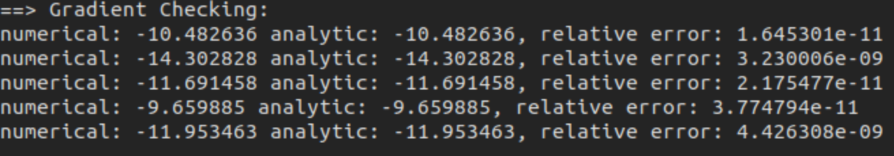
1.Softmax Classifier
Gradient Check
Numerical Gradient
Analytical Gradient

Slide 6
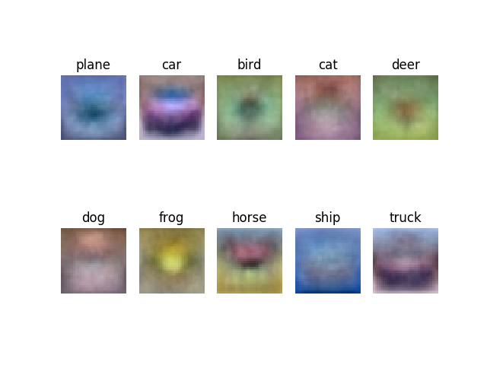
1.Softmax Classifier
Weight Visulization
W.shape: 10*3072
Reshape to 10*32*32*3

Slide 7
2.Discuss
TODO

Slide 8
3.Summary
TODO

Slide 9
4.Reference
Related Work

Slide 10
Q&A
Thank you for watching！

