Slide 1
Databases and JDBC

Slide 2
Daily Interactions with Databases
Trip to a bank
Processes conducted?
Withdraw, deposit, etc …
Stored data?
Customers, accounts , employees, etc …
Student login to Banner?
Student, courses, fees, grades, advisors
Book purchase from Amazon.com?
Book inventory, customer, credit card, credit card company, Amazon’s balance, your balance, etc …

Slide 3
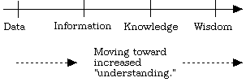
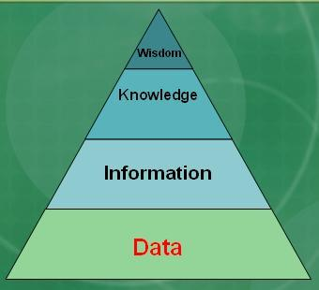
Notes:
Data is stored on a computer
Information is suitable for human visualization
Knowledge is retained in our memory
Notice that we are going towards wisdom as we go down the list

Slide 4
Real Definition
An integrated shared repository of operational data of interest to an enterprise
INTEGRATED: it must be the unification of several distinct files and entities some of which are interrelated
SHARED: same data can be used by more than 1 user (concurrently)
REPOSITORY: implies “persistence”
OPERATIONAL DATA: data on accounts, parts, patients, students, employees, genes, stocks, pixels,...
Non-operational data: I/O data, transient data in buffers, queues...
ENTERPRISE: bank, warehouse, hospital, school, corp., gov. agency, person…

Slide 5
Basic Definitions
Data: Known facts that can be recorded to describe an entity and have an implicit meaning
Database: A collection of related data
Database Management System (DBMS): A collection of programs that facilitates the creation and maintenance of a computerized database
General-purpose complex software
Retrieval, maintenance , concurrency, access control, recovery, etc ..
Database System: The DBMS software together with the database itself

Slide 6
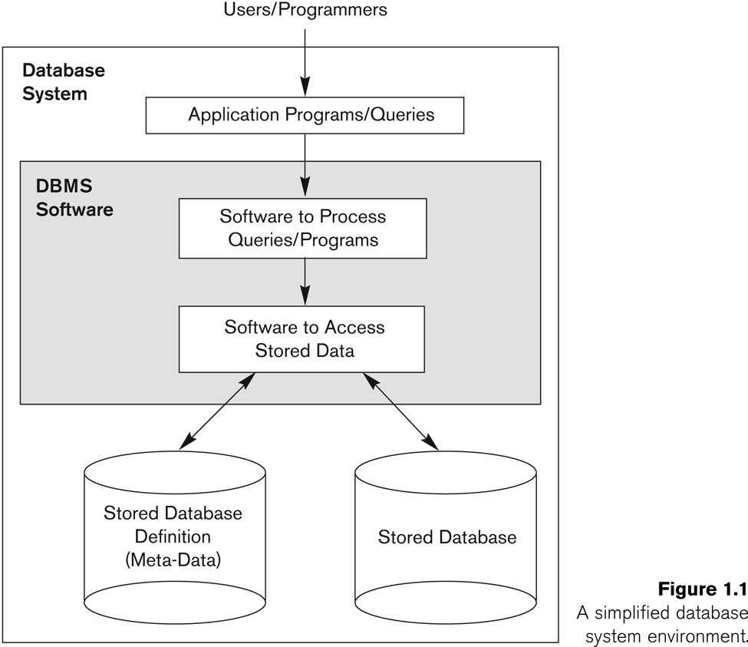

Slide 7
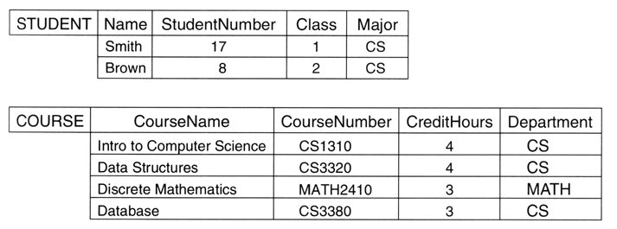
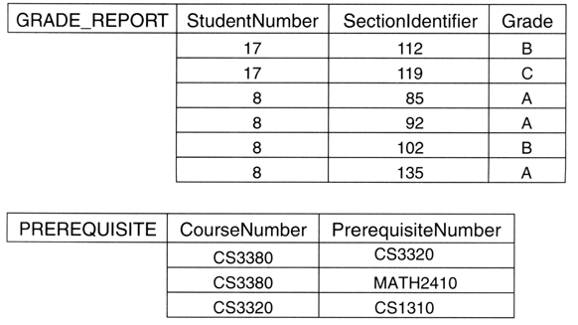
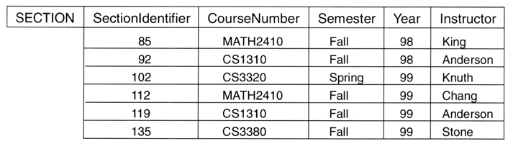
Example of a Database

Slide 8
Components of a Database
Tables, rows (records) and columns (fields)
Related data
SOME Tables have relationships among each other
Embedded by means of a common field

Slide 9
Constraints on Databases
Database?
Made up of tables, rows and columns
Database system
DBMS
Entity integrity?
Pk Unique and not null
Referential integrity?
A constraint involving two tables
Referencing table R₁ and the referenced table R₂
Foreign must have a value of an existing primary Key in R₂ or, a null

Slide 10
In-Class Exercise
Consider the following relations for a database that keeps track of courses and books adopted for each course:
COURSE (Course#, CName, Dept)
TEXT (Book-ISBN, Book-Title, Publisher, Author)
BOOK_ADOPTION (CRN#, ISBN, SEMESTER)
Name all primary and foreign keys

Slide 11
SQL Basics
SQL = Structured Query Language
Comprehensive language developed specifically to query databases
Data definition, query and update
declarative vs. procedural language

Slide 12
CREATE TABLE
Specifies a new base table by giving it a name, and specifying each of its attributes and their data types
Such as INTEGER, FLOAT, CHAR(n), VARCHAR(n)
CREATE TABLE COURSE ( CNAME VARCHAR(10), CNUMBER INTEGER, INSTRUCTOR_ID CHAR(9), CREATE_DATE CHAR(9) );

Slide 13
CREATE TABLE
We can also use the CREATE TABLE command for specifying the primary key attributes, secondary keys, and referential integrity constraints (foreign keys)
Key attributes can be specified via the PRIMARY KEY and UNIQUE phrases
CREATE TABLE COURSE ( CNAME VARCHAR(10), CNUMBER INTEGER, INSTRUCTOR_ID CHAR(9), CREATE_DATE CHAR(9), PRIMARY KEY(CNUMBER), FOREIGN KEY (INSTRUCTOR_ID) REFERENCES FACULTY(INSTRUCTOR_ID) );

Slide 14
Retrieval Queries in SQL
SQL has one basic statement for retrieving information from a database: the SELECT statement
Basic form of the SQL SELECT statement is called a mapping or a SELECT-FROM-WHERE block
SELECT <column list> FROM <table list> WHERE <condition>

Slide 15
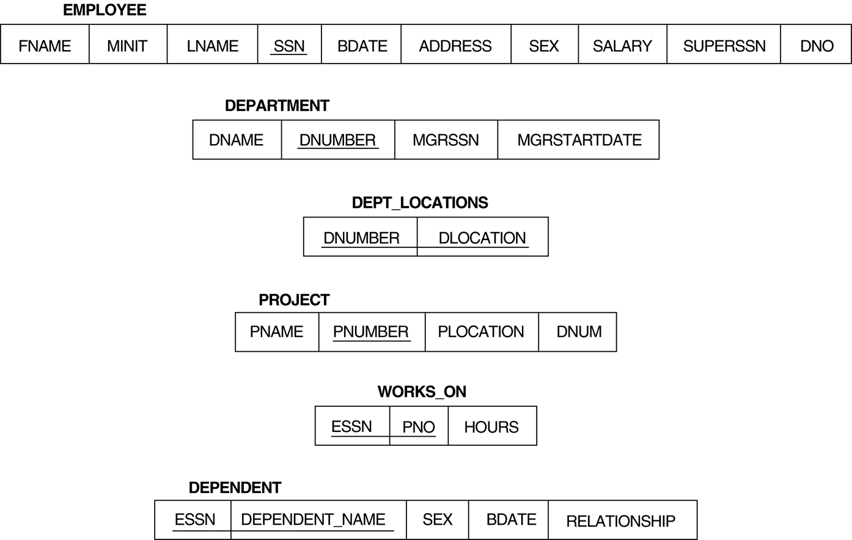
Relational Database Schema--Figure 5.5
DNO
Retrieve the birthdate and address of the employee whose name is 'John B. Smith‘
Retrieve the names and addresses of all employees who work for department# 120
Find department names managed by employee with SSN 111-11-1111
Find department names managed by a ‘Smith’
Find SSN of all employees whose LNames starts with the letter L?
Find SSN of all employees whose LNames ends with the letter L?
Find SSN of all employees whose LNames includes the letter L
Find SSN of all employees whose LNames include the letter L as the third letter?

Slide 16
Simple SQL Queries
Retrieve the birthdate and address of the employee whose name is 'John B. Smith‘
SELECT BDATE, ADDRESS FROM EMPLOYEE WHERE FNAME='John' AND MINIT='B’ AND LNAME='Smith’

Slide 17
Simple SQL Queries
Find department names managed by a ‘Smith’
SELECT DNAME FROM EMPLOYEE, DEPARTMENT WHERE MGRSSN=SSN and LNAME='Smith’

Slide 18
Simple SQL Queries
Find SSN of all employees whose LNames includes the letter L
SELECT SSN FROM EMPLOYEE WHERE LNAME Like‘%L%’
SQL pattern matching allows you to use “_” to match any single character and “%” to match an arbitrary number of characters (including zero characters)
Do not use = or <> when you use SQL patterns; use the LIKE or NOT LIKE comparison operators instead.

Slide 19
There are three SQL commands to modify the database: INSERT, DELETE, and UPDATE
In its simplest form, INSERT is used to add one or more records to a table
Attribute values should be listed in the same order as the attributes were specified in the CREATE TABLE command
INSERT INTO EMPLOYEE VALUES ('Richard', 'K', 'Marini', '653298653', '30-DEC-52', '98 Oak Forest, Katy,TX', 'M', 97332.92, '987654321', 4)

Slide 20
Delete & Update
Fire all employees in department 4:
DELETE FROM EMPLOYEE WHERE DNO=4
Move employee with SSN =‘1123445676’ to department 4:
UPDATE EMPLOYEE SET DNO=4 WHERE SSN=‘1123445676’

Slide 21
Java Database Connectivity
Allows Java applications to interface with relational databases
A Java interface for SQL
The standard is to access databases via their own interfaces
A Java program with JDBC functions
Can access any relational DBMS that has a JDBC driver (JDBC compliant)
Can connect to several databases simultaneously

Slide 22
JDBC Architecture
Driver 1
DBMS
Java
Application
JDBC
Driver
manager
DBMS
Driver 2
Driver 3
DBMS
Application
-Initiates and terminates connection with a data source
-Submits SQL statements and retrieves results through the JDBC API
Driver Manager
-Loads JDBC driver and passes JDBC function calls from application to correct driver
Driver(s)
-Establishes the connection with the data source (thru Driver Manager)
-Submits requests from and return results to application
-Translates data and errors from data source format to JDBC standard
Data source(s)
-Processes commands from the driver and returns results

Slide 23
Steps in JDBC Database Access
(1) Import JDBC library
import java.sql.*
(2) Load & register JDBC driver with manager:
Class.forName("com.mysql.jdbc.Driver");
This will load the driver and register it with the driver manager in order to make it available to the program

Slide 24
Steps in JDBC Database Access
(3) Create a connection object (via getConnection)
DriverManager.getConnection(“jdbc:mysql: //<host>: <port>/<db-name>”, “<username>”, “<password>”)
Connection myConnection = DriverManager.getConnection(“ jdbc:mysql://devsrv.cs.
csbsju.edu:3306/UNIVERSITY","biouser", "biopassword");
(4) Create a statement object :
Statement
Statement stmt = myConnection.createStatement();
String queryString = "Insert Into Student Values('99999', 'Jim', 'CSCI')";
String queryString = "Select ID, Name, Major from Student where Major = ‘CSCI’;

Slide 25
Steps in JDBC Database Access
Statement
ResultSet
ExecuteQuery(String Q)
createStatement()
Statement
Connection
int
ExecuteUpdate(String Q)

Slide 26
Steps in JDBC Database Access
(5) Execute SQL statement (referenced by an object) via JDBC’s
executeQuery (SELECT statements)
Returns a ResultSet
ResultSet resultset = stmt.executeQuery(queryString);
executeUpdate (INSERT, UPDATE, and DELETE statements)
Returns how many tuples have been affected (an integer)
int result = stmt.executeUpdate(updateString);

Slide 27
ResultSet
(6) Process query results
ResultSet is a 2-dimensional hash table
The cursor is positioned before the 1st row upon creation
Statement stmt=con.createStatement();
ResultSet rs = stmt.executeQuery ("SELECT X, Y FROM Table1");
while (rs.next()){
system.out.println(rs.getString(“X”);
system.out.println(rs.getInt(“Y”);
}

Slide 28
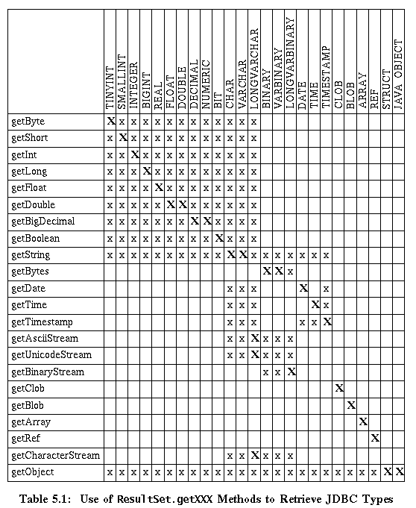
Mapping Java Types to SQL Types
SQL type
The driver maps SQL types (varchar, number,…) to the appropriate Java method (getString, getInt…)
Java method

Slide 29
Cleaning Up After Yourself
(7) Remember to close the Connections, Statements, and ResultSets in the following order
Highly recommended
rs.close()
stmt.close()
con.close()

Slide 30
What Will the Following do?
String table1=“create table Grades(ID integer, Grade integer)”;
Statement st=con.createStatement();
int resCreate=st.executeUpdate(table1);
Statement st2 = con.createStatement();
for(int i=1;i<4;i++){
int resInsert = st2.executeUpdate(“insert into Grades values(“ + i + ”,” + 10*i + ”)”)
}
Statement st3=con.createStatement();
ResultSet rs=st3.executeQuery(“select grade from Grades”);
while(rs.next()){
System.out.println(rs.getInt(“grade”)); }

Slide 31
Useful JDBC links
http://dev.mysql.com/doc/refman/5.0/en/java-connector.html
http://java.sun.com/j2se/1.3/docs/guide/jdbc/getstart/GettingStartedTOC.fm.html
http://notes.corewebprogramming.com/student/JDBC.pdf

