Slide 1
Introduction to CSCI-230: Software Development

Slide 2
Introduction
Purchasing/developing software has become the largest single expenditure for companies
  Why bother?
The cost of maintaining and upgrading occupies the largest portion of this cost
Software costs continue to increase while hardware costs continue to decrease. Why?
  OO software development (OOSD) aims to significantly improve the software development practice

Slide 3
Windows OS – case study
1993 Windows NT 3.1: 6 million lines of code (LOC)
1994 Windows NT 3.5: 10 million LOC
1996 Windows NT 4.0: 16 million LOC
2000 Windows 2000: 29 million LOC
2002 Windows XP: 35-40 million LOC
2007 Windows Vista: >50 million LOC
“I’m not sure of how many millions of lines of code there was in it, but Windows 7 is significantly scaled down from that.”
  “Hasta La Vista, Baby. Hello Windows 7”

Slide 4
Why Vista Failed
http://blogs.techrepublic.com.com/hiner/?p=849&tag=col1;post-10575
Apple successfully demonized Vista
  I’m a Mac / I’m a PC
Windows XP is too entrenched
  In 2001, when Windows XP was released, there were about 600 million computers in use worldwide.
  Over 80% of them were running Windows but it was split between two code bases: Windows 95/98 (65%) and Windows NT/2000 (26%),
  One of the big goals of Windows XP was to unite the Windows 9x and Windows NT code bases, and it eventually accomplished that.
  In 2008, there were over 1.1 billion PCs in use worldwide and over 70% of them are running Windows XP

Slide 5
Why Vista Failed
Vista is too slow
  For years Microsoft has been criticized by developers and IT professionals for “software bloat”
    adding so many changes and features to its programs that the code gets huge and unwieldy
  Vista has over 50 million lines of code
  XP had 35 million when it was released, and since then it has grown to about 40 million
  Software bloat has had the effect of slowing down Windows Vista, especially when it’s running on anything but the latest and fastest hardware
  Even then, the latest version of Windows XP soundly outperforms the latest version of Microsoft Vista
    No one wants to use a new computer that is slower than their old one.

Slide 6
Why Vista Failed
There wasn’t supposed to be a Vista
  When Microsoft launched Windows XP it was actually trying to change its OS business model to move away from shrink-wrapped software and convert customers to software subscribers
  That’s why it abandoned the naming convention of Windows 95, Windows 98, and Windows 2000, and instead chose Windows XP
  The master plan was to get users and businesses to pay a yearly subscription fee for the Windows experience — XP would essentially be the on-going product name but would include all software upgrades and updates, as long as you paid for your subscription.
  Of course, it would disable Windows on your PC if you didn’t pay. That’s why product activation was coupled with Windows XP.

Slide 7
Why Vista Failed
  The idea of doing incremental releases and upgrades of its software — rather than a major shrink-wrapped release every 3-5 years — was a good concept.
  Microsoft just couldn’t figure out how to make the business model work, but instead of figuring out how to get it right, it took the easy route and went back to an old model … Walla! Vista was born

Slide 8
Why Vista Failed
It broke too much stuff
  Windows XP caught on because it had the hardware, software, and driver compatibility of the Windows 9x line plus the stability and industrial strength of the Windows NT line.
  The compatibility issue was huge.
  Having a single, highly-compatible Windows platform simplified the computing experience for users, IT departments, and software and hardware vendors.
  Microsoft either forgot or disregarded that fact when it released Windows Vista, because, despite a long beta period, a lot of existing software and hardware were not compatible with Vista when it was released in January 2007

Slide 9
Why Vista Failed
  Windows was targeted by a nasty string of viruses, worms, and malware in the early 2000s
  Microsoft embarked on the Trustworthy Computing initiative to make its products more secure
    One of the results was Windows XP Service Pack 2 (SP2), which won over IT and paved the way for XP to become the world’s mostly widely deployed OS.
  The other big piece of Trustworthy Computing was the even-further-locked-down version of Windows that Microsoft released in Vista
  This was definitely the most secure OS that Microsoft had ever released but the price was user-hostile features and a far more complicated set of security prompts that accompanied many basic tasks, and a host of software incompatibility issues.
  Vista broke a lot of the things that users were used to doing in XP.

Slide 10
Software Challenges
(1) Size and complexity of software systems
  Windows NT OS
    6 million lines of code
    $150 million to develop
    200 developers, testers and technical writers
    5 years
  Windows Vista
    50 million lines of code (XP ~ 35 million)
    $2 billion in investment (programming and testing)
    4000 developers, testers and technical writers
    7 years in the making [Delayed three or four times]

Slide 11
Software Challenges
  Complexity results from
    Problems intended to be solved and services to be provided
    High user expectations
  No individual can comprehend every detail of the system
    Communications
(2) Software requires continuous maintenance
  What causes the need for maintenance?
  Usually results in over budgeting and delays
  Maintenance cost of a software system over its lifetime is far greater than its initial development goal

Slide 12
Software Challenges
(3) Software systems tend to be “buggy”
  “To err is human, but to really foul things up you need a computer.” – Paul Ehrlich
  Software can’t and isn’t required to be 100% error free!
    How good is good enough?

Slide 13
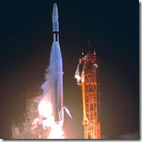
Example 1
Mariner Bugs Out (1962)
Cost: $18.5 million
Disaster: The Mariner 1 rocket with a space probe headed for Venus diverted from its intended flight path shortly after launch. Mission Control destroyed the rocket 293 seconds after liftoff.
Cause: A programmer incorrectly transcribed a handwritten formula into computer code, missing a single superscript bar. Without the smoothing function indicated by the bar, the software treated normal variations of velocity as if they were serious, causing faulty corrections that sent the rocket off course.
  3.12¯34 for 3.123434343434…

Slide 14
Example 2
Toyota’s Prius hybrid vehicles (2005)
Cost: not reported
Disaster: In 2005, Toyota announced a recall of 160,000 of its Prius hybrid vehicles (04 and 05 models) following reports of vehicle warning lights illuminating for no reason, and cars' engines stalling unexpectedly
Cause: Prius’s issue wasn't a hardware problem - it was a programming error in the smart car's embedded code

Slide 15

Example 3
World War III… Almost (1983)
Cost: Nearly all of humanity
Disaster: On September 26, 1983, anew Soviet early warning system falsely indicated the United States had launched five nuclear missiles. Fortunately the Soviet duty officer had a “funny feeling in my gut” and reasoned if the U.S. was really attacking they would launch more than five missiles, so he reported the apparent attack as a false alarm.
Cause: A bug in the Soviet software failed to filter out false missile detections caused by sunlight reflecting off cloud-tops.
  the sun, the Soviet satellite, and U.S. missile fields all lined up in such a way as to maximize the sunlight reflected from high-altitude clouds.

Slide 16
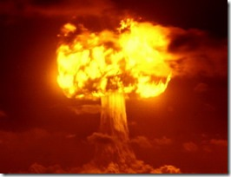
Example 4
Oh, that big 1982 Siberian explosion?(1982)
Cost: Millions of dollars, significant damage to Soviet economy, no casualties
Disaster: Control software went crazy and produced intense pressure in the Trans-Siberian gas pipeline, resulting in the largest man-made non-nuclear explosion in Earth’s history.
Cause:
  In January 1982, President Ronald Reagan approved a CIA plan to sabotage the economy of the Soviet Union through covert transfers of technology that contained hidden malfunctions.
  CIA operatives allegedly planted a bug in a Canadian computer system purchased by the Soviets to control their gas pipelines.
  When the CIA discovered the purchase, they sabotaged the software so that it would pass Soviet inspection but fail in operation

Slide 17
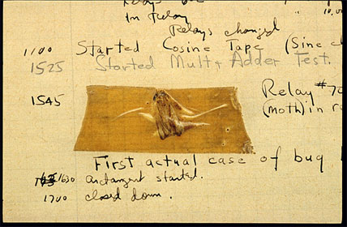
First “Bug”
In 1947, engineers working on the Mark II computer at Harvard University found a moth stuck in one of the components
They taped the insect in their logbook and labeled it “first actual case of bug being found.”
The words “bug” and “debug” soon became a standard part of the language of computer programmers.

Slide 18
Engineering?
Software engineering was coined in 1968
  Discipline concerned with all aspects of developing and delivering useful “high-quality” software in a cost-effective manner
  Little consensus on the precise definition
Software includes the various software development activities along with their products
  Contrast that with a program
Compared to other well-established engineering disciplines
  Civil engineering uses mechanics to help them predict with high confidence that a building or bridge will stand
  Aerospace engineering uses aerodynamics and simulation to build correctly functioning airplanes
  Software engineering depends largely on testing and debugging to establish confidence
    Imagine building a skyscraper and then testing it!
    Formal methods (critical systems)

Slide 19
Engineering?
In well-established engineering fields, the same type of failures are rarely repeated
  Carefully documented to prevent future reoccurrences
  In software engineering, the same types or failures occur time and again
    Few measures can be taken to ensure their absences
In well-established engineering fields, solution knowledge is codified for reuse in future solutions
  Manuals and books
  No systematic codification in software engineering
  Build a house
Software engineering is an abstract domain

Slide 20
Desirable Software Qualities
Usefulness
  Address needs of intended users
Timeliness
  Complete in a timely manner
  Important for software vendor’s ability to remain competitive
Reliability
  Only an acceptable level of failures
Maintainability
  Easy to make changes, corrections and adaptations
  Flexibility (loose coupling)
    Components are easily changeable
    Impact of change should be confined to small regions
      effects and verification should be local as opposed to entire system
  Simplicity
    Reduces possibility of errors
    Divide and conquer
  Readability

Slide 21
Desirable Software Qualities
Reusability
  System components shouldn’t be ad-hoc solutions to specific problems
  Designed as general solutions to a class of problems in different contexts
    Off-the shelf components (an email component)
    Design patterns
User friendliness
Efficiency
  No wasting of resources (processor, memory and hard disk space)

Slide 22
Software Development Process
Requirements collection, analysis and specification
  Functional vs. nonfunctional
Design
Implementation & Unit Testing
Integration and system Testing
Maintenance
  Correcting bugs
  Improving performance
  Enhancing functions or services
  Adapting to new environments

Slide 23
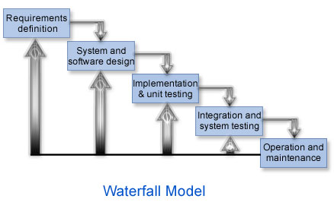
“Waterfall” Model
Every phase must be approved first!

Slide 24
“Waterfall” Model
Development is carried out in successive phases linearly
A phase is the span of type between two major milestones
  Artifacts are completed
  Decisions are made whether or not to move to into next stage
    If artifacts are approved
Rationale: changes to earlier stages cost less
  Not very realistic
  Changes may come from a number of sources and during ANY stage
    Errors or faults in the specification and design many only be discovered after implementation
    Assumptions made in design may be proven false during system testing
    Some requirements seem infeasible during system testing
      Nonfunctional requirements
    User needs and requirements may have changed after requirements analysis is complete

Slide 25
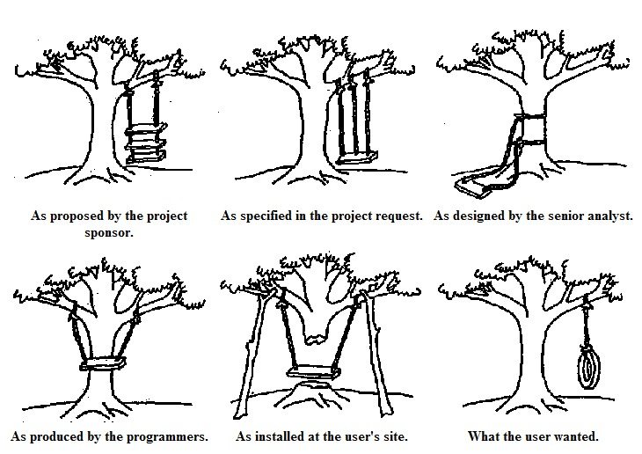

Slide 26
Iterative Software Development
For OOSD
Consists of a number of successive iterations
  During each
    Identifying classes
    Identifying methods and attributes for each
    Identifying relationships among classes
    Implementing classes
  Each iteration deals with a relatively smaller increment of the system
    Incremental developed vs. monolithic
  Each is small and completed in a short amount of time
  Each results in a release or an executable product
    Continues until system is complete
  Change is embraced
    Don’t prevent it, deal with it

Slide 27
Extreme Programming XP
An iterative process with small iterations
  Each lasts no more than few days to few weeks
First iteration produces a minimal skeletal executable implementation of the system
Each subsequent iteration enhances or improves upon the previous one
  Produces a new executable
  Focuses either on enhancement or refactoring
    Introduce new functionality
    Improve code quality, extensibility and maintainability while maintaining its behavior

Slide 28
Extreme Programming XP
Practices
  “Good enough” planning for each iteration which is refined as necessary
    Plan will change
  “Good enough” design – (will change)
  Test first (!)
    Find average of 3 numbers!
  Coding standards
    JavaDoc (http://csis.pace.edu/~bergin/patterns/javadoc.html)
  Refactoring
  Pair programming
  Collective ownership
    All must understand
    Take responsibility of your shortcomings (don’t take it personal)
  Frequent and small releases along with continuous integration
  40-hour weeks
  On-site customer

