Slide 1
Linux
Chapters 1 & 2 (ALBING)

Slide 2
Linux
Provides an incredible array of tools
Unix separated OS commands from OS itself
  “Kernel” of necessary functionality
  Rest are executable programs hosted outside the OS which could be changed by users without modifying the OS
  One such standalone piece is the command processor known as shell

Slide 3
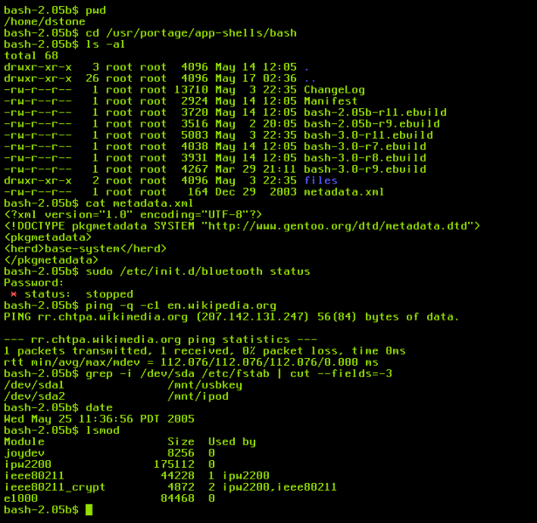
Shell
Program that takes command-line inputs, and decides what programs you’re asking for and then runs them

Slide 4
Shell
was the UI to Unix (pre-Linux era)
  Different shells have been developed, e.g. bash and csh (C-shell)
  ^C exits any running program
Linux is a set of GUI that works on top of UNIX
Open Source ≠ Free Software [http://www.opensource.org/docs/definition.php]
  Access to the source code
  Free Redistribution
  Derived Works (no royalty)

Slide 5
Redirecting Output
UNIX is credited for the concept of redirecting I/O
Every Linux process has three open file descriptors:
  standard in stdin used as the source of input for the process (e.g. keyboard) … file descriptor 0
  standard out stdout destination for process’s output (e.g. screen) … file descriptor 1
  standard error stderr destination for process’s errors messages (e.g. screen) … as file descriptor 2
Processes are written generically to read from standard in as keyboard and write to standard out as screen but that can be changed

Slide 6
Redirecting Output
Redirecting I/O is accomplished on Linux by “<“ and “>”, respectively (>& for stderr)
E.g: ls VS ls > my.files
pico my.files
We didn’t change the ls function, the shell did the work

Slide 7
Redirecting Input
irahal@linfac4 54% sort
once upon a time
a small creature
came to live in
the forest
^D
a small creature
came to live in
once upon a time
the forest
sort < story.txt
sort > story.txt

Slide 8
Linux Pipes
Output of one command can be sent to the input of another making a connection known as a pipe
wc – prints the number of lines, words, and bytes in files
  ls | wc > wc.fields
This leads to modularization ➔ other commands that need counting don’t have to do it (we can just pipe it)

Slide 9
ls and cd
Contents of a directory
ls -l
  Shows permissions, ownership and size
ls -ld
  Shows the directory’s permissions (doesn’t look inside)
ls –lrt
  Shows more recently modified files last so that you can see what have changed
cd tmp
cd ../
cd ../tm
cd ~
pwd

Slide 10
Filenames
alphanumeric, periods and underscore
  Can use others but almost all other punctuation characters have special meaning to the shell ➔ must be escaped
Case sensitive
The dot in name means nothing! No extensions in Linux

Slide 11
File Types & Contents
file filename
Looks at first several hundred bytes of the file and does a statistical analysis of the types of characters that it finds there
Viewing content
  cat, more (use space bar), head -x, and tail -x

Slide 12
Permissions
Divided into three categories
  User (Owner)
  Group
  Others
Any file belongs to a single user and thus to a single group
It has separate R/W/E permissions for each of the above categories
  drwxr-xr-x
  -rw-r--r--

Slide 13
Permissions
Use ls –l to view current permissions
chmod who=permissions filename
Who
  A list of letters that specifies whom you’re going to be giving permissions to
  May be specified in any order
    u The user who owns the file (this means “you.”)
    g The group the file belongs to
    o The other users
    a all of the above (an abbreviation for ugo)
Permissions
  r Permission to read the file
  w Permission to write (or delete) the file
  x Permission to execute the file, or, in the case of a directory, search it

Slide 14
Exampless
Prevent outsiders from executing archive.sh
  chmod o=r archive.sh
Take away all permissions for the group for topsecret.inf
  leave the permissions part of the command empty
  chmod g= topsecret.inf
Open up publicity.html for reading and writing by anyone
  chmod og=rw publicity.html

Slide 15
Generalized Regular Expression Processor - grep
Tool for searching thru the contents of a file for fixed sequences of characters or regular expressions
grep ‘myClass’ Main.java
  Search for and display all lines from the specified files that contain the string myClass
  -i: Ignore case differences
  -l: Only list filenames not actual lines
  -n: show line number where match was found
  -v: reverse meaning of the search (i.e. all lines that don’t match the pattern)
Search for all statements containing println except those using standard I/O (i.e. System.out)
  grep ‘println’ *.java | grep –v ‘System.out’

Slide 16
grep
To match a selection of characters, use []
  [Hh]ello matches lines containing hello or Hello
Ranges of characters are also permitted
  [0-3] is the same as [0123]
  [a-k] is the same as [abcdefghijk]
  [A-C] is the same as [ABC]
  [A-Ca-k] is the same as [ABCabcdefghijk]

Slide 17
find Command
find . -name '*JDBC*' -print
  Looks for a file whose name contains “JDBC”
  It starts looking in the current directory and descends into all subdirectories
find ./over/there ./over/here –name ‘*frag*.java’ –print
find ./JDBC -name '*[jJ]DBC*.java' -exec ls -l '{}' \;
  '{}' are replaced with the name of the file
  \; indicates the end of the command

Slide 18
find Command
-name is called a predicate
  It takes a regular expression as an argument
  Any files that matches the predicate passes the control to the next predicate (-print in previous example)
Other predicates
  -type d ➔ true if the file is a directory
  -type f ➔ true if the file is a plain file
  -mtime -5 ➔ file is less than 5 days old (i.e. modified within the last 5 days … a +5 means older than five days … a 5 with no sign means exactly five days)
  -atime -5➔ file is accessed less than 5 days ago
  -newer myEx.class ➔ file is newer than myEx.class
  -size +24k ➔ file is greater than 24k

Slide 19
find Command
find . -name '*.java' -mtime -10 -atime +10 –print
find . -name '*.java' -mtime -10 -atime +10 -exec rm '{}' \;
  No space between \ and ;
Make sure you are in the right folder first
-maxdepth x (limits how deep you go)

Slide 20
The Shell
Most shells – command interpreters – are viewed as programming languages on their own
They have control structures like
  if, for, etc …
Programs written in shell are often referred to as shell scripts
setenv var value
  setenv FILE /tmp/sample
    ﻿setenv FILE ~/Main.java
  $FILE to access variable
    echo $FILE
Built-in variables
  $PATH (defines directories – separated by : – where shell looks for programs)
    For program/scripts
  $HOME or ${HOME}
  you can tell what shell you are using by doing echo $SHELL

Slide 21
The Shell
To overwrite the existing path
  setenv PATH /my/path/to/stuff:/some/other/path
Overwriting a path will mostly like cause you to lose some functionality, and can cause all sorts of program errors
Much safer to change the above example into:
  setenv PATH /my/path/to/stuff:/some/other/path: ${PATH}
  rehash (to update variable value)
To locate a shell script: whereis

Slide 22
The Shell
To find where a specific program is found try which command (e.g. which cat)
If you want to install a new command so that you can execute it from the command line, you can either
  always type in its full pathname e.g. /bin/cat $FILE
  include its path to the PATH variable
To run a shell script: tcsh (or csh) myscript
Must have execute privileges first
  e.g. save the following into a file
    find . -name '*.java' –print
    ls -ld

Slide 23
Parameterizing Shell
$1, $2, $3 are the variables holding any parameters submitted to the shell
  echo $1
  echo $2
  ls -ld
  find . -name "*.java" –print
$0 - Name of the shell script being executed
$# - Number of arguments specified in the command line
# alone is used for comments
echo can be used to print
cat prints the contents of a file to the screen

Slide 24
Conditions
if (condition_is_true) then
execute commands
else
  if (another_condition_is_true) then
  execute commands
  else
  execute commands
  endif
endif
if ($# != 2) then
  echo "you must give exactly two parameters"
else
  set name1 = $1
  set name2 = $2
  echo $name1
  echo $name2
endif

Slide 25
tar and zip
Allow to compress data and extract it back
Options for tar
  c ➔ create an archive
  x ➔ extract an archive
  t ➔ get a table of contents
  f ➔ next parameter is the filename of the archive
  v ➔ provide verbose output
  z ➔ unzip the file first (for .gz files)
tar tvf packedup.tar
tar xvf packedup.tar
tar cvf packedup.tar mydir

Slide 26
tar and zip
For zip
  unzip –l packed.zip (gives a table of contents)
  unzip packed.zip (unzips)
  zip –r packedup mydor (-r ➔ recursive, zips all subfolders too)
jar (Java Archive file) is similar to tar in options
Find all JDBC java files and zip them into one folder
  find . –name ‘*JDBC*.java’ –print | zip allmysource -@
  The -@ options tells zip to read its files from standard in instead of parameters

Slide 27
Linux
man
  man –k command for keyword search
Editors
  emacs file
  kedit file
  jedit file
  pico file
  vi file (you’re on your own)
Email
  pine email-address

