Slide 1
Software Testing

Slide 2
Software Testing
Process of analyzing a system of components to detect the differences between the specified (i.e. required) and observed (existing) behavior
  To correct failures
Impossible to completely test a nontrivial system
  Testing is not decidable
    An art and a science
  Performed under time and budget constraints
Systems are usually deployed without being completely tested leading to faults discovered by end users

Slide 3

Example
Mariner Bugs Out (1962)
Cost: $18.5 million
Disaster: The Mariner 1 rocket with a space probe headed for Venus diverted from its intended flight path shortly after launch. Mission Control destroyed the rocket 293 seconds after liftoff.
Cause: A programmer incorrectly transcribed a handwritten formula into computer code, missing a single superscript bar. Without the smoothing function indicated by the bar, the software treated normal variations of velocity as if they were serious, causing faulty corrections that sent the rocket off course.
  3.12¯34 for 3.123434343434…

Slide 4
Software Testing
Too costly to fix … not worth it
Testing is often viewed as a job done by beginners
Managers usually assign the new members to the testing team
Experienced programmers
  Detest testing
  Needed for “more important” analysis and design tasks

Slide 5
Overview of Testing
Error vs. Fault vs. Failure
Testing is a systematic attempt to finding faults in a planned way in the implemented software by introducing failures
  Aimed at breaking the system!!!
  Wrong def. “testing is the process of demonstrating that faults are not present!”
    Demonstrating that faults are not present is not possible in systems of any realistic size
  Approach
    Testing is like a scientific hypothesis where the goal is to design experiments that falsify the underlying theory
    If the experiments are unable to break the theory, our confidence in the theory is strengthened and the theory is adopted

Slide 6
Fault Detecting Techniques
Reviews: Manual inspection of parts or all aspects of a system without actually executing it
  Walkthrough:
    Code developer informally presents the API, the code, and associated documentation of the component of to the review team
    Review team makes comments on the mapping of the analysis and design to the code
  Inspection:
    Similar to a walkthrough but presentation is formal
    The developer is not allowed to present artifacts (API, code, and documentation) --- All done by review team
    Programmer is only needed for clarifications about the definition and use of data structures or algorithms
    More effective

Slide 7
Fault Detecting Techniques
Debugging:
  Assumes faults can be found by starting from an unplanned failure
  Programmer moves the system thru a succession of states, ultimately arriving at and identifying a fault
  Once identified, the error causing this state is determined
Testing:
  Tries to create failures in a planned way
  A step that complements debugging

Slide 8
Testing Activities
Test planning
  Allocates resources and schedules the testing
  Occurs early in the development phase so that sufficient time and skill is dedicated to testing
Unit testing
  Tries to find faults in participating objects and/or subsystems with respect to the use cases
Integration testing
  Activity of finding faults when testing the individually tested components together
Usability testing
  Tries to find faults in the user design interface of the system
  Checks if system fails to accomplish the intended purpose because users are confused by the UI and unwillingly introduce failures

Slide 9
Testing Activities
System testing
  Tests all components together seen as a single system to identify faults
  System is viewed as a black box
  Functional testing
    The entire system
    Carried out by developers
    To determine if the system meets the requirements (functional)
      Uses use cases heavily
  Performance testing (nonfunctional)
    Checks non-functional and additional design goals
  Acceptance testing and installation testing
    Evaluates the system delivered by developers
    Carried out by the client (with help from developers)
    May involve executing typical transactions on site on a trial basis
    To demonstrate that the system meets customer requirements and is ready to use

Slide 10
Testing Activities
Requirements
Document
Subsystem
Code
Unit
Requirements
Analysis
Document
System
Design
Document
T
est
Tested
Subsystem
User
Manual
Subsystem
Code
Unit
T
est
Tested
Subsystem
Integration
Functional
Test
Test
Integrated
Subsystems
Functioning
System
Tested Subsystem
Subsystem
Code
Unit
T
est
All tests by developer

Slide 11
Testing Activities
Client’s
Understanding
of Requirements
Global
Requirements
User
Environment
Functioning
System
Validated
System
Accepted
System
Performance
Acceptance
Installation
Test
Test
Test
Usable
System
Tests by client
Tests by developer
System in
Use

Slide 12
Unit Testing
Focuses on the building blocks of the software system
  Objects and subsystems
Motivations for focusing on components
  Reduces the complexity of overall test activities by allowing us to focus on smaller units
    Divide and conquer
    Makes it easier to pinpoint an correct faults
  Allows parallelism in the testing activities (components tested independently)

Slide 13
Unit Testing
Blackbox testing
  Focuses on the IO behavior of the components
  Does not deal with internal aspects, behavior or structure of the component
  Almost always impossible to generate all possible test cases
Whitebox testing
  Focuses on the internal structure of the components
  Makes sure that every state in the dynamic model of the object and every interaction among objects is tested
Good “Unit testing” should combine both

Slide 14
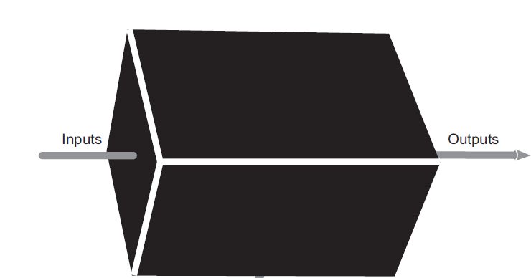
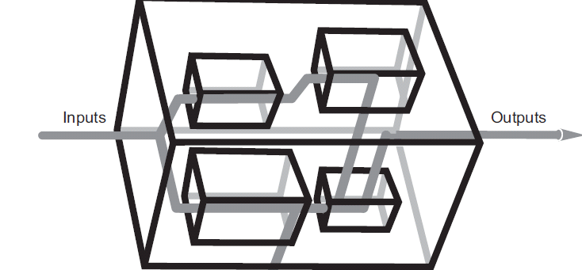

Slide 15
Black-box Testing
No rules, only guidelines…an art more than a science
Equivalence Testing
  Inputs are portioned into equivalence classes
  Assumes that systems behave similarly for all members of an equivalence class ➔ need only 1 test member from each class
  sqrt
Consists of two steps
  Identification of equivalence classes (ec)
    Coverage: Every possible input belongs to one ec
    Disjointedness: No input belongs to more than one ec
    Representation: If an failure occurs at one input, then error is excepted for all other members of the same ec

Slide 16
Boundary Testing
Focuses on conditions at the bounds of the equivalence classes
  i.e. Exceptional cases
Assumptions:
  Developers often overlook special cases at the boundaries
  0, empty strings, year 2000
In the following example, February represents several boundary cases
  Years that are multiple of 4 are leap
  But, years multiple of 100 are not unless if they are multiple of 400 also
    E.g. 2000 is leap year but 1900 is not

Slide 17
Black-box Testing
  Selection of test inputs
    A sample from every ec
Example: A method that returns number of days in a month given the month and year
  public int getNumDaysInMonth(int Month,int year){ … }

Slide 18
Boundary Testing
Focuses on conditions at the bounds of the equivalence classes
  i.e. Exceptional cases
Assumptions:
  Developers often overlook special cases at the boundaries
  0, empty strings, year 2000
February represents several boundary cases
  Years that are multiple of 4 are leap
  But, years multiple of 100 are not unless if they are multiple of 400 also
    E.g. 2000 is leap year but 1900 is not

Slide 19
Example 2
long fastPowerRec (int base, int n){
  if(n==0)
    return 1;
  else if (n%2==0)
    return fastPowerRec(base*base, n/2);
  else
    return base*fastPowerRec(base, n-1);
}

Slide 20
White-box Testing
Focus here is on code coverage
  Every statement in the component is executed at least once
Four types of white-box testing
  Statement Testing
  Branch Testing
  Loop Testing
  Path Testing

Slide 21
Path testing
Make sure all paths in the program are executed
  By exercising all possible paths through the code, at least once, most faults will trigger failures
Identifying paths requires knowledge of the source code and data structures
  First we construct flowchart of the component
    Diamonds are decisions
    Associations represent flow of control
    Rectangles are blocks of code

Slide 22
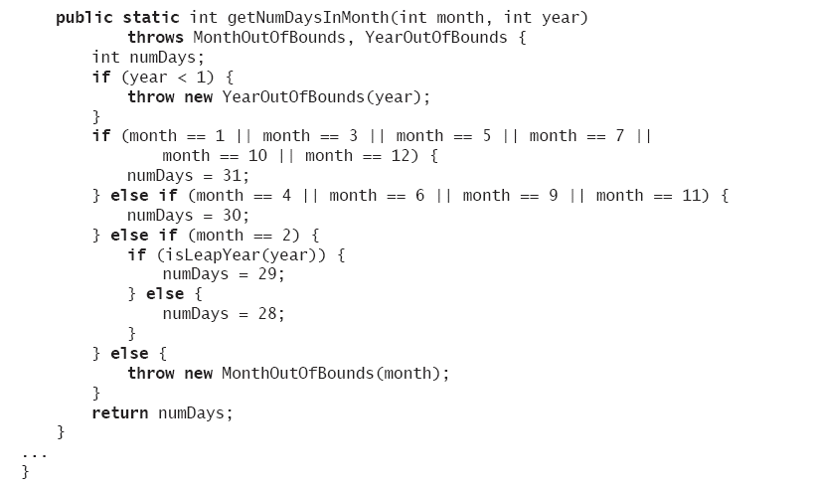

Slide 23
Equivalent flowchart for the getNumDaysInMonth() method
[year < 1]
throw1
[month in (1,3,5,7,10,12)]
n=31
[month in (4,6,9,11)]
n=30
[month == 2]
[leap(year)]
throw2
n=28
n=29
return n

Slide 24
White-box Testing
Complete path testing consists of designing test cases so that every path is traversed once
  i.e. select an input for the true branch and another for the input for the false branch
Test cases
  Year 0, month 1 {throw1}
  Year 1901, month 1 {n=31, return}
  Year 1901, month 4 {n=30, return}
  Year 1901, month 2 {n=29, return}
  Year 1904, month 2 {n=28, return}
  Year 1901, month 0 {throw2}

Slide 25
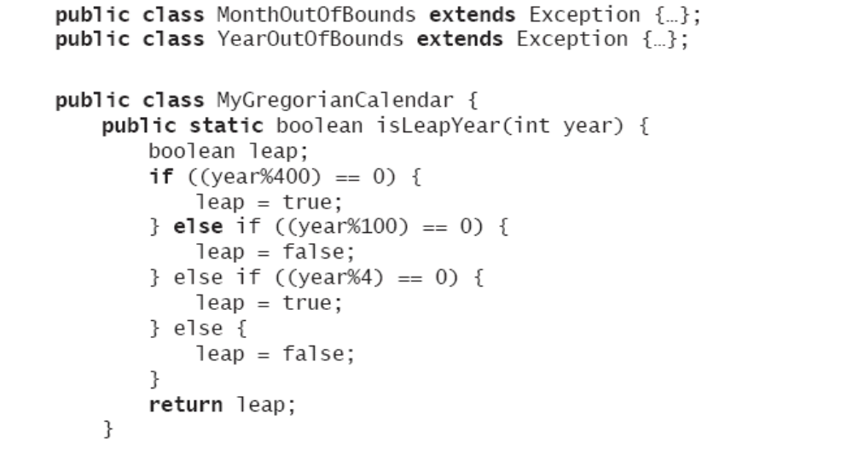
getNumDaysInMonth() method

Slide 26
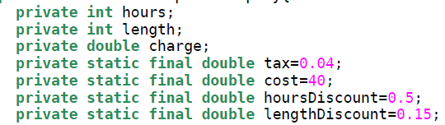
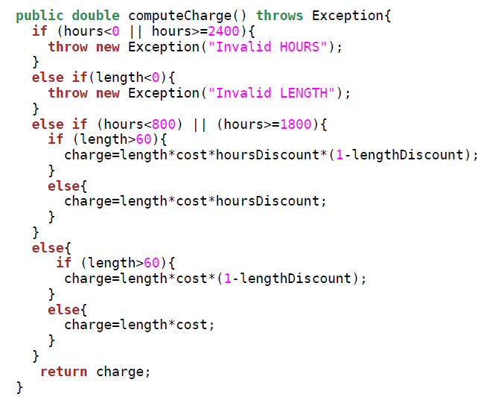
Another Example

Slide 27
Unit-testing Heuristics
Create unit tests as soon as object design is completed
  Test before coding
  Code until tests succeed
Execute the test cases
  Re-execute test cases every time a change is made
Create a test harness
  Automate as much as possible
  Manual testing involves a tester feeding predefined inputs into the system
    using the user interface, a command line console or a debugger
    costly and error prone
Building a test harness is an investment that can only be paid off test if there are many times

Slide 28
JUnit
http://www.junit.org
http://www.cs.laurentian.ca/badams/c2006/junit-docs/junit/framework/TestCase.html
Automates the process of running tests, letting programmer quickly see whether the program returns the expected results
A handful of classes which can be used to build and bundle test cases for testing applications
Recommendations
  Design
  Build stubs (makes testing much easier using Eclipse)
  Test
  Code until tests succeed!

Slide 29
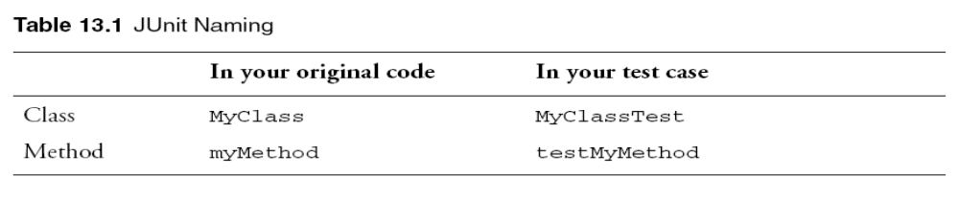
Writing Test Cases
Write a new test class for every class you want to test
With the JUnit framework, a unit test is any public class that
  extends junit.framework.TestCase
    At the top of the test class, include: import junit.framework.*;
  has any number of methods with names beginning with the word "test“
    No parameters and returns void
  whose name usually ends with “Test”

Slide 30
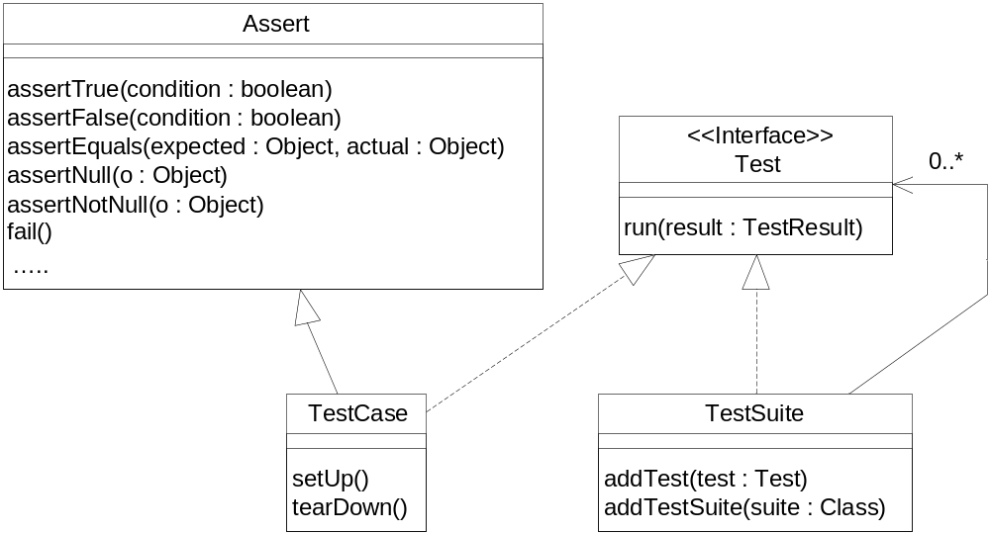
JUnit Framwork
YOURTestCase
setUp()
tearDown()
Notes:
Test.run(TestResult): Runs a test and collects its result in a TestResult instance
TestResult: TestResult collects the results of executing a test case.

Slide 31
Writing Unit Tests with JUnit
Test methods can call any of the following methods:
  void assertTrue(String, boolean)
    issues an error report with the given string if the Boolean is false
  void assertEquals(String, int, int)
    issues an error report with the given string if the two integers are not equal
    The first int is the expected value, and the second int is the actual (tested) value
    Note that this method can also be called using any primitives or with Objects
  void fail(String)
    immediately causes the test to fail, issuing an error report with the given string
    If you reach a place that you shouldn’t have
http://junit.org/apidocs/org/junit/Assert.html

Slide 32
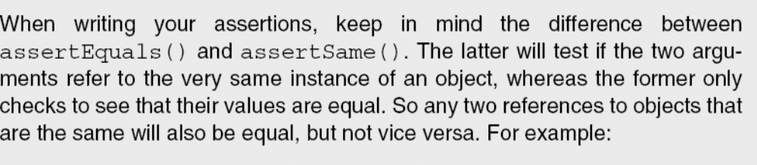
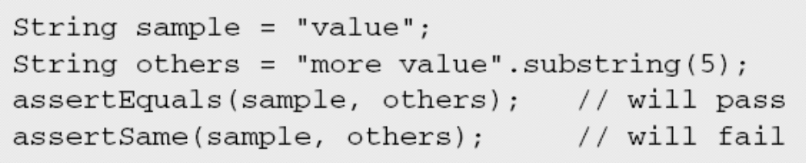
assertEquals vs assertSame

Slide 33
Writing Unit Tests with JUnit
To write a test case, follow these steps:
  Define a subclass of TestCase
  Override the setUp() method to initialize object(s) under test
    Creates a test fixture
    Any common setup work to be done before running each test
  Optionally override the tearDown() method to release object(s) under test
  Define one or more public testXXX() methods that exercise the object(s) under test and assert expected results
  Each test runs in the context of its own fixture, calling setUp() before and tearDown() after each test method to ensure there can be no side effects among test runs
    Order: setUp(); testMethod(); tearDown();

Slide 34
Simple Test Case
To test that the sum of two Moneys with the same currency contains a value which is the sum of the values of the two Moneys, write :
  public Money add(Money M₂)
    …
  public void testAdd() {
    Money m12USD = new Money(12, "USD");
    Money m14USD = new Money(14, "USD");
    Money expected= new Money(26, " USD");
    Money result= m12CHF.add(m14CHF);
    assertTrue(“Sum not correct!”, expected.equals(result));
    //assertEquals(“Sum not correct!”,expected,result);
  }
Notes:
CHF is the ISO code for the Swiss Franc

Slide 35
Running tests
javac net/multitool/core/AccountTest.java
java junit.textui.TestRunner net.multitool.core.AccountTest
Try it again with
  assertEquals(150.0, base.getTotal()); instead of assertEquals(150, base.getTotal());
Try it once with messages and once without

Slide 36
Failures
What happens if an assertion fails?
  The assert method will throws an exception, reporting the failure
  Belong to the java.lang.Error
    not in java.lang.Exception
    Done simply as a convenience for test developers
    don’t have to put throws in method contracts
In JUNIT
  A failure is a test that didn’t pass
    assertNotNull() call failing is a test failure
  An error is a problem with the running of the test
    missing class and null pointer exception are errors

Slide 37
Class Hierarchy
[http://java.sun.com/j2se/1.4.2/docs/api/java/lang/Throwable.html
java.lang.Object
|
+--java.lang.Throwable
|
+--java.lang.Exception (CHECKED)
| |
| +--java.lang.ClassNotFoundException
| |
| +--java.io.IOException
| | |
| | +--java.io.FileNotFoundException
| |
| +--java.lang.RuntimeException (UNCHECKED)
| |
| +--java.lang.NullPointerException
| +--java.lang.ArithmeticException
| +--java.lang.IllegalArgumentException
| +--java.lang.IndexOutOfBoundsException
| |
| +--java.lang.ArrayIndexOutOfBoundsException
|
+--java.lang.Error (UNCHECKED)
|
+--java.lang.VirtualMachineError
|
+--java.lang.OutOfMemoryError

Slide 38
Checked vs. Unchecked
Unchecked exceptions :
  beyond your control (Error) or result from a condition that you should not have allowed in the first place (RuntimeException)
  are subclasses of
    RuntimeException (e.g. ArrayIndexOutOfBoundException)
    Error (e.g. OutOfMemoryError)
  The Java compiler checks all exception handling, except exceptions represented by (subclasses of) Error and RuntimeException

Slide 39
Checked vs. Unchecked
Checked exceptions:
  represent invalid conditions in areas outside the immediate control of the program
    E.g. database problems, network outages, or absent files
  are subclasses of Exception (except RuntimeException)
  the compiler will confirm at compile time that the method includes code that might throw an exception
  must be caught or forwarded (advertised)
    This can be done in a try ... catch statement or by defining the exception in the method definition (via throws)

Slide 40
Test Suites
To get confidence in the state of a system we need to run many tests
test suite is a collection of tests that should be performed in the same session
  A test suite is just a TestCase object which has a static method suite()
  usually with no other tests
Suites are a way of grouping tests together for execution, whether or not the tests are in the same file
http://junit.sourceforge.net/javadoc/junit/framework/TestSuite.html

Slide 41
Test Suites
This method should be of the form :
  CoreTest class example
    public static Test suite() {
      TestSuite suite = new TestSuite(“Suite Name”);
      suite.addTestSuite(testClass.class)
        E.g. suite.addTestSuite (YOURTESTCLASS.class);
        Add all test methods to this suite
      suite.addTest(<classname>.suite());
        E.g. suite.addTest(CreditCardTestSuite.suite());
        Add all test methods in the provided suite to this suite
      return suite;
    }
It is also necessary to import TestSuite and Test from junit.framework
  Already done if you’ve imported junit.framework.*

Slide 42
Test Suites
JUnit TestRunner classes will look for a public static method called suite() in any class that you ask a TestRunner to run
  Runs it
  Otherwise, run test methods
The test suite will allow us to run all of its test cases
  Write a Java class that defines a static suite() method that creates a TestSuite containing all the tests
  Include a constructor that calls the superclass’s constructor with a String
  Optionally define a main() method that runs the TestSuite

Slide 43
Test Suites
Can also have a main method in a test suite
Main method must run suit method
Should look like the following
  public static void main (String args[]) {
    junit.textui.TestRunner(suite());
  }

Slide 44
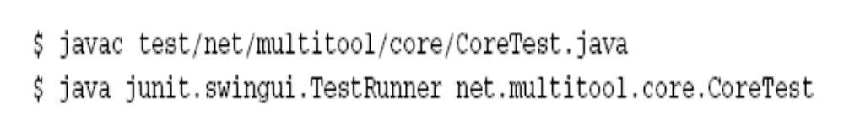
Compiling and Running Test Suites
Orjava net.multitool.core.CoreTest2

