Slide 1
Unified Modeling Language

Slide 2
Motivation for UML
Provides the notation for the basic building blocks
Precondition: System description available
Capture details about a system such that
  the problem is clearly understood
  (design) solution architecture is developed
  a chosen implementation is clearly identified and constructed
  Provides for ways to express complex relationships among the basic building blocks
    Those relationships can be static or dynamic
  Easier to communicate with non-professionals

Slide 3
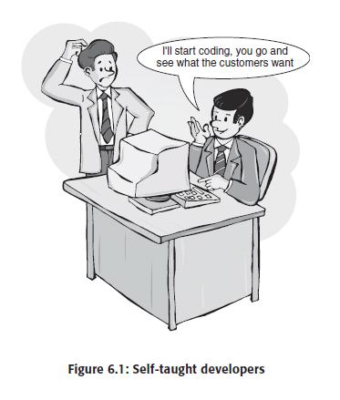
Avoid this

Slide 4
Introduction
Static relationships revolve around the structural aspects of a system
  Inheritance relationships
  Interfaces implemented by a class
  Dependency on another class
Dynamic relationships are concerned with the behavior of a system (exist ONLY at execution time)
  Messages exchanged within a group classes to fulfill some responsibility
  Flow control within a system

Slide 5
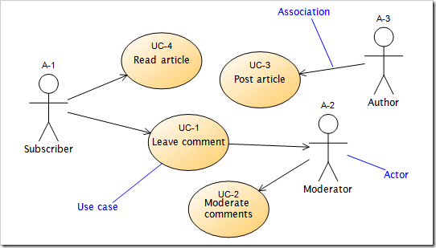
Introduction
Types of diagrams provided by UML
  Use case diagrams
    Show use cases, actors and their relationships
    Capture the precise requirements for the system from a user’s perspective

Slide 6
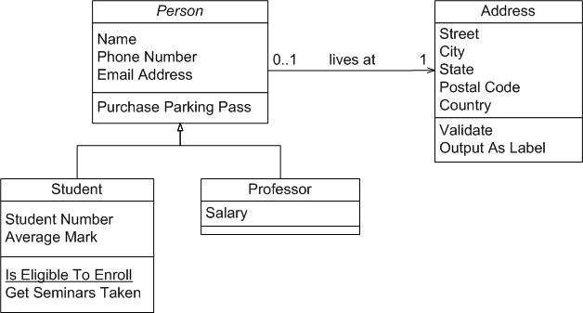
Introduction
  Class diagrams
    Shows the static relationships that exist among a group of classes and interfaces
    Common relationships include inheritance (is-a), aggregation (part-of ), dependency and composition

Slide 7
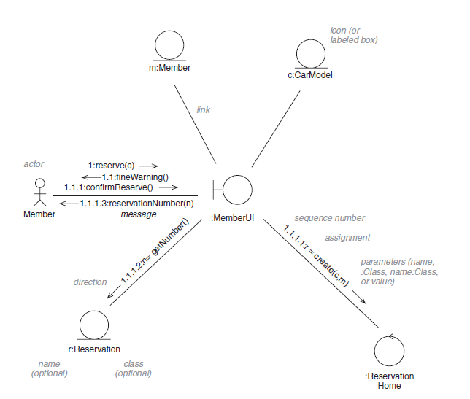
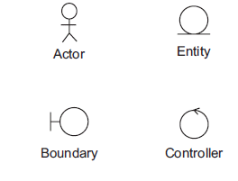
Introduction
  Interaction diagrams
    Used for modeling the dynamic behavior of a system
    Two kinds of diagrams one of which is communication (aka collaboration) diagrams
      Used for modeling the message exchange between objects in a system (what do I mean message?)
      Capture the relative time ordering of messages exchanges

Slide 8
Introduction
  Interaction diagrams
    Used for modeling the dynamic behavior of a system
    Two kinds of diagrams one of which is communication (aka collaboration) diagrams
      Used for modeling the message exchange between objects in a system (what do I mean message?)
      Capture the relative time ordering of messages exchanges

Slide 9


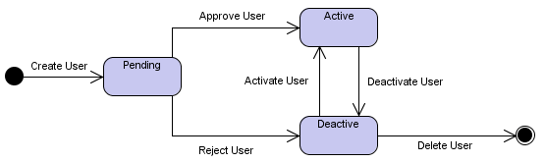
Introduction
  Other
    State chart diagrams
      Similar to finite state machines
    Activity diagrams
    Sequence diagrams
    Components diagrams
    Deployment diagrams
    More than12 now
/cond

Slide 10
Use Cases & Use Case Diagrams

Slide 11
Use Cases
Functional requirements of system to be developed
  Interactions between the system and external entities known as actors (e.g. users, other systems etc …)
Intended to describe what happens and not how things happen
High-level diagrams
  Ease discussions between developers and clients
Each use case has a name, actors and set of scenarios
  A sequence of interactions between the actors and the system
  Main scenario that describes what happens under normal conditions, other scenarios might describe exceptions or alternatives

Slide 12
Use Case Diagrams (UML)
Consists of
  Actors
    A person, organization, or external system that plays a role in one or more interactions with your system
    Can make a service request to the system or be requested to provide a service
    Drawn as stick figures
  Use cases (each includes main scenario, alternatives, and exceptions)
    Scenario
      A little story that outlines some expected sequence of request and responses between actors and the system
      Writing one is a like a game of “what happens next?”
    Drawn as ovals

Slide 13
Use Case Diagrams (UML)
  Relationships among actors and use cases
    Generalization/Specialization relationships among actors
    Association relationships between actors and use cases
    Generalization/Specialization relationships among uses cases
      (special case of): E.g. Search and Browse Index in iCoot specialize Look for Car Models
    Dependency relationships among use cases
      Includes: some steps of one use case provided by another
        Search (for cars) includes View Results
      Extends: a use case that adds value to another one (usually the former is only possible after the latter)
        Log Off extends Log On

Slide 14
Use Case Diagrams (UML)
Includes vs. Extends
  Search (for cars) includes View Results vs. Log Off extends Log On
  Source won’t work w/o target in former but not in latter

Slide 15
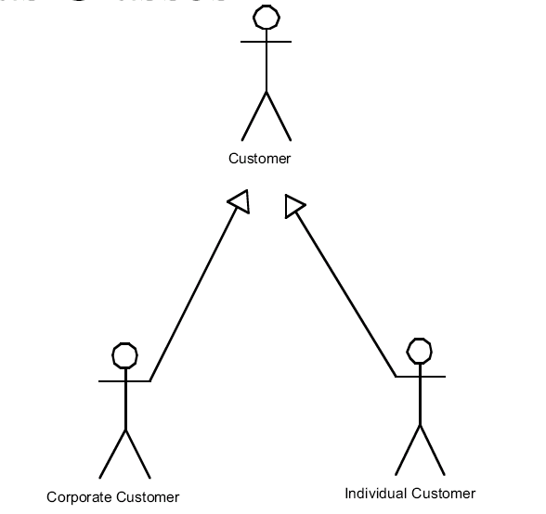
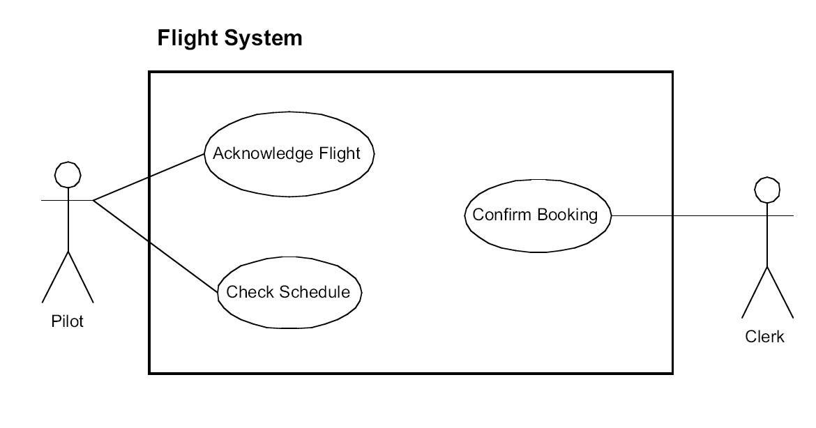

Slide 16

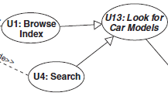
Use case generalizations

Slide 17
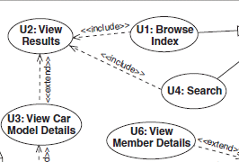
Use case dependencies

Slide 18
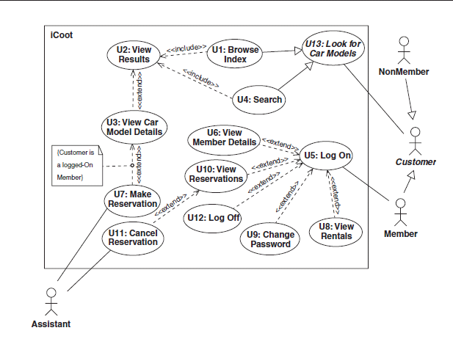

Slide 19
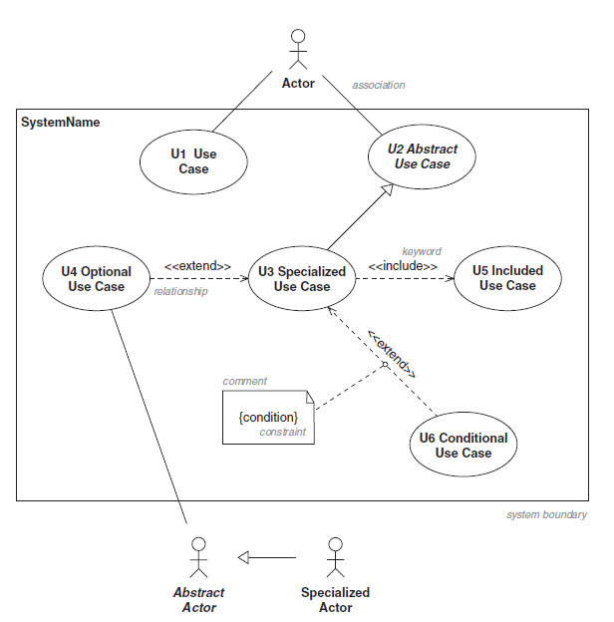

Slide 20
University System
Students, faculty and admins
  Students: Login and get grades
  Faculty: Login, view student roster, & enter grades for a viewed student roster
  Admins: Login, view student roster, and verify grades for a viewed student roster

Slide 21
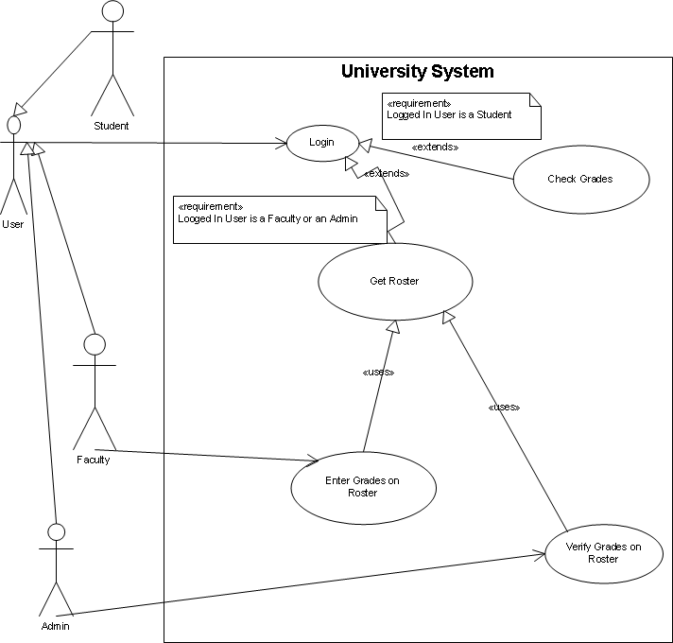
<<uses>> means <<includes>>

Slide 22
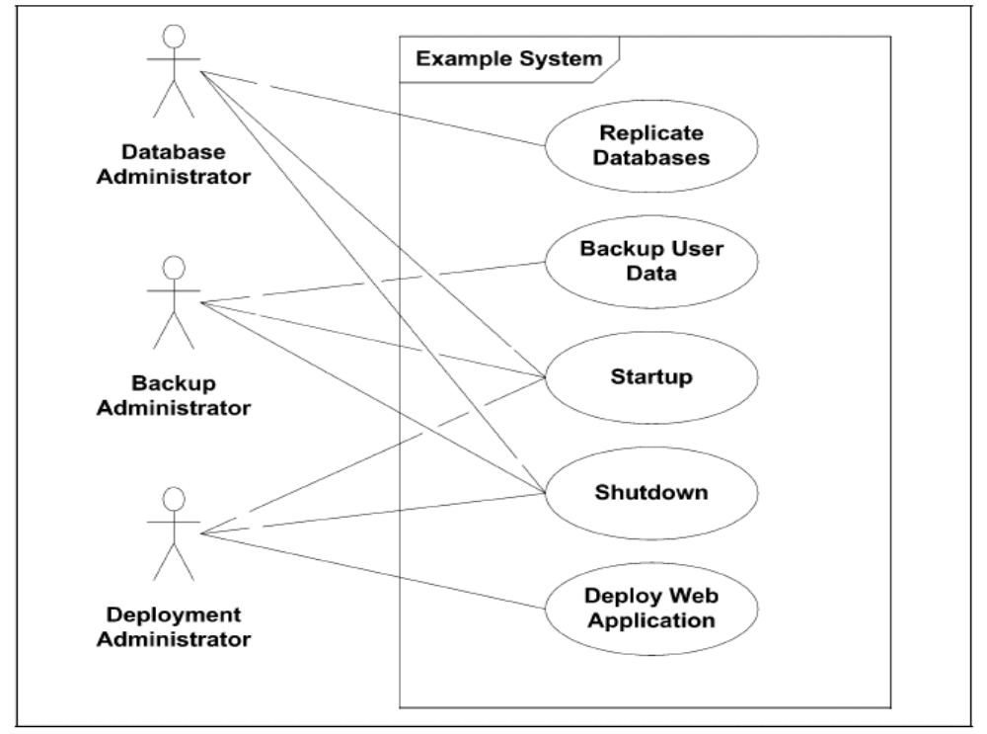

Slide 23
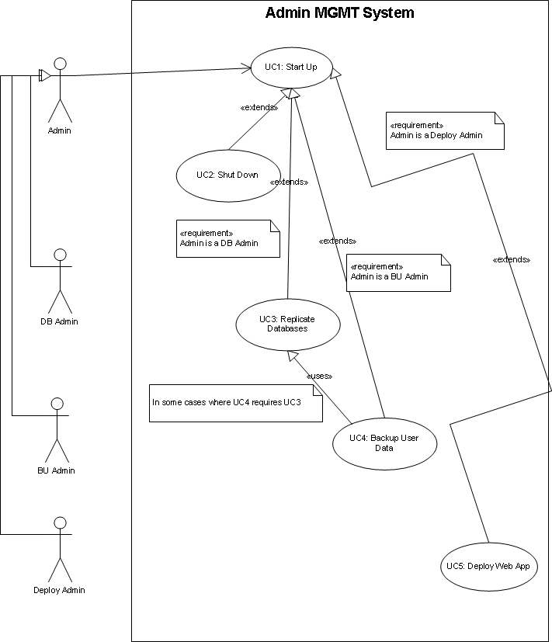

Slide 24
Use Cases
Every use case in the system must be explicitly described
  Number and title (Relationships to other use cases: includes/included by/extends/extended by/specializes/specialized by)
  Whether use case is abstract
  Actors involved
  Preconditions
  Main Scenario (normal path)
  Post conditions
  Alternative Scenarios (abnormal paths)
  Non-functional requirements

Slide 26
Use Case Descriptions
U1:Browse Index. (Specializes U13, includes U2.)
  Actors: Customer (Member or NonMember)
  Preconditions: None.
  1. Customer selects an index heading.
  2. Customer elects to view CarModels for the selected index heading.
  3. Include U2.
  Postconditions: None.
U2:View Results. (Included by U1 and U4, extended by U3.)
  Actors: Customer (Member or NonMember)
  Preconditions: None.
  1. iCoot presents Customer with a summary of each retrieved CarModel, including model number and price.
  2. Extend with U3.
  Postconditions: None.

Slide 27
Use Case Descriptions
U3:View CarModel Details. (Extends U2, extended by U7.)
  Actors: Customer (Member or NonMember)
  Preconditions: None.
  1. Customer selects one of the matching CarModels.
  2. Customer requests details of the selected CarModel.
  3. iCoot displays details for the selected car model (makes, engine size, price, description, advert and poster).
  4. If Customer is a logged-on Member, extend with U7.
  Postconditions: iCoot has displayed details of selected CarModels.
  Non-Functional Requirements: r1. Adverts should be displayed using a streaming protocol rather than requiring a download.

Slide 28
Use Case Descriptions
U4:Search. (Specializes U13, includes U2.)
  Actors: Customer (Member or NonMember)
  Preconditions: None.
  1. Customer selects required categories (if any).
  3. Customer selects required engine sizes (if any).
  4. Customer initiates the search.
  5. Include U2.
  Postconditions: None.
  Abnormal paths: a1. If Customer specifies no categories, makes or engine sizes, rather than retrieving the entire catalog, iCoot should not allow the search to be initiated

Slide 29
Use Case Descriptions
U5:Log On. (Extended by U6, U8, U9, U10 and U12.)
  Actors: Member
  Preconditions: Member has obtained a password from their local Store.
  1. Member enters the membership number.
  2. Member enters the password.
  3. Since iCoot must enforce one logon for a Member, Member can choose to steal (invalidate and thus take over from) an existing session.
  4. Member elects to log on.
  5. Extend with U6, U8, U9, U10, U12.
  Postconditions: Member is logged on.
  Abnormal Paths:
    a1. If the membership number/password combination is incorrect, iCoot informs Member that one of the two is incorrect (for security, they’re not told which one).
    a2. If the membership number/password combination is correct, but Member is already logged on and they have not elected to steal, iCoot informs Member.

Slide 30
Use Case Descriptions
U7:Make Reservation. (Extends U3.)
  Actors: Member, Assistant
  Preconditions: Customer is a Member who has logged on.
  1. Member elects to reserve CarModel for the details on display.
  2. iCoot asks Member for confirmation, issuing a warning that failure to collect a reserved CarModel will result in a fine.
  3. Member confirms Reservation.
  4. iCoot shows Member the Reservation number and indicates that Assistant will be in touch when a Car is available.
  5. When an Assistant logs on to Coot, Assistant is given a list of Reservations that require action.
  6. Assistant takes necessary action to progress Reservations (e.g. promoting to Collectable if a Car is available and moving the Car to the reserved area).
  Postconditions: Any requested Reservations have been made.
  Abnormal Paths:
    a1. If Member declines Reservation conditions, no Reservation is made.

Slide 31
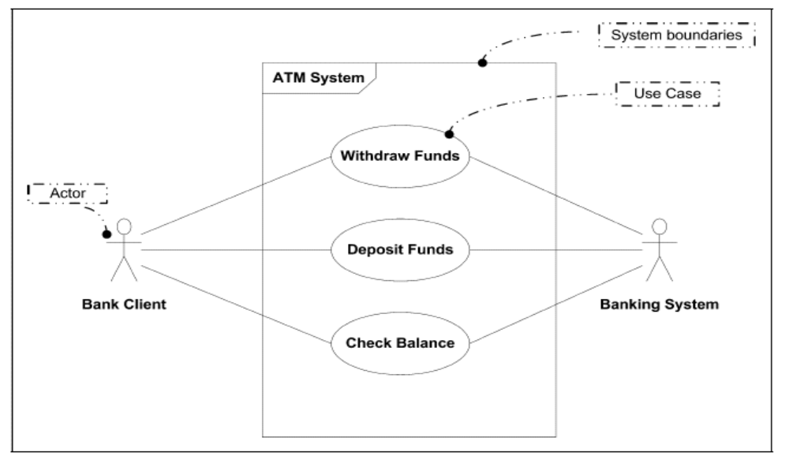
Withdraw Funds from bank via ATM
  Wrong pin
  Balance not enough
  Money not removed in 60 seconds

Slide 32
E-Book Store
Allows customers to lookup (either by browsing or searching) products, view results, view a product, and buy a product. Products carried can be books, music CDs, and computer software
Provides information about the titles it carries to help customers make online purchases
Other functionalities
  Customer registration (needed for shopping only) – first time only, login henceforth (needed for shopping only)
  A Customer can only login if they’ve registered
  Support management of the system such as adding, deleting and updating titles (Catalog manager)
  Updating customer account information & processing orders (Customer manager)
  Manage inventory (Inventory manager) – e.g., order products
  Registration is not supported for Managers

Slide 33
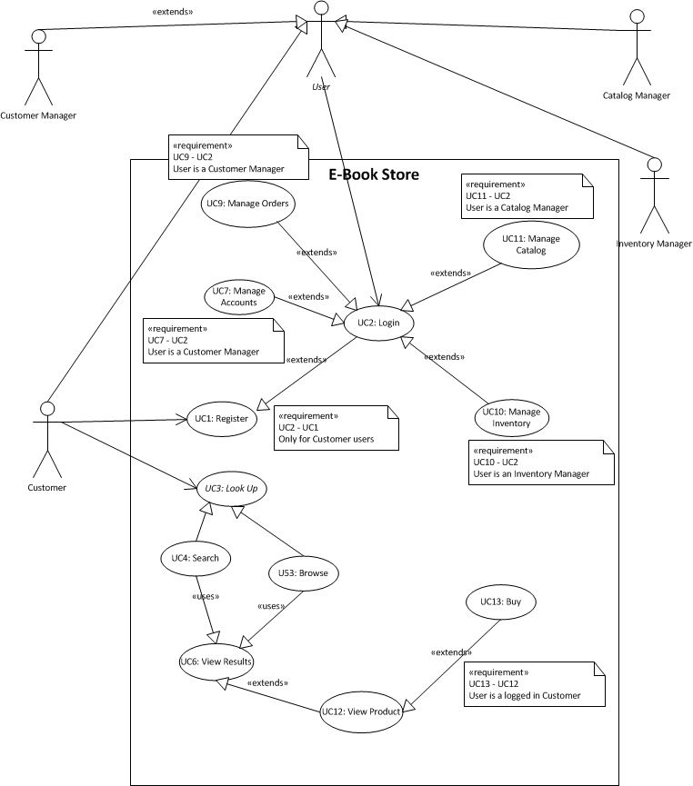

Slide 34
Use Case: Buy
  UC13 Buy (extends UC12 View Product)
  Actors involved: Customer
  Preconditions: User is logged in
  1. Customer elects to buy product for the details on display.
  2. EBook adds product to customer’s shopping cart and asks user to checkout or continue shopping
  3. Customer elects to checkout
  4. EBook displays contents of shopping cart and asks customer to confirm shipping address, payment method and billing address
  5. Customer confirms information
  6. EBook validate payment method, processes order, issues receipt and notifies warehouse
  Postconditions:
    Product has been purchased by customer
    EBook updates its inventory
  Abnormal Paths:
    a1. If Customer elects to continue shopping instead of checkout (repeat steps 1 and 2) until Customer elects to checkout
    a2. Customer never checkouts, save cart for 48 hours
    a3. Validation of payment method fails, request customer to enter valid payment method or cancel order

Slide 35
Analysis Process
1. Use the system requirements model to find candidate classes that describe the objects that might be relevant to the system and record them on a class diagram.
2. Find relationships (association, aggregation, composition and inheritance) between the classes.
3. Find attributes (simple, named properties of the objects) for the classes.
4. Walk through the system use cases, checking that they’re supported by the objects that we have, fine-tuning the classes, attributes and relationships as we go – this use case realization will produce operations to complement the attributes.
5. Update the nonfunctional requirements as necessary – the use cases themselves should not need updating, although perhaps they will need some correcting.

Slide 36
Objects and Classes
OO model an approximate interpretation of real world
  Objects represent real world entities which have identities, states and behaviors
  Classes are sets of objects with similar characteristics and behaviors (collectively ➔ features)
Setters & Getters (or Mutators and Accessors)
Immutable objects
  State never changes
  No mutators
Object equality and “identical”ity
Notes:
The stack:
Stack memory stores primitive types and the addresses of objects (address that refers to the place in heap memory)
The Heap:
Object values are stored in heap memory

Slide 37
OO Development Principles (MAEP)
Modularity
  Intended to control complexity of larges-scale systems through divide-and-conquer
  A complex system should be decomposed into a set of highly cohesive but loosely coupled modules (classes/packages)
    Cohesion: relatedness among the entities within a single module
    Coupling: interdependency among modules

Slide 38
OO Development Principles (MAEP)
Abstraction
  The behavior of a module should be characterized in a precise YET succinct description known as the contractual interface of the module
  Described module = Service provider
  Other modules = clients
  contractual interface = service contract between the two
    Describes only the what and not the how
    Clients only understand contract and not the complex services (complexity is hidden)

Slide 39
OO Development Principles (MAEP)
Telephone service: signals very complex
    routing & connecting calls
    converting voice to electronic signals
    converting from analog to digital and vice versa
    Encryption/decryption
  Yet we are unaware … just know how to dial (phone manual ⬅➔ contract)

Slide 40
OO Development Principles (MAEP)
Encapsulation
  Complements abstraction
  Clients need know nothing other than contract
  The implementation of a module should be separated from its contractual interface and hidden from the clients of the module
  Information hiding to reduce coupling among modules
    The less the clients know, the less the coupling
    ➔ modification of implementation becomes easier without affecting clients

Slide 41
OO Development Principles (MAEP)
E.g. Telephone service
  Signals used to be transferred in analog mode, now digital is used with encryption
  Yet, we still dial in the same way

Slide 42
OO Development Principles (MAEP)
Polymorphism
  Contractual interfaces can have multiple interchangeable implementations
  Several service providers can honor the same contractual interface
  The ability to interchange modules (implementations) dynamically without affecting the clients

Slide 43
OO Development Principles (MAEP)
E.g. Telephone service
  Digital cellular service uses advanced technologies but has smaller service regions compared to analog service
  An analog/digital dual-mode cellular phone is an example of polymorphism
  Provide a single interface for using the phone but employs two different technologies to provide the service
  We are not aware of it

Slide 44
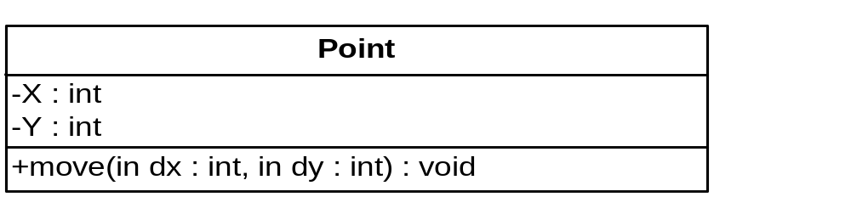
UML Notation for Classes
MS Visio → Software → UML Model Diagram → UML Static Structure
Class Point{
private int x, y;
public void move(int dx, int dy){…}}
Notes:
Shorthand notation useful if class is described elsewhere in document

Slide 45
Visibility
Visibility Java UML
Public Public +
Protected Protected #
Package * ~
Private Private -
Notes:
Protected: accessible to class, subclasses and in-package classes
Package: accessible to class and in-package classes (DEFAULT)

Slide 46
UML Notation for Objects
p1: Point
X = 0
Y = 0
Point p1 = new Point();
p1.x = 0;
p1.y = 0;
Point p2 = new Point();
p2.x = 24;
p2.y = 40;
p2: Point
X = 24
Y = 40

Slide 47
UML Notation for Classes
Class is a rectangle with three portions
  Class name
  Class variables
  Class methods
  Underline static variables and methods
Names of abstract classes are in Italics
Names of Interfaces are enclosed in << and >>
Message Passing ➔ communication among objects
Class x calls p1.move(10,20)
  Recipient p1
  Method move()
  Arguments (10,20)

Slide 48
Modeling Static Structures
Class diagrams
  Nodes representing classes and interfaces
  Links representing relationships among classes
    Inheritance (extension and implementation)
    Association (and aggregation and composition)
    Dependency

Slide 50
Inheritance
is-a relationship: every instance of sub is an instance of super
  Class extension
    Reusing and sharing the implementation (fields and methods) of superclass by subclass
    specialization/generalization in UML
  Interface extension
    Expansions of the service contract
    specialization/generalization in UML
  Implementation
    No reuse but rather implementation of a contractual interface by a class
    realization in UML

Slide 51

Inheritance in UML
Superclass
<<Superinterface>>
<<Interface>>
Subclass
<<Subinterface>>
Implementation Class

Slide 52
Inheritance
Multiple Inheritance
  Available in C++
  Restricted form in Java
    Extend 1 class
    Implement many interfaces
  Interfaces don’t exist, per se, in C++

Slide 53
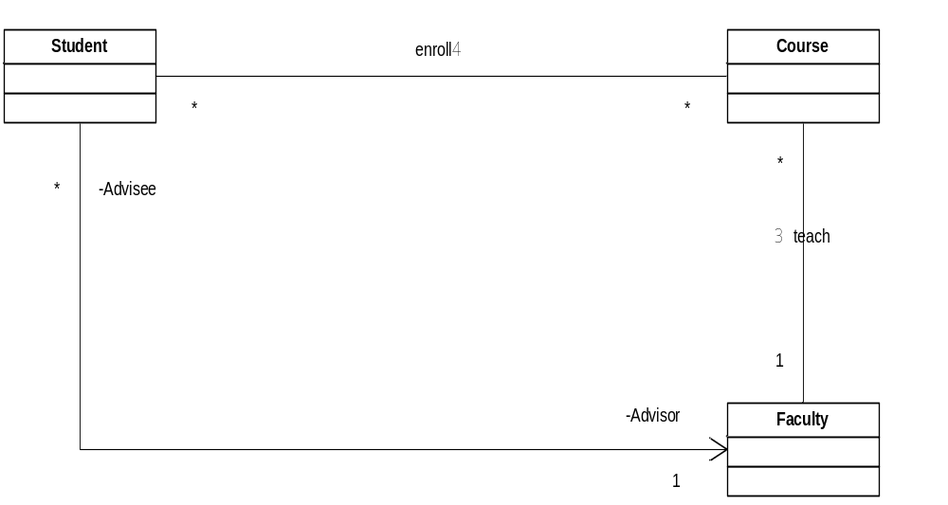
Associations
0..*
0..*
0..*
0..*

Slide 54
Associations
Specify binary relationships between classes
  Either one or both participating classes contain references to the other
    Unidirectional or Bidirectional
  Instance variables holding references to other classes
  Direction tells us which class references the other (referencing to referenced)
Association
  Solid line
  Name or label with direction
  Association Multiplicity
  navigation of association (if known…from referencing to referenced)
    Default: bi-directional

Slide 55
Associations
  Unidirectional associations
    Shown with an arrow at one end
    The class from which the arrow is originating has an instance variable base on the class at the other end of the arrow
  Bidirectional associations
    No arrows
    Each class has an instance variable based on the other
  multiplicity
    l..u, i, or *
    1 as a lower bound?
      Total participation of class
    0 as a lower bound?
      Partial participation of class

Slide 56
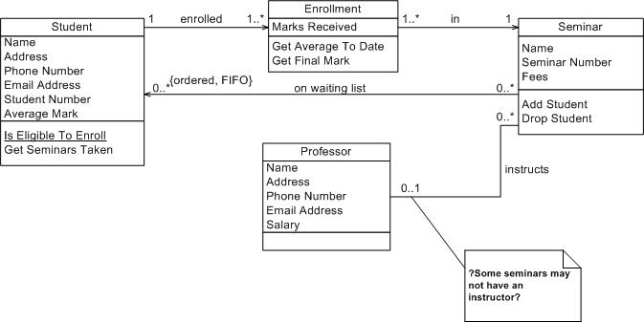

Slide 57
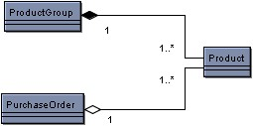
Aggregation & Composition
Special form of association that represents has-a or part-of relationships
Used to distinguish the whole from the part
Composition (parts can’t exist on their own) is a stronger form of aggregation (parts can exist on their own)
0..*

Slide 58
Aggregation & Composition
Aggregation occurs when a class is a collection or container of other classes, but where the contained classes do not have a strong life cycle dependency on the container
  essentially, if the container is destroyed, its contents are not
  clear diamond shape
  Parts can be shared by multiple “whole”s
Composition indicates a strong life cycle dependency between instances of the container class and instances of the contained class(es)
  If the container is destroyed, any contained are also destroyed
  black diamond shape
  Parts can’t be shared by multiple “whole”s

Slide 59
Aggregation & Composition
Composition
  Parts participate totally
  in the whole
Aggregation
  Parts participate partially
  in the whole
Both are implemented as an instance variable of the part in the whole
  (sometimes) in addition to an instance variable of the whole in the part for convenience (composition)
0..*

Slide 60
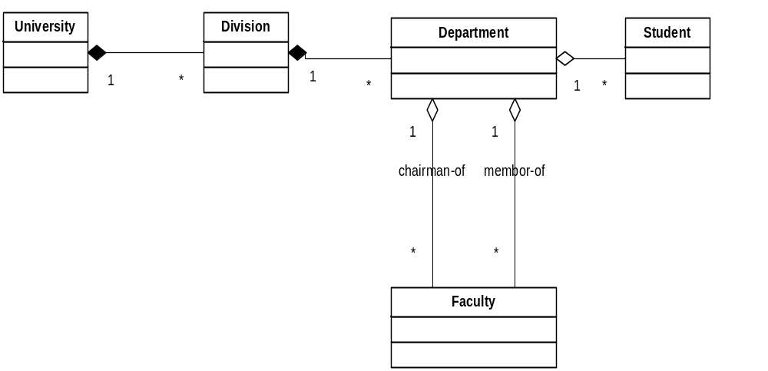
Aggregation & Composition
0 ..*
1..*
1..*
0 ..1
1

Slide 61
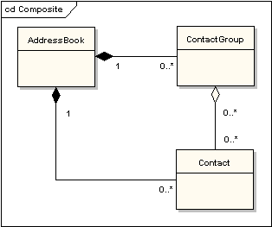

Slide 62
Dependency
The operation of one object depends on the presence of the other entity ➔ changes in one would affect the other
A depends on B if A
  uses B as a method parameter, local method variable, or method return type
  uses any of B’s static methods or variables
Dashed line from A to B (dependent to provider) with the head pointing towards B (provider)

Slide 63
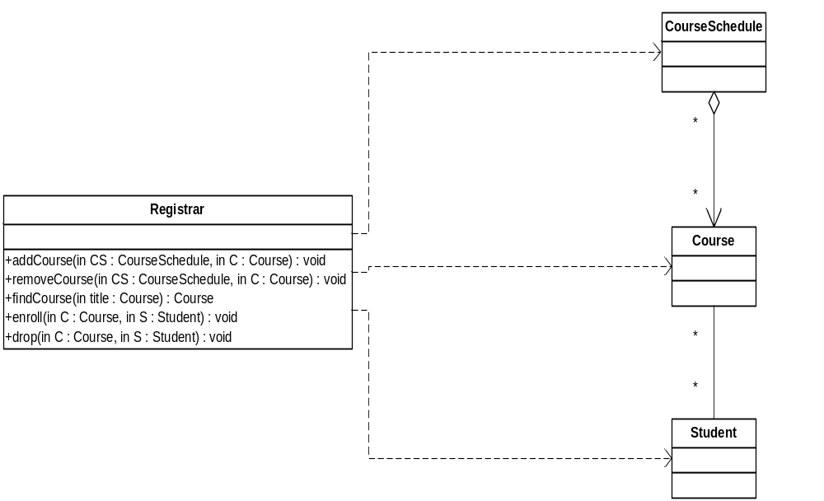
Dependency

Slide 64
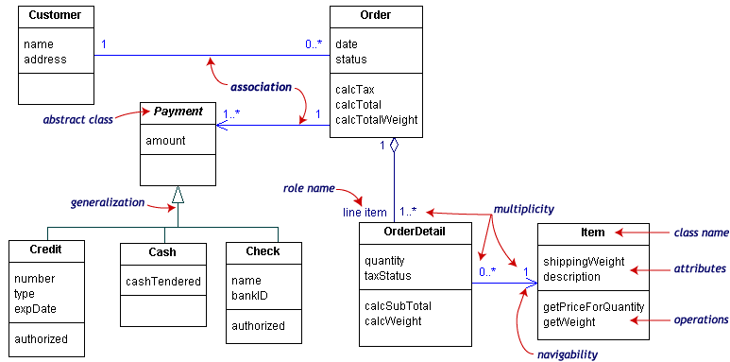
Notes:
Map to classes

Slide 65
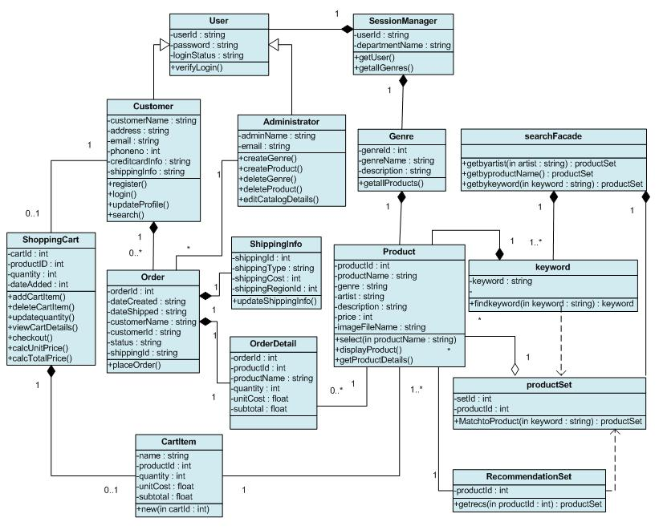

Slide 66
Identifying Classes
Underline verbs and nouns in use cases AND requirements
  Nouns ➔ classes or attributes
  Verbs & action nouns➔ class methods

Slide 67
Analysis Process
Use the system requirements model to find candidate classes that describe the objects that might be relevant to the system and record them on a class diagram.
Find relationships (association, aggregation, composition, dependency and inheritance) between the classes.
Find attributes (simple, named properties of the objects) for the classes.
Walk through the system use cases, checking that they’re supported by the objects that we have, fine-tuning the classes, attributes and relationships as we go – this use case realization will produce operations to complement the attributes.
Update the nonfunctional requirements as necessary – the use cases themselves should not need updating, although perhaps they will need some correcting.

Slide 68
Modeling Dynamic Behavior
Use cases capture user requirements (functional ones only)
Class diagrams model the static structure of the system
We perform dynamic analysis for the following reasons:
  To confirm that our class diagram is complete and accurate, so that we can fix it sooner rather than later: this may involve adding, deleting or modifying classes, relationships, attributes and operations
  To gain confidence that our modeling up to this point can be implemented in software: we’re not the only ones that should be confident before we proceed, our sponsors are just as important
  To verify the functionality of the user interfaces that will appear in the final system: it’s a good idea to partition access to the system into separate interfaces, along use case lines, before we dive into detailed design.

Slide 69
Use Case Realizations using Communication Diagrams
According to Jacobson, the most important part of dynamic analysis is use case realization, i.e. making our use cases real by demonstrating how they can be implemented as collaborating objects.
Use case realization has the following steps:
  Walk through the system use cases, simulating the messages sent between objects and recording the results on communication diagrams.
  Introduce operations on the objects that receive the messages.
  Add classes to represent boundaries (system interfaces) and controllers (placeholders for complex business processes or for the creation and retrieval of objects), as necessary.

Slide 70
Communication Diagrams
Actors interacting with boundaries
  (for example, the Member interacts with a MemberUI)
Boundaries interacting with objects inside the system
  (for example, the MemberUI interacts with a ReservationHome, a Member, a CarModel and a Reservation)
Objects inside the system interacting with boundaries to external systems
  (we might imagine an internal ReportGenerator object interacting with a HeadOffice boundary, for example)

Slide 71
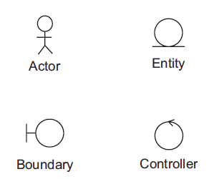
Communication Diagrams
Actor: A person (usually) or system (occasionally) existing outside the system.
Boundary: An object at the edge of the system, between the system and the actors. For system actors, boundaries provide a communication path. For human actors, a boundary means a user interface, capturing commands and queries and displaying feedback and results. Each boundary object usually corresponds to a use case, or a group of related use cases. More specifically, such a boundary usually maps to a user interface sketch (in which case it may be an entire interface or just a sub-window)
Entity: An object inside the system, representing a business concept such as a customer, a car or a car model and containing useful information. Typically, entities are manipulated by boundary and controller objects, rather than having much behavior of their own. Entity classes are the ones that appear on our analysis class diagram
Controller: An object inside the system that encapsulates a complex or untidy process. A controller is a service object that provides the following kinds of service: control of all or part of a system process; creation of new entities; retrieval of existing entities. Without controllers, our entities would become polluted with messy details.

Slide 72
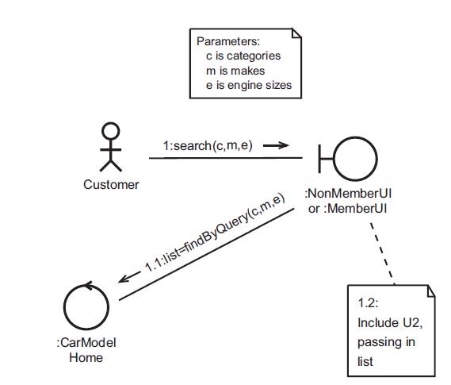
U4 Search

Slide 73
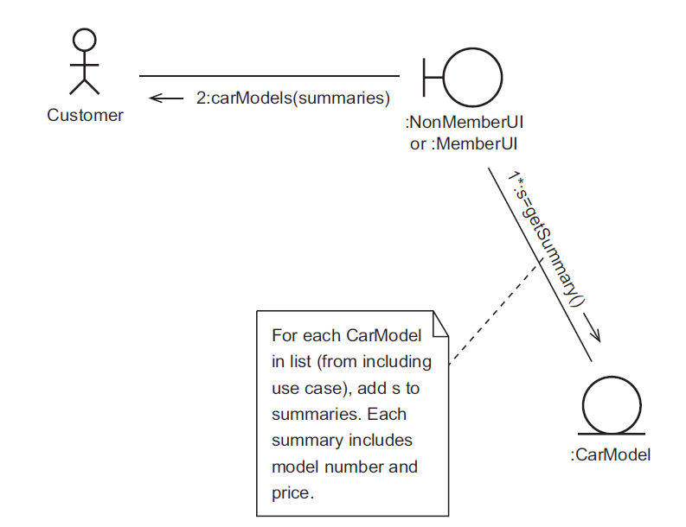
U2 View Results

Slide 74
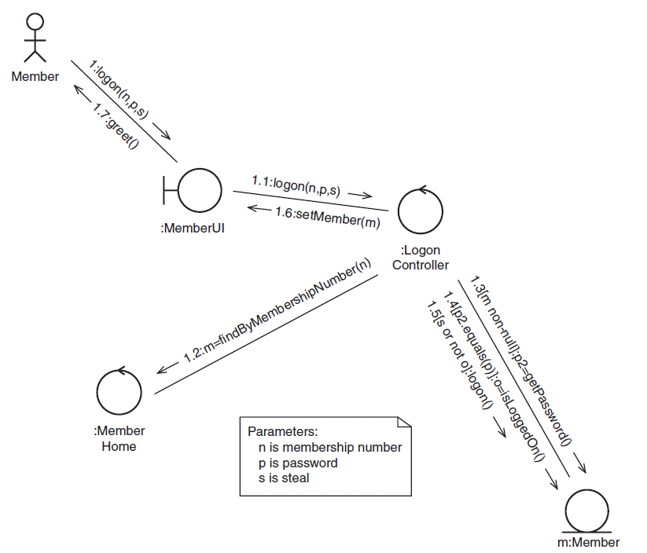
U5 Log on

Slide 75
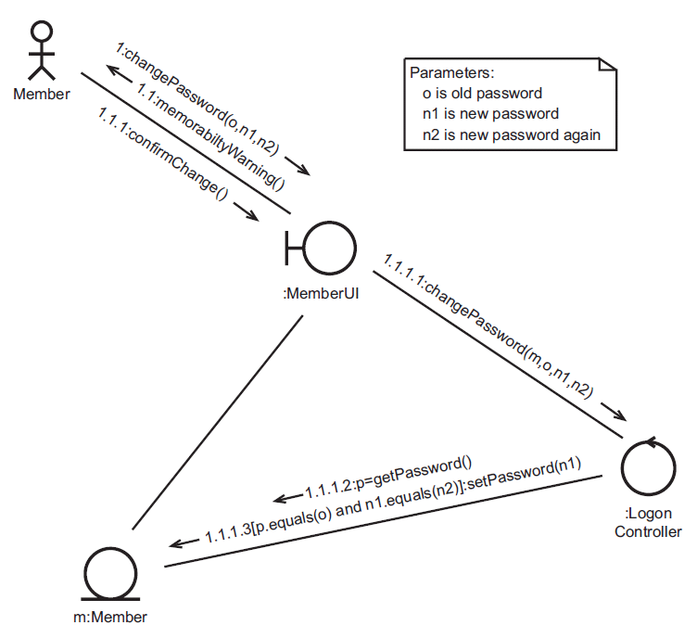
U9 Change Password

Slide 76
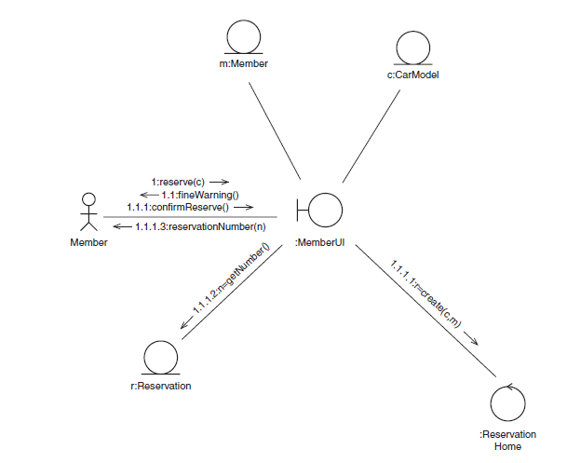
U7 Make Reservation

Slide 77
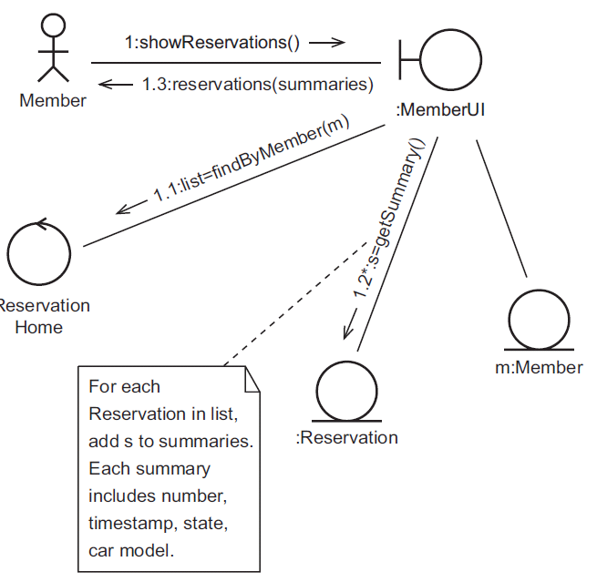
U10 View Reservations

