Slide 1
Hybrid Mobile Applications
Creating Cross-Platform Apps Using Web Technologies
Andrew Zurn

Slide 2
Overview
Background
How Mobile Development has been done
Problems in Native Development
Hybrid Development as a Solution
One App → Many Devices
Appcelerator – Demo
Future of Mobile Development

Slide 3



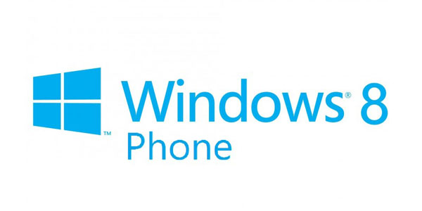
Background
2000 - Java 2 Mobile Edition (J2ME)
2003 – BlackBerry smartphone (C/C++)
2007 – iPhone (Objective C)
2007 – Android (Java)
2010 – Windows Phone (C#)

Slide 4
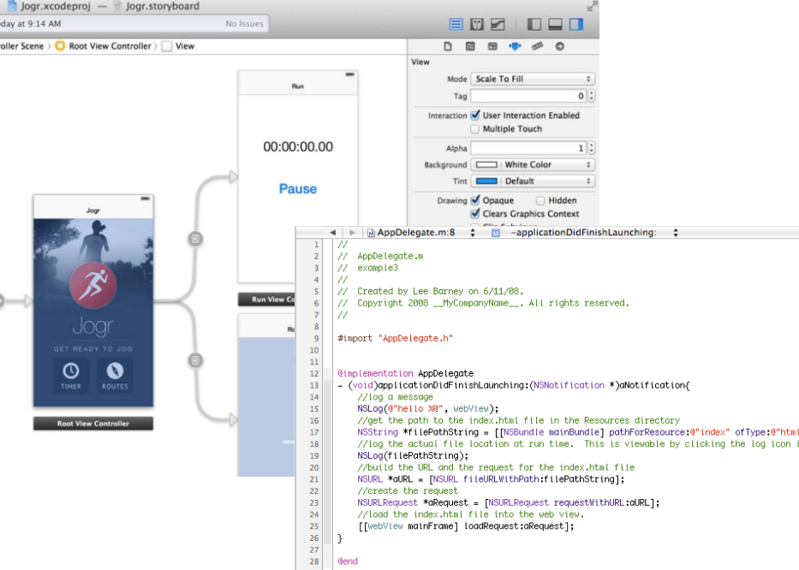
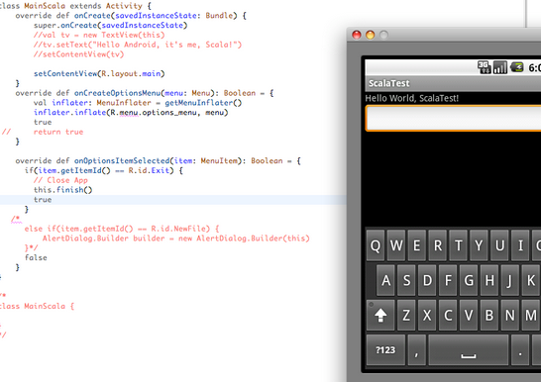
Native Platforms

Slide 5
Problems in Native Development
Various issues for App Development
Dev Time
Case Study: TwitStore – iOS (92 hours) Android (86 hours) [3]
Required Knowledge
Paul Dickson – “Far easier to learn than Xcode” [2]
Multiple Code Bases
Little to no reuse
Cost

Slide 6
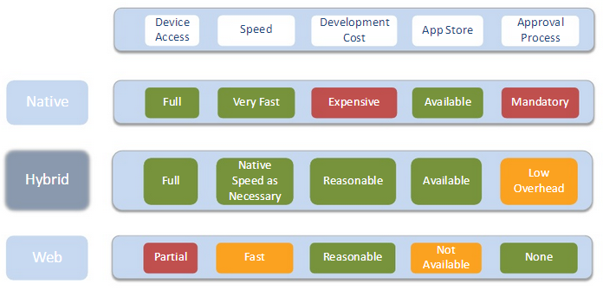
Hybrid Development as a Solution
Common Language
→ ‘Native-like’ App
Cross-compiled vs. Interpreted
Write Once, Run Everywhere
Resolves issues of Native Development

Slide 7
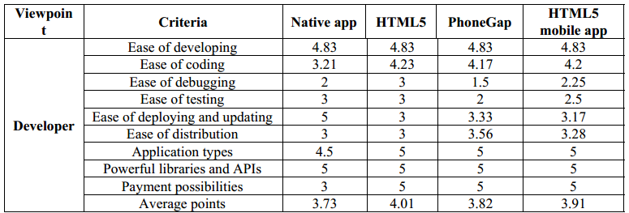
Hybrid Development
Easier to code, deploy, and develop overall. [4]

Slide 8
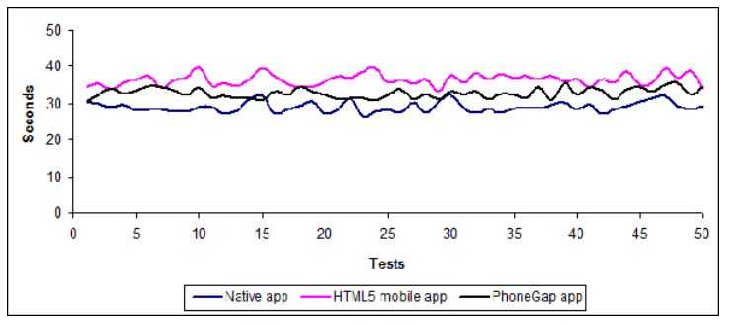
Hybrid Downfalls
Better, Cheaper, but NOT Faster
Leroux – JavaScript hasn’t “achieved” native performance… “but it’s getting close.” [1]

Slide 9
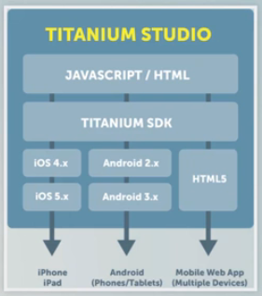

Appcelerator Titanium
Eclipse-based IDE
JavaScript + Native SDKs
iOS, Android, BlackBerry, Mobile Web

Slide 10
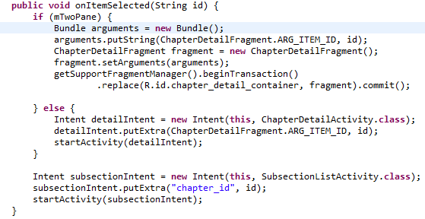
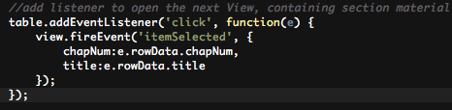
Appcelerator/Android Comparison
Appcelerator – 410 LOC
Android – 1000+ LOC!
Demo!

Slide 11
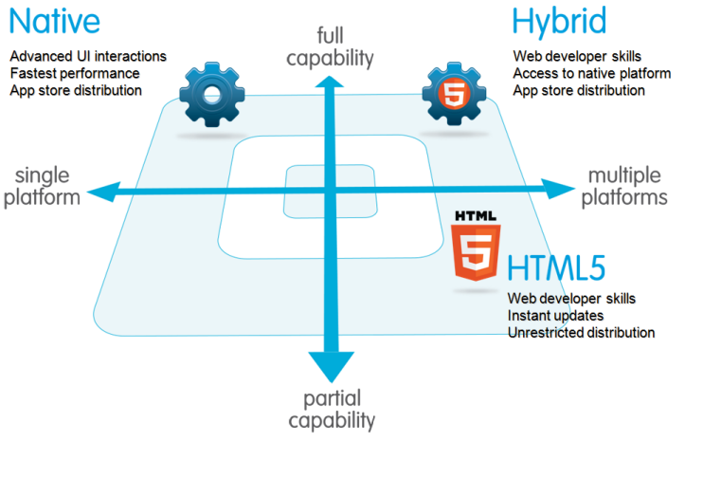
Future of Mobile App Development
Leroux – “As much as native and Web are pitted against one another in this debate, the likely outcome is a hybrid solution.” [1]
Corral – The hybrid-based “paradigm will change the way mobile applications are developed.” Reduces development costs, and allows a developer to conduct a “single development process.” [5]

Slide 12
Conclusion
Take Away:
Native development has created many problems
Hybrid development tools pose a working and sustainable solution
Using Appcelerator Titanium
Hybrid applications to replace native counterparts

Slide 13
Bibliography
[1] Brian Leroux and Andre Charland. Mobile application development: Web vs. native. Communications of the ACM, 54 No.5:4953, 2011.
[2] Paul Dickson. Cabana: A Cross-platform Mobile Development System. SIGCSE’12, Feb 2013.
[3] Michael Nebeling, Christoph Zimmerli, and Moira C. Norrie. Informing the design of new mobile development methods and tools. CHI 2013, na:na, 2013.
[4] Ngu Phuc Huy and Do vanThanh. Evaluation of mobile app paradigms. MoMM, Dec 2012:35, 2012.
[5]Luis Corral, Alberto Sillitti, Giancarlo Succi, Alessandro Garibbo, and Paolo Ramella. Evolution of mobile software development from platform-specic to web-based multiplatform paradigm. Onward!, Oct 2011:na,2011.
http://www.appcelerator.com/
http://www.scribd.com/doc/50805466/Native-Web-or-Hybrid-Mobile-App-Development
http://www.centogram.com/sites/default/files/APPC_landscape.png
http://s3.amazonaws.com/dfc-wiki/en/images/c/c2/Native_html5_hybrid.png

