Slide 1
Some Common Mistakes on Presenting Tables/Figures
Tips 1 and 2: Produce readable plots/tables
Tip 3: Do not duplicate plots!
Do not produce plots that tell nearly the same information
Tip 4: Do not include lines/numbers/etc. that you do not know
Example: Automatically generated smoothing lines in R
Tip 5: Make your plots bigger!!

Slide 2
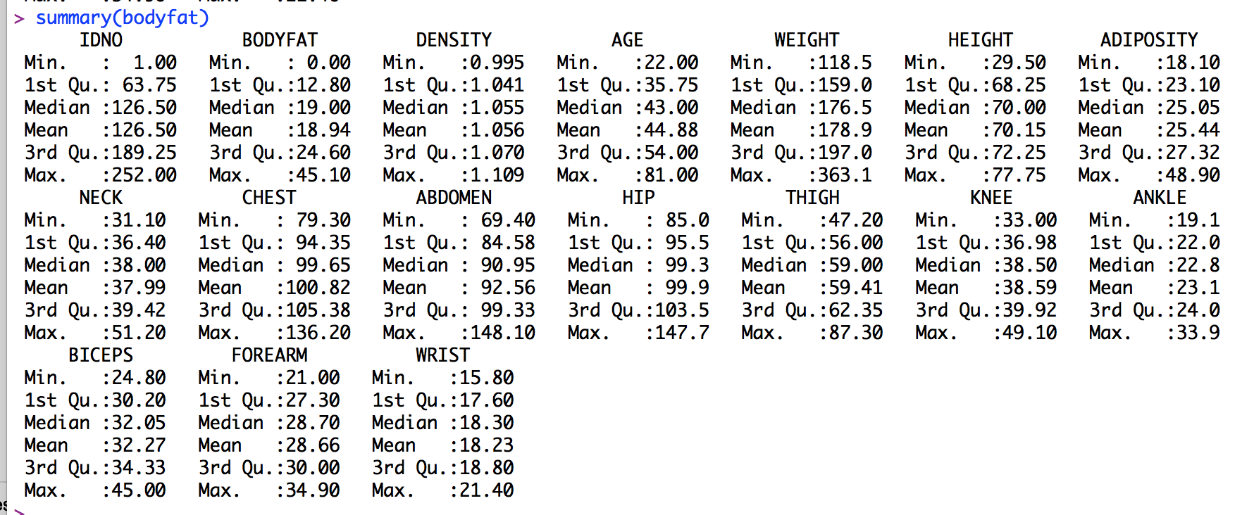
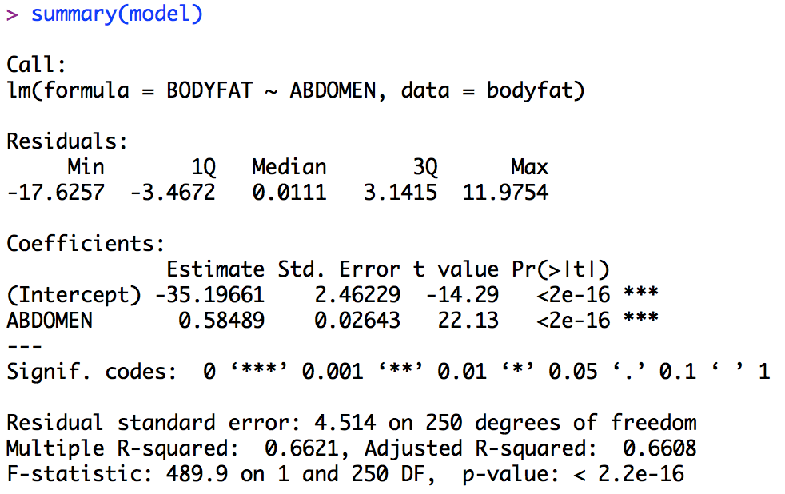
Tip 1: Readable Tables
These are all BAD examples.
It’s impossible to see
Too many numbers
Rounding issues
Solution: Create your own table/plot and only display what you want to talk about

Slide 3
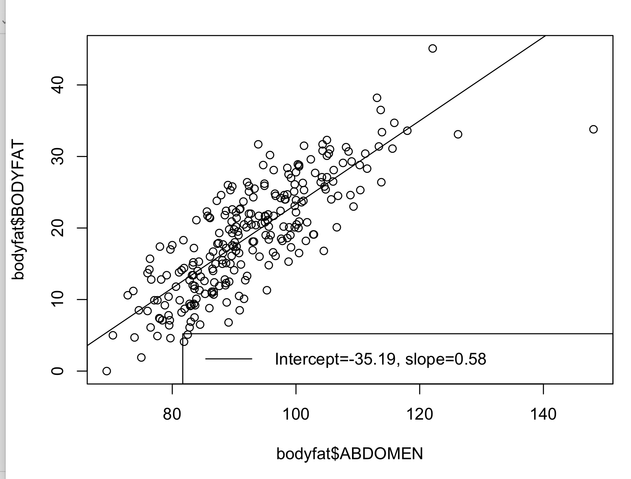
Tip 2: Readable Plots
Several issues with this plot
1. Labels of X/Y axis clearly and in a reader-friendly way (make sure to add units!)
2. Legend box too big/wasted whitespace
3. Grid lines to help guide users (ggplot automatically does this…)
4. Fitted line has the same thickness/color/type as the borders that make up this plot
Fitted line should stand out from other “line-like” objects in the plot, say by using thicker line or different color.

Slide 4
Tip 3: Duplicated/Redundant Plots
These residual plots visually tell the same story (for linearity and homoskedasticity)
This is the Ab + Weight model.
All three residual plots “effectively” tell the same story when it comes to linearity and homoskedasticity! You only need one plot.

Slide 5
Tip 4: Don’t Put Stuff You Don’t Know
You should know everything that’s on your slides/summary. Don’t put analysis that you don’t know.
Any idea what the dotted lines present?
Or the solid red line?
What about the solid red line from the previous slide? Any idea what this represents?

Slide 6
Some Common Mistakes in the Reports
Tip 1: Do not spend a lot of pages/paragraphs on data cleaning
Data cleaning is very important and you should have these details in your Github.
But, for an executive summary, your model description and rationale behind it is far more important than how the data was cleaned.
tl;dr:
Amount of time spent on data cleaning and analysis =!= proportion of material in the executive summary
Think about the audience reading this document!
Tip 2: Remove redundant or useless plots/tables/etc.
If you are not going to talk about number X in the table (or plot), don’t put X in the executive summary!!!!
Tip 3: Proofread your work!!

