Slide 1




Design and Implementation of a Database Management System for Blood Bank Donation and Issue Management
DBMS PBL | REVIEWS 1, 2 AND 3
Andrew Devasani
Roll No. 25WU0102067 | B.Tech CSE, Rhinos AI/ML
Guide: Prof. Sahiti | Woxsen University
Notes:
A relational database for blood donors, donations, blood unit inventory, hospital requests and issues. This deck covers Review 1 (design), Review 2 (normalisation, SQL, prototype) and Review 3 (application and final demo).

Slide 2



Review Roadmap
5 marks
5 marks
5 marks
REVIEW 1 | WEEK 7
REVIEW 2 | WEEK 11
REVIEW 3 | WEEK 16
Analysis and Design
Normalisation and SQL
Application and Demo
Problem, scope, objectives, users
Functional requirements
ER diagram and initial schema
3NF design and data dictionary
DDL with integrity constraints
Sample data, queries, views, prototype
Flask and MySQL application
CRUD, search, validation, reports
Source code, report and viva
3 reviews | 15 slides | 15 marks in total
Notes:
Three reviews at 5 marks each. Review 1 is design, Review 2 is database implementation, Review 3 is the working application.

Slide 3
Problem and Objectives
REVIEW 1 | WEEK 7
THE PROBLEM
OBJECTIVES
Donor and donation records are scattered across registers and sheets
1
Model donors, donations, units, hospitals, requests and issues relationally
2
Enforce integrity: valid groups, unique IDs, expiry rules, no double issue
No live view of stock by blood group and component
3
Keep stock accurate by group, component and status
Expired units are found late, so blood is wasted
4
Provide a Flask and MySQL interface for CRUD, search and reports
Hospital requests are matched to units slowly and with errors
5
Normalise the design to Third Normal Form
Notes:
Paper and spreadsheet records cause fragmented donor data, unknown stock, expiry wastage and slow request handling. The five objectives address these.

Slide 4





Scope and Users
REVIEW 1 | WEEK 7
In scope
Administrator
Manages master data and reviews all reports
Donor registration, update and search
Donation recording with screening result
Blood Bank Staff
Blood unit inventory with expiry tracking
Registers donors, records donations, manages stock, issues units
Hospital registry and blood requests
Issuing units against requests
Hospital Representative
Stock, donor and issue reports
Registered hospital that raises requests and tracks status
Out of scope: billing, patient medical records, lab device integration, SMS or email gateways, multi-branch banks
Donor
Record subject: profile and history held, eligibility checked
Notes:
Scope is one blood bank. Four user types: administrator, blood bank staff, hospital representative and donor (record subject).

Slide 5
Functional Requirements
REVIEW 1 | WEEK 7
Register, update and search donors
Check donor eligibility: age, haemoglobin and gap since last donation
FR1
FR2
Record donations with screening result
Create blood units with component and expiry date
FR3
FR4
Track inventory and flag expiring or expired units
Register hospitals and raise blood requests
FR5
FR6
Issue units against requests and update unit status
Report stock summary, donor history and issue log
FR7
FR8
Notes:
Eight functional requirements covering donors, donations, inventory, hospitals, requests, issuing and reporting.

Slide 6
Conceptual Design: ER Diagram
REVIEW 1 | WEEK 7
DONOR
DONATION
BLOOD_UNIT
donor_id
PK
donation_id
PK
unit_id
PK
full_name
donor_id
FK
donation_id
FK
date_of_birth
1
N
donation_date
1
N
component
gender
volume_ml
expiry_date
blood_group
donates
hemoglobin_gdl
yields
status
phone
UQ
screening_status
city
1
issued in
0..1
HOSPITAL
BLOOD_REQUEST
BLOOD_ISSUE
hospital_id
PK
request_id
PK
issue_id
PK
hospital_name
hospital_id
FK
request_id
FK
license_no
UQ
1
N
blood_group
1
N
unit_id
FK, UQ
contact_person
component
issue_date
phone
raises
units_required
fulfilled by
issued_by
city
urgency
remarks
request_date
status
PK = primary key FK = foreign key UQ = unique Diamonds show relationships with cardinality
Notes:
DONOR donates (1:N) DONATION; a DONATION yields (1:N) BLOOD_UNITs; a HOSPITAL raises (1:N) BLOOD_REQUESTs; a request is fulfilled by (1:N) BLOOD_ISSUE rows; each BLOOD_UNIT is issued in at most one BLOOD_ISSUE (1:0..1).

Slide 7
Initial Relational Schema
REVIEW 1 | WEEK 7
DONOR
DONATION
BLOOD_UNIT
donor_id
INT
PK
donation_id
INT
PK
unit_id
INT
PK
full_name
VARCHAR(100)
donor_id
INT
FK
donation_id
INT
FK
date_of_birth
DATE
donation_date
DATE
component
VARCHAR(20)
gender
CHAR(1)
volume_ml
INT
expiry_date
DATE
blood_group
VARCHAR(3)
hemoglobin_gdl
DECIMAL(4,1)
status
VARCHAR(12)
phone
VARCHAR(15)
UQ
screening_status
VARCHAR(10)
city
VARCHAR(60)
HOSPITAL
BLOOD_REQUEST
BLOOD_ISSUE
hospital_id
INT
PK
request_id
INT
PK
issue_id
INT
PK
hospital_name
VARCHAR(120)
hospital_id
INT
FK
request_id
INT
FK
license_no
VARCHAR(30)
UQ
blood_group
VARCHAR(3)
unit_id
INT
FK, UQ
contact_person
VARCHAR(100)
component
VARCHAR(20)
issue_date
DATE
phone
VARCHAR(15)
units_required
INT
issued_by
VARCHAR(100)
city
VARCHAR(60)
urgency
VARCHAR(10)
remarks
VARCHAR(200)
request_date
DATE
status
VARCHAR(12)
Foreign keys: DONATION.donor_id to DONOR; BLOOD_UNIT.donation_id to DONATION; BLOOD_REQUEST.hospital_id to HOSPITAL; BLOOD_ISSUE.request_id to BLOOD_REQUEST; BLOOD_ISSUE.unit_id to BLOOD_UNIT
Notes:
Six tables with proposed data types. PK primary key, FK foreign key, UQ unique. BLOOD_ISSUE.unit_id is FK and UNIQUE so a unit is issued once.

Slide 8
Normalisation to 3NF
REVIEW 2 | WEEK 11
1NF
Atomic values only, no repeating groups
2NF
Every table has a single-column key, so no partial dependencies
3NF
No transitive dependencies: a unit's blood group comes via donation and donor
Table | Functional dependencies | Candidate keys
DONOR | donor_id → full_name, date_of_birth, gender, blood_group, phone, city | donor_id, phone
DONATION | donation_id → donor_id, donation_date, volume_ml, hemoglobin_gdl, screening_status | donation_id
BLOOD_UNIT | unit_id → donation_id, component, expiry_date, status | unit_id
HOSPITAL | hospital_id → hospital_name, license_no, contact_person, phone, city | hospital_id, license_no
BLOOD_REQUEST | request_id → hospital_id, blood_group, component, units_required, urgency, request_date, status | request_id
BLOOD_ISSUE | issue_id → request_id, unit_id, issue_date, issued_by, remarks | issue_id, unit_id
Notes:
All six tables are in 1NF, 2NF and 3NF. Every non-key attribute depends on the key, the whole key and nothing but the key. Blood group is stored only on DONOR and reached by joins, and last donation date is computed from DONATION rather than stored.

Slide 9
Data Dictionary
REVIEW 2 | WEEK 11
Table | Column | Type | Constraint | Description
DONOR | donor_id | INT | PK, AUTO_INCREMENT | Unique donor identifier
DONOR | blood_group | VARCHAR(3) | NOT NULL, CHECK | One of the 8 ABO and Rh groups
DONOR | phone | VARCHAR(15) | NOT NULL, UNIQUE | Contact number, no duplicates
DONATION | donor_id | INT | FK to DONOR | Who donated
DONATION | volume_ml | INT | CHECK 300 to 500 | Volume collected
DONATION | hemoglobin_gdl | DECIMAL(4,1) | CHECK 12.5 to 20 | Screening haemoglobin
BLOOD_UNIT | component | VARCHAR(20) | NOT NULL | Whole blood, plasma, platelets, RBC
BLOOD_UNIT | expiry_date | DATE | NOT NULL | Date after which unit is unusable
BLOOD_UNIT | status | VARCHAR(12) | DEFAULT 'Available' | Available, Issued or Expired
HOSPITAL | license_no | VARCHAR(30) | UNIQUE | Hospital licence number
BLOOD_REQUEST | units_required | INT | CHECK 1 to 10 | Units asked for, capped per request
BLOOD_ISSUE | unit_id | INT | FK, UNIQUE | Each unit issued at most once
Notes:
A concise dictionary of the most important columns, their types, constraints and meaning.

Slide 10
DDL and Integrity Constraints
REVIEW 2 | WEEK 11
CREATE TABLE donor (
donor_id INT AUTO_INCREMENT PRIMARY KEY,
full_name VARCHAR(100) NOT NULL,
date_of_birth DATE NOT NULL,
gender CHAR(1) CHECK (gender IN ('M','F','O')),
blood_group VARCHAR(3) NOT NULL CHECK (blood_group IN
('A+','A-','B+','B-','AB+','AB-','O+','O-')),
phone VARCHAR(15) NOT NULL UNIQUE,
city VARCHAR(60)
);
CREATE TABLE donation (
donation_id INT AUTO_INCREMENT PRIMARY KEY,
donor_id INT NOT NULL,
donation_date DATE NOT NULL,
volume_ml INT CHECK (volume_ml BETWEEN 300 AND 500),
hemoglobin_gdl DECIMAL(4,1)
CHECK (hemoglobin_gdl BETWEEN 12.5 AND 20),
FOREIGN KEY (donor_id) REFERENCES donor(donor_id)
);
CREATE TABLE blood_unit (
unit_id INT AUTO_INCREMENT PRIMARY KEY,
donation_id INT NOT NULL,
component VARCHAR(20) NOT NULL,
expiry_date DATE NOT NULL,
status VARCHAR(12) DEFAULT 'Available',
FOREIGN KEY (donation_id)
REFERENCES donation(donation_id)
);
CREATE TABLE blood_issue (
issue_id INT AUTO_INCREMENT PRIMARY KEY,
request_id INT NOT NULL,
unit_id INT NOT NULL UNIQUE,
issue_date DATE NOT NULL,
FOREIGN KEY (request_id)
REFERENCES blood_request(request_id),
FOREIGN KEY (unit_id)
REFERENCES blood_unit(unit_id)
);
-- blood_request.units_required
-- CHECK (units_required BETWEEN 1 AND 10)
UNIQUE donor phone and hospital licence
CHECK on blood group, volume and haemoglobin
UNIQUE unit_id: no double issue
Request limit of 1 to 10 units
Notes:
Excerpts of the DDL. Constraints: UNIQUE phone and licence number, CHECK ranges for groups, volume and haemoglobin, UNIQUE unit_id so a unit cannot be issued twice, and a cap on units per request. CHECK constraints are enforced in MySQL 8.0.16 and later.

Slide 11
Sample SQL Queries and Views
REVIEW 2 | WEEK 11
Join: donor-wise donation history
Aggregation: available stock by group
SELECT d.full_name, d.blood_group,
n.donation_date, n.volume_ml
FROM donor d
JOIN donation n ON n.donor_id = d.donor_id
ORDER BY d.full_name, n.donation_date;
SELECT d.blood_group, u.component, COUNT(*) AS units
FROM blood_unit u
JOIN donation n ON n.donation_id = u.donation_id
JOIN donor d ON d.donor_id = n.donor_id
WHERE u.status = 'Available'
AND u.expiry_date >= CURDATE()
GROUP BY d.blood_group, u.component;
Subquery: donors eligible to donate again
View: units expiring within 7 days
SELECT donor_id, full_name FROM donor
WHERE donor_id NOT IN (
SELECT donor_id FROM donation
WHERE donation_date >=
CURDATE() - INTERVAL 90 DAY
);
CREATE VIEW v_expiring_units AS
SELECT unit_id, component, expiry_date
FROM blood_unit
WHERE status = 'Available'
AND expiry_date BETWEEN CURDATE()
AND CURDATE() + INTERVAL 7 DAY;
Notes:
Four representative queries: a join for donor history, an aggregate for stock by blood group and component, a subquery for donor eligibility and a view for units close to expiry. Further queries cover request fulfilment and hospital summaries.

Slide 12
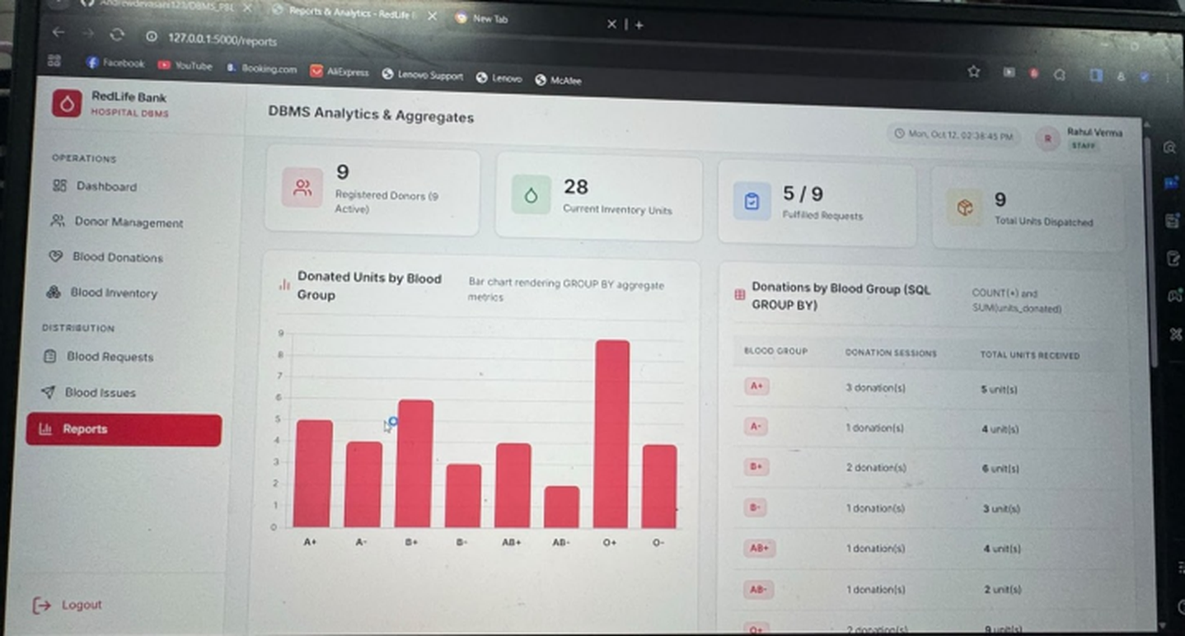

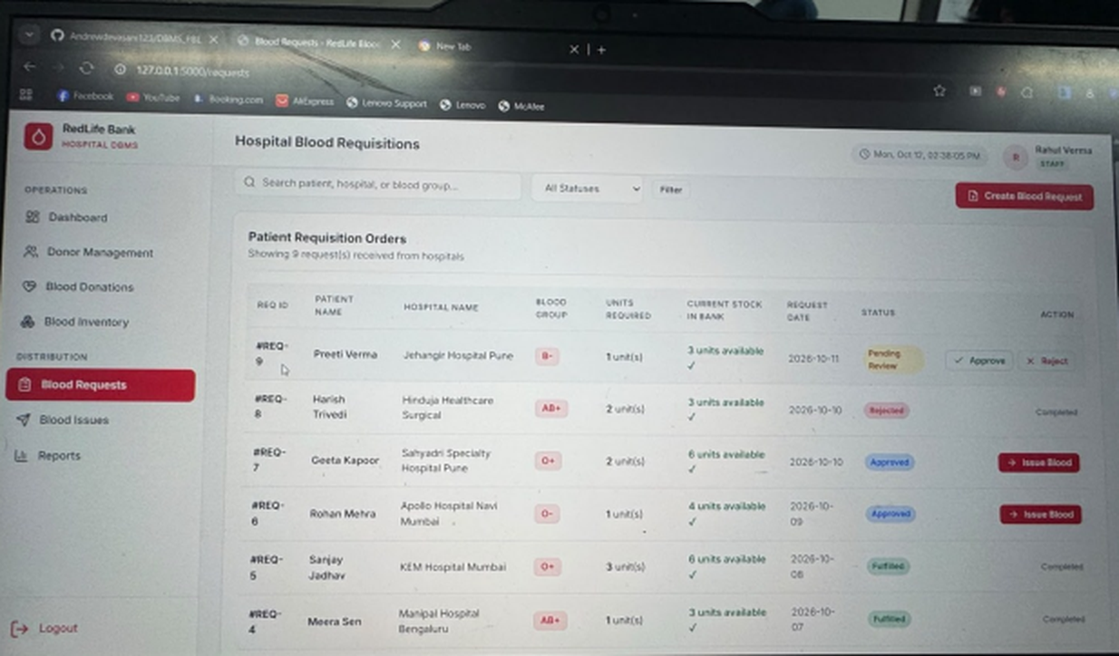
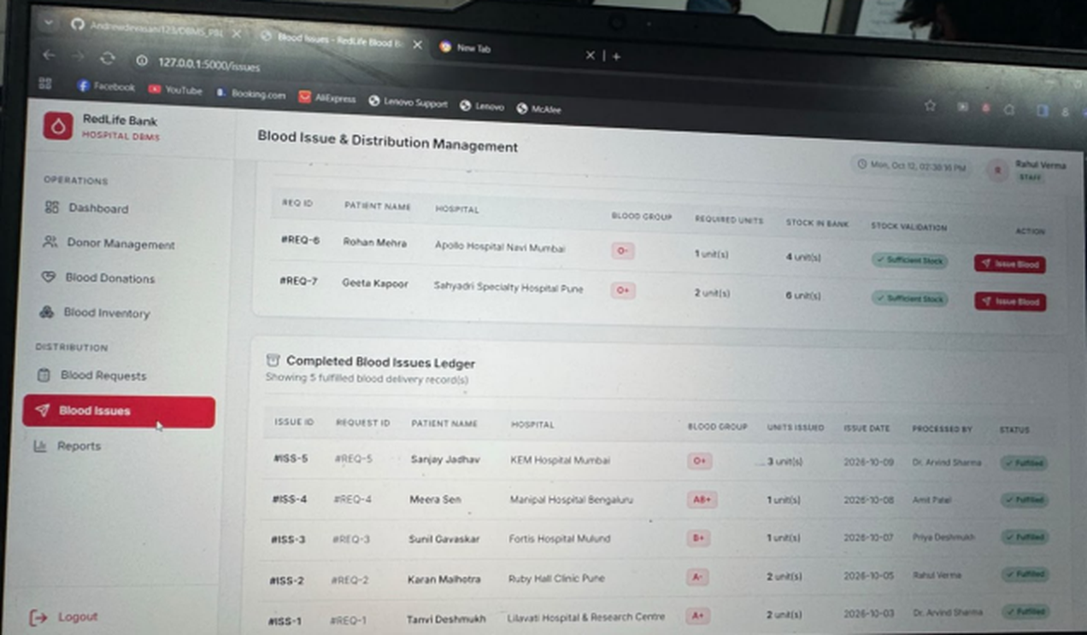
Progress and Prototype
REVIEW 2 | WEEK 11
Database designed and normalised to 3NF
DDL executed with constraints in MySQL 8
Sample data loaded into all six tables
Joins, subqueries, aggregates and views tested
Reports and analytics
Flask prototype connected to the database
Prototype demonstration to the guide
Blood requests
Blood issues
Notes:
Progress so far and the prototype demo. Screenshots are of the running RedLife Bank Flask application: the reports page with GROUP BY aggregates, the blood requests page and the blood issues ledger.

Slide 13



Application Architecture
REVIEW 3 | WEEK 16
Browser interface
Flask application
MySQL 8 database
HTML, CSS and JavaScript forms and tables
Routes, input validation and error handling
Six 3NF tables, constraints and views
APPLICATION MODULES
Donor registration
Donation entry
Inventory management
Hospital requests
Issue processing
Search
Reports and views
Validation and errors
Notes:
Three tiers: browser, Flask and MySQL. Eight modules cover registration, donations, inventory, requests, issuing, search, reports and validation.

Slide 14





Final Demonstration
REVIEW 3 | WEEK 16
CRUD operations
Submission package
Add, view, update and delete donors, units and requests
Source code (GitHub repo DBMS_PBL)
Search
By donor name, blood group, phone or hospital
Database script: DDL and sample data
Validation
Test data
Rejects invalid groups, ranges and duplicate phones
Output screens
Reports
Stock summary, donor history and issue log
Project report
Error handling
Viva-voce
Clear messages for failed or blocked actions
Notes:
Demo order: CRUD on donors, search, a validation failure, the reports, and a deliberate error. Then show the submission package: code, database script, test data, output screens, report, viva.

Slide 15
Summary
REVIEW 1 | WEEK 7
REVIEW 2 | WEEK 11
REVIEW 3 | WEEK 16
Design
Database
Application
Problem, scope and requirements
ER diagram of six entities
Initial relational schema
3NF design and data dictionary
DDL with integrity constraints
Queries, views and prototype
Flask and MySQL application
CRUD, search, validation, reports
Code, report and viva
Thank you | Questions?
Notes:
Design, database and application together make a complete blood bank donation and issue management system.

