Slide 1
HW2
109030605
黃昭學

Slide 2
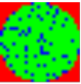
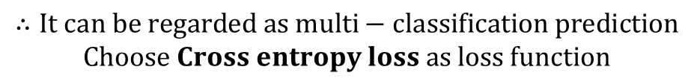
Auto-encoder architecture
Input
Shape = (26, 26, 3)
Output:
Shape= (26, 26)
Auto-encoder
Each pixel is a one-hot label
[[[1. 0. 0.]
[0. 0. 1.]
[0. 1. 0.]
...]]]
Each pixel is a label
[[0,2,1…
...]]
$$∴It can be regarded as multi−classification prediction$$
$$Choose Cross entropy loss as loss function$$

Slide 3
Auto-encoder architecture
AF = Activation function = Leaky-ReLU (negative slope = 0.5)
(10, 26, 26)
(20, 13, 13)
(40, 6, 6)
(160, 6, 6)
Latent Vector
(10, 26, 26)
(3, 26, 26)
(40, 12, 12)
(20, 13, 13)
Convolution layer 1
Convolution layer 2
Convolution layer 3
Convolution layer 4
Deconvolution layer 1
Deconvolution layer 2
Deconvolution layer 3
Deconvolution layer 4
(3, 26, 26)
(10, 13, 13)
(20, 6, 6)
(160, 12, 12)
(20, 26, 26)
Label images
Maxpooling
Maxpooling
Upsample
Upsample
Cross entropy
(160, 6, 6)
Leaky-ReLU
Negative slope = 0.5
Leaky-ReLU
Negative slope = 0.5
Leaky-ReLU
Negative slope = 0.5

Slide 4
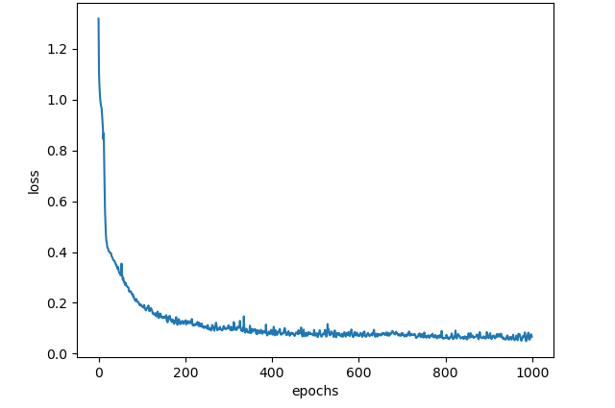
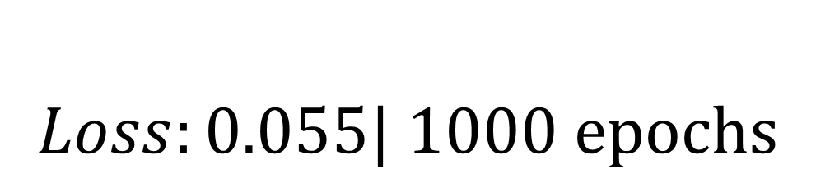
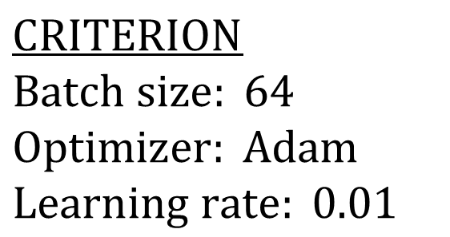
Training Loss v.s epochs
$$CRITERION$$
$$Batch size: 64$$
$$Optimizer: Adam$$
$$Learning rate: 0.01$$
$$Loss:0.055| 1000 epochs$$

Slide 5
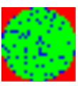
Visualize noise images
Sample 1
First batch of generated noise images

