Slide 1
Python (II)
- Constructor
Numpy
Random
More Control Flow Tools
楊延齡 博士
hayato655169@gmail.com
07/10/2020

Slide 2

Constructor
63
Types | Definition | Constructor | Example
string | ' ' or " " | str() | str('NTHUCHE')
list | [ ] | list() | list(1,2,3)
tuple | ( ) | tuple() | tuple(1,2,3)
range | range() | range() | range(3)
dictionary | {key, value} | dict() | dict(x=5, y=0) dict([('x', 5), ('y', -5)]) dict([('x', 5), ('y', -5)], z=8)

Slide 3
Constructor
64
list(iterable)
Iterable: string, list, tuple, dict
Non-iterable: int, float
tuple(iterable)
Create list from empty list
>>> a = list() # => [ ]
Create list from empty list
>>> a = tuple() # => ( )
Create list from string
>>> String = 'NTHUCHE'
>>> a = list(String) # => ['N', 'T', 'H', 'U', 'C', 'H', 'E' ]
Create list from string
>>> String = 'NTHUCHE'
>>> a = tuple(String) # => ('N', 'T', 'H', 'U', 'C', 'H', 'E' )
Create list from list
>>> List = ['NTHUCHE']
>>> a = list(List) # => ['NTHUCHE']
Create list from list
>>> List = ['NTHUCHE']
>>> a = tuple(List) # => ('NTHUCHE')
Create list from tuple
>>> Tuple = ('NTHUCHE',)
>>> a = list(Tuple) # => ['NTHUCHE']
Create list from tuple
>>> Tuple = ('NTHUCHE',)
>>> a = tuple(Tuple) # => ('NTHUCHE')

Slide 4
Constructor
65
dict(**kwarg)
Keyword Argument (kwarg): send arguments with ”key = value” syntax
Create dict from empty dict
>>> a = dict()
>>> print('a =', a) # => a = {}
Create dict from keyword arguments "only"
>>> a = dict(x=5, y=0) # keyword argument
>>> print('a =', a) # => a = {'x': 5, 'y': 0}

Slide 5
Constructor
66
dict(iterable)
Create dict from list
>>> a = dict([('x', 5), ('y', -5)])
>>> print('a =', a) # => a = {'x': 5, 'y': -5}
Create dict from tuple
>>> a = dict( ( ('x', 5), ('y', -5) ) )
>>> print('a =', a) # => a = {'x': 5, 'y': -5}

Slide 6
Constructor
67
dict(iterable, **kwarg)
Create dict from list
>>> a = dict([('x', 5), ('y', -5)], z=8)
>>> print('a =', a) # => a = {'x': 5, 'y': -5, 'z': 8}
'''SyntaxError: positional argument follows keyword argument
a = dict(z=8, [('x', 5), ('y', -5)])
print('a =', a)
'''
Create dict from keyword arguments "only"

Slide 7
Constructor
68
dict(mapping, **kwarg)
>>> a = dict({'x': 4, 'y': 5})
>>> print('a =', a) # => a = {'x': 4, 'y': 5}
>>> a = dict({'x': 4, 'y': 5}, z=8)
>>> print('a =', a) # => a = {'x': 4, 'y': 5, 'z': 8}
'''TypeError: dict expected at most 1 arguments, got 2
a = dict({'x': 4, 'y': 5}, [('z', 8)])
print(‘a =', a)
'''

Slide 8
Built-in Types
69
Immutable object (str, int, tuple, etc.): All the variables that refer to it will always see the same value, but operations that transform that value into a new value always return a new object.
Mutable object (list, dict, set, etc.): We can use some specific operations to mutate it and all the variables that refer to it will see the change.
Type | Mutable | Immutable
integer, float, complex |  | ✓
string |  | ✓
list | ✓
tuple |  | ✓
range |  | ✓
dictionary | ✓

Slide 9
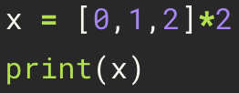



Numpy
70
Sequence
Array

Slide 10
Numpy Array vs. Python List
71
Numpy arrays consume less memory than Python list
Numpy arrays are fast as compared to the Python list
Numpy arrays are great for numerical operations; Python list cannot directly handle math operations

Slide 11
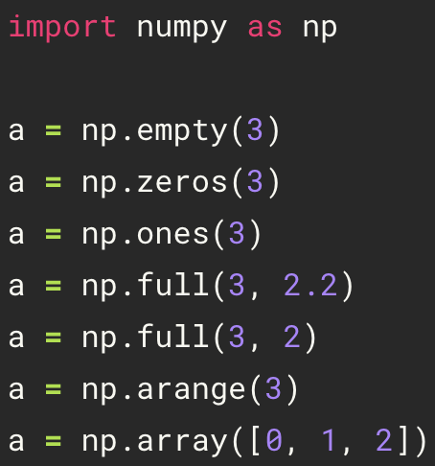
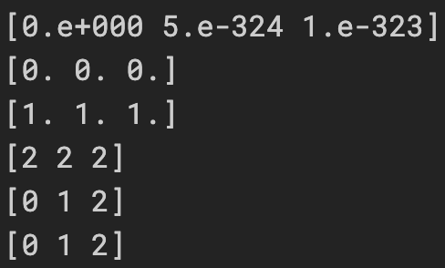

Array Creation
72
empty function
import numpy
zeros function
random and float
ones function
full function
float
arange function
integer
array function

Slide 12
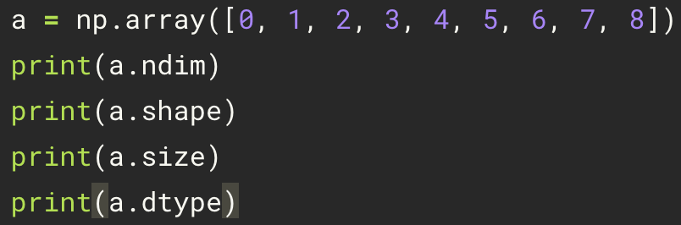
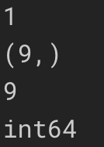
Numpy Method
73
ndim
shape
size
dtype

Slide 13

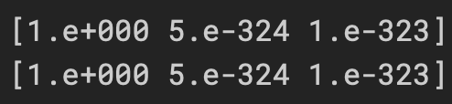
Same Data Type
74
All elements are same data type
>>> a = np.empty(3)
>>> print(a)
>>> a[0] = int(1)
>>> print(a)
>>> a = np.array([1, 2., 'NTU'])
>>> print(a)

Slide 14
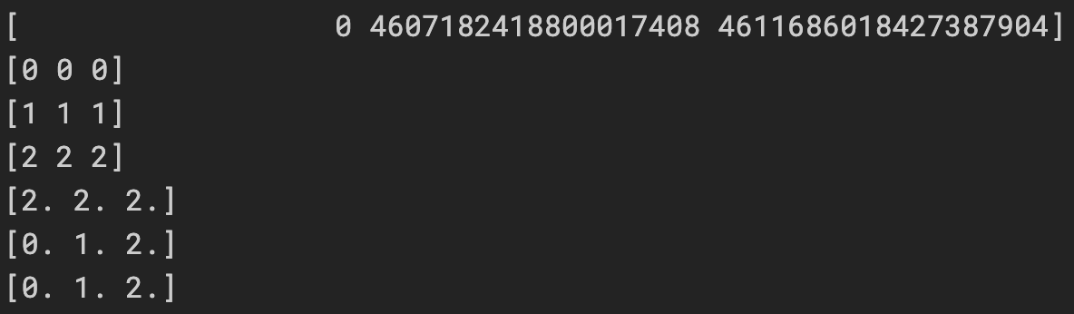
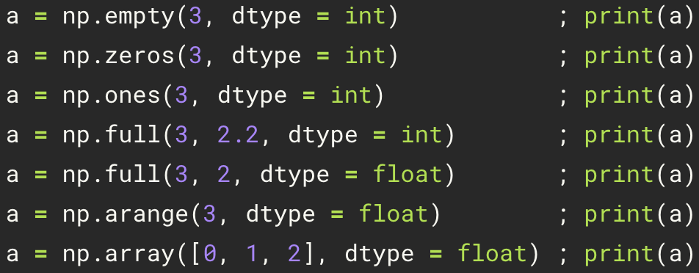
dtype
75
random and integer
integer
float

Slide 15
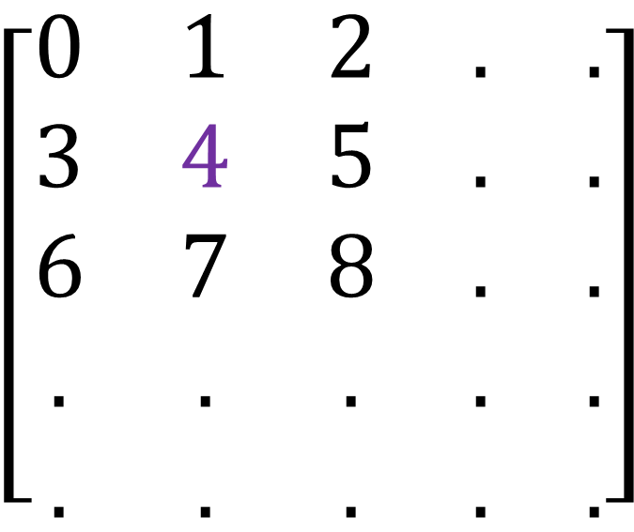
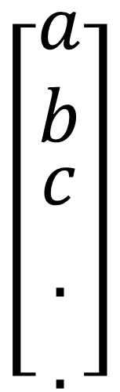
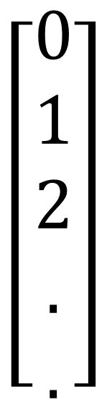
N-dimension Array
76
Column
index
0 1 2 . . . n
0
1
2
.
m
$$\left[\begin{matrix}0 & 1 & 2 & . & . \\ 3 & 4 & 5 & . & . \\ 6 & 7 & 8 & . & . \\ . & . & . & . & . \\ . & . & . & . & .\end{matrix}\right]$$
$$\left[\begin{matrix}0 \\ 1 \\ 2 \\ . \\ .\end{matrix}\right]$$
$$\left[\begin{matrix}a \\ b \\ \begin{aligned}c \\ . \\ .\end{aligned}\end{matrix}\right]$$
=
Row
a[1][1]=4
a[1,1]=4
m×n matrix
a[1]= 3 4 5 . .

Slide 16
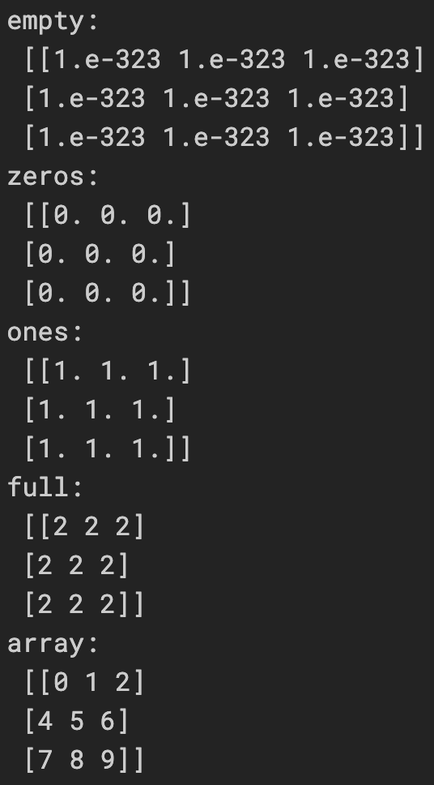
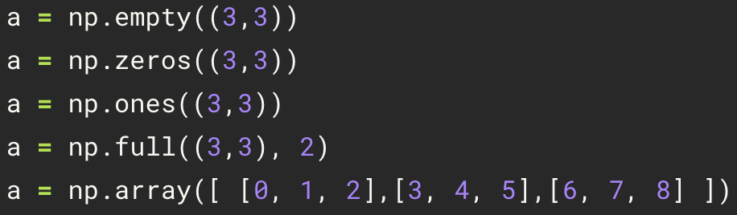
Creating an n-dimension Array
77

Slide 17
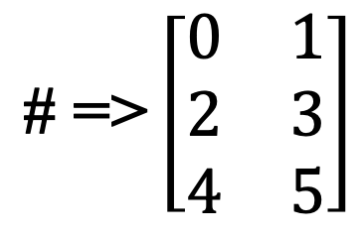
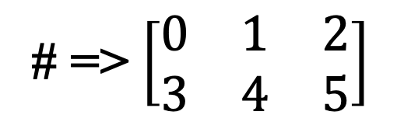
reshape
78
>>> a = np.arange(6).reshape(2,3)
0 | 1 | 2
3 | 4 | 5
2×3 matrix
# => $\left[\begin{matrix}0 & 1 & 2 \\ 3 & 4 & 5\end{matrix}\right]$
>>> a = np.arange(6)
0 | 1 | 2 | 3 | 4 | 5
>>> a = np.arange(6).reshape(3,2)
# => [0 1 2 3 4 5]
0 | 1
2 | 3
4 | 5
>>> print(a.shape)
3×2 matrix
# => (6, )
$$\text{\# =>}\left[\begin{matrix}0 & 1 \\ 2 & 3 \\ 4 & 5\end{matrix}\right]$$
(1-Dimension)

Slide 18
(6, ), (1, 6), (6, 1)
79
>>> a = np.arange(6)
# => [0 1 2 3 4 5]
>>> print(a.shape)
# => (6, )
(1-Dimension)
>>> a = np.arange(6).reshape(1,6)
# => [[0 1 2 3 4 5]]
>>> print(a.shape)
# => (1, 6)
(2-Dimension)
>>> a = np.arange(6).reshape(6,1)
# => [[0] [1] [2] [3] [4] [5]]
>>> print(a.shape)
# => (6, 1)
(2-Dimension)

Slide 19
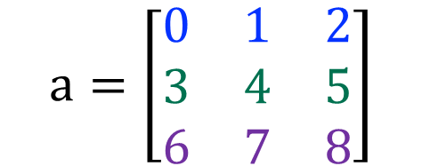


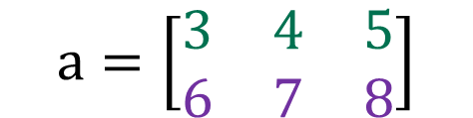
Get Value
80
>>> a = np.arange(9).reshape(3,3)
>>> print(a)
$$\text{a}=\left[\begin{matrix}0 & 1 & 2 \\ 3 & 4 & 5 \\ 6 & 7 & 8\end{matrix}\right]$$
# => a = [ [0 1 2] [3 4 5] [6 7 8] ]
(2-Dimension)
>>> print(a[1:])
>>> print(a[1:][1])
$$\text{a}=\left[\begin{matrix}6 & 7 & 8\end{matrix}\right]$$
$$\text{a}=\left[\begin{matrix}3 & 4 & 5 \\ 6 & 7 & 8\end{matrix}\right]$$
# => [6 7 8]
(1-Dimension)
# => [ [3 4 5] [6 7 8] ]
>>> print(a[1:,1])
(2-Dimension)
$$\text{a}=\left[\begin{matrix}4 & 7\end{matrix}\right]$$
# => [4 7]
(1-Dimension)

Slide 20
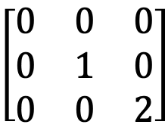
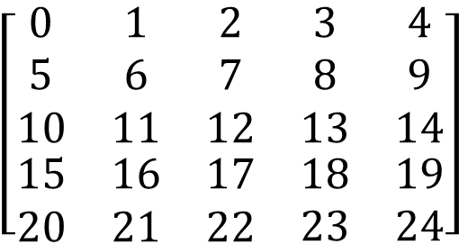
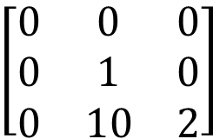
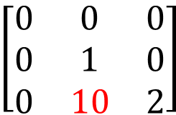
Index and Slice
81
column
Index
Slice
0 1 2
0
1
2
$$\left[\begin{matrix}0 & 0 & 0 \\ 0 & 1 & 0 \\ 0 & 0 & 2\end{matrix}\right]$$
row
>>> a = np.arange(25).reshape(5,5)
>>> a[0, 2:4] # => [2 3]
>>> a = np.array([[0, 0, 0], [0, 1, 0], [0, 0, 2]])
>>> a[3:, 3:] # => [[18 19] [23 24]]
>>> print(a[1, 1]) # => 1
>>> a[:, 1] # => [ 1 6 11 16 21]
>>> a[2, 1] = 10
>>> print(a)
# => [[ 0 0 0] [ 0 1 0] [ 0 10 2]]
>>> a[2::2, ::2] # => [[10 12 14] [20 22 24]]
$$\left[\begin{matrix}0 & 0 & 0 \\ 0 & 1 & 0 \\ 0 & 10 & 2\end{matrix}\right]$$
0 1 2 3 4
column
0
1
2
3
4
$$\left[\begin{matrix}\begin{matrix}0 & 1 & 2 \\ 5 & 6 & 7 \\ 10 & 11 & 12\end{matrix} & \begin{matrix}3 & 4 \\ 8 & 9 \\ 13 & 14\end{matrix} \\ \begin{matrix}15 & 16 & 17 \\ 20 & 21 & 22\end{matrix} & \begin{matrix}18 & 19 \\ 23 & 24\end{matrix}\end{matrix}\right]$$
$$\left[\begin{matrix}0 & 0 & 0 \\ 0 & 1 & 0 \\ 0 & 10 & 2\end{matrix}\right]$$
row
>>> a[1] # => [0 1 0]

Slide 21

Operation
82
Comparisons
Statistics
>>> a = np.array([1, 2, 3, 4])
>>> b = np.array([4, 2, 2, 4])
>>> print(a = = b) # => [False True False True]
>>> print(a > b) # => [False False True False]
>>> x = np.array([1, 2, 3, 1])
>>> print( x.mean() ) # => 1.75
>>> print( np.median(x) ) # => 1.5
>>> print( x.std() ) # => 0.82915619758885
Sum
Extrema
>>> x = np.array([ [1, 2, 3, 4] ])
>>> x = np.array([1, 3, 2])
>>> print( x.min() ) # => 1
>>> print( x.max() ) # => 3
>>> np.sum(x) # => 10
(x.sum())
2
4
$$\left[\begin{matrix}1 & 1 \\ 2 & 2\end{matrix}\right]$$
>>> x = np.array([ [1, 1], [2, 2] ])
3 3
>>> x.sum(axis=0) # columns (first dimension) => [3 3]
>>> print( x[:, 0].sum(), x[:, 1].sum() ) # => 3 3
>>> x.sum(axis=1) # rows (second dimension) => [2 4]
>>> print( x[0, :].sum(), x[1, :].sum() ) # => 2 4

Slide 22
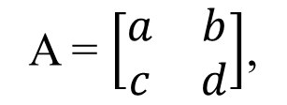
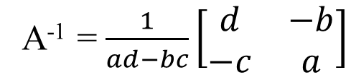
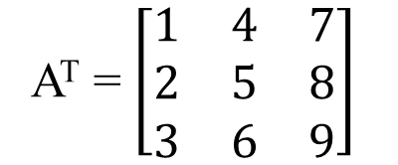
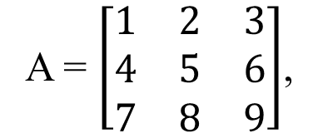
Transpose and Inverse
83
Transpose
Inverse
A = $\left[\begin{matrix}1 & 2 & 3 \\ 4 & 5 & 6 \\ 7 & 8 & 9\end{matrix}\right]$,
A^{T} = $\left[\begin{matrix}1 & 4 & 7 \\ 2 & 5 & 8 \\ 3 & 6 & 9\end{matrix}\right]$
A = $\left[\begin{matrix}a & b \\ c & d\end{matrix}\right]$,
A⁻¹ = $\frac{1}{ad−bc}\left[\begin{matrix}d & −b \\ −c & a\end{matrix}\right]$
>>> A = np.array([ [1,2,3], [4,5,6], [7,8,9] ])
>>> AT = A.T
>>> print(AT)
>>> A = np.array([ [1,2], [3,4] ])
>>> Ainv = np.linalg.inv(A)
>>> print(Ainv)
# => [ [1 4 7] [2 5 8] [3 6 9] ]
# => [ [-2. 1. ] [ 1.5 -0.5] ]

Slide 23
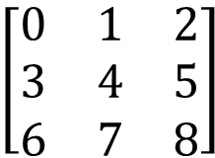

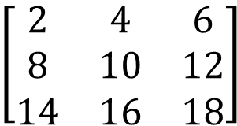
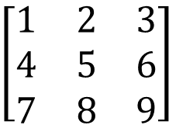
Matrix-Scalar Operations
84
$$\left[\begin{matrix}0 & 1 & 2 \\ 3 & 4 & 5 \\ 6 & 7 & 8\end{matrix}\right]$$
>>> a = np.arange(9).reshape(3,3) # => [ [0 1 2] [3 4 5] [6 7 8] ]
$$\left[\begin{matrix}1 & 2 & 3 \\ 4 & 5 & 6 \\ 7 & 8 & 9\end{matrix}\right]$$
>>> b = a + 1 # => [ [1 2 3] [4 5 6] [7 8 9] ]
$$\left[\begin{matrix}2 & 4 & 6 \\ 8 & 10 & 12 \\ 14 & 16 & 18\end{matrix}\right]$$
>>> c = a * 2 # => [ [ 0 2 4] [ 6 8 10] [12 14 16] ]
$$\left[\begin{matrix}0 & 1 & 4 \\ 9 & 16 & 25 \\ 36 & 49 & 64\end{matrix}\right]$$
>>> d = a ** 2 # => [ [ 0 1 4] [ 9 16 25] [36 49 64] ]

Slide 24
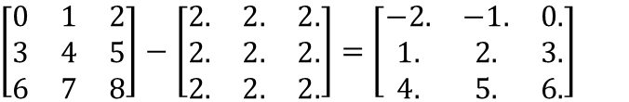
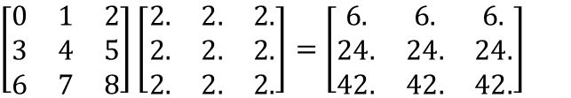
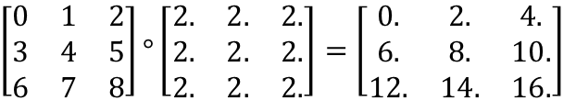
Matrix-Matrix Operations
85
>>> a = np.arange(9).reshape(3,3) # => [ [0 1 2] [3 4 5] [6 7 8] ]
>>> b = np.ones(9).reshape(3,3)+1 # => [ [2. 2. 2.] [2. 2. 2.] [2. 2. 2.] ]
>>> a - b # => [ [-2. -1. 0.] [ 1. 2. 3.] [ 4. 5. 6.] ]
$\left[\begin{matrix}0 & 1 & 2 \\ 3 & 4 & 5 \\ 6 & 7 & 8\end{matrix}\right]−\left[\begin{matrix}2. & 2. & 2. \\ 2. & 2. & 2. \\ 2. & 2. & 2.\end{matrix}\right]=$ $\left[\begin{matrix}−2. & −1. & 0. \\ 1. & 2. & 3. \\ 4. & 5. & 6.\end{matrix}\right]$
Elementwise product
>>> a * b # => [ [ 0. 2. 4.] [ 6. 8. 10.] [12. 14. 16.] ]
$\left[\begin{matrix}0 & 1 & 2 \\ 3 & 4 & 5 \\ 6 & 7 & 8\end{matrix}\right]°\left[\begin{matrix}2. & 2. & 2. \\ 2. & 2. & 2. \\ 2. & 2. & 2.\end{matrix}\right]=$ $\left[\begin{matrix}0. & 2. & 4. \\ 6. & 8. & 10. \\ 12. & 14. & 16.\end{matrix}\right]$
Matrix product
>>> a @ b # => [ [ 6. 6. 6.] [24. 24. 24.] [42. 42. 42.] ]
(a.dot(b))
$\left[\begin{matrix}0 & 1 & 2 \\ 3 & 4 & 5 \\ 6 & 7 & 8\end{matrix}\right]\left[\begin{matrix}2. & 2. & 2. \\ 2. & 2. & 2. \\ 2. & 2. & 2.\end{matrix}\right]=$ $\left[\begin{matrix}6. & 6. & 6. \\ 24. & 24. & 24. \\ 42. & 42. & 42.\end{matrix}\right]$

Slide 25




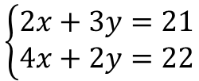

Example
86
$$\left\{\begin{aligned}2x+3y=21 \\ 4x+2y=22\end{aligned}\right.$$
AX = B
A⁻¹AX = A⁻¹B
X = A⁻¹B
A = $\left[\begin{matrix}2 & 3 \\ 4 & 2\end{matrix}\right]$,
X = $\left[\begin{matrix}x \\ y\end{matrix}\right]$,
B = $\left[\begin{matrix}21 \\ 22\end{matrix}\right]$
A = $\left[\begin{matrix}a & b \\ c & d\end{matrix}\right]$,
A⁻¹ = $\frac{1}{ad−bc}\left[\begin{matrix}d & −b \\ −c & a\end{matrix}\right]$
>>> import numpy as np
>>> A = np.array([ [2,3], [4,2] ])
>>> B = np.array([21,22]).reshape(2,1)
>>> a = A[0,0]
>>> b = A[0,1]
>>> c = A[1,0]
>>> d = A[1,1]
>>> invA = [ [d,-b], [-c,d] ] / (a*d-b*c)
>>> X = invA @ B
>>> print(X) # => [ [3.] [5.] ]
>>> import numpy as np
>>> A = np.array([ [2,3], [4,2] ])
>>> B = np.array([ [21,22] ]).T
>>> X = np.linalg.inv(A) @ B
>>> print(X) # => [ [3.] [5.] ]

Slide 26

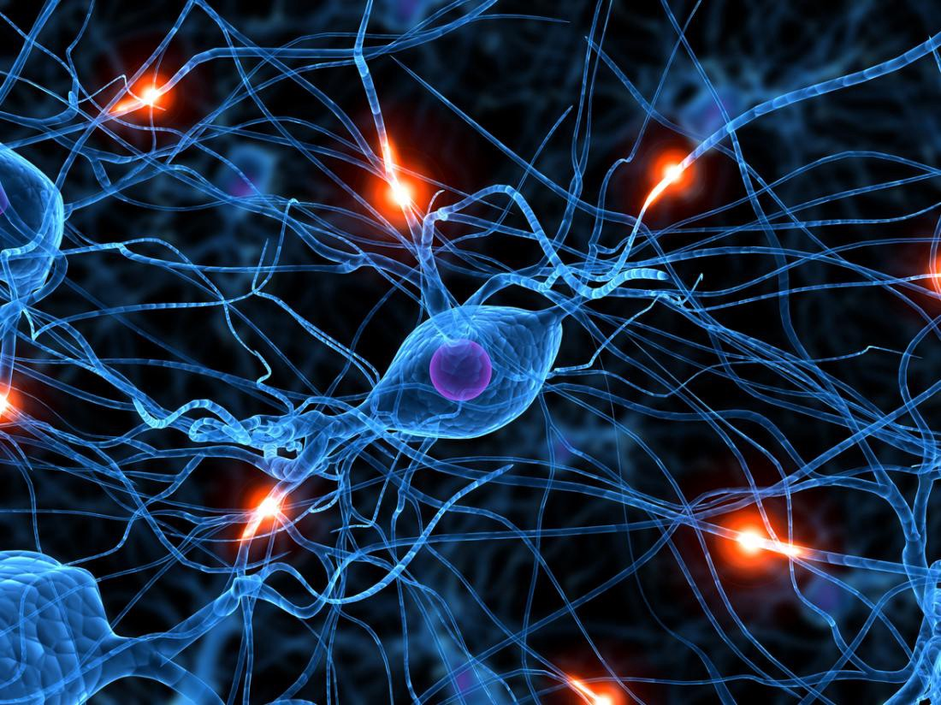
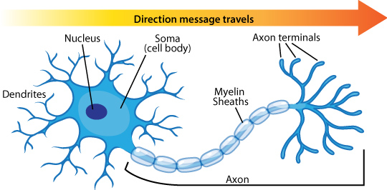


Practice
87
Input
Output
x
f(x)=喬傑立形狀
5566
ax+b
183
a = -0.22763
b = 1450
Notes:
Ref. 1: https://technologynewstracking.blogspot.com/2019/05/scientists-have-managed-to-turn-brain.html
Ref. 2: https://medium.com/predict/artificial-neural-networks-mapping-the-human-brain-2e0bd4a93160
Ref. 3: https://vivadifferences.com/structural-and-functional-difference-between-sensory-and-motor-neuron/

Slide 27
Practice
88
Input layer
Hidden layer
Output layer
B_{j1}
B_{j1}
T×W_{i1j1}+B_{j1}
j₁
W_{j1k1}
W_{i1j1}
T = 298 K
W_{i1j1}
W_{i1j2}
B_{j2}
i₁
T×W_{i1j2}+B_{j2}
i₁
W_{i1j2}
Water Density?
T = 298 K
W_{i1j3}
B_{j2}
B_{k1}
W_{i1j3}
j₂
W_{j2k1}
k₁
B_{j3}
T×W_{i1j3}+B_{j3}
W_{i2j1}
P = 1 atm
i₂
i₁
W_{i1j1}
W_{i2j2}
T = 298 K
W_{i2j3}
B_{j1}
j₁
B_{j3}
B_{j1}
j₃
W_{j3k1}
D = 1 g/cm₃
i₂
j₁ = T×W_{i1j1}+B_{j1}+ D×W_{i2j1}+B_{j1}
W_{i2j1}

Slide 28


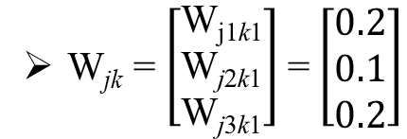


Practice
89
Input layer
Hidden layer
Output layer
B_{j1}
j₁
W_{j1k1}
Input = $\left[\begin{matrix}T & D\end{matrix}\right] \text{= }\left[\begin{matrix}298 & 1\end{matrix}\right]$
T = 298 K
W_{i1j1}
i₁
W_{i1j2}
W_{ij} = $\left[\begin{matrix}\text{W}\text{i}\text{1}\text{j}\text{1} & \text{W}\text{i}\text{1}\text{j}\text{2} & \text{W}\text{i}\text{1}\text{j}\text{3} \\ \text{W}\text{i}\text{2}\text{j}\text{1} & \text{W}\text{i}\text{2}\text{j}\text{2} & \text{W}\text{i}\text{2}\text{j}\text{3}\end{matrix}\right]$ = $\left[\begin{matrix}0.1 & 0.2 & 0.3 \\ 0.3 & 0.2 & 0.1\end{matrix}\right]$
W_{i1j3}
B_{j2}
W_{j2k1}
B_{k1}
j₂
k₁
P = 1 atm
W_{i2j1}
B_{j} = $\left[\begin{matrix}\text{B}\text{j}\text{1} & \text{B}\text{j}\text{2} & \text{B}\text{j}\text{3}\end{matrix}\right] \text{= }\left[\begin{matrix}0.1 & 0.2 & 0.3\end{matrix}\right]$
Water Density?
i₂
W_{i2j2}
W_{jk} = $\left[\begin{matrix}\text{W}\text{j}\text{1}\text{k}\text{1} \\ \text{W}\text{j}\text{2}\text{k}\text{1} \\ \text{W}\text{j}\text{3}\text{k}\text{1}\end{matrix}\right]$= $\left[\begin{matrix}0.2 \\ 0.1 \\ 0.2\end{matrix}\right]$
W_{i2j3}
B_{j3}
B_{k} = $\left[\begin{matrix}\text{B}\text{k}\text{1} & \text{B}\text{k}\text{2} & \text{B}\text{k}\text{3}\end{matrix}\right] \text{= }\left[\begin{matrix}0.3 & 0.2 & 0.1\end{matrix}\right]$
j₃
W_{j3k1}

Slide 29
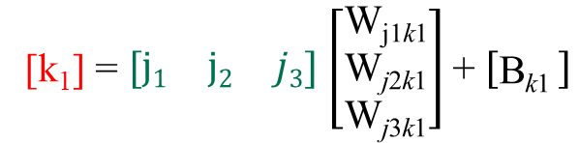
Practice
90
Input layer
Hidden layer
Output layer
B_{j1}
j₁
W_{j1k1}
Hidden = Input × W_{ij} + B_{j}
T = 298 K
W_{i1j1}
$$\left[\begin{matrix}j1 & j2 & j3\end{matrix}\right]=\left[\begin{matrix}T & P\end{matrix}\right]\left[\begin{matrix}\text{W}\text{i}\text{1}\text{j}\text{1} & \text{W}\text{i}\text{1}\text{j}\text{2} & \text{W}\text{i}\text{1}\text{j}\text{3} \\ \text{W}\text{i}\text{2}\text{j}\text{1} & \text{W}\text{i}\text{2}\text{j}\text{2} & \text{W}\text{i}\text{2}\text{j}\text{3}\end{matrix}\right]+\left[\begin{matrix}\text{B}\text{j}\text{1} & \text{B}\text{j}\text{2} & \text{B}\text{j}\text{3}\end{matrix}\right]$$
i₁
W_{i1j2}
W_{i1j3}
B_{j2}
W_{j2k1}
B_{k1}
j₂
k₁
P = 1 atm
W_{i2j1}
Water Density?
i₂
W_{i2j2}
W_{i2j3}
Output = Hidden × W_{jk} + B_{k}
B_{j3}
[k₁] = $\left[\begin{matrix}j1 & j2 & j3\end{matrix}\right]$ $\left[\begin{matrix}\text{W}\text{j}\text{1}\text{k}\text{1} \\ \text{W}\text{j}\text{2}\text{k}\text{1} \\ \text{W}\text{j}\text{3}\text{k}\text{1}\end{matrix}\right]$ + $\left[\begin{matrix}\text{B}\text{k}\text{1} \end{matrix}\right]$
j₃
W_{j3k1}

Slide 30
Random
91
Data
Training data
random sampling
Test
data

Slide 31
Integer-valued Random
92
>>> import random
import random
random.randint(a, b)
Return a random integer N ( a <= N <= b)
>>> random.randint(0, 1) # => 0 or 1
random.randrange(stop) # => [0, stop)
random.randrange(start, stop[, step])
>>> random.randrange(2) ) # => 0 or 1
>>> random.randrange(2, 6, 2) ) # => 2 or 4

Slide 32
Real-valued Random
93
random.random()
Return a random float N ( 0.0 <= N < 1.0)
>>> random.random() # => 0.0 <= N < 1.0
random.uniform(a, b)
a <= N <= b for a <= b or b <= N <= a for b < a
>>> random.uniform(1, 2) # => 1.0 <= N < 2.0

Slide 33
Functions for Sequences
94
random.choice(seq)
Sampling with replacement
random.choices(population, k=1)
>>> sample = ['1', '2', '3', '4', '5']
>>> random.choice(sample) # => '2'
>>> random.choices(sample, k=3) # => ['4', '4', '1']
random.sample(population, k)
Sampling without replacement
>>> sample = ['1', '2', '3', '4', '5']
>>> random.sample(sample, k=3) # => ['3', '1', '2']

Slide 34
Functions for Numpy
95
>>> import numpy as np
import numpy
np.random.randint(low, high=None, size=None)
Return random integers from low (inclusive) to high (exclusive)
>>> np.random.randint(5, size=3) # => [0 3 3]
>>> np.random.randint(3, 5, size=3) # => [4 3 4]
>>> np.random.randint(5, size=(2, 4)) # => [ [3 0 2 3] [4 2 3 1] ]
np.random.rand(d0, d1, ..., dn)
Return random floats in a given shape
>>> np.random.rand() # => 0.21723828389853272
>>> np.random.rand(2, 1) # => [ [0.82177856] [0.48189158] ]

Slide 35
Functions for Numpy
96
>>> import numpy as np
import numpy
np.random.shuffle(x)
>>> a = np.arange(10)
>>> np.random.shuffle(a)
>>> print(a) # => [1 7 5 2 9 4 3 6 0 8]
>>> a = np.arange(9).reshape((3, 3))
>>> np.random.shuffle(a)
>>> print(a) # => [ [3 4 5] [6 7 8] [0 1 2] ]

Slide 36
Practice
97
Input layer
Hidden layer
Hidden = Input × W_{ij} + B_{j}
B_{j1}
j₁
$$\left[\begin{matrix}j1 & j2 & j3\end{matrix}\right]=\left[\begin{matrix}T & P\end{matrix}\right]\left[\begin{matrix}\text{W}\text{i}\text{1}\text{j}\text{1} & \text{W}\text{i}\text{1}\text{j}\text{2} & \text{W}\text{i}\text{1}\text{j}\text{3} \\ \text{W}\text{i}\text{2}\text{j}\text{1} & \text{W}\text{i}\text{2}\text{j}\text{2} & \text{W}\text{i}\text{2}\text{j}\text{3}\end{matrix}\right]+\left[\begin{matrix}\text{B}\text{j}\text{1} & \text{B}\text{j}\text{2} & \text{B}\text{j}\text{3}\end{matrix}\right]$$
T = 298 K
W_{i1j1}
i₁
W_{i1j2}
Random=[0,1)
Random=[-2,3)
W_{i1j3}
B_{j2}
j₂
>>> input = [298, 1]
>>> Input = np.array(input)
>>> W = np.random.rand(2, 3)
>>> #[-2,3) => a=-2, b=3 (b>a)
>>> #(b - a) * random_sample() + a
>>> a = -2
>>> b = 3
>>> B = (b-a)*np.random.rand(1, 3)+a
>>> Hidden = (Input @ W)+B
P = 1 atm
W_{i2j1}
i₂
W_{i2j2}
W_{i2j3}
B_{j3}
j₃

Slide 37
Practice
98
Randomly splitting data into training and test sets (3:2)
Batch_size | Temperature (x₁) | Pressure (x₂) | Density (y)
1 | 273 | 1 | 0.9999
2 | 277 | 1 | 1
3 | 283 | 1 | 0.99975
4 | 294 | 1 | 0.99802
5 | 333 | 1 | 0.98338
>>> data = np.array([ [273, 1, 0.9999], [277, 1, 1], [283, 1, 0.99975], [294, 1, 0.99802], [333, 1, 0.98338] ])
>>> np.random.shuffle(data)
>>> x_train = data[:3, :2]
>>> x_test = data[3:, :2]
>>> y_train = data[:3, 2]
>>> y_test = data[3:, 2]
>>> x_train
>>> x_test
>>> y_train
>>> y_test
# => [[283. 1.]
[294. 1.]
[277. 1.]]
# => [[333. 1.]
[273. 1.]]
# => [0.99975 0.99802 1. ]
# => [0.98338 0.9999 ]

Slide 38
More Control Flow Tools
99
>>> print('NTHUCHE')
>>> print('NTHUCHE')
.
.
.
1 million
times
or
>>> print('NTUCHE')
True or False
1000th
>>> print('NTHUCHE')
True or False

Slide 39
Python Comparison Operators
100
Comparison Operators | Meaning | Example
> | It returns True, if left operand is greater than the right | a > b
< | It returns True, if left operand is less than the right | a < b
== | It returns True, if both operands are equal | a == b
!= | It returns True, if operands are not equal | a != b
>= | It returns True, if left operand is greater than or equal to the right | a >= b
<= | It returns True, if left operand is less than or equal to the right | a <= b

Slide 40
Python Comparison Operators
101
>>> print(2 > 1) # => True
>>> print(2 < 1) # => False
>>> print(1 == 1) # => True
>>> print(9.2 == 1450) # => False
>>> print(9.2 != 1450) # => True
>>> print(2 >= 1) # => True

Slide 41
Python Logical Operators
102
Logical Operators | Meaning | Example
and | It returns True, if both the operands are true | a and b
or | It returns True, if either of the operands is true | a or b
not | It returns True, if operand is false (complements the operand) | not a

Slide 42


Python Logical Operators
103
>>> a = 9.2
>>> b = 1450
>>> print(a < b and a != b)
>>> a = 9.2
>>> b = 1450
>>> print(a > b or a != b)
>>> a = 0
>>> print(not a)
>>> a = 1
>>> print(not a)

Slide 43
Python Membership Operators
104
Assignment Operators | Meaning | Example
in | It returns True, if a variable/value found in the sequence. | 8 in [9, 8, 7]
not in | It returns True, if a variable/value does not found in the sequence. | 10 not in [9, 8, 7]
>>> a = 10
>>> b = 20
>>> list = [1, 2, 3, 4, 5 ]
>>> print(a in list) # => True
>>> print(b not in list) # => True

Slide 44
Python Operator Precedence
105
Assignment Operators | Meaning
** | exponent
*, /, % | multiplication, division, modulo
+, - | addition, subtraction
<, <=, >=, > | comparison operators
==, !=, is, is not, in, | comparison operators
not in | comparison operators
not | boolean NOT
and | boolean AND
or | boolean OR

Slide 45
More Control Flow Tools
106
grade = ?
grade >=60
grade <60
print('pass')
print('fail')

Slide 46
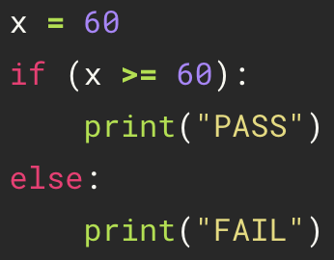
if-else
107
if condition:
indented statement block for when condition is True
else:
indented statement block for when condition is False
x=60
False
space
if x>=60
else
True
indent
'PASS'
'FAIL'

Slide 47
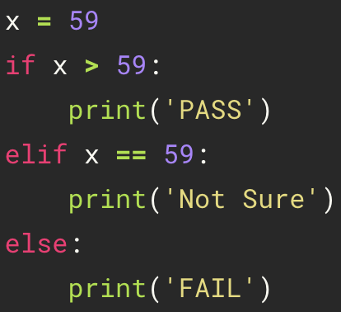
if-elif-else
108
if condition1:
indented statement block for condition1
elif condition2:
indented statement block for condition2
else:
indented statement block if all condition check above fails
x=59
False
False
if x > 59:
elif x == 59:
else
True
True
'PASS'
'Not Sure'
'FAIL'

Slide 48
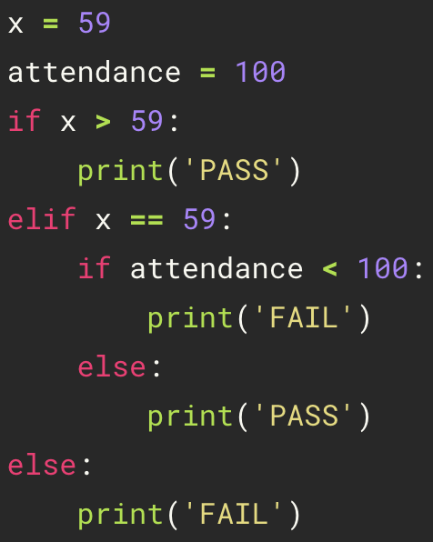
Nested if-elif-else
109
x=59
attendance=100
False
False
if x > 59:
elif x == 59:
else
True
True
False
'PASS'
elif x < 100:
else
True
'FAIL'
'PASS'

Slide 49
Practice
110
>>> 1 == 1 # => True
>>> 2 == 1 # => False
>>> 1 != 1 # => False
>>> 2 != 1 # => True
>>> 1 < 10 # => True
>>> 1 > 10 # => False
>>> 2 <= 2 # => True
>>> 2 >= 2 # => True
>>> 1 < 2 < 3 # => True
>>> 2 < 3 < 2 # => False
>>> not True # => False
>>> not False # => True
>>> True and False # => False
>>> False or True # => True
>>> 0 and 2 # => 0
>>> -5 or 0 # => -5
>>> 0 == False # => True
>>> 2 == True # => False
>>> 1 == True # => True
>>> -5 != False != True #=> True

Slide 50
Practice
111
>>> score = 101
>>> if score > 100:
>>> print('imposible')
>>> elif score >= 90 and score <= 100:
>>> print('A+')
>>> elif score >= 80 and score < 90:
>>> print('B+')
>>> elif score >= 70 and score < 80:
>>> print('B')
>>> else:
>>> print('C')
>>> num = 0
>>> if num >= 0:
>>> if num == 0:
>>> print("Zero")
>>> else:
>>> print("Positive")
>>> else:
>>> print("Negative")

Slide 51

For Loop
112
$$∗$$
>>> print('NTHUCHE')
10000000 times

Slide 52
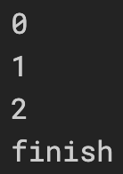
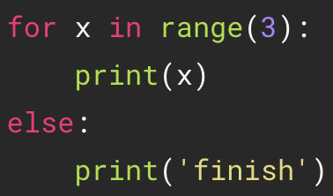
for
113
for variable in sequence:
indented statement1
else:
indented statement2
range(3)
0
1
2
x
x
x
Print in order
space
print(x)
print(x)
print(x)
indent
print('finish')

Slide 53
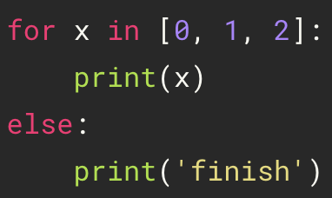
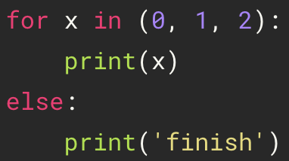
for
114
range(3); list(3); tuple(3)
range
0
1
2
x
x
x
list
print(x)
print(x)
print(x)
tuple
print('finish')

Slide 54
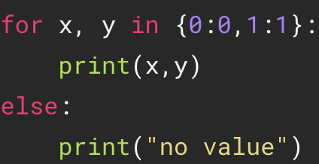
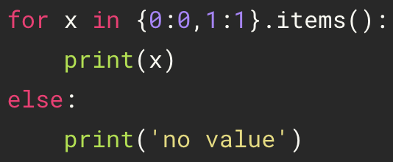
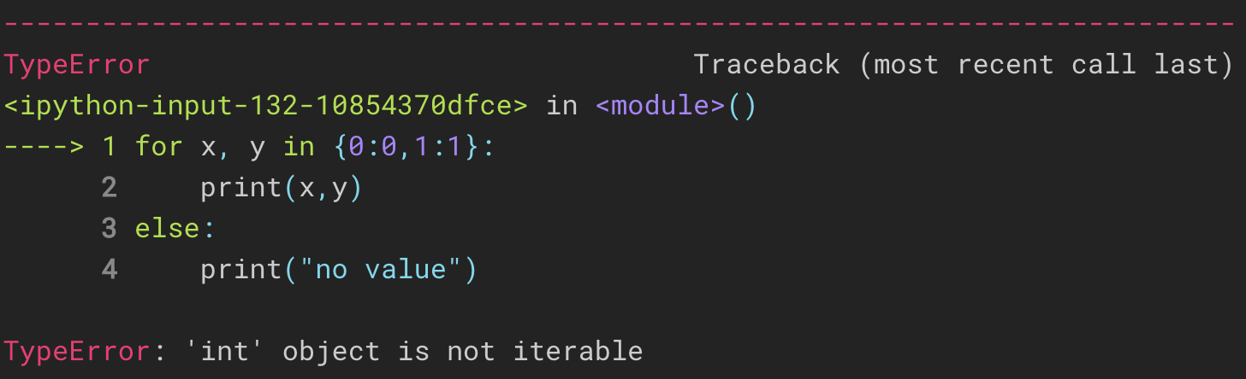
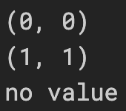
for
115
for variable in mapping:
indented statement1
else:
indented statement2
.items() returns a list of dict's (key, value)
tuple pairs =>[(0, 0), (1, 1)]
Not sequence type
incorrect
correct

Slide 55
for
116
{0:0, 1:1}
for variable in mapping.items():
indented statement1
else:
indented statement2
0:0
1:1
(0,0)
(1,1)
x
space
x
Print in order
print(x)
indent
print(x)
print('finish')

Slide 56
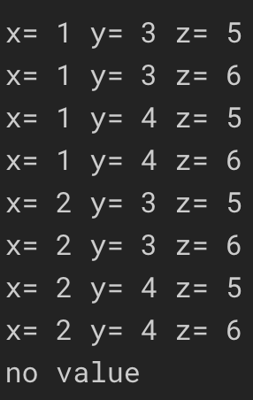
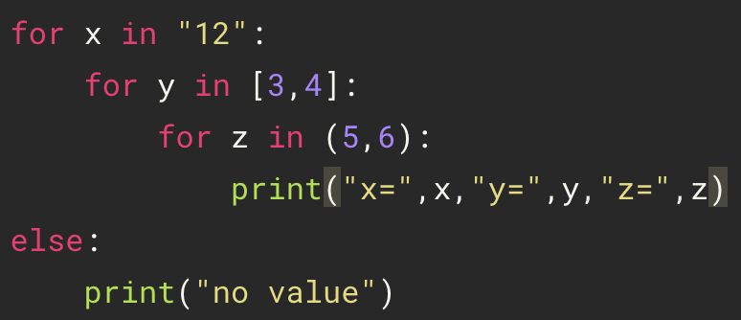
Nested For Loop
117
nest for
Print in order
x[0]y[0]z[0]
x[0]y[0]z[1]
x[0]y[1]z[0]
x[0]y[1]z[1]
x[1]y[0]z[0]
x[1]y[0]z[1]
x[1]y[1]z[0]
x[1]y[1]z[1]
else

Slide 57

Break
118
>>> for x in range(4):
>>> if x < 2:
>>> print(x)
>>> else:
>>> print("no value")
>>> break
range(4)
0
1
2
3
x
x
x
if x < 2
if x < 2
if x < 2
True
True
False
print(x)
print(x)
print('no value')
break

Slide 58

Continue
119
>>> for x in range(4):
>>> if x < 2:
>>> print(x)
>>> continue
>>> print("no value")
range(4)
0
1
2
3
x
x
x
x
if x < 2
if x < 2
if x < 2
if x < 2
True
True
False
False
print(x)
print(x)
print('no value')
continue
continue

Slide 59
While Loop
120
while condition:
statement1
else:
statement2
>>> n = 2
>>> while n > 0:
>>> n -= 1
>>> print(n)
>>> else:
>>> print('Loop done.')
n = 2
False
while n > 0
else
True
n -= 1
print(n)
# => n = 1
False
while n > 0
else
True
n -= 1
print(n)
# => n = 0
False
while n > 0
else
True
print('Loop done.')

Slide 60
Infinite Loops
121
while True:
statement1
if (condition):
statement2
break
>>> n = 1
>>> while True :
>>> n -= 1
>>> print(n)
>>> if n < 0:
>>> break
n = 1
while True
False
True
n -= 1
print(n)
# => n = 0
if n < 0
True
False
while True
False
True
n -= 1
print(n)
# => n = -1
True
if n < 0
break
False

Slide 61

Nested While Loops
122
while condition 1:
indented statement1
while condition 2:
indented statement2
>>> a = [1, 2]
>>> while len(a):
>>> print('outer:', a.pop(0))
>>> b = [3, 4]
>>> while len(b):
>>> print('inner:', b.pop(0))

Slide 62
Practice
123
>>> animals = ['cat', 'dog', 'monkey']
>>> for animal in animals:
>>> print(animal)
>>> for i in "Hey Jude":
>>> if i == "u":
>>> break
>>> print(i)
>>> sequences = [0, 1, 2, 3, 4, 5]
>>> i = 0
>>> while 1:
>>> print(sequences[i], end = " ")
>>> i = i + 1
>>> if i == len(sequences):
>>> print("No elements left.")
>>> break
>>> for i in "Hey Jude":
>>> if i == "u":
>>> continue
>>> print(i)

