Slide 1
Prepared by: Andrew Kimutai Kiptoo C027-01-1062/2022
Date: 27th January 2026
Dedan Kimathi University of Technology (DeKUT)
Skin Care Connect: Integrated Skin Disease Detection and Dermatologist Booking Platform

Slide 2
Problem Statement
Skin diseases represent a significant global health burden, affecting approximately 2 billion people worldwide at any given time. In many regions, particularly rural and underserved communities, access to dermatological expertise is severely limited. The World Health Organization reports that there is approximately one dermatologist per 2 million people in some African countries, creating a critical gap in skin disease diagnosis and treatment.
The current diagnostic process for skin conditions relies heavily on visual inspection by trained specialists. This approach presents several challenges:
Geographic barriers: Patients in remote areas often travel long distances to reach specialists.
Time delays: Long waiting periods for appointments can lead to disease progression.
Subjectivity: Diagnosis can vary between practitioners due to experience levels.
Cost factors: Specialist consultations are often expensive for average patients.

Slide 3
Objectives
Primary Objectives:
Design and implement a custom CNN model for 7-class skin disease classification (HAM10000) that achieves a minimum accuracy of 80% on a validation dataset.
Develop a user-friendly Streamlit-based web application that allows users to upload skin images for preliminary assessment and book appointments with verified dermatologists using Streamlit's interactive widgets and layout features.
Implement an image validation system that uses HSV color space analysis to verify that uploaded images contain sufficient skin content (minimum 10%), rejecting non-skin images before classification within the Streamlit flow.
Integrate the assessment and booking workflows in Streamlit, allowing users to easily schedule a consultation based on their AI-generated results using session state management.
Deploy the complete integrated Streamlit application with documentation and user manual by the end of the project timeline (15 weeks), ensuring it can run efficiently using Streamlit's sharing capabilities or a standard server setup.

Slide 4
Methodology
• Agile development approach with iterative cycles and stakeholder feedback.
Machine Learning Approach:
Model Type: CNN for image classification.
Architecture: Transfer learning using a pre-trained model (e.g., ResNet50) as the base.
Task: Multi-class classification (7 classes from HAM10000).
Training: Supervised learning using the HAM10000 dataset.
Validation: Split data into training, validation, and test sets; use cross-validation techniques.
Data Handling: Uses the HAM10000 dataset (HAM10000_metadata.csv and image files) organized into class-specific folders for training and evaluation. Data augmentation techniques are applied during training
Technology Stack: Python, TensorFlow/Keras for ML, OpenCV/PIL for image processing, Streamlit for the web interface.

Slide 5
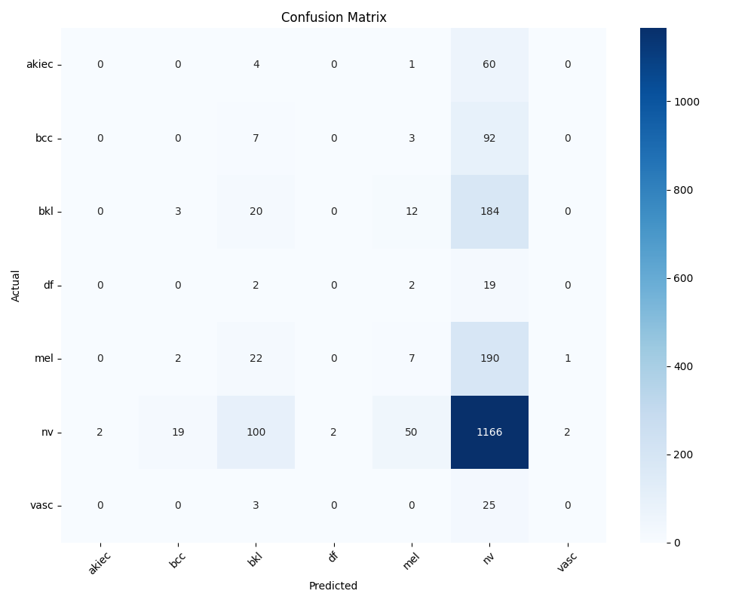
Confusion matrix

Slide 6
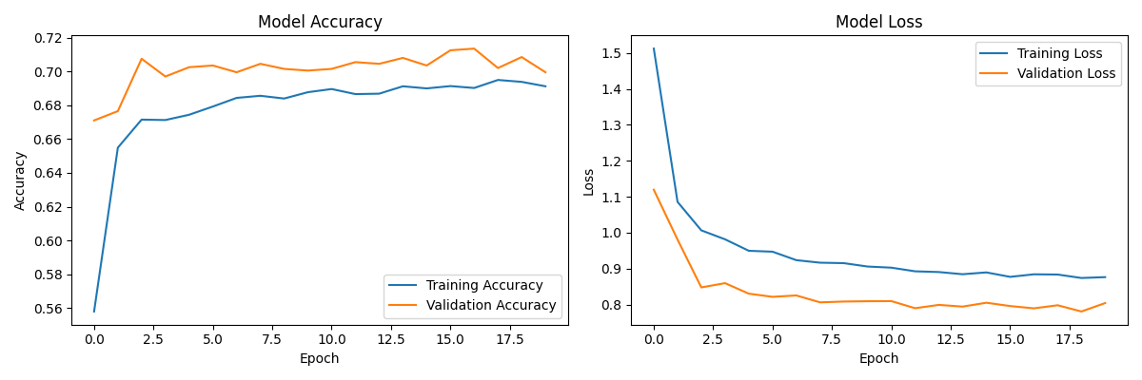
Model

