Slide 1



Android
Taking over your mobile market
Andrew Ribeiro
December 10, 2009
CS 450

Slide 2
Outline
What is android ?
History of android
Overview of the Android operating system
Android Runtime
Linux Kernel

Slide 3

What is android
Android is a mobile operating system that was created to be open, robust, and reliable.
Design goals
Robustness : since the android OS is a smart phone, it must rival the functionality of general computers.
Reliability: as a real-time operating system, the operating system must perform under rough conditions.
Open: the platform is open in order to stimulate further development for the platform.

Slide 4

History
Developed by Android Inc.
Bought out by Google in 2005
Google teamed up with the Open Handset Alliance to develop the OS.
Release history
The first version: November 5, 2007.
The second version (cupcake): April 30, 2009
The third version(donut): September 15, 2009
The fourth version(éclair): October 26, 2009

Slide 5
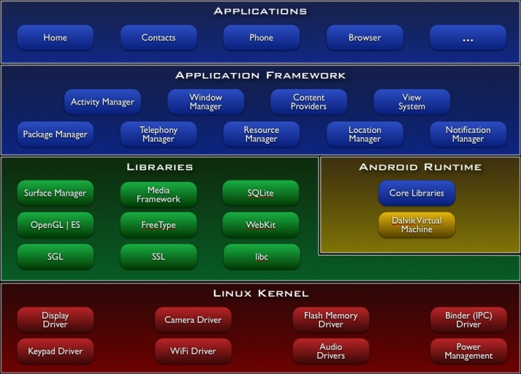
Android overview
Notes:
Android uses a custom distribution of the 2.6 Linux kernel.
The Dalvik virtual machine(JVM substitute) is responsible for running all of the applications.
Applications are written in a non-standard version of Java.

Slide 6
ANDROID RUNTIME

Slide 7
Android Runtime?
Android includes a set of core libraries that provides most of the functionality available in the core libraries of the Java programming language.
Every Android application runs in its own process, with its own instance of the Dalvik virtual machine.

Slide 8
Android processes
An android process can be thought of as an system processes with an instance of a Dalvik virtual machine.
An idol android process is a system process with the state of the application, but is not actively running a Dalvik virtual machine.

Slide 9
Android applications
Activities: An activity presents a visual user interface for one focused endeavor the user can undertake.
Services: A service doesn't have a visual user interface, but rather runs in the background for an indefinite period of time.
Broadcast receivers: A broadcast receiver is a component that does nothing but receive and react to broadcast announcements.
Content providers: A content provider makes a specific set of the application's data available to other applications.
Notes:
From android.com
Content provider:. The data can be stored in the file system, in an SQLite database, or in any other manner that makes sense

Slide 10
Application life cycle Example
LOG
Application A State
Application A starts up
Application B starts up
Application C starts up
Application D starts up
Application E starts up
Switch back to application A
In foreground, VM running
InBackground, VM running
inBackground,VM running
inBackground, VM not running
inBackground, VM not running
In foreground
Start up VM
Restore application state

Slide 11
Dalvik Virtual Machine
Runs android applications which are compiled into Dalvik byte code
Note a just-in-time compiler.
Designed so many instances can be run on the same device.
The Dalvik VM relies on the Linux kernel for underlying functionality such as threading and low-level memory management.

Slide 12

Linux Kernel
2.6 Custom Distribution

Slide 13
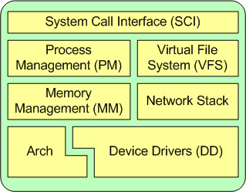
Linux Kernel Overview

Slide 14
System Call Interface (SCI)
The system call interface provides a way for applications in the user space to call kernel functionality
for example, if a user application needs to write a file to the disk, it must make a system call to do so, because the file management system falls within the domain of the kernel
In terms of the Android OS, a user application never directly makes a system call; the Dalvik virtual machine that is interpreting the application does instead, because Android applications are not natively run on the device.

Slide 15
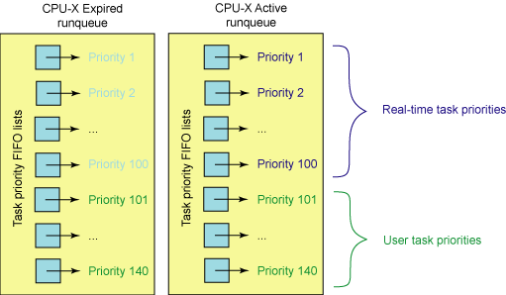
Process Management (PM)
Uses the O (1) scheduler
Symmetric Multiprocessing (SMP) : multiple processors can be connected to a single memory bank.
Notes:
O(1) does not mean it is extra fast, it just means that it will always take the same time to schedule threads
Does not reflect processing time.
Algorithm better supports SMP
Real-time task: OS task
Usertask: user task
Expired runque: time slice expired, priority and time slice recalculated when placed in the expired queue
Switches with active queue if given priority is empty
Active runque: gueue that is being processed.
Finishes the highest priority before starting lower priority
FIFO

Slide 16
Virtual File System (VFS)
Linux provides a common interface for file I/O via a Virtual File System.
VFS API: Linux exposes file system operations through the VFS API, which contains commands like close, read, and write
device drivers: The device drivers are hardware dependant for the physical devices.
physical devices: The physical devices are the actual disks that store information.

Slide 17
Memory Management (MM)
Virtual memory scheme called slab allocation
“This memory management scheme uses 4KB buffers as its base, but then allocates structures from within, keeping track of which pages are full, partially used, and empty. This allows the scheme to dynamically grow and shrink based on the needs of the greater system.” (Linux Kernel IBM Analysis).

Slide 18
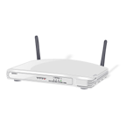
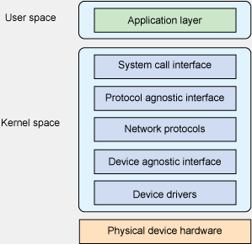
Network Stack (NS)
Consists of 7 levels
application layer
system call interface
protocol agnostic interface
network protocols
device agnostic interface
device drivers
physical device hardware
Notes:
The application layer is in the user space and consists of the applications that require network functionality.
The system call interface allows user space applications to make system calls to the networking platform.
The protocol agnostic interface is considered the sockets level, which provides access to various communication channels regardless of protocol, meaning all sockets have a standard structure; for example, the sockets layer can establish sockets with “TCP and UDP protocols, but also IP, raw Ethernet, and other transport protocols, such as Stream Control Transmission Protocol (SCTP)” (Linux Network Stack).
The network protocols layer establishes how the sockets are going to be used to exchange data over the network.
The device agnostic interface “provides a common set of functions to be used by lower-level network device drivers to allow them to operate with the higher-level protocol stack” (Linux Network Stack).
Device drivers contain specific code that enables the computer to establish I/O operations with the device. Finally, we have the physical device layer, which contains the actual networking hardware—i.e. a network interface card (NIC).

Slide 19
Arch
The Arch portion of the Linux kernel refers to code that links primary hardware like the processor to software. Arch differs from devices drivers, in that the device drivers can be added on to the system, but Arch code is platform specific.

Slide 20
Device Drivers (DD)
Device drivers allow the Linux kernel to interact with external devices. In the context of the Android OS, a common device driver to have is a camera, so applications written that utilize a camera can run on phones that have camera hardware and the respective device drivers. External device functionality is accessed via the SCI.

Slide 21
Protection And security
The Linux kernel provides the basic standard OS protection rules such as thread safety and memory access boundaries. The Android runtime also adds a layer of protection to the system because it only allows manage code to be run on the system rather than native code.
Authentication is handled by the android system.
Android is not multiuser, so there is no need for permissions tables.

Slide 22

Sources
Android Developer
http://developer.android.com/
Linux Kernel IBM Analysis
http://www.ibm.com/developerworks/linux/library/l-linux-kernel/
Open Handset Alliance
http://www.openhandsetalliance.com/press_110507.html
Symbian OS Open Source
http://www.symbian.org/symbian-feature-set/going-open-source
Android Basics
http://developer.android.com/guide/basics/what-is-android.html
Ad Mob
http://www.admob.com/
Linux Process Scheduler
http://www.ibm.com/developerworks/linux/library/l-scheduler/
Linux Network Stack
http://ldn.linuxfoundation.org/node/22518
Android Laptop
http://www.youtube.com/watch?v=SXq__YWVAew
Android Logo
http://www.topnews.in/arm-launches-solution-center-android-2237255
Dalvak Problem
http://android-developers.blogspot.com/2009/02/track-memory-allocations.html

