Slide 1
Danbury AI
Deep Learning Study Group
Notes on Section 3.9
Doug Cowles

Slide 2
Bernoulli Distribution
The simplest distribution, for yes-no questions: coin flips, Male/Female, etc.,
One happens with probability p, the other with 1-p. – described in book as 3.16 & 3.17 with letter phi.
3.18 P(X = x) refers to the probability that the random variable X is equal to a particular value, denoted by x. As an example, P(X = 1) refers to the probability that the random variable X is equal to 1.
3.19 is the Expected Value
3.20 is the Variance

Slide 3
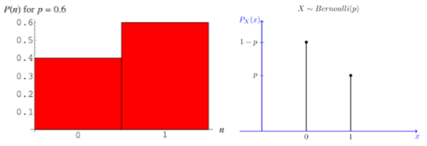
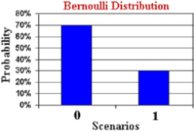
Examples of Bernoulli Distributions

Slide 4
Multinoulli Distribution
Essentially, a form of a binomial distribution where instead of 2 outcomes, there are K outcomes – like rolling a die.
The multinomial distribution is when there are multiple identical independent trials where each trial has k possible outcomes. The categorical (multinoulli) distribution is when there is only one such trial.
Best explained here: https://www.statlect.com/probability-distributions/multinomial-distribution
A Multinoulli Distribution is not the same thing as a multinomial distribution. Explained here: https://geekyisawesome.blogspot.com/2016/12/bernoulli-vs-binomial-vs-multinoulli-vs.html

Slide 5
Gaussian Distribution
Also known as “bell curve” or “Normal” distribution
The formula is interesting but few people worry about it 3.21
The normal distribution is important because of the Central limit theorem. In simple terms, if you have many independent variables that may be generated by all kinds of distributions, assuming that nothing too crazy happens, the aggregate of those variables will tend toward a normal distribution.
It’s sometimes stated that many things in nature just seem to be normally distributed but I hear that challenged more and more. In other words, test scores, heights, foot sizes, density of leaves under a tree. There appear to be slight variations on the normal distribution being brought up more frequently.

Slide 6
Gaussian Disribution part 2
Normal or Gaussian Distribution
68.2% within 1 Standard Deviation
Another 95.4% within 2 Standard Deviations
99.6% within 3 Standard Deviations
Often called the 68-95-99.7 rule.

Slide 7
Central Limit Theorem
The Central Limit Theorem (CLT for short) basically says that for non-normal data, the distribution of the sample means has an approximate normal distribution, no matter what the distribution of the original data looks like, as long as the sample size is large enough (usually at least 30) and all samples have the same size. And it doesn’t just apply to the sample mean; the CLT is also true for other sample statistics, such as the sample proportion. Because statisticians know so much about the normal distribution, these analyses are much easier.
Great explanation here - https://www.quora.com/What-is-the-importance-of-the-central-limit-theorem if you see the answer by Wisnu Subekti, K-12 math teacher

Slide 8
Exponential Distribution
Consider how long glass vases last before being broken. Glass vases do not age, so it is just as likely to break at 10 years old, as 80 years old. This is unlike a human, whose probability goes up at 80, compared to 10.
It is “memoryless” - it is the probability distribution that describes the time between events in a Poisson process, i.e. a process in which events occur continuously and independently at a constant average rate. (Examples of a Poisson process - # of pieces of mail that arrive at your mailbox.. Cars at a tollbooth – Assuming no obvious external factors like rush hour)
Great link here - https://www.statlect.com/probability-distributions/exponential-distribution

Slide 9
Laplace Distribution
Haven’t figured this out yet. Video here: https://www.youtube.com/watch?v=1wsig_TGrtg I haven’t gotten through it yet.

Slide 10
Dirac Delta Function
Explained very well here: https://www.khanacademy.org/math/differential-equations/laplace-transform/properties-of-laplace-transform/v/dirac-delta-function
It is a function that is zero at every point but one, and whose integral is 1. It is a “generalized function”
The book describing the function as that which is defined in terms of its properties when integrated seems a good definition.
The concepts of “empirical distribution” and “empirical frequency” are still unclear to me at this time.

Slide 11
Mixture Distributions
On the face of it, seems like obvious concept. Distributions that are a composite of other distributions.
Significant for finding “latent” variables.
Gaussian Mixture Models https://www.youtube.com/watch?v=Rkl30Fr2S38

