Slide 1


AUTONOMOUS VIDEO AD-PLACEMENT
AND CONTEXTUAL SAFETY ANALYZER
Initial Draft · BCA Specialization Project
Andrew Shelton S 2441609
Akash Ganesh 2441604
Andrew Judah 2441608
Ramona Elisha Mary 2441646
Under the guidance of Dr. Chanti, Assistant Professor
Department of Computer Science · School of Sciences
CHRIST (Deemed to be University), Bengaluru · August 2026
Notes:
Offline tool that audits video for advertiser-suitability risks and ad placement surfaces before publication. Everything runs locally.

Slide 2
INTRODUCTION
SYSTEM STUDY
DESIGN
IMPLEMENTATION
TESTING
CONCLUSION
AGENDA
01
Problem Statement
02
Objectives
why automated demonetization needs a pre-check
eight measurable goals
03
Existing vs Proposed
04
Requirements
what is wrong and what replaces it
functional, non-functional, hardware and software
05
Design and Models
06
Implementation
architecture, use case, DFD, activity, class, ER
stack, modules and individual contribution
07
Testing and Results
08
Working System
169 tests and what real video revealed
live demonstration, conclusion, future work
ADSAFE STUDIO
AY 2026-27
INITIAL DRAFT - SPECIALIZATION PROJECT
2 / 22

Slide 3
INTRODUCTION
SYSTEM STUDY
DESIGN
IMPLEMENTATION
TESTING
CONCLUSION
PROBLEM STATEMENT
What is the problem?
Who faces it?
Advertiser-suitability is decided automatically, after publication.
The verdict arrives with no explanation and no context.
Appeals resolve after the period of peak viewership has passed.
Independent creators who depend on advertising revenue.
Educational, journalistic and documentary channels, whose subject matter is assessed identically to gratuitous use.
Why does it matter?
A video earns most of its revenue in its first days — exactly the window an appeal cannot recover.
Creators have no way to predict the outcome before publishing: the alternatives are to publish and find out, to self-review manually, or to upload footage to a commercial third party.
None of those is available to an individual working on unreleased or confidential material.
ADSAFE STUDIO
AY 2026-27
INITIAL DRAFT - SPECIALIZATION PROJECT
3 / 22
Notes:
The core failure is not detection accuracy — it is that a detection is treated as a fact rather than as evidence needing context.

Slide 4
INTRODUCTION
SYSTEM STUDY
DESIGN
IMPLEMENTATION
TESTING
CONCLUSION
OBJECTIVES
1
Analyse video entirely on local hardware, with nothing sent to any external service.
2
Transcribe speech with word-level timestamps and match restricted terminology.
3
Detect visual risks — weapons, alcohol, tobacco — in sampled frames.
4
Identify continuous empty regions suitable for advertisement placement.
5
Distinguish content rendered inside a game from genuine filmed footage.
6
Produce a compliance verdict together with the reasoning that produced it.
7
Export findings as formatted PDF, CSV and JSON reports.
8
Present everything through a web interface with a navigable audit timeline.
ADSAFE STUDIO
AY 2026-27
INITIAL DRAFT - SPECIALIZATION PROJECT
4 / 22

Slide 5
INTRODUCTION
SYSTEM STUDY
DESIGN
IMPLEMENTATION
TESTING
CONCLUSION
EXISTING SYSTEM VS PROPOSED SYSTEM
 | Existing approaches | Proposed system
When the verdict arrives | after publication | before publication
Explanation given | none | reasoning on every verdict
Context considered | no | rendered vs filmed content
Where footage goes | uploaded to a third party | never leaves the machine
Recurring cost | subscription or lost revenue | none
Ad placement | located by hand in an editor | located automatically
Coverage | whole platform catalogue | one creator's own library
The trade is deliberate: narrower coverage, in exchange for advance warning, an explanation, and privacy.
ADSAFE STUDIO
AY 2026-27
INITIAL DRAFT - SPECIALIZATION PROJECT
5 / 22

Slide 6
INTRODUCTION
SYSTEM STUDY
DESIGN
IMPLEMENTATION
TESTING
CONCLUSION
SYSTEM REQUIREMENTS
Functional
Non-functional
FR1 Video ingestion — MP4, MOV, AVI, validated before upload.
FR2 Audio analysis — 16 kHz extraction, word-level transcription, dictionary matching.
FR3 Visual analysis — frame sampling, detection at two resolutions, risk categorisation.
FR4 Ad placement — occupancy and texture masks, largest free rectangles, ≥ 5 s persistence.
FR5 Overlay context — per-pixel temporal statistics across sampled frames.
FR6 Compliance verdict — Monetizable, Review or Restricted, with reasoning.
FR7 Report generation — PDF, CSV and JSON with an archive of what was produced.
Performance — analysis within roughly twice the video's duration, on a laptop with no GPU.
Reliability — a failed video does not affect others; re-analysis is idempotent.
Privacy — no content transmitted anywhere; all models held locally.
Usability — four breakpoints, light and dark, every finding navigable to its timestamp.
Integrity — constraints enforced in the database, not only in application code.
Accountability — every finding records the engine that produced it.
ADSAFE STUDIO
AY 2026-27
INITIAL DRAFT - SPECIALIZATION PROJECT
6 / 22

Slide 7
INTRODUCTION
SYSTEM STUDY
DESIGN
IMPLEMENTATION
TESTING
CONCLUSION
HARDWARE AND SOFTWARE REQUIREMENTS
Hardware
Software
Component | Requirement
Processor | Intel Core i5 or equivalent
Memory | 8 GB RAM minimum
Storage | 5 GB for models and analysis data
Graphics | not required — used if present
Display | 1280 x 720 minimum
Component | Version
Operating system | Windows 10+, Linux, macOS
Language runtime | Python 3.12
Database | SQLite 3
Node runtime | Node.js 22 (interface build)
Browser | any with HTML5 video
Verified, not assumed
The whole pipeline has been run on an Intel i5-1235U with no CUDA device. Analysis takes roughly the video's own duration: 45 s for a 25 s clip, including transcription and detection at two resolutions.
ADSAFE STUDIO
AY 2026-27
INITIAL DRAFT - SPECIALIZATION PROJECT
7 / 22

Slide 8
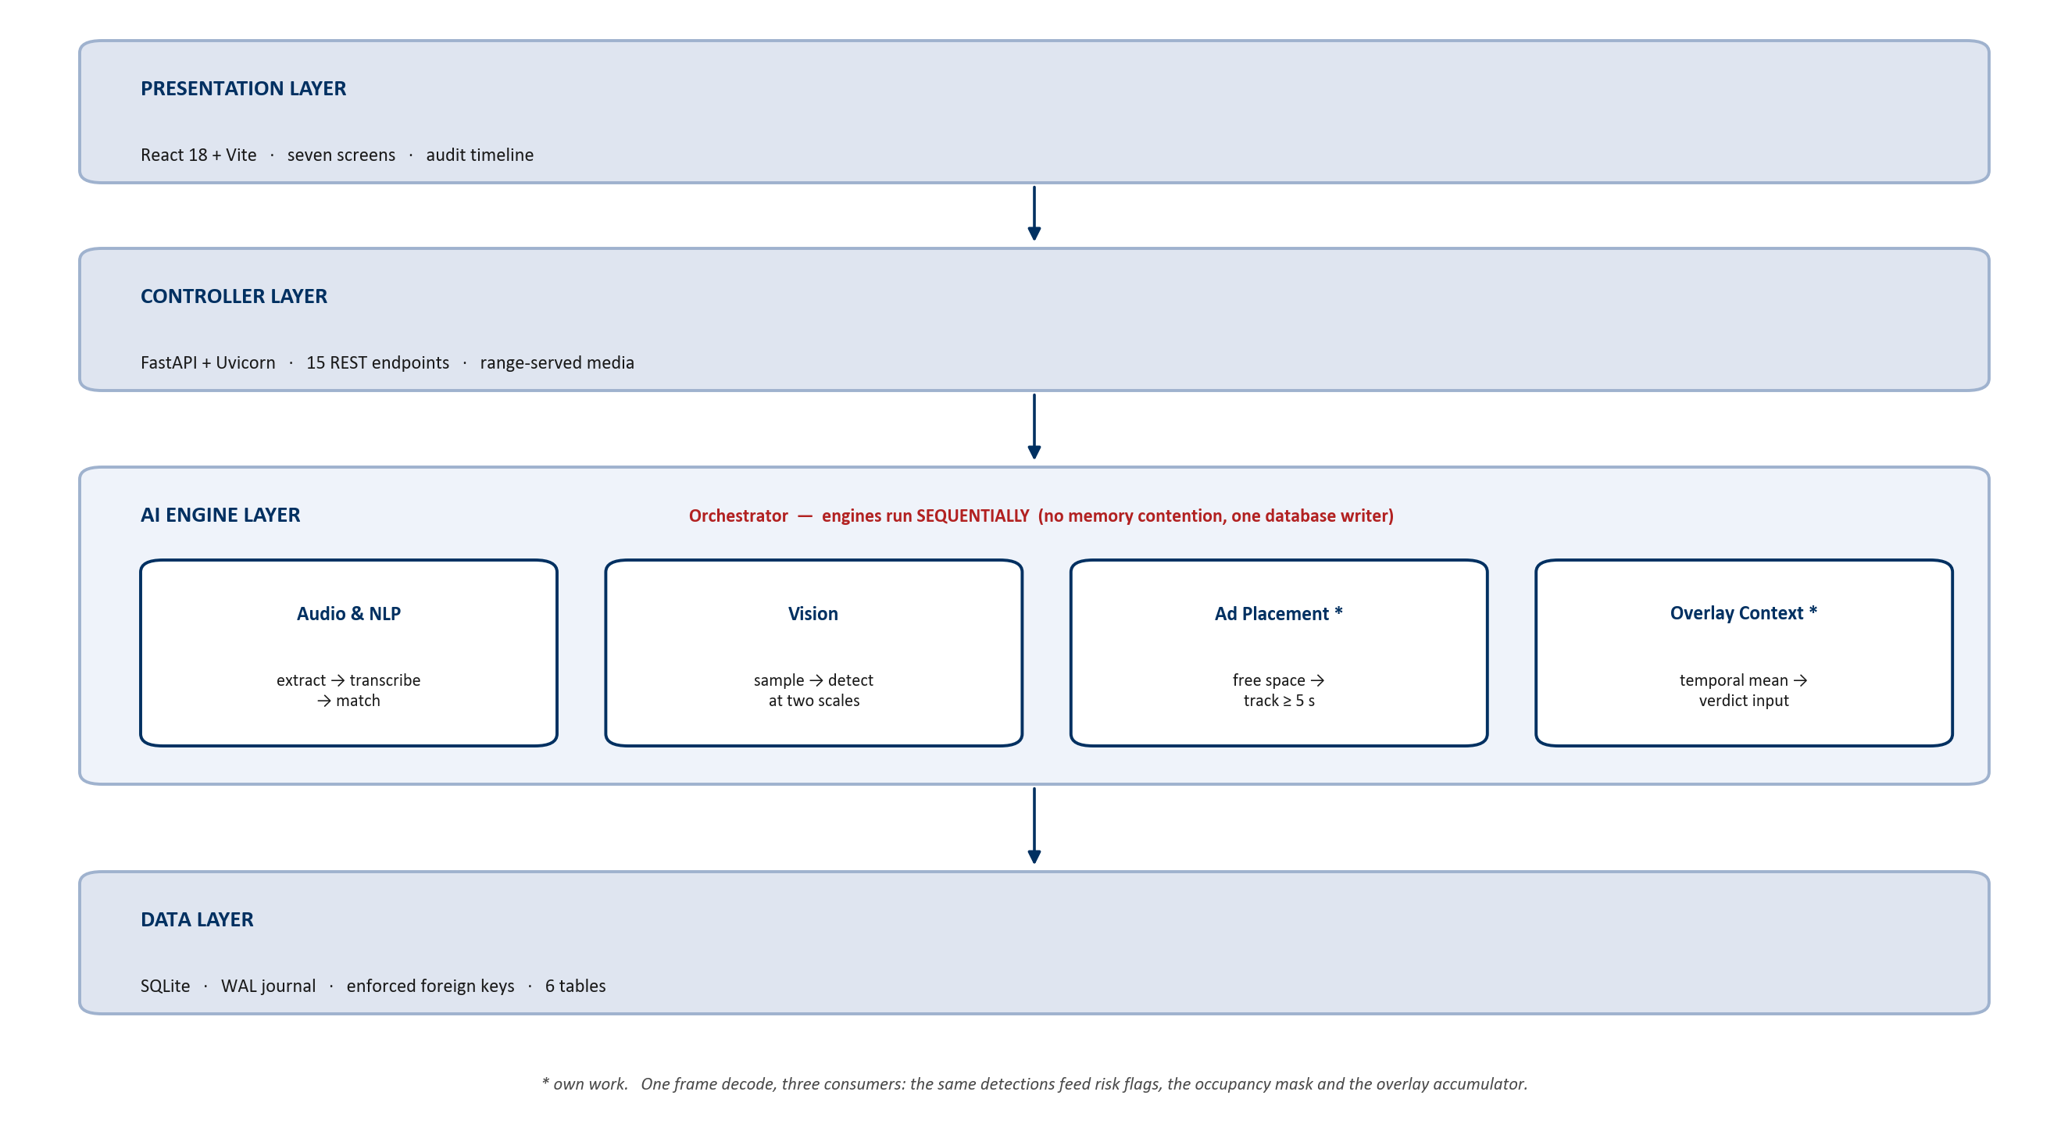
INTRODUCTION
SYSTEM STUDY
DESIGN
IMPLEMENTATION
TESTING
CONCLUSION
SYSTEM ARCHITECTURE
Four layers. The engines run sequentially, and one frame decode serves three consumers.
ADSAFE STUDIO
AY 2026-27
INITIAL DRAFT - SPECIALIZATION PROJECT
8 / 22

Slide 9
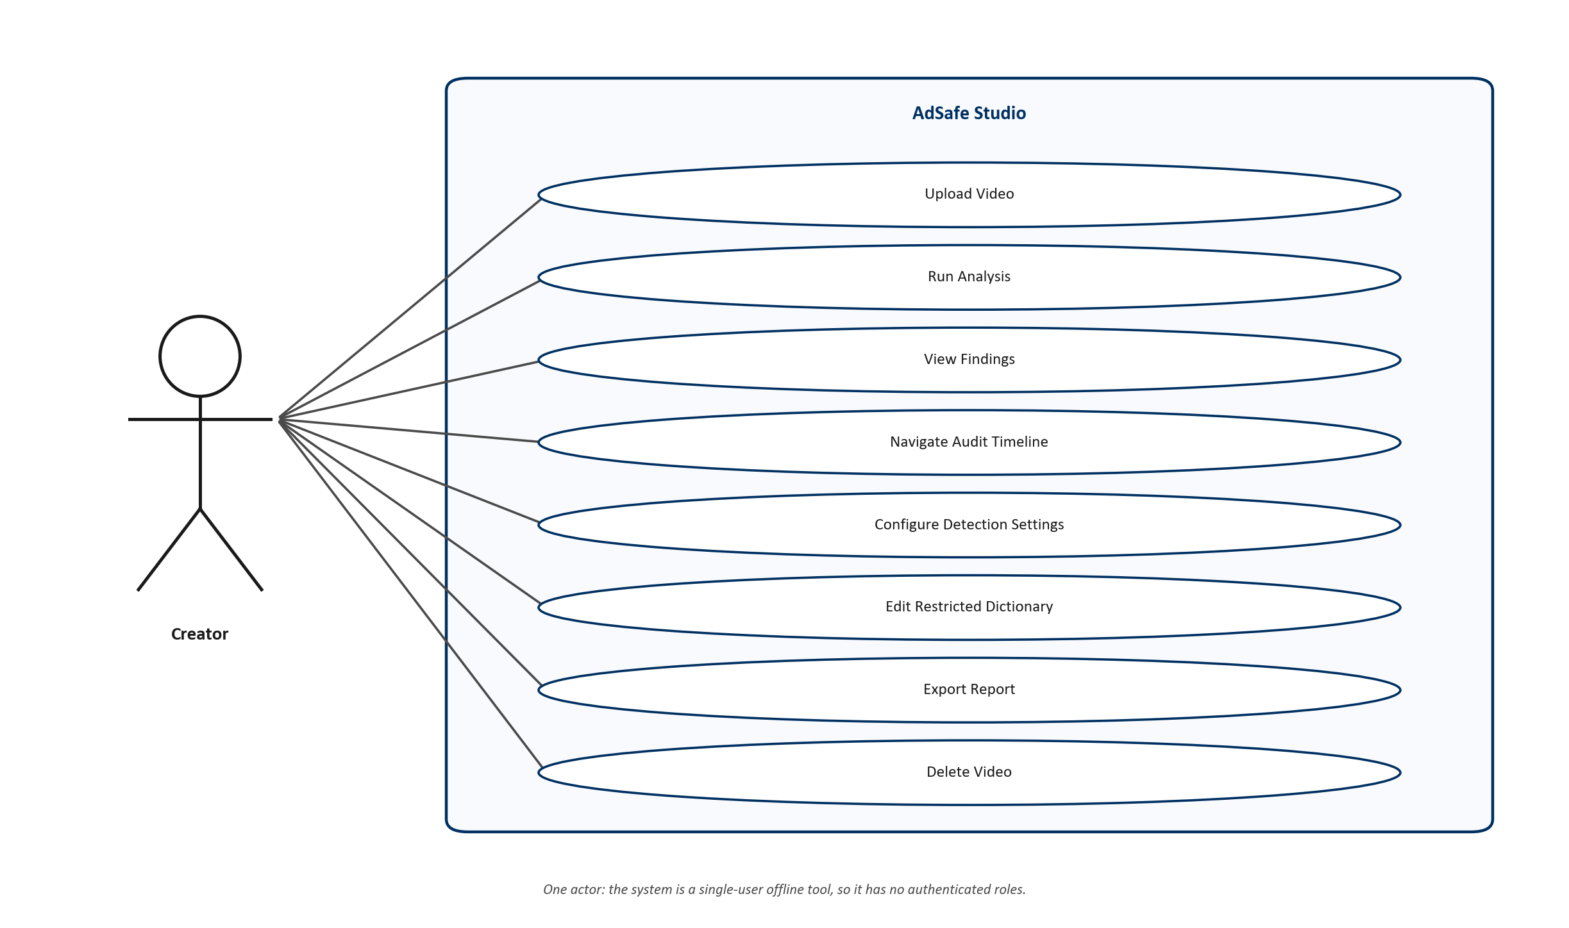
INTRODUCTION
SYSTEM STUDY
DESIGN
IMPLEMENTATION
TESTING
CONCLUSION
USE CASE DIAGRAM
One actor: a single-user offline tool has no authenticated roles.
ADSAFE STUDIO
AY 2026-27
INITIAL DRAFT - SPECIALIZATION PROJECT
9 / 22

Slide 10
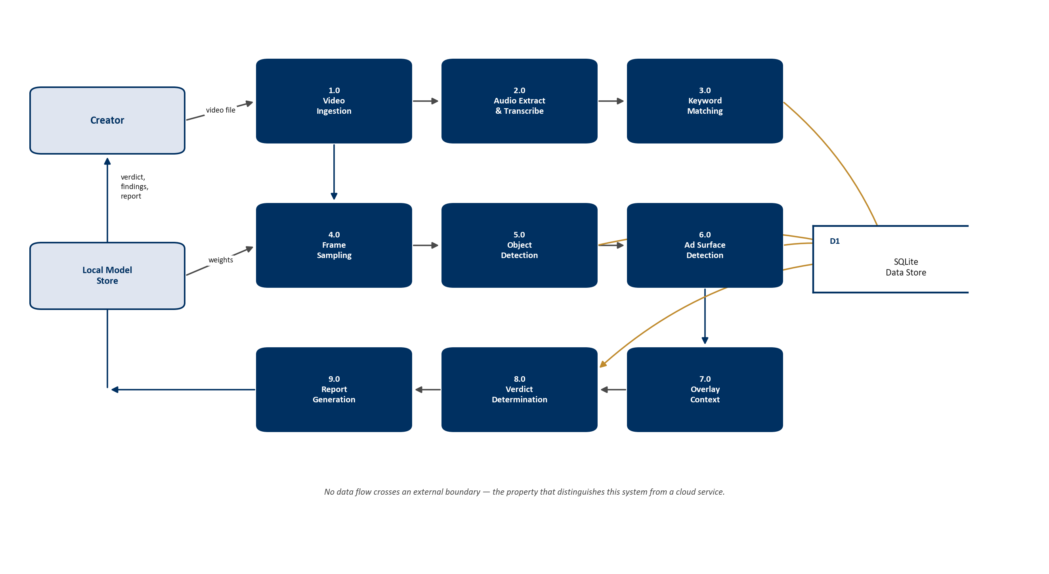
INTRODUCTION
SYSTEM STUDY
DESIGN
IMPLEMENTATION
TESTING
CONCLUSION
DATA FLOW DIAGRAM (LEVEL 1)
Nine processes and one data store. No flow crosses an external boundary.
ADSAFE STUDIO
AY 2026-27
INITIAL DRAFT - SPECIALIZATION PROJECT
10 / 22

Slide 11
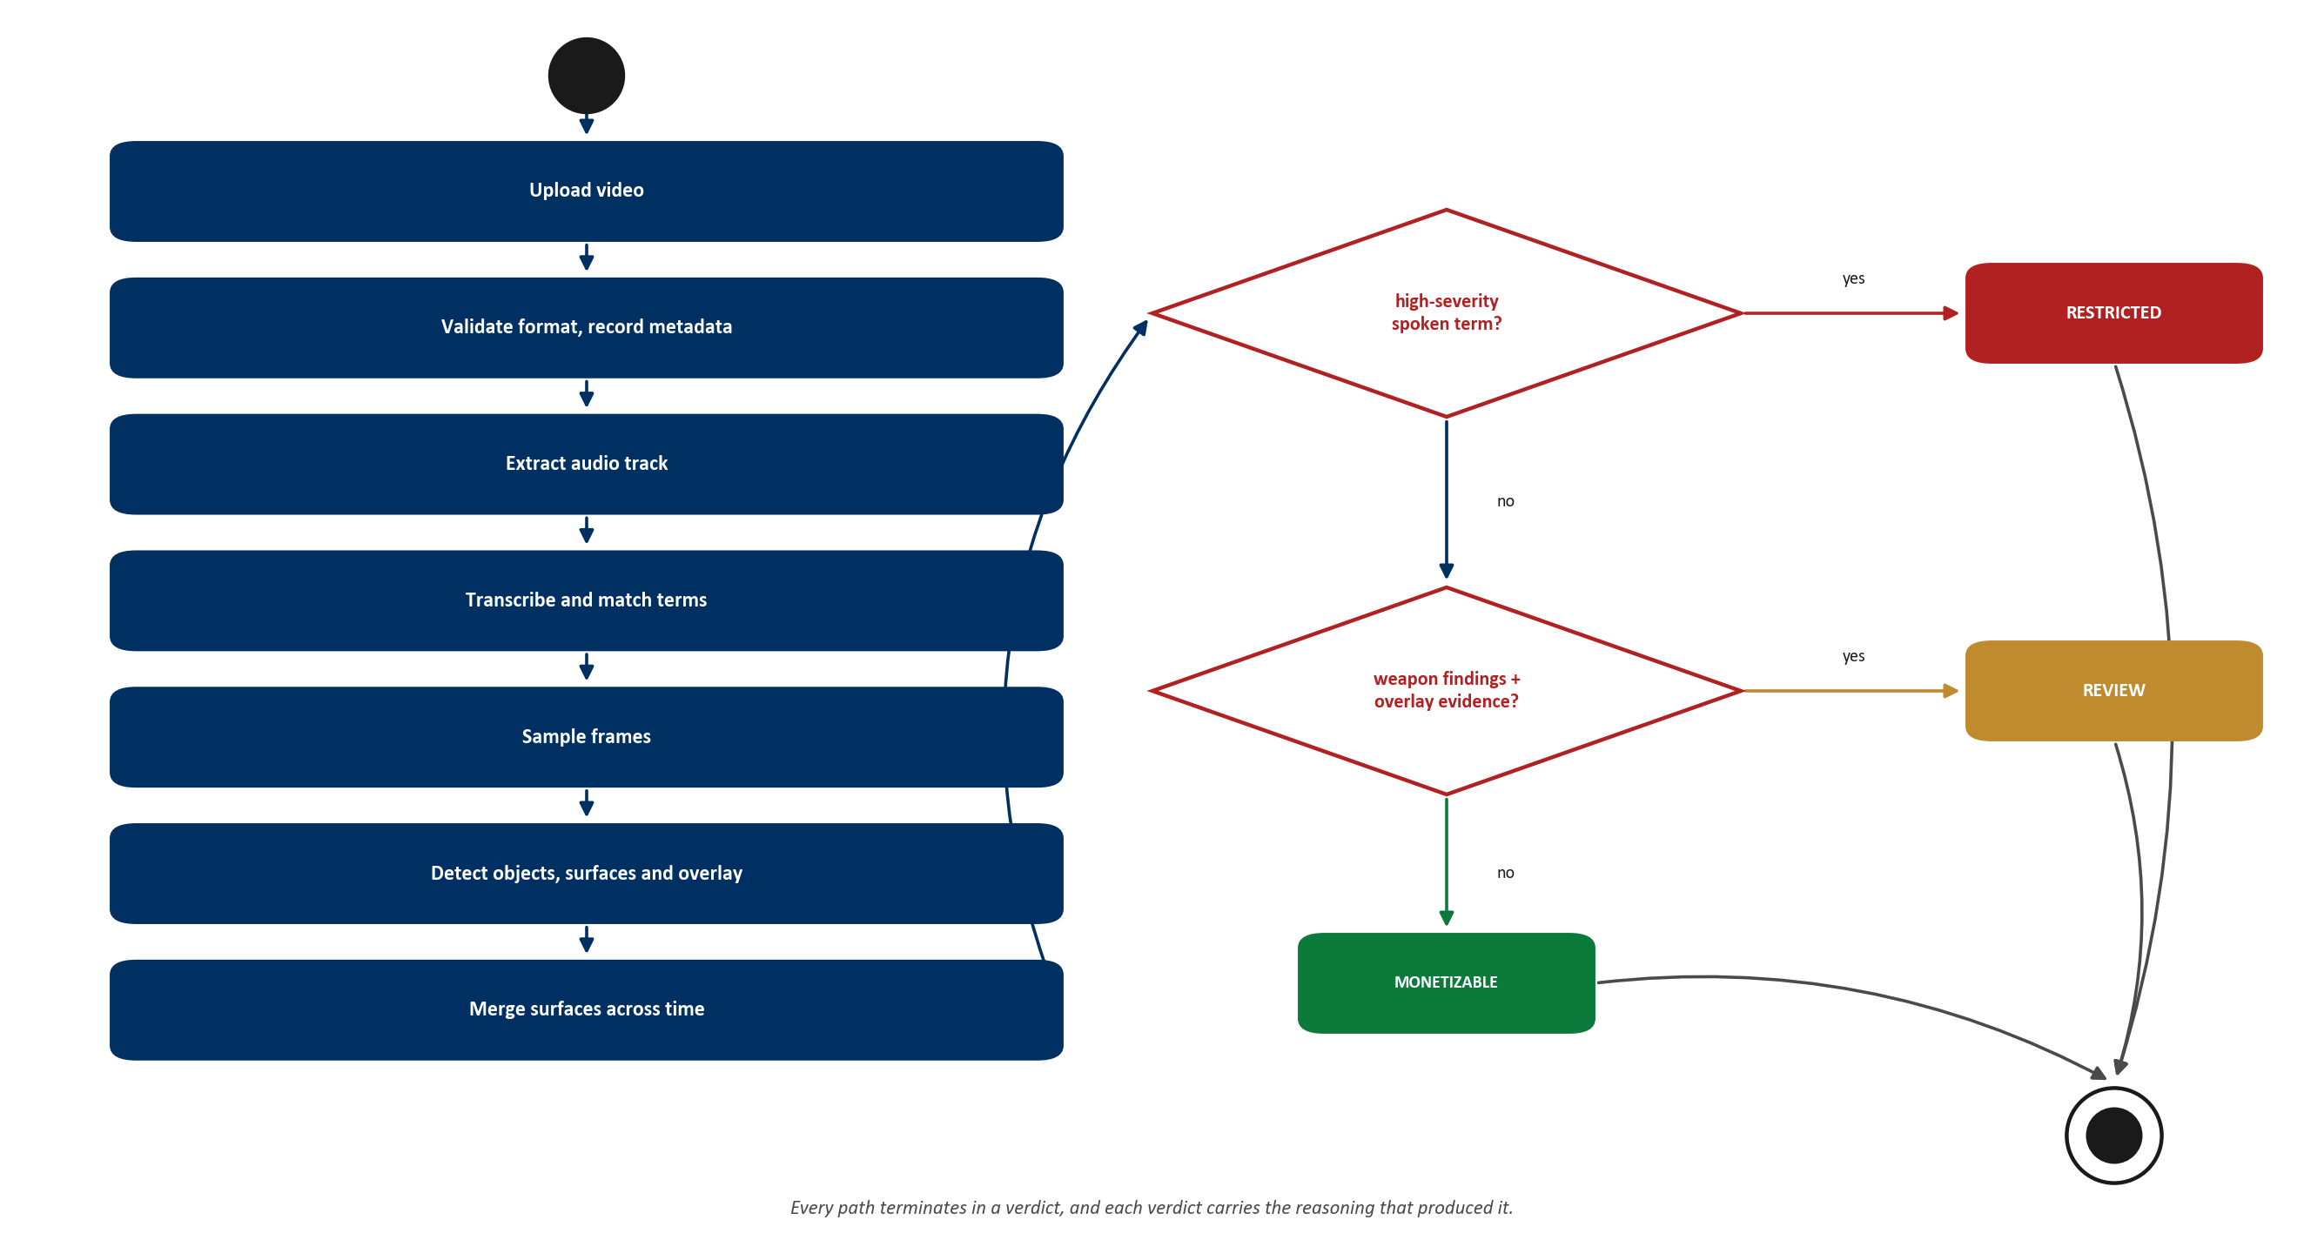
INTRODUCTION
SYSTEM STUDY
DESIGN
IMPLEMENTATION
TESTING
CONCLUSION
ACTIVITY DIAGRAM
The analysis sequence, ending in one of three verdicts.
ADSAFE STUDIO
AY 2026-27
INITIAL DRAFT - SPECIALIZATION PROJECT
11 / 22

Slide 12
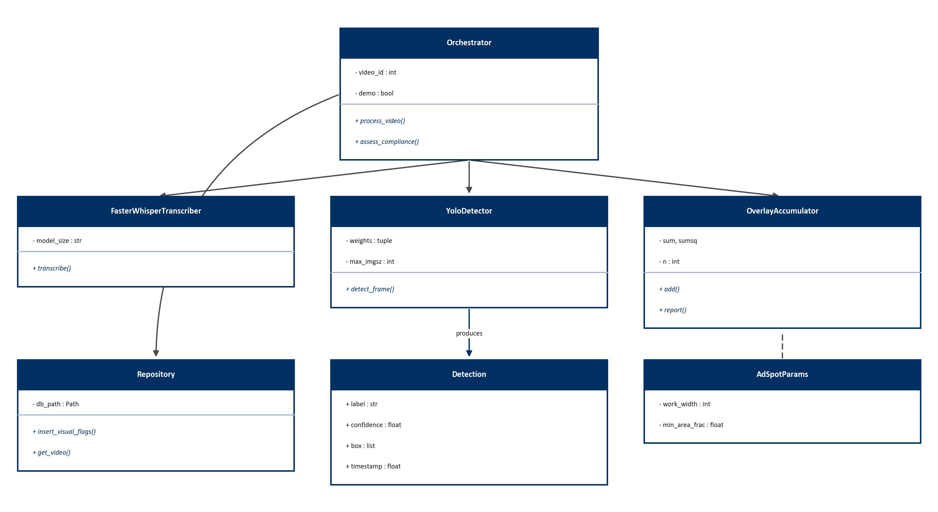
INTRODUCTION
SYSTEM STUDY
DESIGN
IMPLEMENTATION
TESTING
CONCLUSION
CLASS DIAGRAM
Principal classes, named as they are in the implementation.
ADSAFE STUDIO
AY 2026-27
INITIAL DRAFT - SPECIALIZATION PROJECT
12 / 22

Slide 13
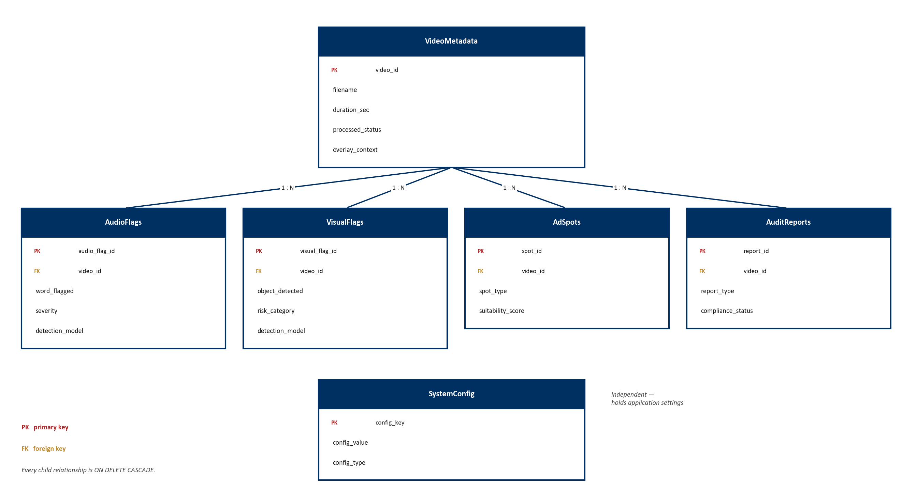
INTRODUCTION
SYSTEM STUDY
DESIGN
IMPLEMENTATION
TESTING
CONCLUSION
ENTITY RELATIONSHIP DIAGRAM
Six tables in third normal form; every child cascades on delete.
ADSAFE STUDIO
AY 2026-27
INITIAL DRAFT - SPECIALIZATION PROJECT
13 / 22

Slide 14
INTRODUCTION
SYSTEM STUDY
DESIGN
IMPLEMENTATION
TESTING
CONCLUSION
DATABASE DESIGN
Table | Primary key | Foreign key | Key constraint
VideoMetadata | video_id | — | processed_status in 4 states
AudioFlags | audio_flag_id | video_id | severity in Low / Medium / High
VisualFlags | visual_flag_id | video_id | risk_category in Weapon / Substance / Graphic
AdSpots | spot_id | video_id | timestamps and box not null
AuditReports | report_id | video_id | report_type in PDF / CSV / JSON
SystemConfig | config_key | — | config_type in string / int / float / json
Integrity is enforced by the database, not the caller
Foreign keys are switched on per connection — SQLite disables them by default — and every child cascades on delete, so a removed video leaves no orphaned findings. Write-ahead logging lets the interface read while analysis writes.
ADSAFE STUDIO
AY 2026-27
INITIAL DRAFT - SPECIALIZATION PROJECT
14 / 22

Slide 15
INTRODUCTION
SYSTEM STUDY
DESIGN
IMPLEMENTATION
TESTING
CONCLUSION
TECHNOLOGY STACK
Language and runtime
Backend
AI and vision
Python 3.12
Node.js 22
JavaScript (ES2022)
FastAPI
Uvicorn
SQLite 3 with WAL
faster-whisper (CTranslate2)
Ultralytics YOLOv8
OpenCV
NumPy
Frontend
Reporting
Tooling
React 18
Vite 5
react-router 6
hand-written CSS system
ReportLab (PDF)
pandas (CSV)
imageio-ffmpeg
pytest — 169 tests
Git
matplotlib (diagrams)
ADSAFE STUDIO
AY 2026-27
INITIAL DRAFT - SPECIALIZATION PROJECT
15 / 22

Slide 16
INTRODUCTION
SYSTEM STUDY
DESIGN
IMPLEMENTATION
TESTING
CONCLUSION
MODULES IMPLEMENTED
Audio and NLP
faster-whisper with word timestamps; phrase and word-boundary matching against a 43-term dictionary.
built
Vision
COCO plus a fine-tuned risk model, run at two resolutions per frame and merged.
built
Ad placement
occupancy and texture masks, largest-rectangle search, ≥ 5 s persistence.
built
Overlay context
streaming per-pixel statistics; distinguishes rendered from filmed content.
built
Orchestration
sequential stages, background execution, progress reporting, per-stage engine naming.
built
Reporting
PDF with a drawn timeline, plus CSV and JSON, each stating its provenance.
built
ADSAFE STUDIO
AY 2026-27
INITIAL DRAFT - SPECIALIZATION PROJECT
16 / 22

Slide 17
INTRODUCTION
SYSTEM STUDY
DESIGN
IMPLEMENTATION
TESTING
CONCLUSION
INDIVIDUAL CONTRIBUTION
Andrew Shelton S 2441609
Akash Ganesh 2441604
Module 3 — Orchestration, database and API
Module 1 — Audio and natural language engine
Six-table schema, WAL and foreign key enforcement, repository layer
Sequential orchestrator with per-stage engine selection
15 REST endpoints; compliance verdict and its reasoning
Audio extraction to 16 kHz via bundled ffmpeg
faster-whisper integration with word-level timestamps
Keyword matcher and the restricted-term dictionary
Andrew Judah 2441608
Ramona Elisha Mary 2441646
Module 2 — Vision, ad placement and overlay
Module 4 — Web interface and reporting
Frame sampling and multi-scale object detection
Free-space advertisement placement algorithm
Persistent-overlay detection and the temporal tracker
Seven React screens, four breakpoints, light and dark themes
Audit timeline with click-to-seek navigation
PDF, CSV and JSON report generation
ADSAFE STUDIO
AY 2026-27
INITIAL DRAFT - SPECIALIZATION PROJECT
17 / 22

Slide 18
INTRODUCTION
SYSTEM STUDY
DESIGN
IMPLEMENTATION
TESTING
CONCLUSION
TESTING AND VALIDATION
Area | What is covered | Tests
Data layer | schema, constraints, cascade delete, config migrations | 12
Audio engine | transcription contract, phrase matching, severity rules | 17
Vision engine | label mapping, multi-scale merge, class-list drift guards | 31
Ad placement | largest-rectangle search, masks, temporal tracking | 26
Overlay context | translucent HUD, letterboxing, static camera, real footage | 20
Verdict logic | three states and the limits of the overlay exemption | 16
Reports and API | PDF/CSV/JSON output, endpoints, validation, error paths | 47
Total | across 12 files, run before every commit | 169
Validation and error handling
Checks at three levels — interface, API boundary and database. Unsupported formats, duplicate dictionary terms and out-of-range settings are rejected; a video with no audio track is analysed visually rather than failed.
ADSAFE STUDIO
AY 2026-27
INITIAL DRAFT - SPECIALIZATION PROJECT
18 / 22

Slide 19
INTRODUCTION
SYSTEM STUDY
DESIGN
IMPLEMENTATION
TESTING
CONCLUSION
RESULTS ON REAL VIDEO
Four real clips were analysed. Each exposed a defect that synthetic footage had hidden.
Clip | What it exposed | Outcome
Firearms news report | detection ran at 640 px, shrinking a distant weapon below what the network resolves | 0 → 13 detections
Air pistol review | raising resolution fixed the first clip and broke this one — the relationship is inverted | detect at two scales
Gameplay capture | a real HUD is translucent and its contents change, so it is not pixel-static | judge stability relative to the frame
Firearms news report (audio) | transcription was perfect; the nine-word dictionary matched none of it | 43-term vocabulary
Model accuracy (Open Images validation)
Still outstanding
mAP@50 0.566 · precision 0.569 · recall 0.548
11 classes, trained for this project — no pretrained model covers this taxonomy.
The benchmark against labelled creator footage has 0 of 20 clips labelled, so no accuracy figure on real video is claimed. The harness refuses to publish one below its evidence threshold.
ADSAFE STUDIO
AY 2026-27
INITIAL DRAFT - SPECIALIZATION PROJECT
19 / 22

Slide 20
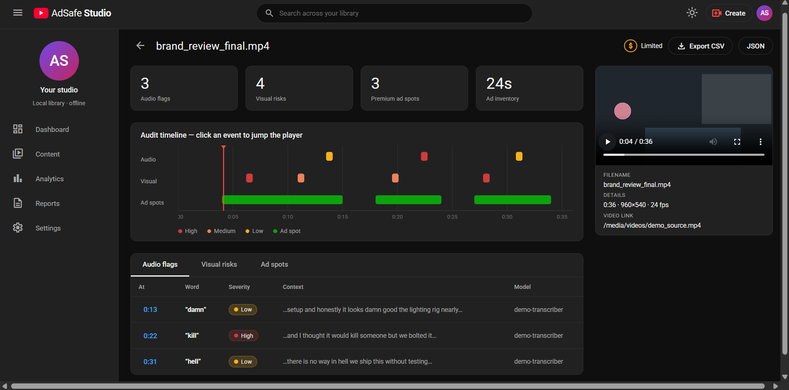
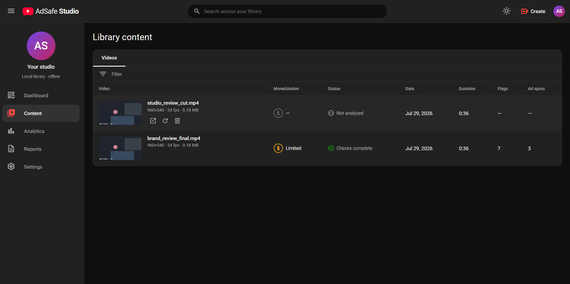
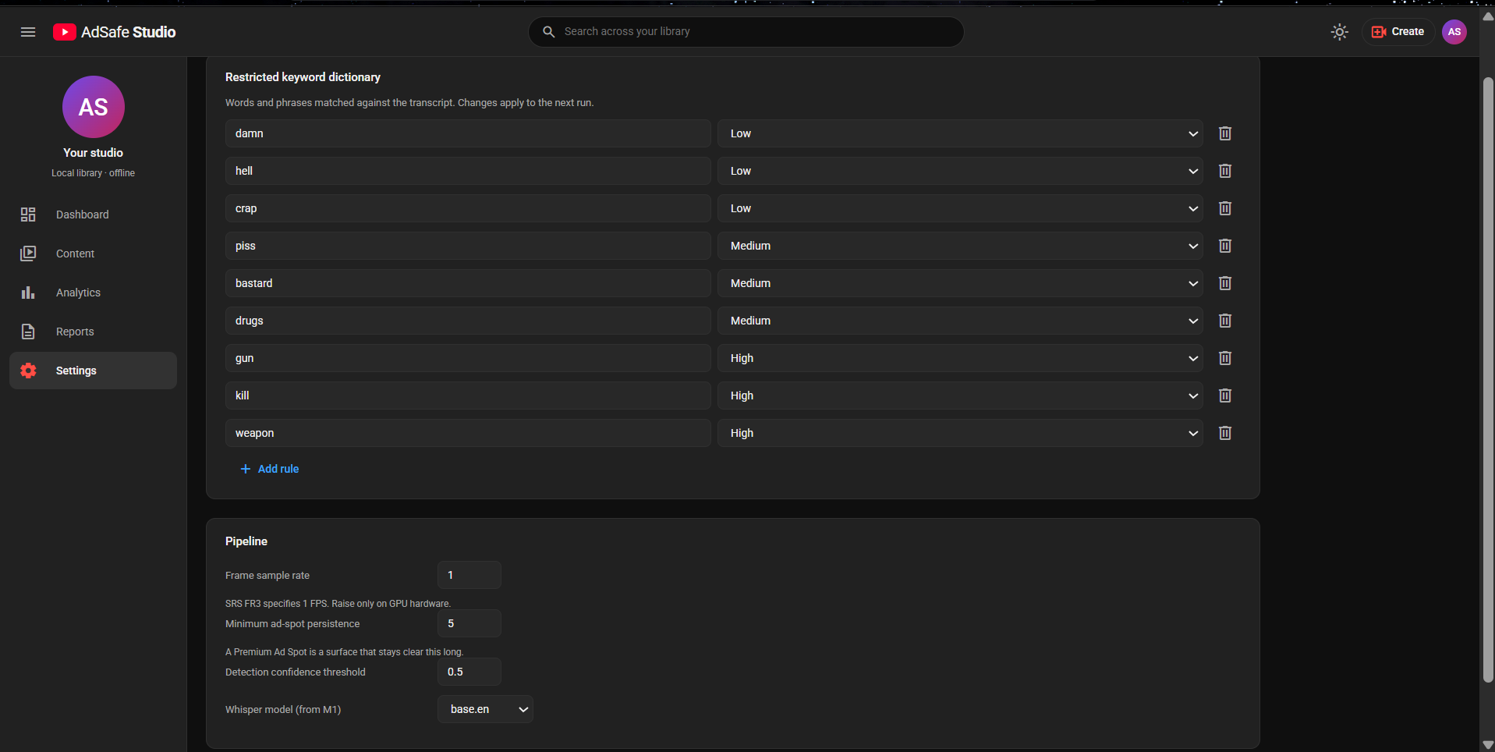
INTRODUCTION
SYSTEM STUDY
DESIGN
IMPLEMENTATION
TESTING
CONCLUSION
WORKING SYSTEM
Content library
Video detail — monetization status, audit timeline, per-finding tables
Settings and detection coverage
ADSAFE STUDIO
AY 2026-27
INITIAL DRAFT - SPECIALIZATION PROJECT
20 / 22
Notes:
Demonstrate live: upload a clip, run checks in real mode, open the timeline, export the PDF.

Slide 21
INTRODUCTION
SYSTEM STUDY
DESIGN
IMPLEMENTATION
TESTING
CONCLUSION
CONCLUSION AND FUTURE WORK
Achieved
Future work
A complete offline pipeline: transcription, detection, ad placement and overlay context.
A risk model trained for this project, since no pretrained model covers the taxonomy.
Two original components — the free-space placement algorithm and overlay detection.
A three-state verdict that explains itself, replacing a binary rule that restricted gameplay for rendered weapons.
169 automated tests; every defect found is kept as a regression test.
Validated against real video, not only against generated footage.
Label the 20 benchmark clips and publish a measured accuracy figure.
Retrain with augmentation drawn from video rather than photographs.
Suppress advertisement placement over detected overlay regions.
Extend transcription beyond English.
Batch analysis across a whole library.
ADSAFE STUDIO
AY 2026-27
INITIAL DRAFT - SPECIALIZATION PROJECT
21 / 22

Slide 22
THANK YOU
Questions are welcome — and a live demonstration is ready.

