Slide 1


INTRODUCTION SYSTEM STUDY SOFTWARE DESIGN IMPLEMENTATION PROGRESS PROJECT MANAGEMENT CONCLUSION
ADSAFE STUDIO
AUTONOMOUS VIDEO AD-PLACEMENT & CONTEXTUAL SAFETY ANALYZER
PRESENTATION-II (70% PROJECT PROGRESS)
Andrew Shelton S (2441609)
Akash Ganesh (2441604)
Andrew Judah (2441608)
Ramona Elisha Mary (2441646)
Under the guidance of Dr. Chanti, Assistant Professor
Department of Computer Science · School of Sciences
CHRIST (Deemed to be University), Bangalore
ACADEMIC YEAR 2026–2027
ADSAFE STUDIO
AY 2026–27
PRESENTATION-II · 70% PROJECT PROGRESS
1 / 25
Notes:
Presentation-II, 70% progress. Headline: every AI engine is now real; the remaining work is evidence, not engineering.

Slide 2
INTRODUCTION SYSTEM STUDY SOFTWARE DESIGN IMPLEMENTATION PROGRESS PROJECT MANAGEMENT CONCLUSION
AGENDA
INTRODUCTION
SYSTEM STUDY
SOFTWARE DESIGN
IMPLEMENTATION PROGRESS
PROJECT MANAGEMENT
CONCLUSION
ADSAFE STUDIO
AY 2026–27
PRESENTATION-II · 70% PROJECT PROGRESS
2 / 25

Slide 3
INTRODUCTION SYSTEM STUDY SOFTWARE DESIGN IMPLEMENTATION PROGRESS PROJECT MANAGEMENT CONCLUSION
PROGRESS SINCE PRESENTATION-I
 | Presentation-I (40%) | Presentation-II (70%)
AI engines | all stubbed | all four real
Risk detection | none | 13 labels, own fine-tune
Ad-spot algorithm ★ | designed only | built and verified
Automated tests | 15 | 95
REST endpoints | 9 | 15
Interface screens | 4 | 7, responsive, light + dark
Report formats | CSV · JSON | CSV · JSON · PDF
Stage deliverables | Synopsis · SRS · DDD | + UID submitted
In one line: the tool now works end to end — what it still lacks is published evidence.
ADSAFE STUDIO
AY 2026–27
PRESENTATION-II · 70% PROJECT PROGRESS
3 / 25
Notes:
Open here. It orients the panel immediately and frames everything after it.

Slide 4
INTRODUCTION SYSTEM STUDY SOFTWARE DESIGN IMPLEMENTATION PROGRESS PROJECT MANAGEMENT CONCLUSION
PROBLEM AND OBJECTIVES
THE PROBLEM
Creators lose revenue to automated demonetisation decisions they cannot inspect: 93% of removed videos are flagged first by machines, and creators win roughly 67% of the claims they dispute.
Cloud vision APIs are priced per minute and require uploading unreleased footage — a non-starter under NDA.
OBJECTIVES — STATUS AT 70%
Automate contextual safety detection — DONE: faster-whisper transcription with word-level timestamps, dictionary matching
Identify premium ad-placement zones — DONE: free-space algorithm, the project's novel contribution
Eliminate cloud dependency — DONE: every model runs locally, no footage leaves the machine
Consolidate multimodal metadata — DONE: six tables in 3NF, WAL journal, cascade integrity
Deliver an interactive review dashboard — DONE: 7 screens with PDF / CSV / JSON export
ADSAFE STUDIO
AY 2026–27
PRESENTATION-II · 70% PROJECT PROGRESS
4 / 25
Notes:
Every objective from Presentation-I is now met. The gap is evidence, not scope.

Slide 5
INTRODUCTION SYSTEM STUDY SOFTWARE DESIGN IMPLEMENTATION PROGRESS PROJECT MANAGEMENT CONCLUSION
EXISTING SYSTEM
Current approach | What it does | How it is used today
Manual review | An editor scrubs the full timeline by eye | The default for most creators
Keyword filters | Flags restricted words in a transcript | Bundled into editing and upload tools
Cloud vision APIs | Object detection at scale — AWS Rekognition, Google Video Intelligence | Used by larger agencies
Platform classifiers | The platform's own enforcement after upload | Applied automatically to every video
Ad placement is absent from all four. None of these approaches locates sponsor surfaces at all — finding an empty wall or a clear desk is still done by eye, frame by frame.
ADSAFE STUDIO
AY 2026–27
PRESENTATION-II · 70% PROJECT PROGRESS
5 / 25
Notes:
Be fair to the alternatives here: cloud services really are accurate, and platform enforcement really does operate at a scale we cannot match. The gap is in what they are for, not in how well they work.

Slide 6
INTRODUCTION SYSTEM STUDY SOFTWARE DESIGN IMPLEMENTATION PROGRESS PROJECT MANAGEMENT CONCLUSION
LIMITATIONS OF EXISTING SYSTEMS
KEY LIMITATIONS
• Time consuming — hours of manual review for every long-form video, and the cost scales with the library.
• Reactive — platform classifiers act only after upload, when the revenue has already been lost.
• Opaque — a demonetisation verdict arrives with no timestamp and no reason, so it cannot be corrected.
• Expensive — cloud vision is billed per minute of footage, which does not suit auditing hours of raw material.
• Privacy — uploading unreleased client footage to a third party breaches the NDAs agencies work under.
RESEARCH GAP
No existing tool synchronises spatial computer-vision data with audio NLP on a single timeline while running entirely offline — and none of them addresses ad placement at all.
Our position: the two problems share the same sampled frames and the same timeline, so solving them together costs little more than solving either one alone.
ADSAFE STUDIO
AY 2026–27
PRESENTATION-II · 70% PROJECT PROGRESS
6 / 25

Slide 7
INTRODUCTION SYSTEM STUDY SOFTWARE DESIGN IMPLEMENTATION PROGRESS PROJECT MANAGEMENT CONCLUSION
RESEARCH FINDING — SOURCING A RISK MODEL
WHAT WE FOUND
Roboflow's trained weights are paywalled; the free tier is a hosted API, which would break the offline requirement outright.
Public weapon models on HuggingFace had negligible adoption (0–13 downloads), wrong-domain bases such as aerial imagery, or no stated licence at all — meaning all rights reserved.
The obvious smoking model reports mAP 0.995 from 140 images, and does not distinguish cigarette smoke from fire smoke.
PyTorch checkpoints are pickle-based, so loading a third-party file executes its code.
CONSEQUENCE — DECISION D1 INVERTED
• The datasets are freely licensed even though the weights are not, so training our own model became the lower-risk route, not the optional upgrade it was planned as.
Licensing: Ultralytics YOLOv8 is AGPL-3.0, and the licence covers models produced by the training code. Fine for academic use, and stated in the report.
ADSAFE STUDIO
AY 2026–27
PRESENTATION-II · 70% PROJECT PROGRESS
7 / 25
Notes:
This is a genuine research finding — the assumption in the plan was wrong, and the evidence changed the decision. Panels reward that.

Slide 8
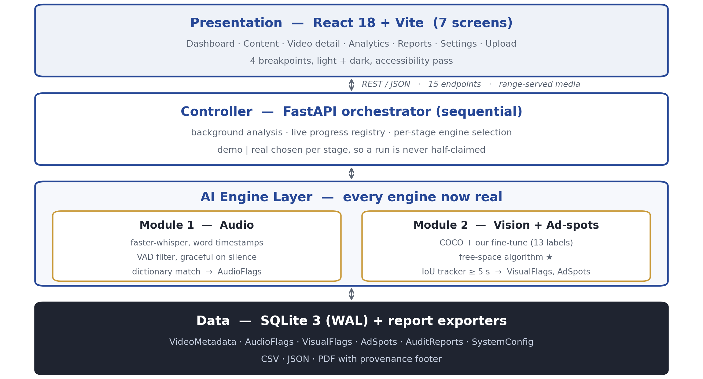
INTRODUCTION SYSTEM STUDY SOFTWARE DESIGN IMPLEMENTATION PROGRESS PROJECT MANAGEMENT CONCLUSION
SYSTEM ARCHITECTURE
Four layers, sequential pipeline. One inference pass feeds both the risk flags and the ad-spot occupancy mask, so frames decode and models run once.
ADSAFE STUDIO
AY 2026–27
PRESENTATION-II · 70% PROJECT PROGRESS
8 / 25

Slide 9
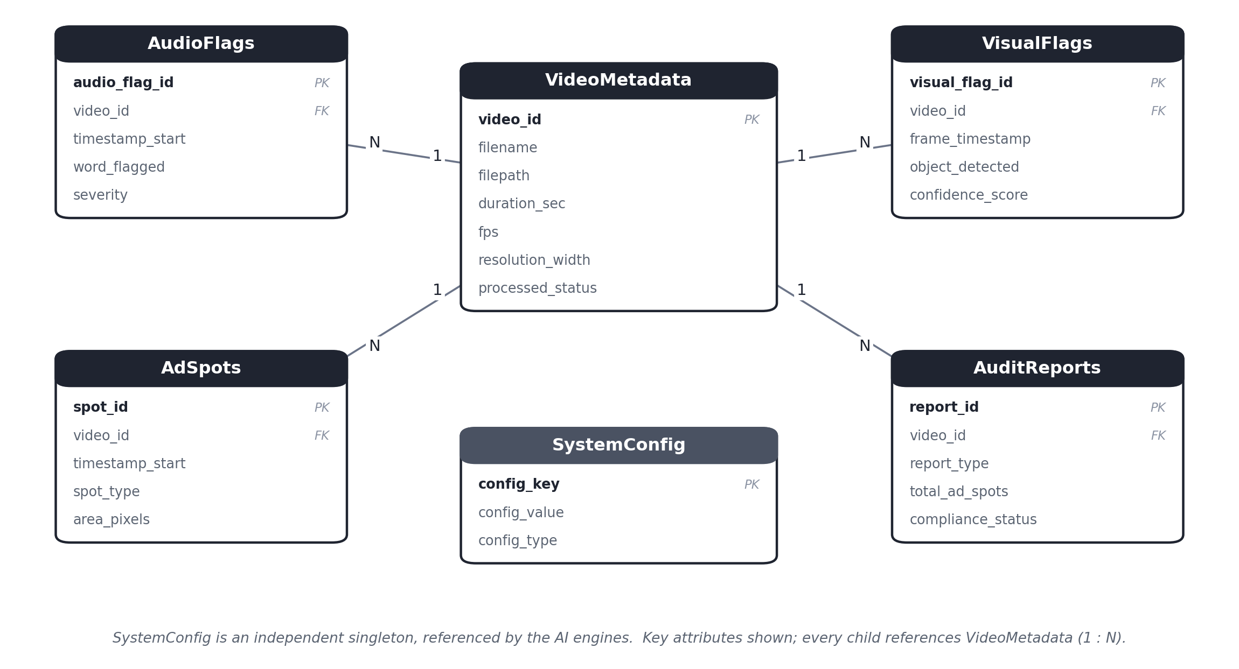
INTRODUCTION SYSTEM STUDY SOFTWARE DESIGN IMPLEMENTATION PROGRESS PROJECT MANAGEMENT CONCLUSION
DATA MODEL AND REPORTING
SCHEMA
6 tables, 3NF
FK cascade on delete
WAL journal mode
Boxes as JSON arrays
REPORTS
PDF with drawn timeline
CSV · JSON export
Archived in AuditReports
Provenance in the footer
Compliance verdict: Restricted if any High-severity audio flag or any Weapon-category visual flag exists.
ADSAFE STUDIO
AY 2026–27
PRESENTATION-II · 70% PROJECT PROGRESS
9 / 25

Slide 10
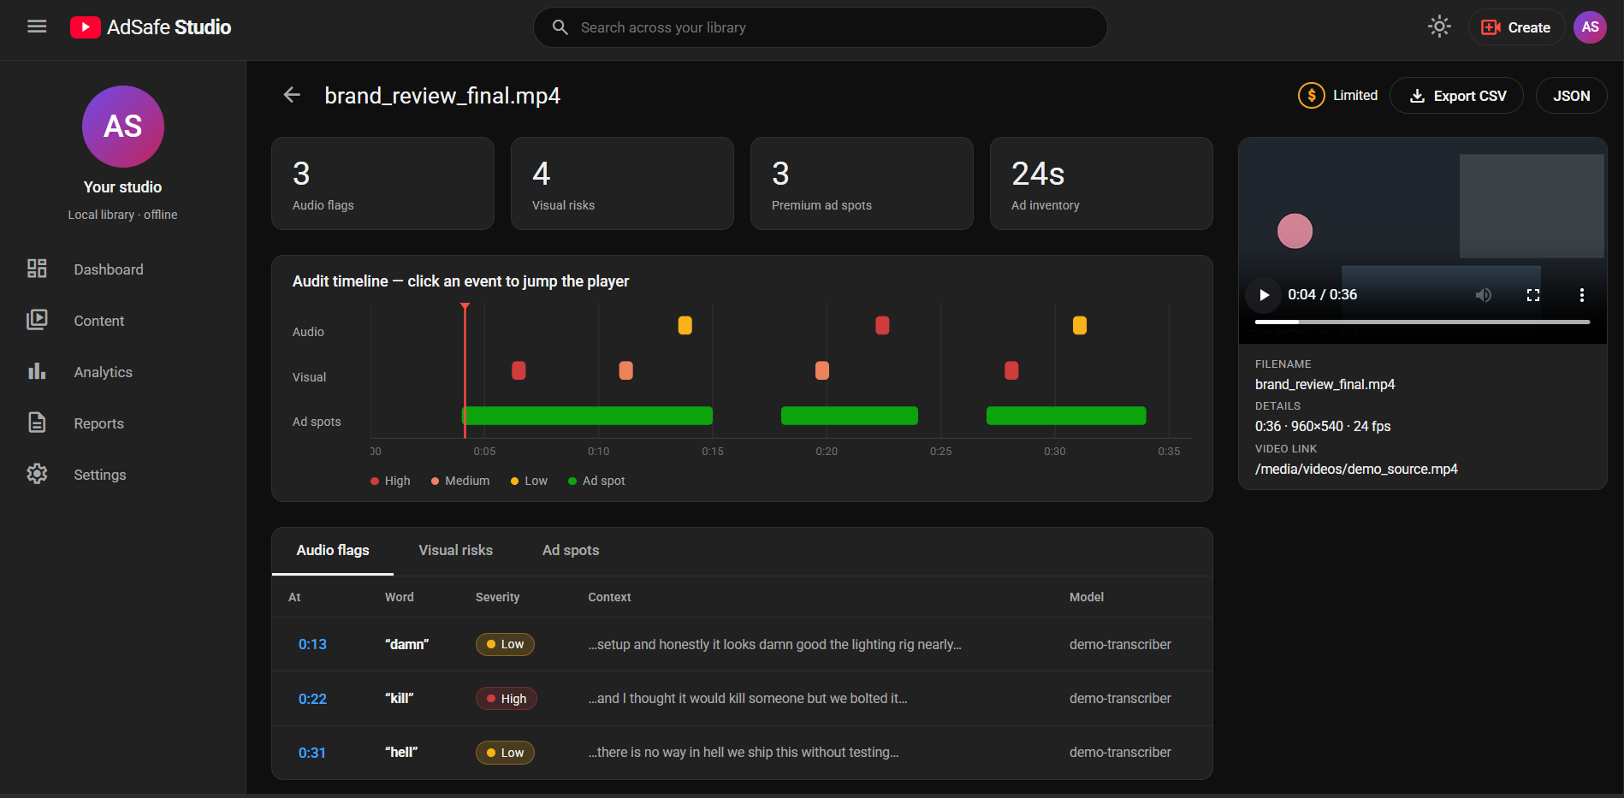
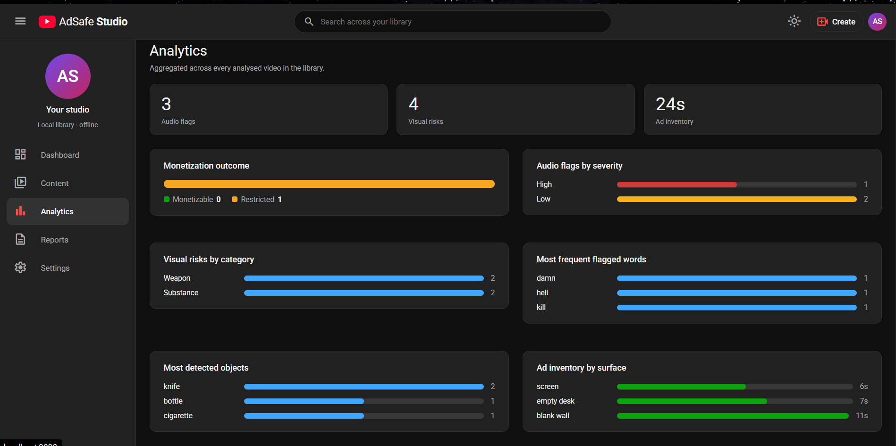
INTRODUCTION SYSTEM STUDY SOFTWARE DESIGN IMPLEMENTATION PROGRESS PROJECT MANAGEMENT CONCLUSION
USER INTERFACE — 7 SCREENS
Video detail — audit timeline, click an event to seek
Analytics — aggregates across the library
Dashboard · Content · Video detail · Analytics · Reports · Settings · Upload dialog
Four breakpoints — desktop, laptop icon rail, tablet drawer, mobile card list — in light and dark
No authentication by design: a single-user offline tool, documented in the UID
ADSAFE STUDIO
AY 2026–27
PRESENTATION-II · 70% PROJECT PROGRESS
10 / 25
Notes:
These are live captures of the running application, not mock-ups.

Slide 11
INTRODUCTION SYSTEM STUDY SOFTWARE DESIGN IMPLEMENTATION PROGRESS PROJECT MANAGEMENT CONCLUSION
MODULE 1 — AUDIO ENGINE
NOW REAL
faster-whisper on the CTranslate2 runtime — same weights as OpenAI Whisper, lower memory, and native word-level timestamps, which the AudioFlags schema requires.
Voice-activity filter; weights cached under models/, so inference is fully offline after the first download.
Dictionary matching on whole tokens with multi-word phrase support — “gun” never fires inside “gunmetal”.
Silent video degrades gracefully: no audio flags, and the run still completes.
VERIFIED END TO END
On a generated speech clip the transcript was word-perfect and the timestamps accurate.
All three planted dictionary terms were flagged at the correct severities — damn / Low, hell / Low, gun / High.
Every flag records the engine that produced it: detection_model = faster-whisper-base.en.
ADSAFE STUDIO
AY 2026–27
PRESENTATION-II · 70% PROJECT PROGRESS
11 / 25

Slide 12
INTRODUCTION SYSTEM STUDY SOFTWARE DESIGN IMPLEMENTATION PROGRESS PROJECT MANAGEMENT CONCLUSION
MODULE 2 — VISUAL RISK DETECTION
TWO MODELS, ONE PASS
COCO YOLOv8 for scene understanding and occupancy — what COCO is genuinely good at, and the input the ad-spot algorithm needs.
Our own fine-tuned model for the risk taxonomy COCO cannot see: its 80 classes contain no gun, no cigarette, no drugs.
Class names are normalised to our risk vocabulary at the detector boundary, so swapping weights never reaches the database or the interface.
COVERAGE — STATED HONESTLY
13 risk labels: handgun, rifle, shotgun, dagger, sword, knife, scissors, baseball bat, beer, wine, cocktail, wine glass, bottle.
Graphic content is not covered, and smoking is not covered by any reputable source we could find — Open Images has no cigarette class.
/api/vision-coverage reports what the loaded weights can actually detect, surfaced on the Settings screen.
A test we added: the training class list is compared against the label map — five classes were once trained but unmapped, and their detections were being silently discarded.
ADSAFE STUDIO
AY 2026–27
PRESENTATION-II · 70% PROJECT PROGRESS
12 / 25

Slide 13
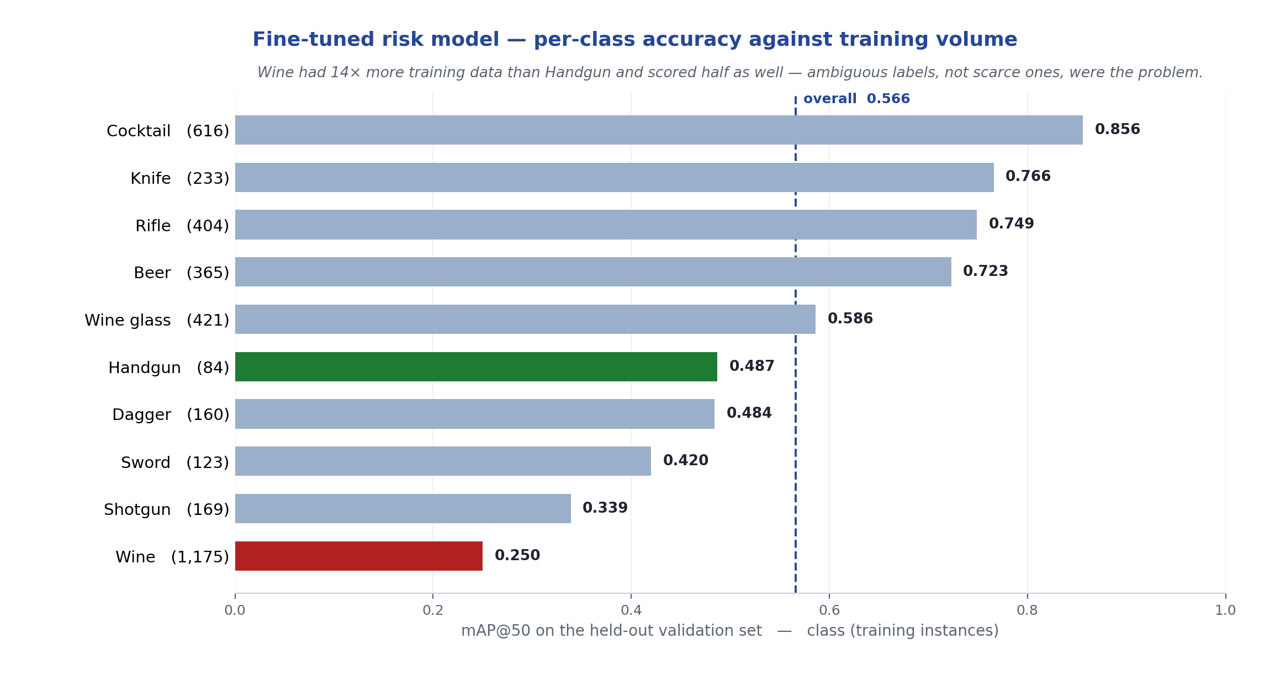
INTRODUCTION SYSTEM STUDY SOFTWARE DESIGN IMPLEMENTATION PROGRESS PROJECT MANAGEMENT CONCLUSION
CUSTOM FINE-TUNE — RESULTS
ADSAFE STUDIO
AY 2026–27
PRESENTATION-II · 70% PROJECT PROGRESS
13 / 25
Notes:
Open Images V7 subset under CC BY 4.0: 1,516 train / 500 validation images, 10 classes, yolov8n fine-tuned for 12 epochs on CPU — 10.8 hours. The counter-intuitive result is the point of this slide.

Slide 14
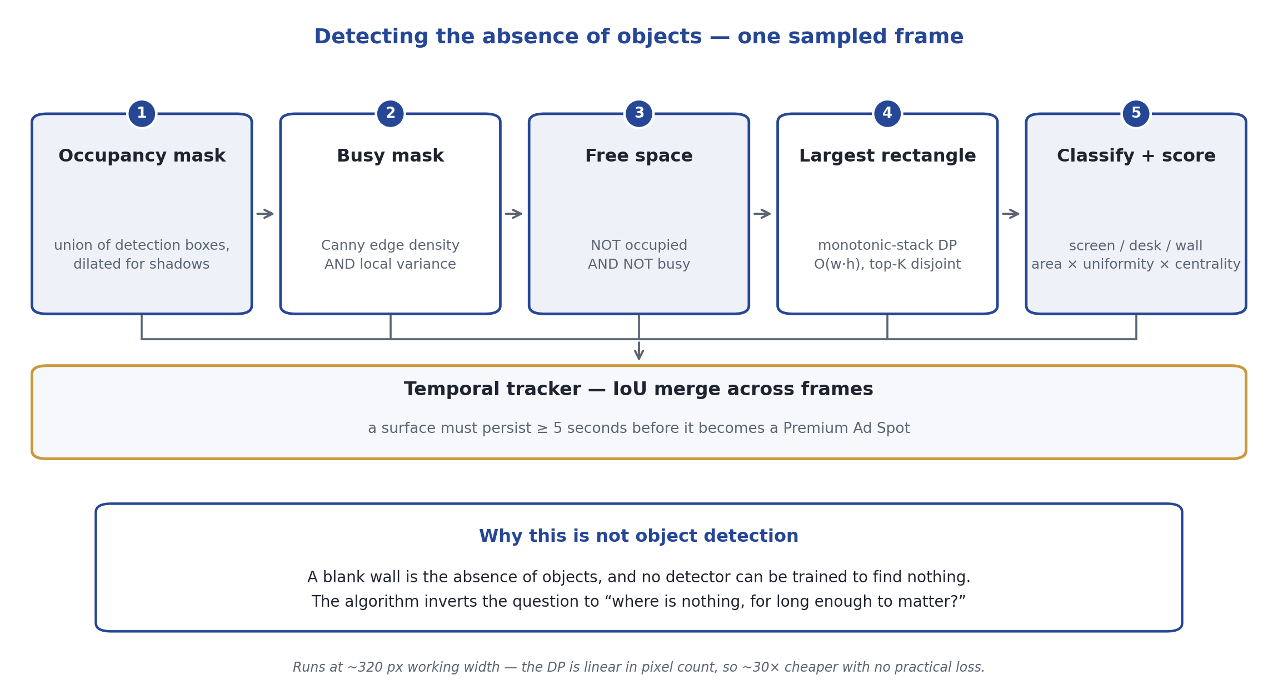
INTRODUCTION SYSTEM STUDY SOFTWARE DESIGN IMPLEMENTATION PROGRESS PROJECT MANAGEMENT CONCLUSION
AD-SPOT DETECTION — OUR CONTRIBUTION
ADSAFE STUDIO
AY 2026–27
PRESENTATION-II · 70% PROJECT PROGRESS
14 / 25
Notes:
The strongest slide in the deck. Everything else is competent integration of existing models; this is the one component that could not be solved by pointing another pretrained model at it. Verified on a clip with a flat wall on one side and random texture on the other: found a single 13-second blank_wall spot, clear of the textured region and stopping above a moving figure. 27 tests cover the geometry.

Slide 15
INTRODUCTION SYSTEM STUDY SOFTWARE DESIGN IMPLEMENTATION PROGRESS PROJECT MANAGEMENT CONCLUSION
IMPLEMENTATION PROGRESS (70%)
Component | Status | Evidence
Database, repository, orchestrator | Complete | tested
M1 — Audio engine (faster-whisper) | Complete | tested end to end
M2 — Vision detection (COCO + fine-tune) | Complete | 13 labels, verified
M3a — Ad-spot free-space algorithm ★ | Complete | 27 geometry tests
M3b — Fine-tuned risk model | Complete | mAP@50 0.566
M4 — Web interface (7 screens) | Complete | responsive, a11y pass
M5 — PDF / CSV / JSON reports | Complete | tested
M5 — Accuracy benchmark | Harness only | 0 of 20 clips labelled
95 automated tests pass across the database, matcher, tracker, ad-spot geometry, reports and benchmark rules.
ADSAFE STUDIO
AY 2026–27
PRESENTATION-II · 70% PROJECT PROGRESS
15 / 25

Slide 16
INTRODUCTION SYSTEM STUDY SOFTWARE DESIGN IMPLEMENTATION PROGRESS PROJECT MANAGEMENT CONCLUSION
PROJECT DEMONSTRATION
WHAT YOU WILL SEE
The library with monetisation verdicts — a green or amber $ badge per video, the same language creators already read.
A live analysis run with per-stage progress, then the audit timeline: click any event and the player seeks to that second.
Audio flags with transcript context, visual risks with confidence, and ad spots with suitability scores.
A generated PDF compliance report, and the Settings screen showing exactly what the loaded weights can detect.
TWO MODES, SELECTED PER STAGE
Demo mode needs no model weights and is instant — the safer choice in front of a panel.
Real mode runs faster-whisper and YOLOv8 locally. The run summary names the engine behind every stage, so a demo run can never be mistaken for a real one.
ADSAFE STUDIO
AY 2026–27
PRESENTATION-II · 70% PROJECT PROGRESS
16 / 25

Slide 17
INTRODUCTION SYSTEM STUDY SOFTWARE DESIGN IMPLEMENTATION PROGRESS PROJECT MANAGEMENT CONCLUSION
TOOLS AND TECHNOLOGIES
Technology | Purpose | Status
Python 3.12 · FastAPI · Uvicorn | Pipeline, orchestration and REST API | In use
React 18 · Vite 5 · react-router 6 | Interactive dashboard, hand-rolled CSS | In use
SQLite 3 (WAL) | Local relational database | In use
faster-whisper (CTranslate2) | Speech-to-text with word timestamps | In use
Ultralytics YOLOv8 | COCO detection + our fine-tune | In use
OpenCV | Frame sampling, free-space algorithm | In use
reportlab · pandas | PDF and CSV compliance reports | In use
imageio-ffmpeg | Bundled binary — no system ffmpeg needed | In use
Open Images V7 (CC BY 4.0) | Training data for the risk model | In use
pytest · Git & GitHub | 95 tests, version control | In use
ADSAFE STUDIO
AY 2026–27
PRESENTATION-II · 70% PROJECT PROGRESS
17 / 25

Slide 18
INTRODUCTION SYSTEM STUDY SOFTWARE DESIGN IMPLEMENTATION PROGRESS PROJECT MANAGEMENT CONCLUSION
ACCURACY BENCHMARK — OUR POSITION
THE HARNESS IS BUILT AND TESTED
Greedy one-to-one matching, so a repeated flag cannot farm true positives.
Audio keys on the word within ±2 s; severity is not scored, because it is a dictionary lookup rather than a prediction. Visual keys on risk category within ±1.5 s, not the model-specific class name. Ad spots match on temporal IoU ≥ 0.3.
Runs against a throwaway database, never the real library, and excludes any stubbed stage from the headline figure automatically.
THE EVIDENCE IS NOT
• 0 of 20 real clips labelled. The SRS claims precision above 85%, and we will not quote a figure until the evidence supports it.
• The harness prints NOT YET PUBLISHABLE below 30 events or 10 real clips, so under-labelling is caught rather than quietly shipped.
The rule that protects the numbers: label from the source, never from the tool's own output — and include clips with no violations, or false positives cannot be caught.
ADSAFE STUDIO
AY 2026–27
PRESENTATION-II · 70% PROJECT PROGRESS
18 / 25
Notes:
Volunteer this before the panel finds it. Being explicit about the one weak point is far stronger than being caught quoting an unmeasured figure.

Slide 19
INTRODUCTION SYSTEM STUDY SOFTWARE DESIGN IMPLEMENTATION PROGRESS PROJECT MANAGEMENT CONCLUSION
ENGINEERING DISCIPLINE
THREE PLACES THE SYSTEM REFUSES TO OVERCLAIM
The run summary names the engine behind each stage, so a result always carries its provenance.
The PDF report prints that provenance and states in bold when findings came from demo stand-ins — a report gets forwarded to people who were not in the room when it was made.
The benchmark excludes stubbed stages from the headline figure and refuses to publish below 30 events or 10 real clips.
WHY THIS IS A DESIGN POSITION, NOT TIMIDITY
Partial coverage, accurately described, survives questioning. A broad claim collapses under the first one.
The interface states what the loaded weights can and cannot detect, rather than implying full coverage of the SRS taxonomy.
ADSAFE STUDIO
AY 2026–27
PRESENTATION-II · 70% PROJECT PROGRESS
19 / 25

Slide 20
INTRODUCTION SYSTEM STUDY SOFTWARE DESIGN IMPLEMENTATION PROGRESS PROJECT MANAGEMENT CONCLUSION
CHALLENGES FACED
CHALLENGE AND RESOLUTION
Every community risk model was paywalled, unlicensed or trained on the wrong domain. Resolved by training our own on freely licensed Open Images data — which inverted our original decision D1.
More training data did not mean better accuracy: Wine had 14× more instances than Handgun and scored half as well. Resolved by diagnosing label ambiguity rather than collecting more images.
Detecting a blank wall is not object detection, because no model can be trained to find nothing. Resolved with the free-space algorithm.
The dataset tooling pulled numpy 2.x and MongoDB and broke the project environment. Resolved by isolating it in a second virtual environment that only writes files to disk.
Twelve training epochs took 10.8 hours on CPU. Mitigated by treating the CPU run as a correctness check and reserving quality runs for a cloud GPU.
ADSAFE STUDIO
AY 2026–27
PRESENTATION-II · 70% PROJECT PROGRESS
20 / 25

Slide 21
INTRODUCTION SYSTEM STUDY SOFTWARE DESIGN IMPLEMENTATION PROGRESS PROJECT MANAGEMENT CONCLUSION
REMAINING WORK (30%)
IN PRIORITY ORDER
Collect and label 20–30 real benchmark clips — the only true blocker, and manual work that cannot be compressed at the end.
Run the benchmark and record the figure; if precision falls below 85%, tune thresholds, dictionary or model before repeating the claim.
Quality run for the fine-tune on a cloud GPU — 40 epochs at 640 px is roughly 20 minutes on a free T4.
Resolve the ambiguous Wine class before adding any further training images.
Apply the pending SRS amendments: parallel to sequential, soften the YOLO ad-spot claim, correct the transcription model default.
Rehearse the demonstration on a clean machine and finish viva preparation.
Roughly 2–3 weeks, and almost all of it is labelling — manual effort rather than remaining engineering risk.
ADSAFE STUDIO
AY 2026–27
PRESENTATION-II · 70% PROJECT PROGRESS
21 / 25

Slide 22
INTRODUCTION SYSTEM STUDY SOFTWARE DESIGN IMPLEMENTATION PROGRESS PROJECT MANAGEMENT CONCLUSION
UPDATED PROJECT TIMELINE
Phase | Status
Requirement analysis · Literature review | Complete
Synopsis · SRS · DDD · UID | Complete
Database and API development | Complete
User interface — 7 screens | Complete
M1 — Audio engine | Complete
M2 — Visual risk detection | Complete
M3a — Ad-spot algorithm ★ | Complete
M3b — Custom fine-tune | Complete
M5 — Reports and export | Complete
Benchmark labelling and evaluation | In Progress
SRS amendments · documentation | Pending
Deployment, polish and viva preparation | Pending
ADSAFE STUDIO
AY 2026–27
PRESENTATION-II · 70% PROJECT PROGRESS
22 / 25

Slide 23
INTRODUCTION SYSTEM STUDY SOFTWARE DESIGN IMPLEMENTATION PROGRESS PROJECT MANAGEMENT CONCLUSION
CONCLUSION
WHERE WE STAND
70% delivered. Every AI engine is real: audio transcribes, vision detects, and the free-space algorithm finds ad surfaces — all of it landing in the database and the interface.
The novel contribution is built and verified, not merely designed. Detecting the absence of objects required an algorithm rather than another pretrained model.
We trained our own risk model when the community weights proved unusable, and we can account for its provenance, its licence and its per-class weaknesses.
The one gap is evidence: the benchmark harness is finished and the clips are not labelled. We would rather report that than publish a figure we cannot defend.
The tool works end to end. What remains is proving how well — and the harness that will prove it is already built.
ADSAFE STUDIO
AY 2026–27
PRESENTATION-II · 70% PROJECT PROGRESS
23 / 25

Slide 24
INTRODUCTION SYSTEM STUDY SOFTWARE DESIGN IMPLEMENTATION PROGRESS PROJECT MANAGEMENT CONCLUSION
REFERENCES
Radford, A., Kim, J. W., Xu, T., et al. (2022). Robust Speech Recognition via Large-Scale Weak Supervision. OpenAI.
Jocher, G., Chaurasia, A., & Qiu, J. (2023). Ultralytics YOLOv8 (AGPL-3.0). https://github.com/ultralytics/ultralytics
Kuznetsova, A., et al. (2020). The Open Images Dataset V4/V7. IJCV. Annotations under CC BY 4.0.
Klein, G., et al. CTranslate2 — fast inference for Transformer models (faster-whisper backend).
Bradski, G. (2000). The OpenCV Library. Dr. Dobb's Journal of Software Tools.
Google. YouTube Community Guidelines Enforcement — Transparency Report.
IEEE Std 830-1998. Recommended Practice for Software Requirements Specifications.
Ramírez, S. FastAPI Documentation. · SQLite Consortium. Write-Ahead Logging.
ADSAFE STUDIO
AY 2026–27
PRESENTATION-II · 70% PROJECT PROGRESS
24 / 25

Slide 25
INTRODUCTION SYSTEM STUDY SOFTWARE DESIGN IMPLEMENTATION PROGRESS PROJECT MANAGEMENT CONCLUSION
Thank You
Questions and Discussion
Andrew Shelton S · Akash Ganesh · Andrew Judah · Ramona Elisha Mary
ADSAFE STUDIO
AY 2026–27
PRESENTATION-II · 70% PROJECT PROGRESS
25 / 25

