Slide 1


INTRODUCTION SYSTEM STUDY SOFTWARE DESIGN IMPLEMENTATION PROGRESS PROJECT MANAGEMENT CONCLUSION
ADSAFE STUDIO
AUTONOMOUS VIDEO AD-PLACEMENT & CONTEXTUAL SAFETY ANALYZER
PRESENTATION-I (40% PROJECT PROGRESS)
Akash Ganesh (2441604)
Andrew Judah (2441608)
Andrew Shelton S (2441609)
Ramona Elisha Mary (2441646)
Under the guidance of Dr. Chanti, Assistant Professor
Department of Computer Science · School of Sciences
CHRIST (Deemed to be University), Bangalore
ACADEMIC YEAR 2026–2027
ADSAFE STUDIO
AY 2026–27
AUTONOMOUS VIDEO AD-PLACEMENT & CONTEXTUAL SAFETY ANALYZER
1 / 19
Notes:
Presentation-I covering 40% project progress.

Slide 2
INTRODUCTION SYSTEM STUDY SOFTWARE DESIGN IMPLEMENTATION PROGRESS PROJECT MANAGEMENT CONCLUSION
AGENDA
INTRODUCTION
SYSTEM STUDY
SOFTWARE DESIGN
IMPLEMENTATION PROGRESS
PROJECT MANAGEMENT
CONCLUSION
ADSAFE STUDIO
AY 2026–27
AUTONOMOUS VIDEO AD-PLACEMENT & CONTEXTUAL SAFETY ANALYZER
2 / 19
Notes:
Six sections, following the prescribed review structure.

Slide 3
INTRODUCTION SYSTEM STUDY SOFTWARE DESIGN IMPLEMENTATION PROGRESS PROJECT MANAGEMENT CONCLUSION
PROBLEM STATEMENT
PROBLEM DESCRIPTION
Creators and agencies lose revenue to automated demonetisation decisions they cannot inspect.
Manual review does not scale; keyword filters miss visual and contextual risk.
Cloud vision APIs cost heavily and require uploading unreleased footage, breaching NDAs.
Target users: marketing agencies, video creators and editors, compliance officers.
Impact: monetisation risk is predicted before publishing instead of discovered after.
EVIDENCE
93% of removed videos are first flagged by automated systems, not humans.
50–90% ad-revenue loss reported on a video marked “limited ads”.
~67% of disputed automated claims are won by the creator.
ADSAFE STUDIO
AY 2026–27
AUTONOMOUS VIDEO AD-PLACEMENT & CONTEXTUAL SAFETY ANALYZER
3 / 19
Notes:
Sources: Google YouTube Transparency Report; industry reporting; Content ID disputes 2025.

Slide 4
INTRODUCTION SYSTEM STUDY SOFTWARE DESIGN IMPLEMENTATION PROGRESS PROJECT MANAGEMENT CONCLUSION
PROJECT OBJECTIVES
Automate contextual safety detection — flag profanity and sensitive speech using local NLP.
Identify premium ad-placement zones — detect stable, unobstructed surfaces for sponsor overlays.
Eliminate cloud dependency — run every model locally, at zero API cost.
Consolidate multimodal metadata into one normalised relational database.
Deliver an interactive, timeline-based review dashboard with report export.
ADSAFE STUDIO
AY 2026–27
AUTONOMOUS VIDEO AD-PLACEMENT & CONTEXTUAL SAFETY ANALYZER
4 / 19

Slide 5
INTRODUCTION SYSTEM STUDY SOFTWARE DESIGN IMPLEMENTATION PROGRESS PROJECT MANAGEMENT CONCLUSION
EXISTING SYSTEM
Current process: manual frame-by-frame review by editors before publishing.
Technologies used: basic keyword filters and enterprise cloud vision APIs.
Advantages: cloud services are accurate and need no local hardware.
Limitations: reactive, expensive, and privacy-compromising.
Research gap: no tool synchronises spatial CV data with audio NLP offline.
KEY LIMITATIONS
• Time consuming — hours of manual review per long-form video
• Human intervention — subjective and prone to oversight
• Low efficiency — problems surface only after upload
• Security concerns — uploading unreleased footage breaches NDAs
ADSAFE STUDIO
AY 2026–27
AUTONOMOUS VIDEO AD-PLACEMENT & CONTEXTUAL SAFETY ANALYZER
5 / 19

Slide 6
INTRODUCTION SYSTEM STUDY SOFTWARE DESIGN IMPLEMENTATION PROGRESS PROJECT MANAGEMENT CONCLUSION
PROPOSED SYSTEM
OVERVIEW
An offline desktop analyser that audits a video's audio and visual tracks together, then reports compliance risk and ad inventory on one interactive timeline.
MAJOR FEATURES
Audio compliance — local transcription, then keyword and phrase matching with severity levels.
Visual risk detection — frame sampling at 1 FPS with object detection for weapons and substances.
Ad-spot discovery — surfaces persisting five seconds or more become placement inventory.
Unified timeline UI, local-only storage, and CSV / JSON report export.
Scope: single-user desktop application, pre-recorded MP4/MOV/AVI input, English audio; live streaming and multi-user deployment are out of scope.
ADSAFE STUDIO
AY 2026–27
AUTONOMOUS VIDEO AD-PLACEMENT & CONTEXTUAL SAFETY ANALYZER
6 / 19

Slide 7
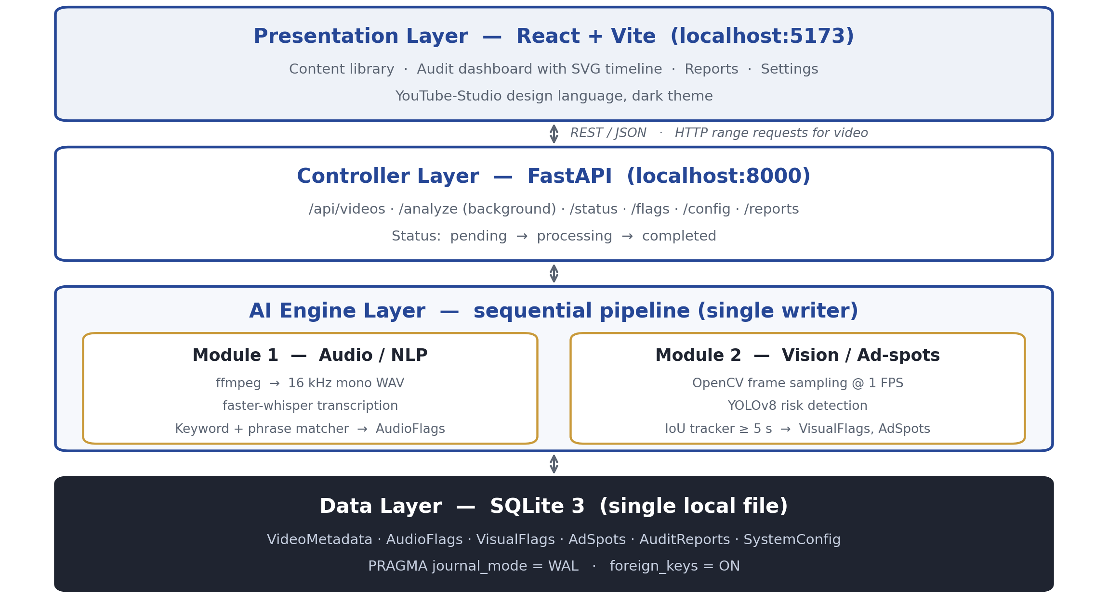
INTRODUCTION SYSTEM STUDY SOFTWARE DESIGN IMPLEMENTATION PROGRESS PROJECT MANAGEMENT CONCLUSION
SYSTEM ARCHITECTURE
Four layers — presentation, controller, AI engines, storage. All processing is local.
ADSAFE STUDIO
AY 2026–27
AUTONOMOUS VIDEO AD-PLACEMENT & CONTEXTUAL SAFETY ANALYZER
7 / 19

Slide 8
INTRODUCTION SYSTEM STUDY SOFTWARE DESIGN IMPLEMENTATION PROGRESS PROJECT MANAGEMENT CONCLUSION
SOFTWARE REQUIREMENT SPECIFICATION
FUNCTIONAL REQUIREMENTS
NON-FUNCTIONAL REQUIREMENTS
FR1 — Video ingestion and controller pipeline
FR2 — Audio extraction, transcription and keyword auditing
FR3 — Frame sampling at 1 FPS and visual risk detection
FR4 — Ad-spot geometry and persistence analysis
FR5 — Interactive dashboard, timeline and report export
Offline privacy — no media leaves the host machine
Performance — 1 FPS sampling; under 0.5× realtime on GPU
Accuracy — precision above 85% on the benchmark set
Reliability — ACID writes; WAL journal for concurrent reads
Usability — results interpretable without model knowledge
ADSAFE STUDIO
AY 2026–27
AUTONOMOUS VIDEO AD-PLACEMENT & CONTEXTUAL SAFETY ANALYZER
8 / 19

Slide 9
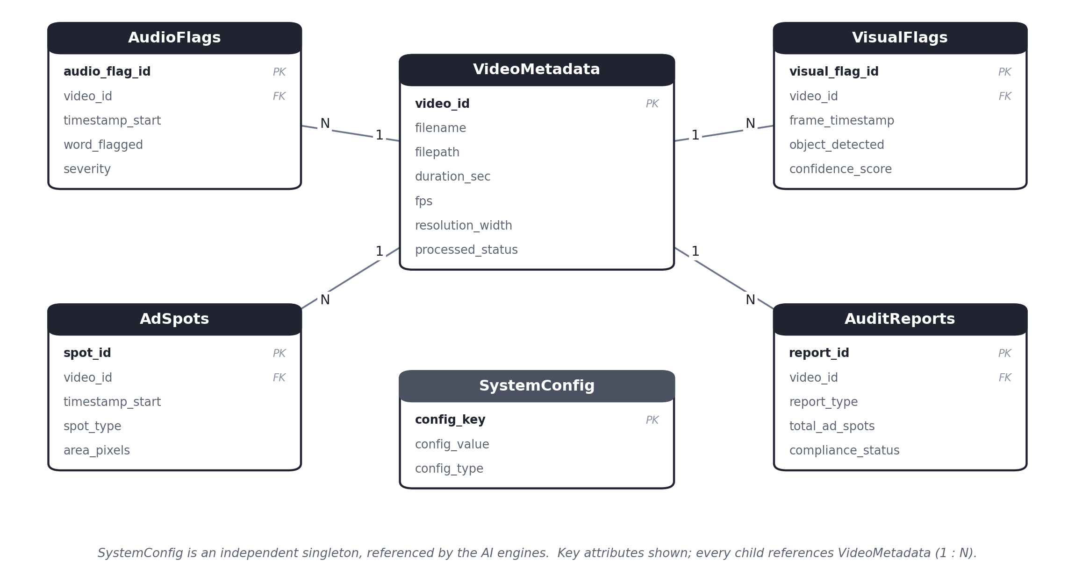
INTRODUCTION SYSTEM STUDY SOFTWARE DESIGN IMPLEMENTATION PROGRESS PROJECT MANAGEMENT CONCLUSION
DATABASE DESIGN
SCHEMA
VideoMetadata (parent)
AudioFlags · VisualFlags
AdSpots · AuditReports
SystemConfig (singleton)
INTEGRITY
1 : N from VideoMetadata
FK cascade on delete
CHECK on severity & status
Normalised to 3NF
Six entities; bounding boxes stored as atomic JSON arrays.
ADSAFE STUDIO
AY 2026–27
AUTONOMOUS VIDEO AD-PLACEMENT & CONTEXTUAL SAFETY ANALYZER
9 / 19

Slide 10
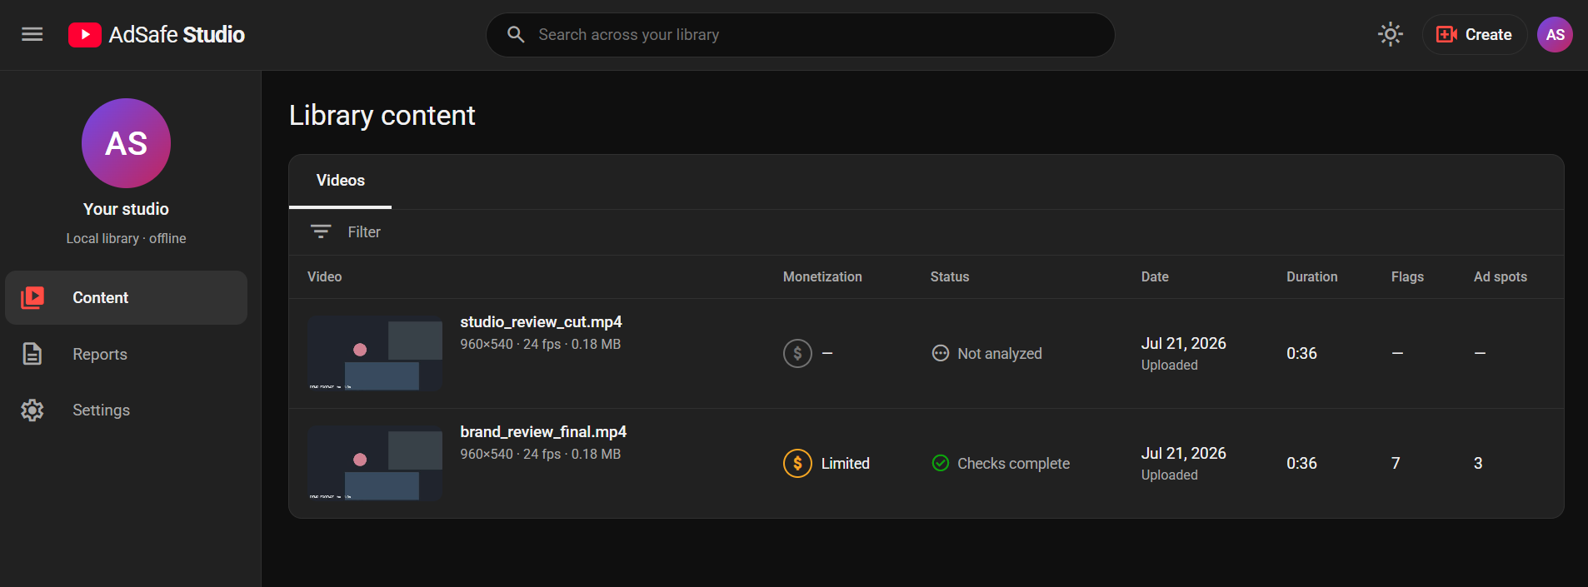
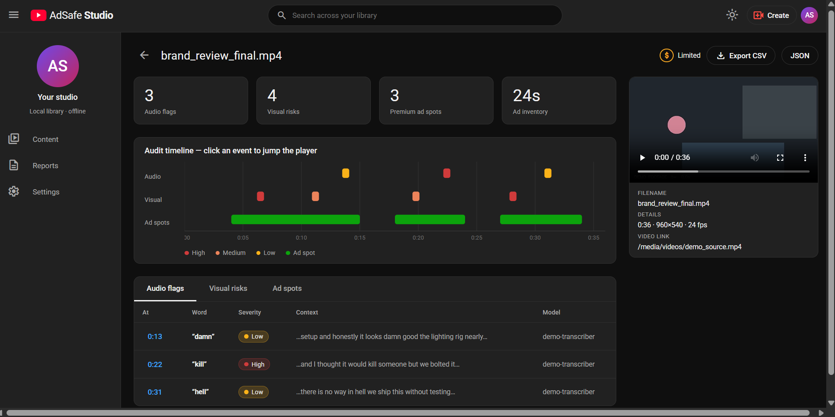
INTRODUCTION SYSTEM STUDY SOFTWARE DESIGN IMPLEMENTATION PROGRESS PROJECT MANAGEMENT CONCLUSION
USER INTERFACE DESIGN
Content library — monetisation status per video
Audit dashboard — timeline, player and flag tables
Content library — thumbnails, monetisation badge, live progress
Audit dashboard — timeline, player, filterable flag tables
Reports and Settings — CSV / JSON export; keyword dictionary and thresholds
ADSAFE STUDIO
AY 2026–27
AUTONOMOUS VIDEO AD-PLACEMENT & CONTEXTUAL SAFETY ANALYZER
10 / 19
Notes:
Replace the two schematics with live screenshots of the running application before the review.

Slide 11
INTRODUCTION SYSTEM STUDY SOFTWARE DESIGN IMPLEMENTATION PROGRESS PROJECT MANAGEMENT CONCLUSION
IMPLEMENTATION PROGRESS (40%)
Module | Status
Requirement analysis & synopsis | Completed
Software Requirement Specification | Completed
Database design & implementation | Completed
REST API — FastAPI controller | Completed
Web user interface — React | Completed
Compliance matcher & ad-spot tracker | Completed
Audio engine — transcription | In Progress
Vision engine — object detection | Pending
15 automated tests pass across the database, matcher and tracker modules.
ADSAFE STUDIO
AY 2026–27
AUTONOMOUS VIDEO AD-PLACEMENT & CONTEXTUAL SAFETY ANALYZER
11 / 19

Slide 12
INTRODUCTION SYSTEM STUDY SOFTWARE DESIGN IMPLEMENTATION PROGRESS PROJECT MANAGEMENT CONCLUSION
PROJECT DEMONSTRATION
MODULES DEMONSTRATED
Ingest a video — upload through the dashboard; metadata probed and stored
Run the analysis — background pipeline with live progress reporting
Review the timeline — colour-coded flags synchronised with playback
Inspect flag tables — audio, visual and ad-spot records with jump-to-time
Export a report — CSV / JSON summary, archived in the database
Adjust settings — edit the keyword dictionary and thresholds, then re-run
Note: the audio and vision models are stubbed behind their production interfaces; the demonstration exercises the real database, matching, tracking, API and UI code paths.
ADSAFE STUDIO
AY 2026–27
AUTONOMOUS VIDEO AD-PLACEMENT & CONTEXTUAL SAFETY ANALYZER
12 / 19
Notes:
Live demonstration is mandatory for this review.

Slide 13
INTRODUCTION SYSTEM STUDY SOFTWARE DESIGN IMPLEMENTATION PROGRESS PROJECT MANAGEMENT CONCLUSION
TOOLS AND TECHNOLOGIES
Technology | Purpose | Status
Python 3.12 | Core pipeline and engine development | In use
FastAPI + Uvicorn | REST API and pipeline orchestration | In use
React 18 + Vite | Interactive dashboard front end | In use
SQLite 3 (WAL) | Local relational database | In use
OpenCV | Frame sampling and thumbnails | In use
FFmpeg | Audio extraction and H.264 transcoding | In use
faster-whisper | Local speech-to-text transcription | Next
Ultralytics YOLOv8 | Visual risk object detection | Next
pytest | Automated regression testing | In use
Git & GitHub | Version control and collaboration | In use
ADSAFE STUDIO
AY 2026–27
AUTONOMOUS VIDEO AD-PLACEMENT & CONTEXTUAL SAFETY ANALYZER
13 / 19

Slide 14
INTRODUCTION SYSTEM STUDY SOFTWARE DESIGN IMPLEMENTATION PROGRESS PROJECT MANAGEMENT CONCLUSION
CHALLENGES FACED
CHALLENGE AND RESOLUTION
Detection classes unavailable — the pretrained COCO model has no weapon or cigarette class. Resolved with community risk-class weights, normalised at the detector boundary.
Concurrent database writes risked lock contention. Resolved by making the pipeline sequential with a single writer and a WAL journal.
Naïve substring matching flagged “gun” inside “gunmetal”. Resolved with tokenised word-boundary matching, covered by unit tests.
Generated test footage would not play in the browser. Resolved by transcoding through a bundled FFmpeg binary.
The standard action blue measured only 2.76 : 1 on the dark surface. Resolved with a theme-aware palette measuring 6.21 : 1.
ADSAFE STUDIO
AY 2026–27
AUTONOMOUS VIDEO AD-PLACEMENT & CONTEXTUAL SAFETY ANALYZER
14 / 19

Slide 15
INTRODUCTION SYSTEM STUDY SOFTWARE DESIGN IMPLEMENTATION PROGRESS PROJECT MANAGEMENT CONCLUSION
REMAINING WORK (60%)
Audio engine — integrate local transcription with word-level timestamps.
Vision engine — deploy risk-class detection weights with confidence-scored boxes.
Ad-spot algorithm — occupancy masking, edge density and largest-rectangle search.
PDF reporting — formatted export alongside CSV and JSON.
Testing and accuracy — build a benchmark set and verify the 85% requirement.
Optimisation, security testing, documentation and deployment.
Priority order: audio engine → vision engine → ad-spot algorithm → accuracy benchmarking.
ADSAFE STUDIO
AY 2026–27
AUTONOMOUS VIDEO AD-PLACEMENT & CONTEXTUAL SAFETY ANALYZER
15 / 19

Slide 16
INTRODUCTION SYSTEM STUDY SOFTWARE DESIGN IMPLEMENTATION PROGRESS PROJECT MANAGEMENT CONCLUSION
UPDATED PROJECT TIMELINE
Phase | Status
Requirement analysis | Completed
Literature review | Completed
Synopsis | Completed
Software Requirement Specification | Completed
Database design | Completed
User interface design | Completed
Backend & API development | Completed
Core AI module development | In Progress
Testing & accuracy benchmarking | Pending
Documentation | Pending
Deployment & packaging | Pending
ADSAFE STUDIO
AY 2026–27
AUTONOMOUS VIDEO AD-PLACEMENT & CONTEXTUAL SAFETY ANALYZER
16 / 19

Slide 17
INTRODUCTION SYSTEM STUDY SOFTWARE DESIGN IMPLEMENTATION PROGRESS PROJECT MANAGEMENT CONCLUSION
CONCLUSION
SUMMARY
40% delivered — design documentation, database, REST API and interface are complete.
The problem is evidenced: automated systems make most monetisation decisions and are demonstrably fallible.
A working skeleton runs end to end — 6 database entities in 3NF and 15 passing tests.
Remaining work is concentrated in the two AI engines, behind stable documented interfaces.
Expected completion: both engines integrated and benchmarked for Presentation-II.
Local processing gives creators the predictive check that platform pipelines apply only after publication.
ADSAFE STUDIO
AY 2026–27
AUTONOMOUS VIDEO AD-PLACEMENT & CONTEXTUAL SAFETY ANALYZER
17 / 19

Slide 18
INTRODUCTION SYSTEM STUDY SOFTWARE DESIGN IMPLEMENTATION PROGRESS PROJECT MANAGEMENT CONCLUSION
REFERENCES
Radford, A., Kim, J. W., Xu, T., et al. (2022). Robust Speech Recognition via Large-Scale Weak Supervision. OpenAI.
Jocher, G., Chaurasia, A., & Qiu, J. (2023). YOLO by Ultralytics. https://github.com/ultralytics/ultralytics
Bradski, G. (2000). The OpenCV Library. Dr. Dobb's Journal of Software Tools.
Google. YouTube Community Guidelines Enforcement — Transparency Report.
YouTube Help. Advertiser-friendly content guidelines.
IEEE Std 830-1998. Recommended Practice for Software Requirements Specifications.
Ramírez, S. FastAPI Documentation. https://fastapi.tiangolo.com
SQLite Consortium. Write-Ahead Logging. https://sqlite.org/wal.html
ADSAFE STUDIO
AY 2026–27
AUTONOMOUS VIDEO AD-PLACEMENT & CONTEXTUAL SAFETY ANALYZER
18 / 19

Slide 19
INTRODUCTION SYSTEM STUDY SOFTWARE DESIGN IMPLEMENTATION PROGRESS PROJECT MANAGEMENT CONCLUSION
Thank You
Questions and Discussion
Akash Ganesh · Andrew Judah · Andrew Shelton S · Ramona Elisha Mary
ADSAFE STUDIO
AY 2026–27
AUTONOMOUS VIDEO AD-PLACEMENT & CONTEXTUAL SAFETY ANALYZER
19 / 19

