Slide 1
GSOE9011 | GROUP 95 | ELEVATOR PITCH
Traffic forecasts fail exactly when
we need them most.
Context-Aware Deep Learning for Non-Recurring Traffic Congestion Forecasting
Zhilin Ye z5719978
A 12-month research proposal - Greater Los Angeles freeway network

Slide 2
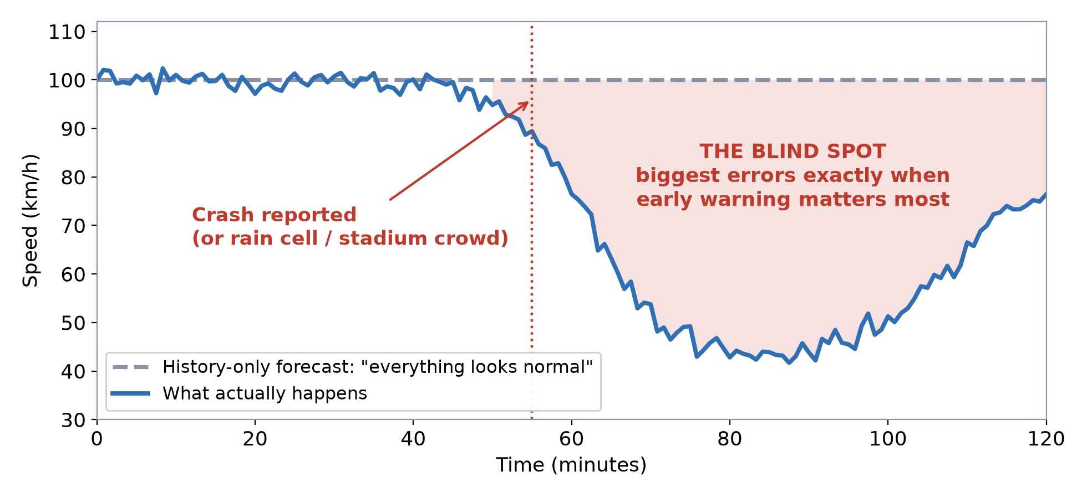
The problem: a blind spot worth billions of lost hours
Deep-learning models learn routine weekday patterns from millions of sensor readings - then a crash, a rain cell or a stadium crowd changes everything in minutes.
Group 95 - Context-Aware Deep Learning for Non-Recurring Traffic Congestion Forecasting
2

Slide 3
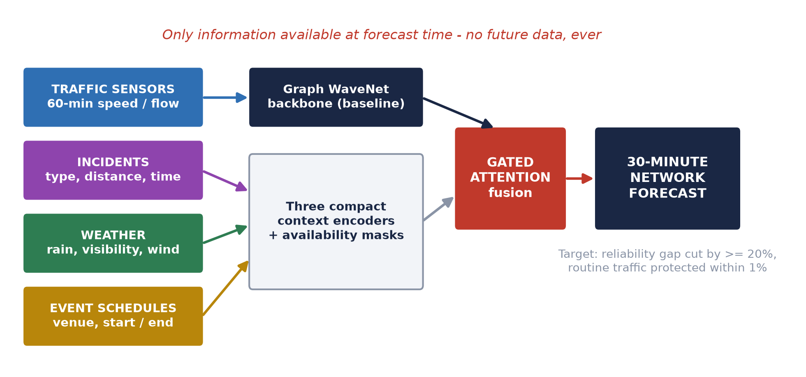
Our idea: give the model the context it cannot see
One falsifiable question: can context cut the 30-minute error gap between normal and disrupted traffic by at least 20% - without hurting everyday forecasts by more than 1%?
Group 95 - Context-Aware Deep Learning for Non-Recurring Traffic Congestion Forecasting
3

Slide 4
Why you can trust the answer
REAL DATA, AT SCALE
3 years of 5-minute data (2022-2024), hundreds of LA freeway sensors, aligned incidents, NOAA weather, venue event calendars.
A FAIR FIGHT
Context model vs matched Graph WaveNet baseline: same backbone, same leak-free chronological splits, same tuning budget.
BUILT-IN LIE DETECTOR
Source-by-source ablations, a parameter-matched control, and a shuffled-context negative control that exposes fake gains.
SUCCESS DEFINED IN ADVANCE
Pre-registered decision rules with bootstrap confidence intervals - the experiment can pass, fail, or be inconclusive. All three are useful.
Group 95 - Context-Aware Deep Learning for Non-Recurring Traffic Congestion Forecasting
4

Slide 5
Reliable forecasts when it matters most.
▪ Travellers & freight - trustworthy travel times during disruption
▪ Emergency services - earlier warning, faster response
▪ Traffic-management centres - act 30 minutes ahead, not behind
▪ Transport agencies - evidence on which data feeds are worth buying
Whatever the outcome, agencies get an auditable answer to one question:
is context data worth investing in? Thank you.

