Slide 1
GSOE9011 | GROUP 95 | INDIVIDUAL PRESENTATION
Experimental Design & Feasibility
for Context-Aware Non-Recurring Traffic Congestion Forecasting
Zhilin Ye z5719978
My role: defining evaluation episodes, leakage controls, metrics & decision rules,
ablations, sensitivity analysis and risk planning

Slide 2
CONTEXT
The project in one minute
Can incidents, weather and event schedules make 30-minute traffic forecasts reliable during disruptions,
when models trained on routine sensor patterns fail exactly when early warning matters most?
RESEARCH QUESTION (pre-registered)
Can a context-aware deep-learning model integrating traffic sensors, incidents, weather and major-event schedules reduce the 30-minute MAE gap between recurring and non-recurring congestion by at least 20% versus a matched traffic-history baseline, while keeping recurring-congestion MAE within a 1% non-inferiority margin?
Greater Los Angeles freeway network | TraffiDent / PeMS 2022-2024 | NOAA weather | venue event calendars
MY ROLE
The research question is a falsifiable, quantified claim. My job was to design the experiment that makes this claim testable: fairly, reproducibly, and within a 12-month budget.
Zhilin Ye z5719978 | Group 95 | GSOE9011
2

Slide 3
OVERVIEW
My contribution: four building blocks
1. Evaluation episodes
What transparently counts as recurring vs non-recurring congestion; exposure rules for incidents, weather and events.
Proposal § 4.3
2. Leakage controls
Chronological 60/20/20 splits, 7-day embargoes, episode-safe boundaries, forecast-time availability rules.
Proposal § 4.3, 4.5
3. Metrics & decision rules
MAE / WAPE choice, episode-block bootstrap, pre-registered 20% gap reduction and 1% non-inferiority criteria.
Proposal § 2.4, 4.5
4. Ablations, sensitivity & risk
E0-E8 comparison set, negative controls, alignment sensitivity envelope, month-1 feasibility audit.
Proposal § 4.5, 4.6
Together these turn the group's model idea into an auditable experiment.
Zhilin Ye z5719978 | Group 95 | GSOE9011
3

Slide 4
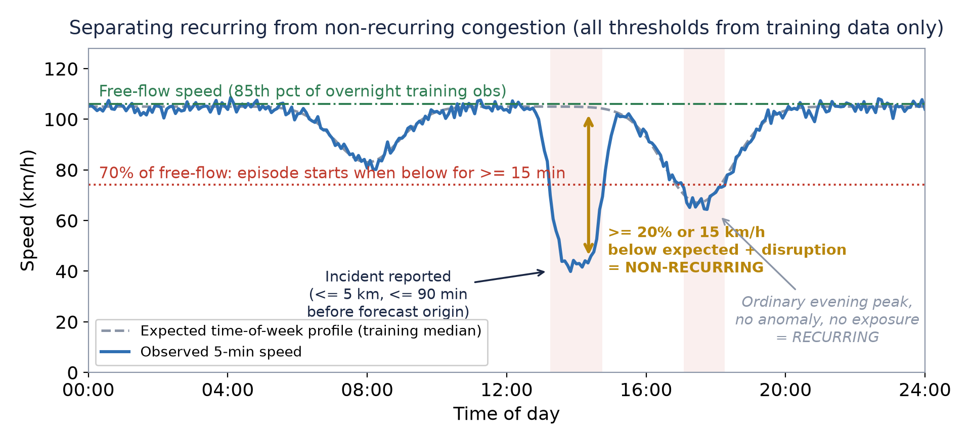
BLOCK 1 · § 4.3
Defining what counts as non-recurring congestion
▪ Problem: a detector fault, an ordinary peak and a crash queue all look like "low speed".
▪ Every threshold from training data only: free-flow = 85th pct of overnight obs; episode = < 70% free-flow for ≥ 15 min.
▪ Non-recurring needs two signals: ≥ 20% / 15 km/h below expected profile AND an independently recorded disruption.
▪ Labels stratify evaluation only - never training targets, so the model cannot learn the labels.
Answers tutor feedback #9: "define how it will be labelled experimentally".
Ambiguous cases are excluded from the primary analysis and reported in sensitivity analysis.
Zhilin Ye z5719978 | Group 95 | GSOE9011
4

Slide 5
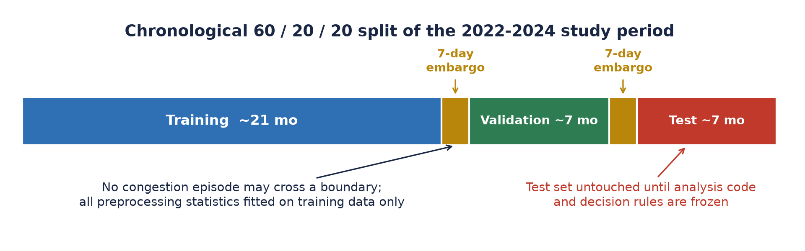
BLOCK 2 · § 4.3, 4.5
Leakage controls and a fair comparison
▪ Random splits leak: two windows of the same crash land in train AND test.
▪ Forecast-time rules: no final incident duration, no future weather at origin t.
FAIRNESS BY CONSTRUCTION (with Zhenyu)
▪ Same backbone: baseline and context model share the Graph WaveNet encoder, splits, target and tuning budget.
▪ E8 capacity control: a widened, parameter-matched traffic-only model - so a win cannot be explained by "more parameters".
Zhilin Ye z5719978 | Group 95 | GSOE9011
5

Slide 6
BLOCK 3 · § 2.4, 4.5
Pre-registered decision rules and statistics
Condition (ALL three required) | Criterion
1. Reliability gap G = MAE(non-rec) - MAE(rec) | Reduced by ≥ 20% vs Graph WaveNet baseline
2. Non-recurring improvement is real | 95% episode-block bootstrap CI excludes zero (10,000 resamples, 5 seeds)
3. Routine traffic is protected | Recurring MAE upper confidence bound within 1% of baseline
▪ Why MAE? Directly interpretable in km/h; RMSE is dominated by extreme errors; WAPE replaces MAPE, which explodes in stop-and-go traffic near zero speed.
▪ Why episode-block bootstrap? Overlapping 5-min windows are not independent - resampling whole episodes preserves within-episode dependence. Diebold-Mariano as secondary diagnostic; Holm correction across ablations.
BUILT-IN LIE DETECTOR (E7)
Re-run the model with context shuffled within time-of-day. If shuffled context still "helps", the pipeline is lying to us.
Zhilin Ye z5719978 | Group 95 | GSOE9011
6

Slide 7
BLOCK 4 · § 4.6
Feasibility first: risks, triggers, contingencies
The biggest risk is not building the model - it is having too few well-aligned non-recurring episodes to say anything meaningful.
Risk | Early trigger | My contingency
Too few non-recurring episodes | < 200 test episodes or < 30 per source | Month-1 audit BEFORE building anything; relax completeness gate to 85%, extend to next-largest connected component
Event data incomplete | Missing venue dates or unverifiable reuse terms | Official public schedules only; demote event ablation to exploratory before test access
Context model overfits | Validation gain vanishes across seeds, or shuffled context helps | Fall back to simple concatenation; strengthen regularisation; keep negative controls
Compute exceeds budget | One trial > 24 h or memory limit | Sensor cap (300-800 stations), mixed precision, fixed trials, early stopping
Even if the 20% target is not met, the project still succeeds: the threshold is a decision rule, not a promised result.
Zhilin Ye z5719978 | Group 95 | GSOE9011
7

Slide 8
“A model idea becomes research only when the experiment around it is trustworthy.”
▪ Connective tissue: aligned data-quality assumptions with Xin and comparison fairness with Zhenyu, so one set of definitions runs through data, model and evaluation.
▪ Feasibility as design: episode-count audit, compute caps and pre-declared fallbacks are built into the plan, not patched on later.
▪ The real product: an auditable answer to when and where context data actually helps - my job was to make that answer worth believing.
Thank you | Zhilin Ye z5719978

