Slide 1
System Planning and Development
Learning Objectives:
Explain the importance of and steps in IT planning
Describe the SDLC
Explain the challenges involved in systems development
Enumerate and explain the principles of agile systems development methods

Slide 2
The benefits of standardization in planning
Cost saving
When the organization decides to purchase the same hardware or software for all its units, it has better bargaining power and therefore can obtain lower prices from vendors.
Efficient training
It is easier to train employees how to use a small variety of software than to train them how to use a large variety.

Slide 3
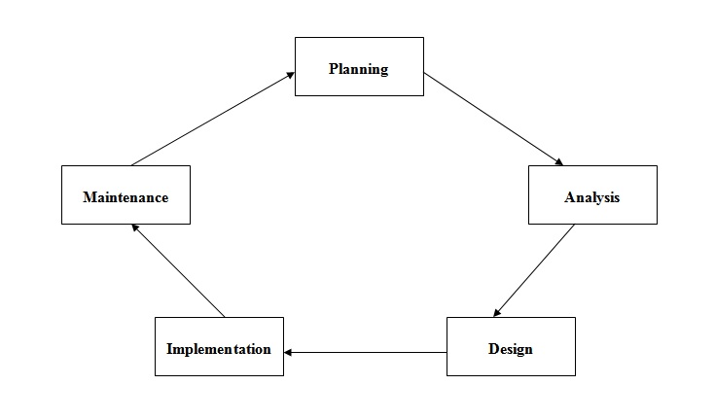
Efficient support
Standardizing on a small no. of comp. Models and software app. Enables the IT staff to specialize in the hardware and software they have to support.
The System Development Life Cycle
Large IS that address structured problems (accounting, payroll, enterprise software app.)

Slide 4
Analysis
Involves 5 step process
Investigation
Determine whether there is a real need for a system and whether the system is feasible.
What is the business process that the system is to support?
What business opportunity do you want the system to seize, what problems do you want it solve, or what directive must you fulfill?

Slide 5
Technical feasibility study
A new IS is technically feasible if its components exist or can be developed with available tools.
Should also consider the org. existing commitment to:
Hardware
Software
Telecommunication equipment
Is there a technology to create the new system?

Slide 6
Economic Feasibility
The benefits of the new system must outweigh the cost
Cost/benefit analysis
ROI
Operational cost:
Software license fees
Maintenance personnel
Telecommunications
Power & computer related supplies
What resources do you need to implement the system?

Slide 7
Operational Feasibility study
The purpose of the operational feasibility study is to determine whether the new system will be used as intended.
Will the system fit into the culture of this org?
Will all the intended users use the system to its full capacity?
Will the system interfere with company policies or statutory laws?
System requirements
The system should be able to do and the means by which it will fulfill its stated goal.

Slide 8
Design
Comprises of 3 steps:
Description of components & how they work
Construction
Testing
DFD
Data Flow Diagram
Used to describe the flow of data in a business operation using symbols.

Slide 9
DFD Symbols
Entity
Process
Data Store
Flow of Data

Slide 10
External entities
Individuals and groups of people who are external to the system. (customers, employees, depts.)
Origin or destination of data.
Process
Work or action performed on data.
Data store
Is any form of data at rest
Represent physical locations for data.
Data flow
Data in motion, moving from one place in a system to another.
Labeled with a meaningful name for the data in motion.

Slide 11
Context diagram
Highest level view of a system
An overview of an org. system that shows the system boundaries, external entities that interact with the system, and the major info. Flows between the entities and the system.
CUSTOMER
KITCHEN
Food Ordering System
0
Customer Order
Receipt
Food Order
RESTAURANT MANAGER

Slide 12
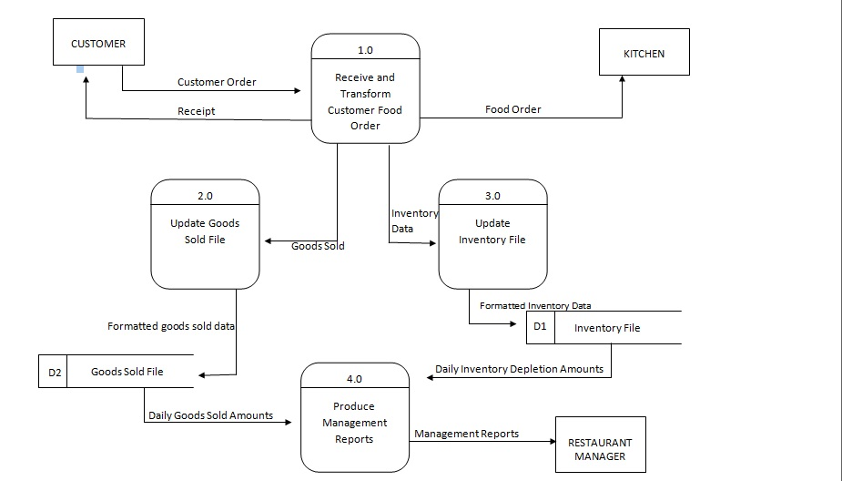
Level-0 Diagram

Slide 13
Level-0-Diagram
DFD that represents a system’s major processes, data flows, and data stores.
Data Flow Diagramming Rules
The inputs to a process are different from the outputs of that process.
Processes transform inputs into outputs
2. Object on a DFD have unique names.
Every process has a unique name.

Slide 14
Process:
No process can have only outputs.
No process can have only inputs.
Verb phrase label.
Data Store:
Data cannot move directly from 1 data store to another.
Data cannot move directly from an outside source to a data store.
Has a noun phrase label.
Source/Sink:
Data cannot move directly from a source to sink
Has a noun phrase label.

Slide 15
Data Flow:
Has only 1 direction of flow between symbols.
Fork in a data flow means that exactly the same data goes from a common location to 2 or more different processes, data stores, or source/sinks.
Join in a data flow means that exactly same data come from any 2 or more different processes, data stores, or source/sinks.
Data flow cannot go directly back to the same process it leaves.
Data flow to a data store means update.
Data flow from a data store means retrieve or use
Data flow has a noun phrase label

Slide 16
UML
Unified Modeling Language
Graphical standard for visualizing, specifying, and documenting software.
Class Diagram
Sequence Diagram
Collaboration Diagram
Activity Diagram
Use Case Diagram

Slide 17
Use Case
Shows system’s behavior or functionality under various conditions as the system responds to a request from users.
Actor
External entity that interacts with the system
Someone or something that exchanges info. With the system.

Slide 18
For identifying use cases:
What are the main tasks performed by each actor?
Will the actor read or update any info. In the system?
Will the actor have to inform the system about changes outside the system?
Does the actor have to be informed of unexpected changes?

Slide 19
Use case
Represented as an ellipse
Each use case represents a single system function.
System boundary
Is represented as a box that includes all of the relevant use cases.
Connections
A solid line connecting an actor to a use case shows that the actor is involved in that particular system function.

Slide 20
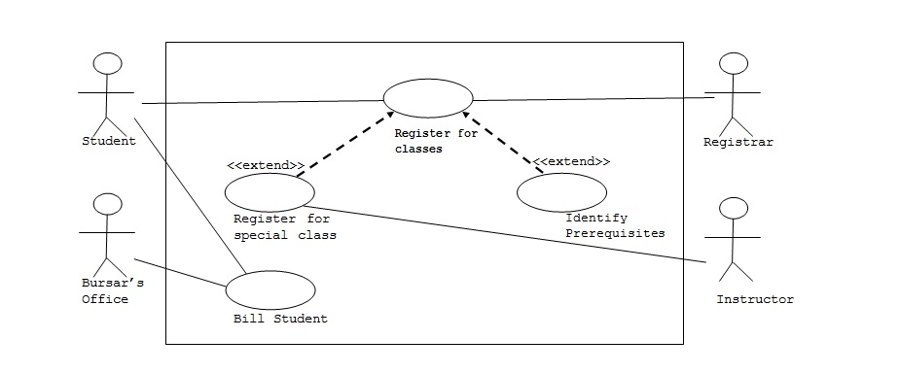
Extend Relationship
Extends a use case by adding new behaviors or actions.

Slide 21
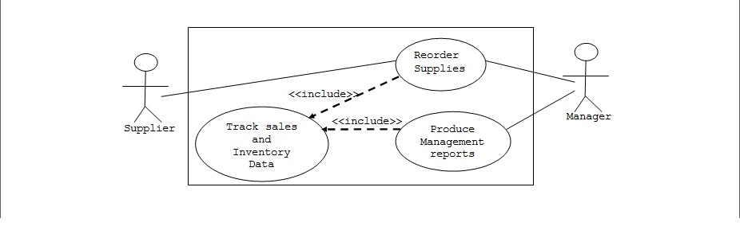
Include Relationship
Implies that the use case where the arrow originates uses the use case where the arrow ends while it is executing.

Slide 22
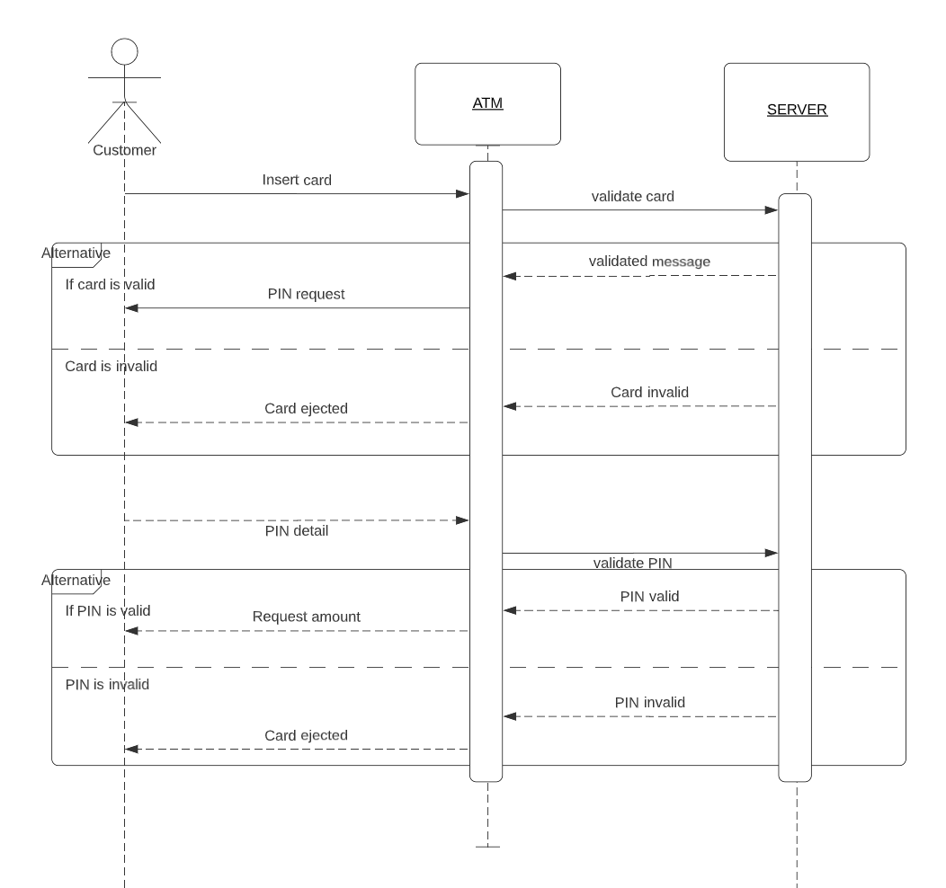
Sequence Diagram

Slide 23
Construction
Predominantly programming
Implementation
Coding
Testing
Installation
Documentation
Training
Support

Slide 24
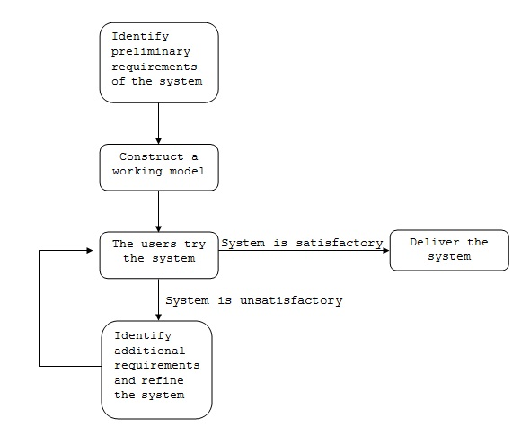
Agile Methods
Treat software development as a series of contacts with users, with a goal of fast development of software to satisfy user requirements, and improving the software shortly after users request modification.

Slide 25
Risk:
Analysis phase is minimal!
Developers devote most of their time to construction and little time to documentation.
When to use agile methods
Efficient approach to development when a system is small.
When the users cannot specify all their requirements at the start of the project.
When not to use agile methods
If a system is large and complex
Designed to interface with other systems

Slide 26
END OF THE TOPIC!

