Slide 1

Socorex Care Guide
OpSciHack 2026
Andrey Sinyavskiy
  Sara Kadesch
Notes:
Welcome, and thank you all for being here.
Socorex develops wet-lab instruments based on the principles of a circular economy, with products designed to be disassembled, maintained, repaired, and reused.

Slide 2
Table of Contents
1. Problem Understanding & Relevance
2. Solution & Innovation
3. Sustainability & Research Efficiency
4. Feasibility & Usability
5. Limitation & next Steps

Slide 3
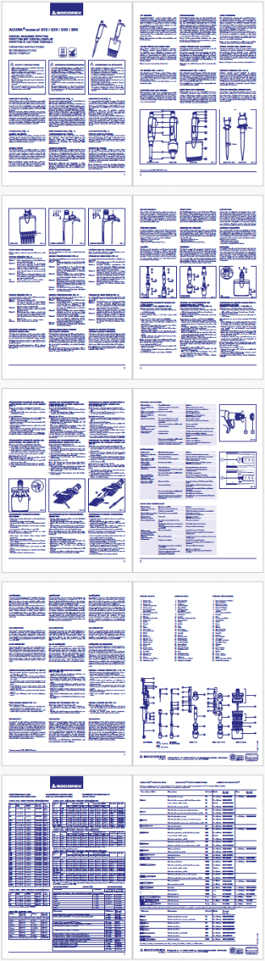
Problem Understanding & Relevance
How can the maintenance and calibration guidance be redesigned to:
Reduce user uncertainty and practical difficulties
Improve user-friendliness and accessibility
Notes:
Problems:
Maintenance and calibration guidance is difficult to navigate
Users may experience uncertainty, confusion, and practical difficulties
Limited accessibility and user-friendliness of relevant information

Slide 4
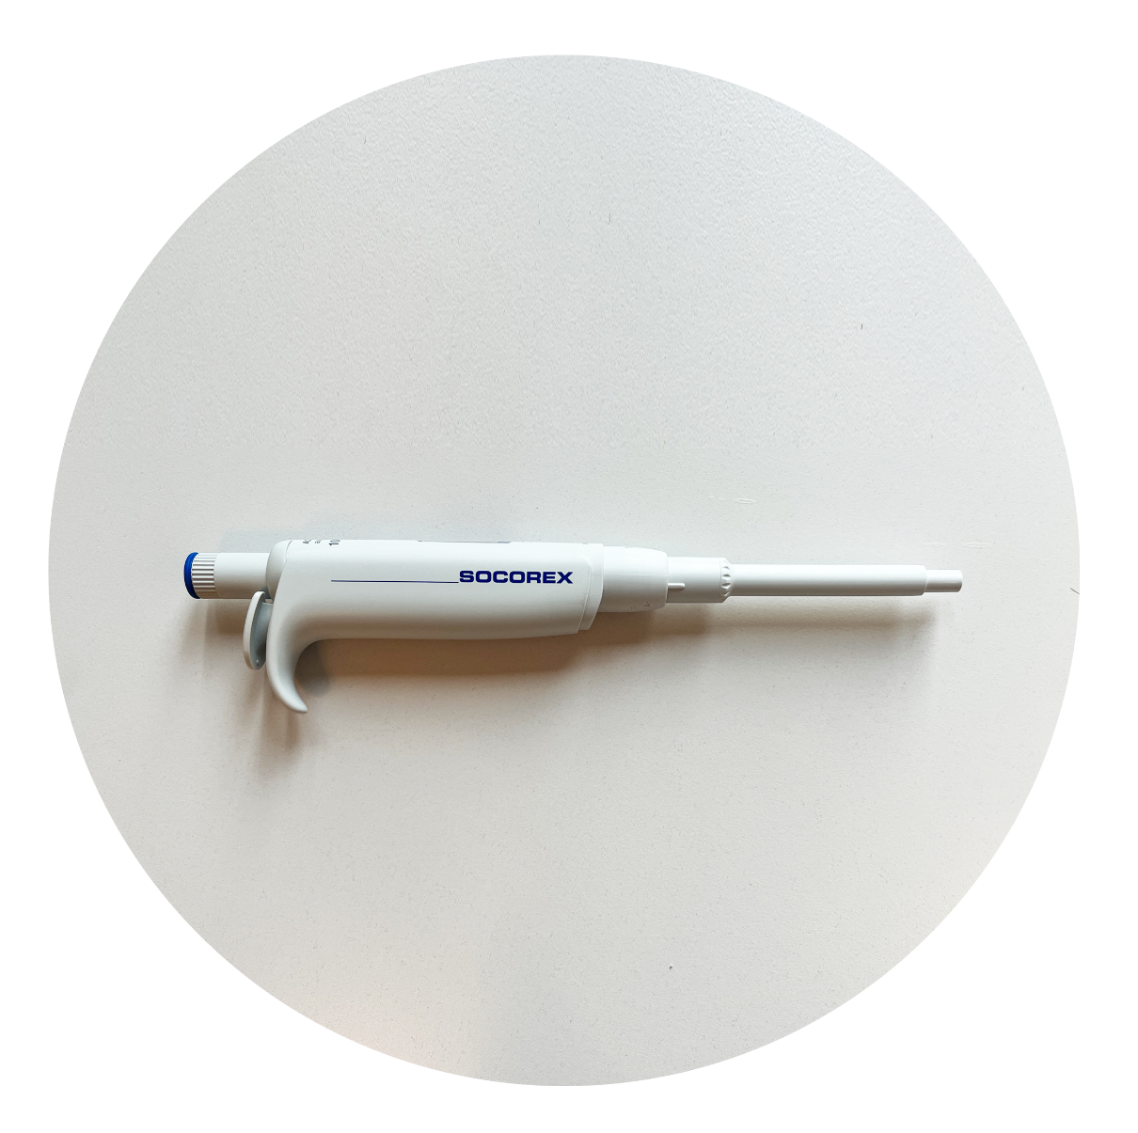

Problem Understanding & Relevance
Acura Manual 825
Notes:
We focused on the Acura Manual 825, a manual pipette designed for reliable and precise volume adjustment.

Slide 5
Problem Understanding & Relevance
Method
Identify usability issues, information gaps and points of uncertainty
Analyse Acura Manual 825
Mapped customer journey across the website, manual, YouTube
Socorex Care Guide
Notes:
Analyse Acura Manual 825
Mapped the customer journey across the website, online manual, YouTube.
Identify practical difficulties, information gaps, and points of uncertainty

Slide 6
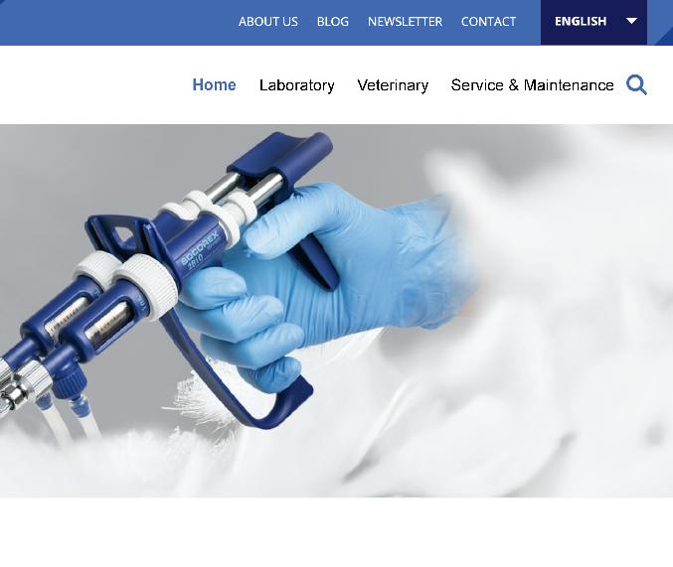
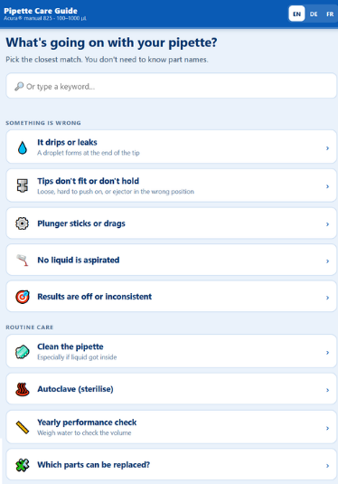
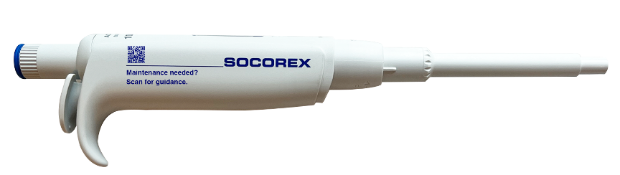
Solution & Innovation
A Guided Path to the Page You Need
3.
Targeted instructions and solutions
1.
User encounters a product issue
2.
Guided Q&A
Notes:
The idea is to guide the user from the problem to the right solution.
First, the user encounters a product issue.
Then, a guided Q&A in form of decision tree will helps narrow down the problem.
Finally, the user is directed to targeted instructions and a practical solution.

Slide 7
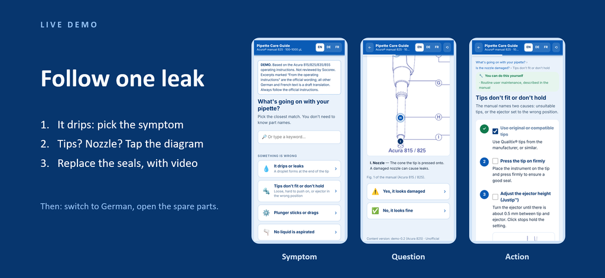
Solution & Innovation

Slide 8
Sustainability & Research Efficiency
Instruments designed to last only last if they are maintained
Simplify the maintenance journey
Reduce printed documentation
Easier updates through centralised digital information
Reusable framework across the Socorex product portfolio
Notes:
Simplify the maintenance journey with a Care Guide linking manuals, videos, and troubleshooting support
Reduce printed documentation through product-specific QR codes linking directly to the Care Guide
Easier updates through centralised digital information
Reusable framework across the Socorex product portfolio

Slide 9
Limitation & Next Steps
Most important next step:
Technical review by Socorex
User feedback from novices and technicians
Extend to mobile and add QR codes across the product portfolio
Enable easy content updates with a form-based editor and live preview
Notes:
Mobile version & OR codes
Form based editor for contentr.json

Slide 10
Q&A
How do you make sure the safety content is right? Every step quotes or closely follows the official manual and shows its page number. Nothing goes live without a technical review by Socorex. That is our first next step.
Why not just videos? Videos are embedded where they exist. But at the bench you need something you can scan with gloves on, in your language, and a video cannot show a parts diagram you tap or an outcome you can decide on.
How do you add another instrument? Write another content file. The app does not change.
Who decides what users may do themselves? Socorex. The outcome labels come straight from the manual (user maintenance, calibration, return to dealer). Where the manual is unclear, we flagged it as a gap instead of guessing.
Feedback and privacy? Optional and anonymous by default. Only a short text and the page it was sent from.
What evidence do you have? We reviewed the manual and found multiple gaps. We have no user tests yet. We would measure time to answer, tasks finished unaided and service requests avoided.
Which licence? MIT for everything. Excerpts and figures from the Socorex operating instructions, and the Socorex videos, remain the property of Socorex and are not covered by this licence.
Notes:
Mobile version & OR codes
Form based editor for contentr.json

