Slide 1

Health Insurance Call Centre Daily Performance
For confidentiality reasons, all sensitive information has been removed, and some data have been artificially generated

Slide 2
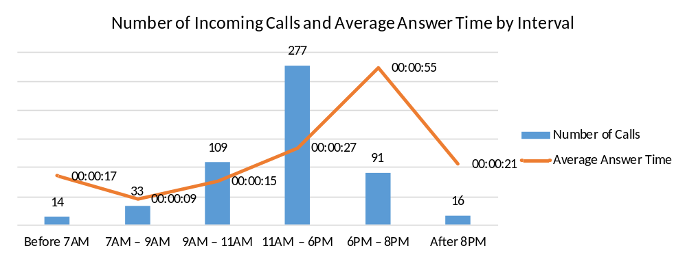
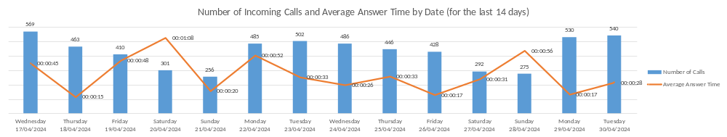
1. Number of Calls and Average Answer Time
Summary for the entire reporting period:
Late evenings on working days had the longest answer times, and the highest rate of missed calls.
The outsourced provider returned up to 70% of overflow calls back to the main line, indicating severe performance issues.
General calls represented only a small share of total activity. Most calls were medical requests, with service approval calls being the most frequent. A large proportion of calls fell into the “Other” category
Overall customer satisfaction remained relatively high despite long waiting times and missed calls.

Slide 3
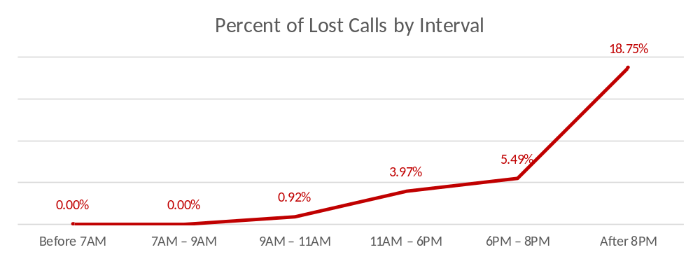
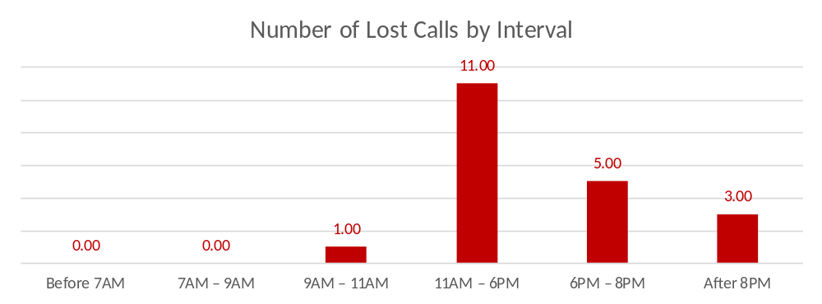
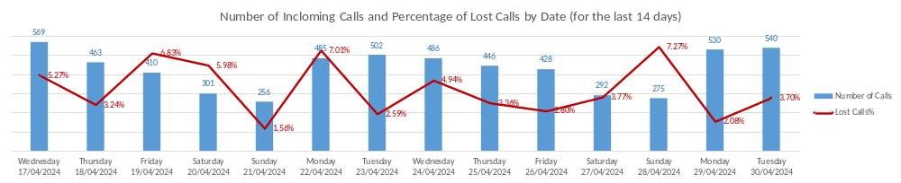
2. Lost Calls

Slide 4
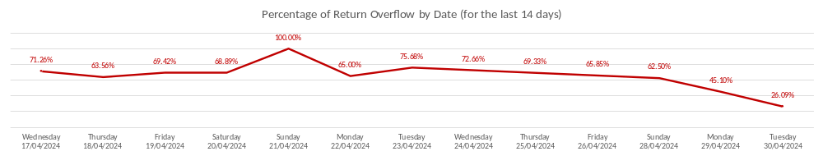
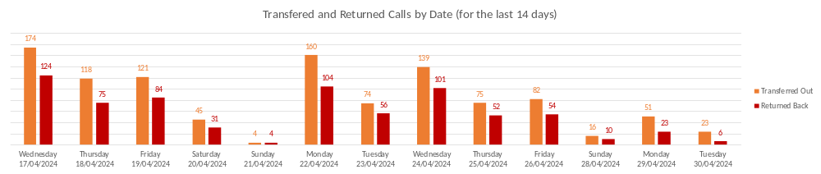
3. Outsourced Call-Center Performance

Slide 5
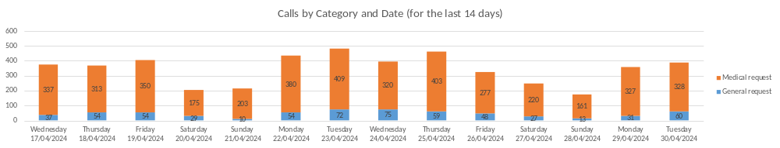
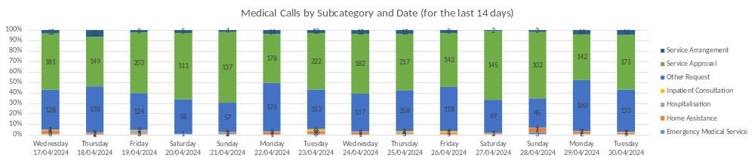
4. Call Types

Slide 6
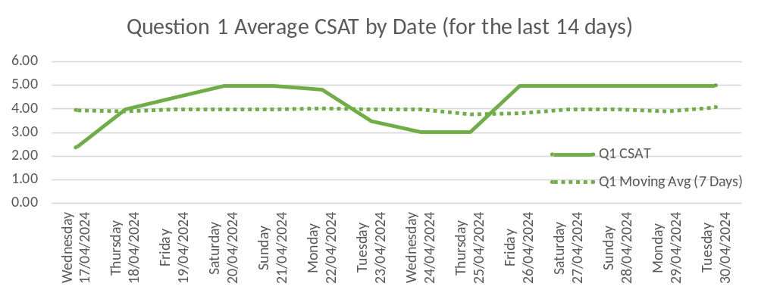
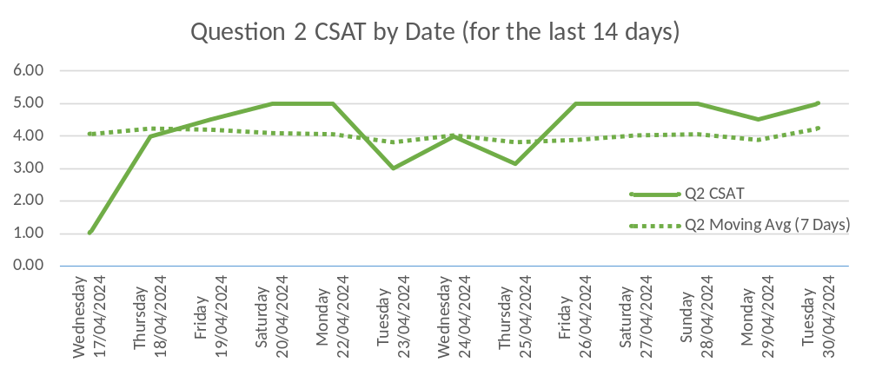
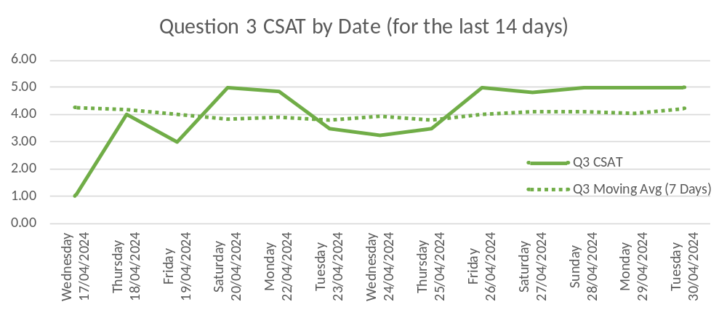
5. Customer Satisfaction Score (CSAT)
To obtain immediate feedback and evaluate the quality of call-centre services, all callers were asked to provide ratings on a scale from 1 to 5.
Question 1 assesses whether the caller’s inquiry was successfully resolved during the interaction with the call centre.
Question 2 evaluates the caller’s level of satisfaction with the waiting time.
Question 3 measures the caller’s overall satisfaction with the call-centre service.

