Slide 1

RequireJS

Slide 2
Overview
World before AMD
What AMD is trying to solve
RequireJS
Implementation of user management application with RequireJS + Jquery + Underscore

Slide 3
World before AMD
Sites are turning into complex web apps
Scripts are loaded into the blocking way
Code complexity grows as a result global scope is polluting
There are no clear dependencies
Deployment wants optimized code which is not suitable for the development

Slide 4
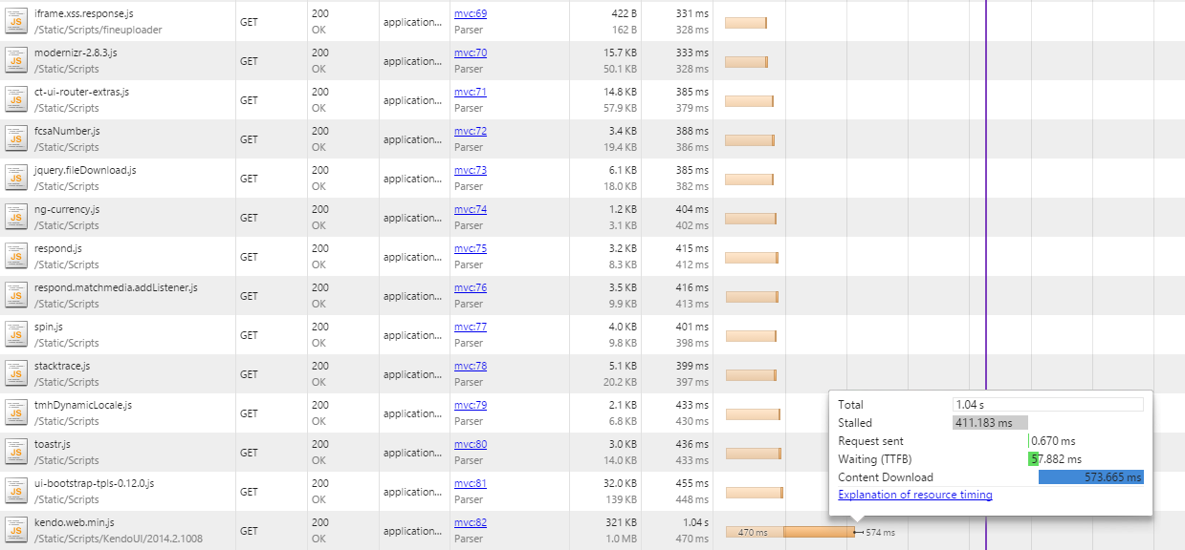
Loading scripts sample

Slide 5
Loading scripts sample
So what is the issue?
Browser is limited to the number of requests it can make to the certain domain
Scripts are not executed in parallel
And yeah that was not whole app
Whole app required 179 requests to be made and required 5 seconds just to load and execute all scripts

Slide 6
What is wrong with that?
Slow
You need to handle dependencies on your own
Global scope polluting

Slide 7

AMD
Asynchronous module definition (AMD) is a JavaScript specification that defines an API for defining code modules and their dependencies, and loading them asynchronously if desired. Implementations of AMD provide the following benefits:
Website performance improvements. AMD implementations load smaller JavaScript files, and only load them when they're needed.
Fewer page errors. AMD implementations allow developers to define dependencies that must load before a module is executed, so the module doesn't try to use outside code that isn't yet available.
In addition to loading multiple JavaScript files at runtime, AMD implementations allow developers to encapsulate code in smaller, more logically-organized files in a way similar to other programming languages such as Java. For production and deployment, developers can concatenate and minify JavaScript modules based on an AMD API into one file, the same as traditional JavaScript.
http://en.wikipedia.org/wiki/Asynchronous_module_definition

Slide 8
AMD remarks
This is specification not the technology
This is just the basis for libraries like:
RequireJS
CommonJS
And many others

Slide 9
So RequireJS brings us?
Async script loader
Encapsulation
Nested dependencies support
Avoiding polluting of global scope
Optimization tool for JS/CSS

Slide 10
Let’s start with configuration
<!-- will load require and then load configuration from main.js --> <script data-main="scripts/main.js" src="scripts/require.js"></script> <!-- or you can add path to require config inside of require function --> <script> require('src="scripts/main.js"',function(){ //config is loaded }); </script> <!-- or you can simply load configuration after require.js --> <script src="scripts/main.js"></script> <!-- or execute it right on the page --> <script> require.config({ //configuratiob goes here }); </script>

Slide 11
So what can be in the configuration
requirejs.config({ //base path to the scripts baseUrl: '/Scripts' //get part of the url that would be added to the scipt path //normally is used to fix caching ,urlArgs: 'rev=1' //unfortunately not all of the libraries follow AMD //so if you face such library it needs to be added to shims //as a result you may work with like it is being AMD module ,shim: { bootstrap: {deps: ['jquery']} } //if I have long path to some file or file is
//version specific or being outside of root folder //I can easily provide name association ,paths: { "bootstrap-clickover": "../SomePathToTheFile/Scripts/bootstrapx-clickover", "jqueryUI": "jquery-ui-1.10.3" } }); //well yeah I can load common application modules right here require(["jquery","underscore"]);

Slide 12
Few words on dependency management
Dependencies can be nested
Loaded once and used in multiple locations
You can load html pages or other resources as dependencies as well

Slide 13
Let’s define a module
//Let's define a module //in the array we list module dependencies //then we pass dependencies to the function define(['jquery', 'underscore'], function ($, _) { //Define the module value by returning a value. return function () { return { getSomething: function(){}, data: {} }; }; //or we can return object return {}; });

Slide 14
Let’s define a module that can work in both modes
if ( typeof define === "function" && define.amd ) { define( "myModule", [], function() { return mymodule; }); }

Slide 15
What is the difference?
So what is the difference between passing them as function arguments or inject them via require?

Slide 16
What is the difference?
Constructor injection
Service locator

Slide 17
So what are the main pros
We can clearly see module dependencies
We receive them as arguments or can load them into variables
We do not add anything to the global scope
If there is no dependency we will get clear error
External code does not affect us

Slide 18
How would we use it on the page and initialize module?
//list module or modules you need to run the code //in this case domReady just ensures that callback is fired after page load //as a last argument specify function which will accept AMD results //and will be called when all scripts are loaded require(['pageStartModule','domReady'], function (pageStart) { pageStart.run({ //initial data }); });

Slide 19
RequireJS optimizer (r.js)
Files uglifying (minimizes content size)
Files concatenation (minimizes number of requests)
https://github.com/jrburke/r.js/

Slide 20
Optimizer high level overview
You create configuration file (js)
Run r.js either from node, java or browser

Slide 21
Configuration file structure
You create configuration file (js)
Run r.js either from node, java or browser

Slide 22
Configuration file sample
{ baseUrl: '/Scripts' ,dir: 'Outputpath' ,generateSourceMaps: true ,preserveLicenseComments: false ,shim: 'shims contiguration' ,paths: 'paths configuration‘ ,modules: [ { name: 'main' ,include: ['domReady'] ,exclude: [] } ]}

Slide 23
What’s next?
Let’s create sample application.
User management page (CRUD)
With JQuery, RequireJS, Underscore

Slide 24
Homework
Reimplement the page
Add ability to sort users
Add paging
API Endpoint: http://lohika-js-course.herokuapp.com/User

Slide 25


