Slide 1


SailsJS
Developing REST services

Slide 2

What is SailsJS?
MVC backend framework for Node.js
Built on top of Express
Inspired by Ruby on Rails / Zend
Convention over configuration
Ideal for real time applications, games, REST services

Slide 3
Core features
Database agnostic (Waterline ORM)
Front end agnostic
Auto generated REST API
Auto generated model methods
DB migration support
Easy web socket support
Flexible configuration
Multiple environments support
Localization support
Still allows to use Express or integrate other frameworks

Slide 4
Installation and first application
npm I –g sails //installs framework
cd to your project folder
sails new //or you can pass path as argument
npm install //installing package dependencies
run sails lift

Slide 5
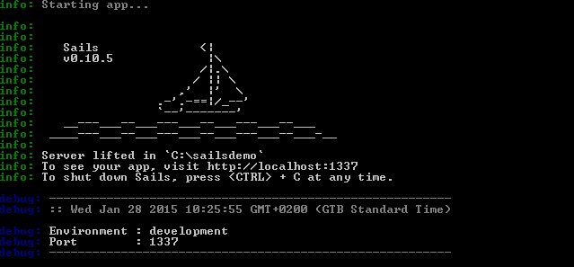
Running application

Slide 6
Project structure
api/controller – controllers
api/model – models
api/policies – policies
api/responses – application responses
api/services – reusable services
assets – static assets
config – application configuration settings
views – application views
tasks – grunt cli tasks

Slide 7
Generate API Sample
Sails generate api Category
What just has happened:
  CategoryController is created
  Category model is created
  Sails created blueprint for route /category
Let’s run the app
Model and controller can be generated same way
Notes:
Controller or Model

Slide 8
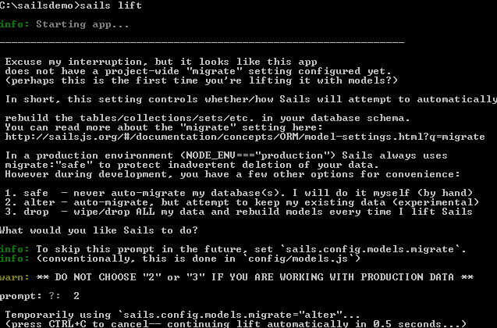
Generate API Sample

Slide 9
Models
Located at: Api/models
Describes DB mapping, validation rules, custom functions
Please refer to Waterline ORM documentation
Notes:
Controller or Model

Slide 10
Supported databases
PostgreSQL
MySQL
MongoDB
Memory
Disk
Redis
Riak
OrientDB
Neo4j
FoundationDB SQL Layer
And others
Notes:
Controller or Model

Slide 11

Model sample
module.exports = {
//by default will match model name
tableName: 'user',
//each model may have its own adapter and stored in separate database
//if not specified default adapter is used
adapter: 'postgresql',
attributes: {
name: {
type: 'string',
required: true,
indexed: true,
maxLength: 50
//custom validation can be added here like contains, before, after etc.
},
//supports associations 1 to 1, 1 to many and many to many
items:{ collection: "item“, via: ‘user’},
//supports custom functions
formattedName: function(){
return this.name;
}
},
//supports lifecycle callbacks: beforeValidate, afterValidate, beforeUpdate,
// afterUpdate, beforeCreate, afterCreate. beforeDestroy, afterDestroy
beforeCreate: function(values, cb) {
//do something with values
//then call callback, callback expects error arg if occurred
cb();
}
};

Slide 12
Model blueprints
following methods are available for each property:
  findOneByPropertyName
  findOneByPropertyNameIn
  findOneByPropertyNameLike
  findByPropertyName
  findByPropertyNameIn
  findByPropertyNameLike
  countByPropertyName
  countByPropertyNameIn
  countByPropertyNameLike
  propertyNameStartsWith
  propertyNameEndsWith
  propertyNameContains

Slide 13
Data filtering
find() – accepts object with field definition like {filter:{name:{startsWith:”A”}}}
Or it can an be called as chain: Category.find().skip(10).limit(10)
Supports:
  Filtering
  Paging
  Sorting

Slide 14
Controller
Full support for RESTful routes
Shortcut routes
Can have custom actions
Can be put in subdirs and subdir becomes part of the route
Has standard methods for CRUD support which can be overridden
Policies either per action or for entire controller

Slide 15
Controller: custom action sample
//register route
module.exports.routes = {
'post /category/:id/activate': 'CategoryController.activate'
};
//add method to the controller
module.exports = {
activate: function(req,res){
Category.findOne({id: req.param.id}, function(err, model){
if(err || !model)
return res.badRequest("Category not found");
model.active = true;
model.save(function(err){
return res.ok(model);
});
});
}
};

Slide 16
Policies
Used for authentication/authorization or like simple handlers
Integrated with controllers
Can be integrated with Passport

Slide 17
Policy sample
// api/policies/canWrite.js
module.exports = function canWrite(req, res, next) {
var categoryId = req.param('id');
CategoryPermissions.findOneByCategoryId(categoryId, function (err, permission) {
//skip to default error handler
if (err) return next(err);
//if there is no permission or write is not allowed
if(!permission || permission.type !== 'write')
return res.forbidden('You do not have access to perform this action');
next();
});
};
//in config/policies.js
module.exports.policies = {
//specifying controller policies will be applied against
CategoryController: {
// Apply the 'isLoggedIn' policy to all actions
'*': 'isLoggedIn',
// Apply the 'canWrite' to create
create: ['canWrite']
}
};

Slide 18
Services
Used for authentication/authorization or like simple handlers
Contains reusable logic across application
Automatically registered by Sails like Model or Controller
Sample: https://github.com/balderdashy/sails-docs/blob/0.9/services.md

Slide 19
Assets
This folder is just for static content
No need to assets in URL

Slide 20
Configuration
Allows to configure:
  Environments
  Locales
  Blueprints – routing rules
  Connection strings
  Application bootstrap
  Sessions
  Sockets
  View engine
  Logging

Slide 21
Views
View is simple HTML page
Multiple view engines are supported
Default is EJB
displayCategories: function(req,res){
Category.find({},function(error, categories){
//returning res.view will look up view
//if view name is not passed it will try to find it by action name
//object can be passed to view as a model
return res.view('display-categories', {title:'Display categories',
categories: categories});
});

Slide 22
Web socket support
Integrated with socket.io
You need to write just client side code for web sockets
Still you may subscribe to the model change events for fallbacks
You may broadcast your own messages

Slide 23

Demo

Slide 24
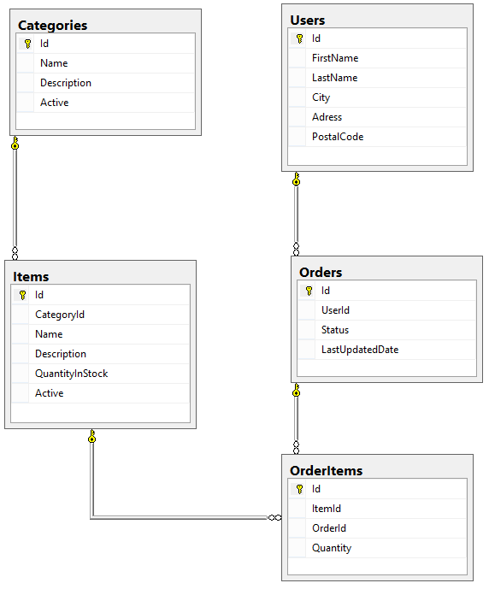
Demo
https://github.com/AndreyKol/lohika-tech-talk-sailsjs

Slide 25
Sum Up
Runs on any platform
DB agnostic
Front end agnostic
Good for prototyping
Incredibly speeds up implementation
Does not require sails to be installed in production

Slide 26
Thank You!

