Slide 1

JavaScript
Lecture 1. Basics

Slide 2

Lesson Plan
ECMAScript
Variables
Data Types
Operators
Logical branching

Slide 3
ECMAScript
Scripting-language specification
Was created to standardize JavaScript
ECMA-262

Slide 4
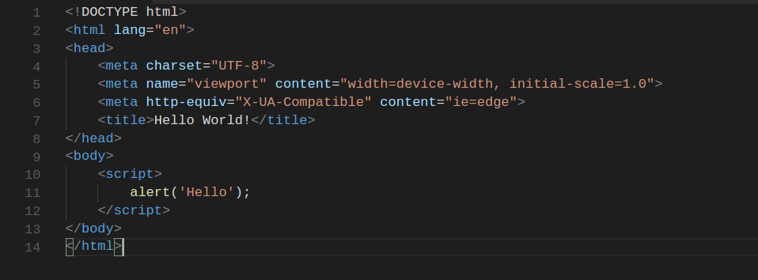
First JavaScript Application

Slide 5
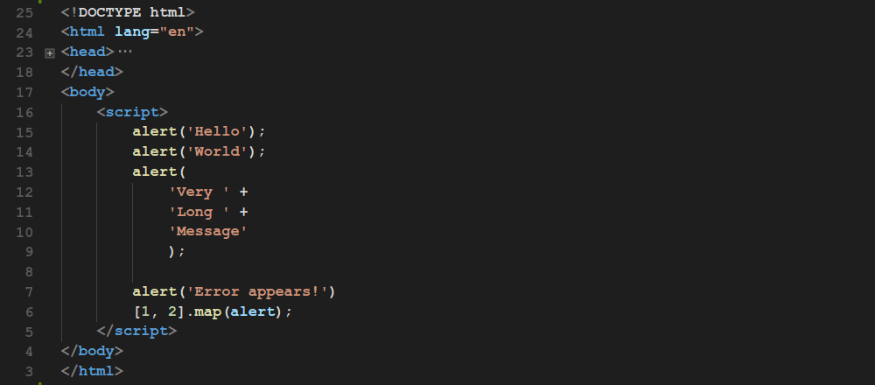
Line Break and Semicolon

Slide 6
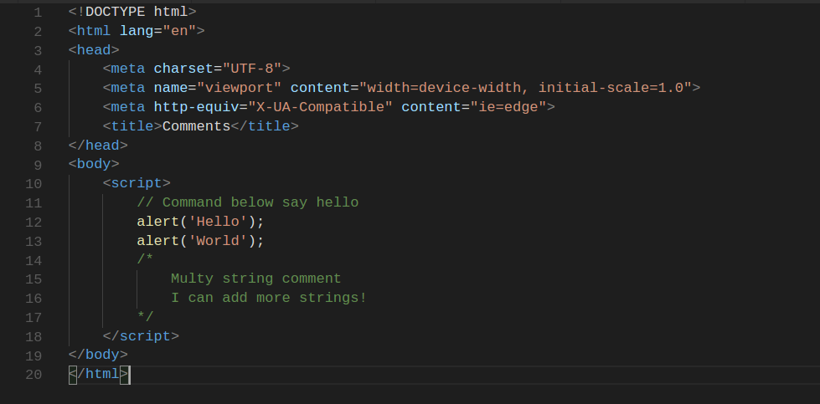
Comments

Slide 7
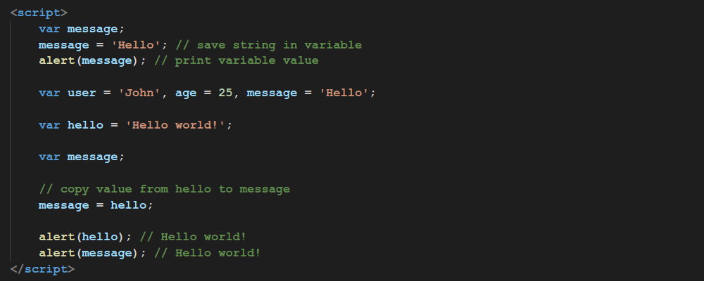
Variables in ES5

Slide 8
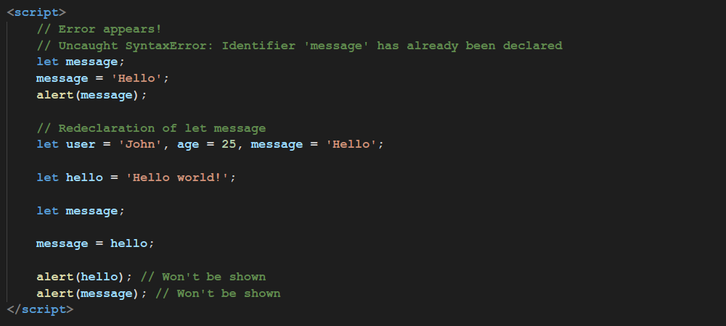
Variables in ES6

Slide 9
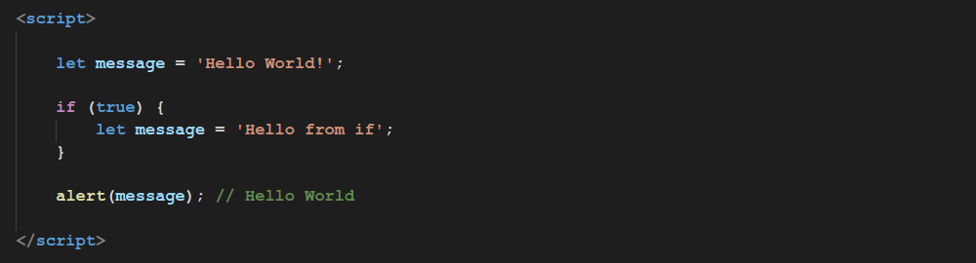
Variables in ES6

Slide 10
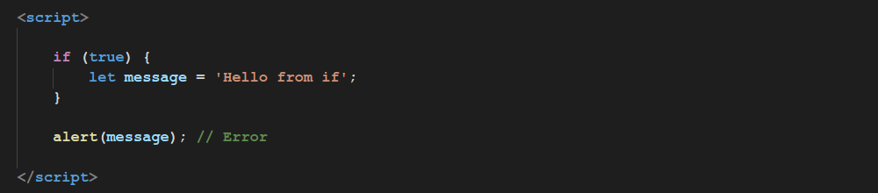
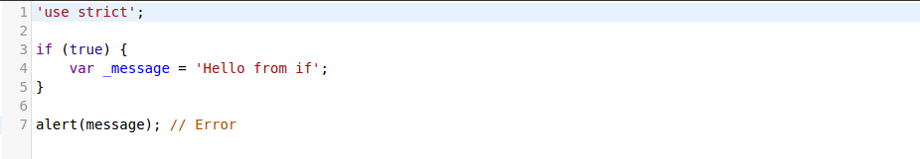
Variables in ES6

Slide 11
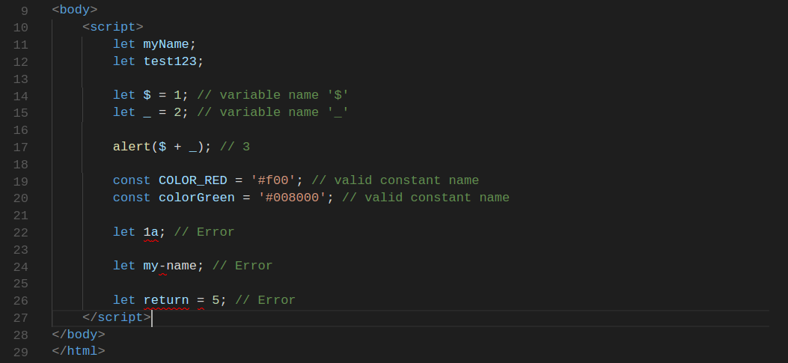
Variables Naming

Slide 12
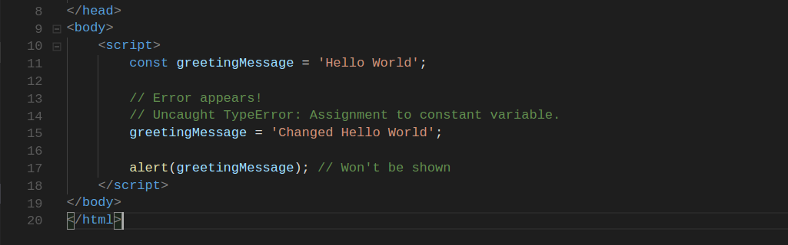
Constants

Slide 13
Data Types
The latest ECMAScript standard defines seven data types:
Six primitive types:
Boolean
Null
Undefined
Number
String
Symbol (new in ECMAScript 6)
and Object

Slide 14
Data Types
boolean | true, false
null | null
undefined | undefined
number | 0, 1, -1, 3.14, NaN
string | ‘hello’, ‘hello again’, ‘’
symbol | Symbol()
object | { name: ‘John’ }, []

Slide 15
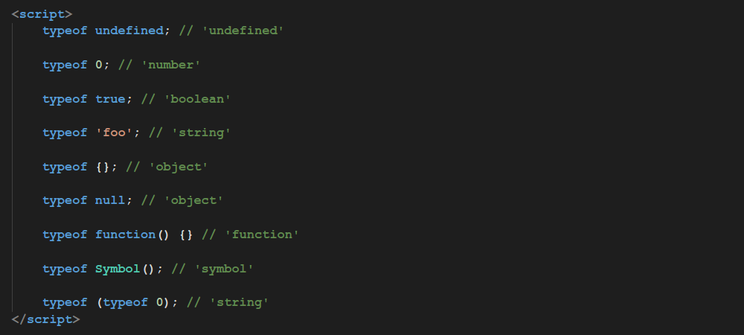
typeof

Slide 16
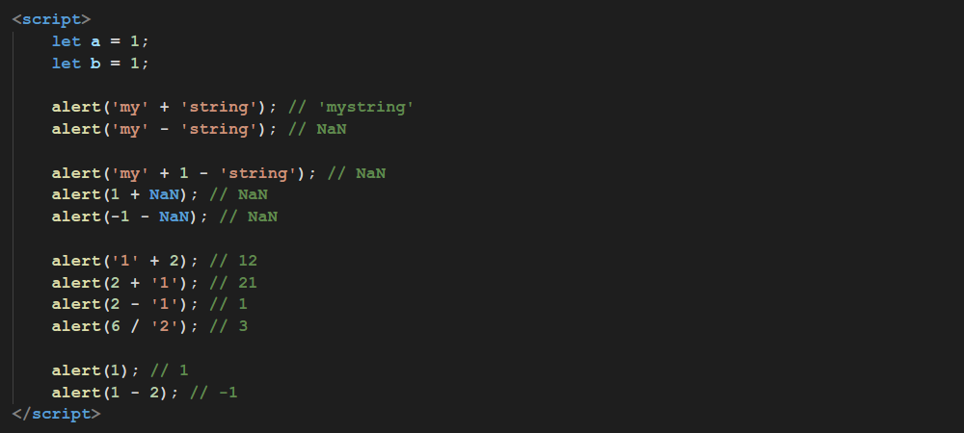
Math Operators

Slide 17
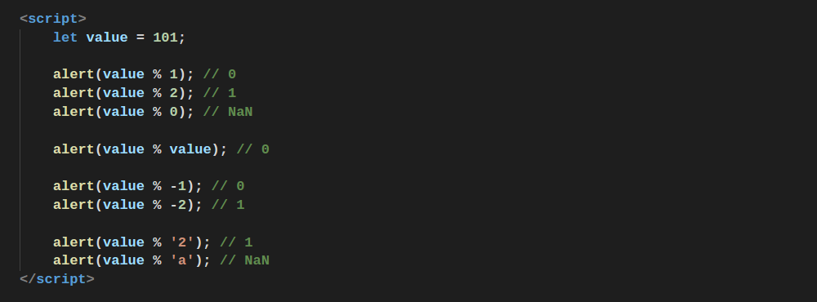
Modulo Operation

Slide 18
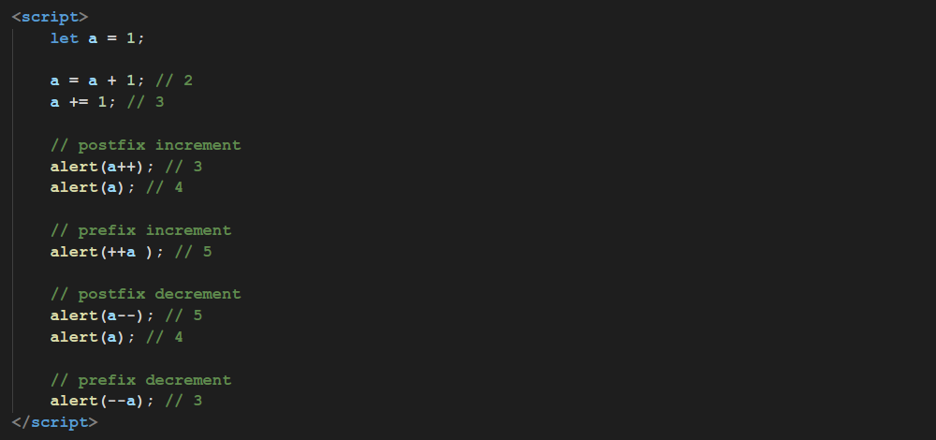
Unary Operators

Slide 19
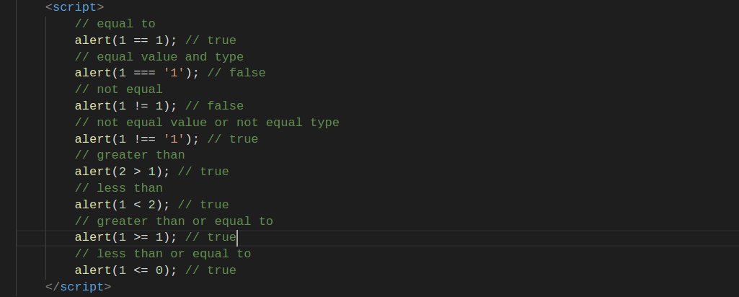
Logical Operators

Slide 20
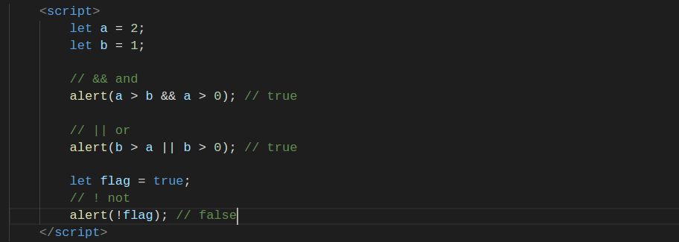
Logical Operators

Slide 21
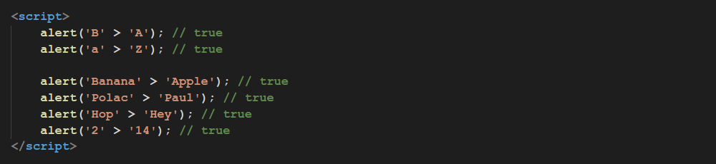
Strings Comparison

Slide 22
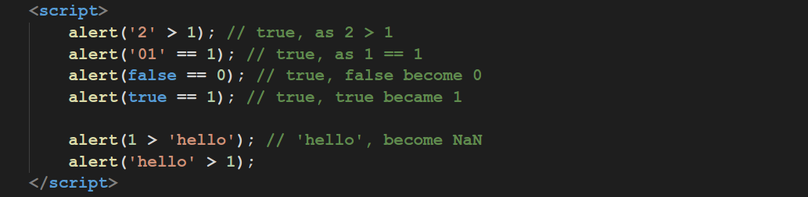
Types Comparison

Slide 23
Conversion to Boolean
‘string’, ‘ ’ (space character string) | true
‘’ (empty string) | false
1, -1, 0.01 | true
0 | false
[ ], (empty array), [ 1, 2, 3 ] | true
{ } (empty object), { value: 100 } | true

Slide 24
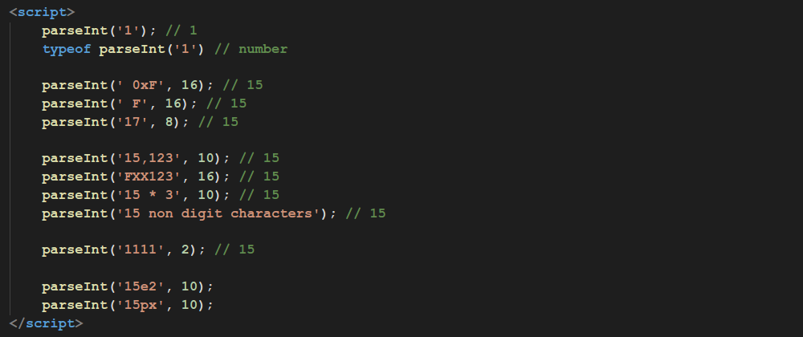
parseInt

Slide 25
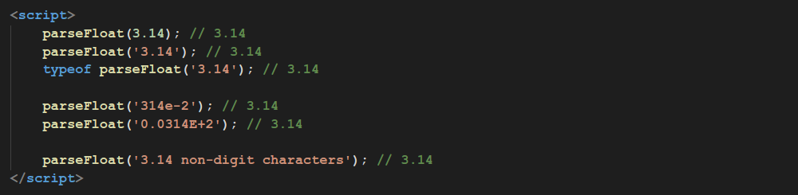
parseFloat

Slide 26
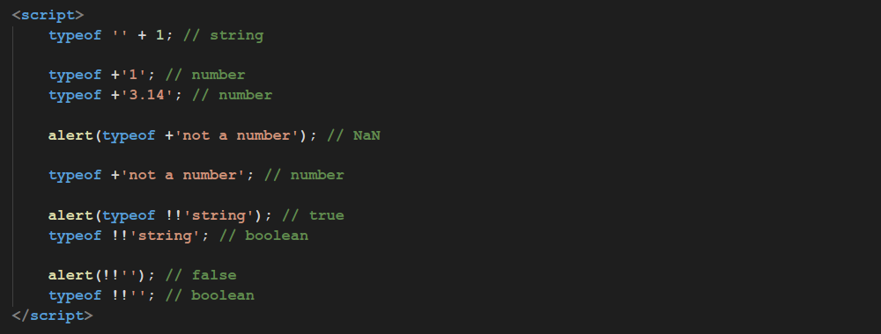
Inline Explicit Type Conversion

Slide 27
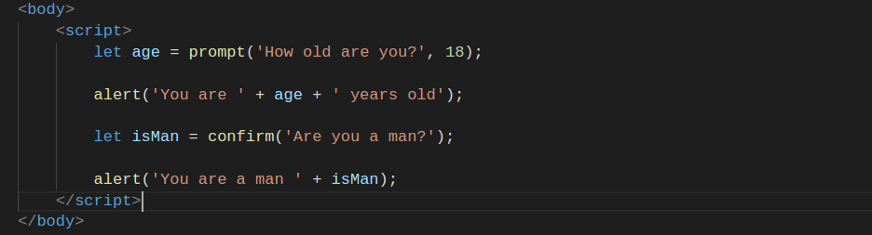
Modal Dialogs

Slide 28
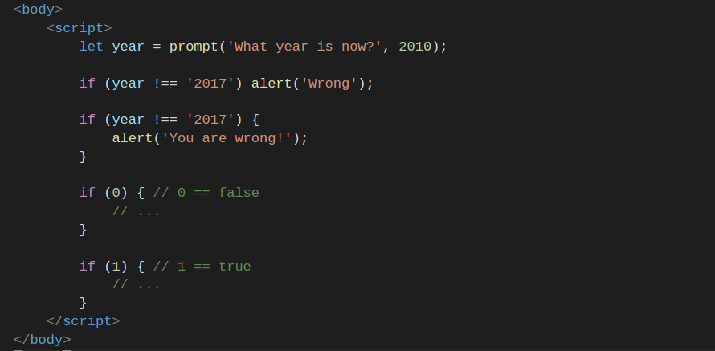
If Statement

Slide 29
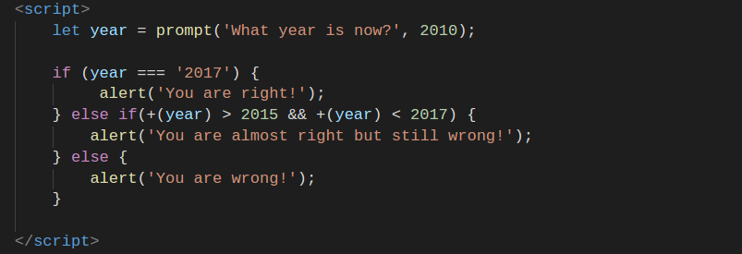
Else Statement

Slide 30
Home Work
Implement a game “Who Want to Be a Millionaire”
The game should contains 15 questions;
The game should has guaranteed amounts, 3 or more;
In case when player win, the game will show greeting message. In case when player lose, the game will show message about lose and earned money only if player passed at least one guaranteed amount.
Implement simple calculator, calculator should handle division to 0 calculator should has following functions
addition (+)
subtraction (-)
multiplication (*)
division (/)

Slide 31
Thanks for attention

