Slide 1

JavaScript
Lecture 1. Basics

Slide 2

Lesson Plan
Number constructor
Type conversion
Ternary operator
Switch
Loops
Eval
Try Catch

Slide 3
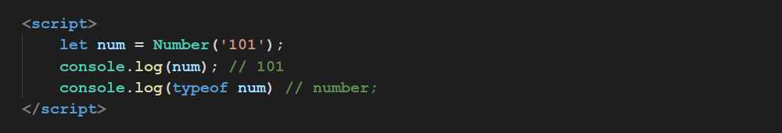
Number Constructor
The Number JavaScript object
is a wrapper object allowing you to work with numerical values.

Slide 4
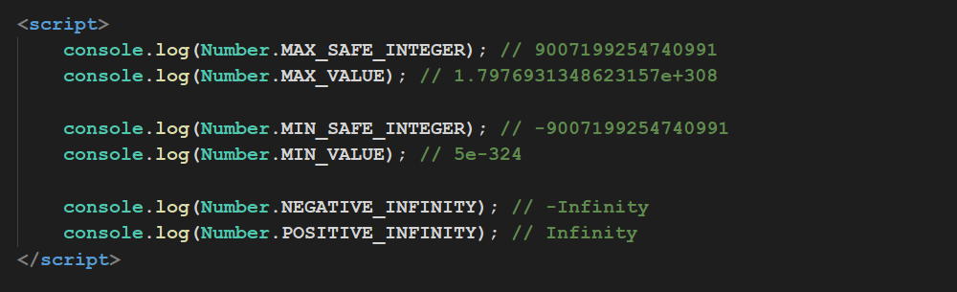
Number Properties

Slide 5
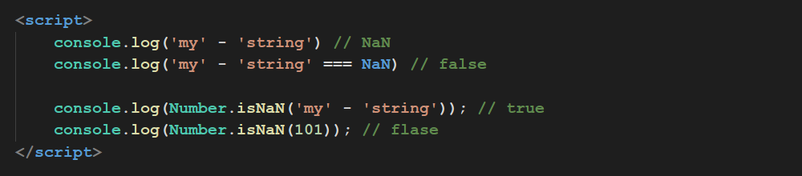
Number.isNaN
There is no direct way to get whether is value NaN or not

Slide 6
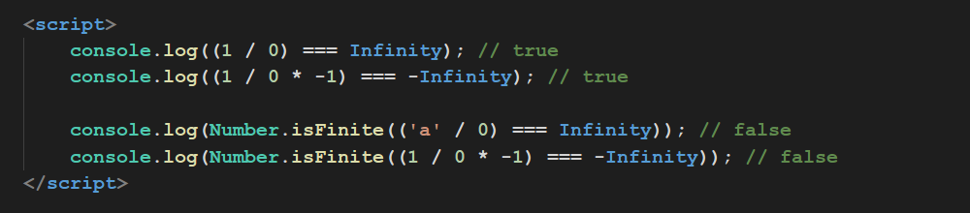
Number.isFinite()

Slide 7
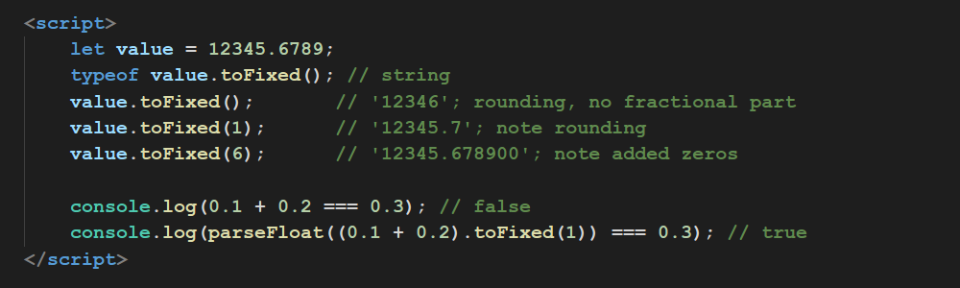
Number.toFixed()

Slide 8
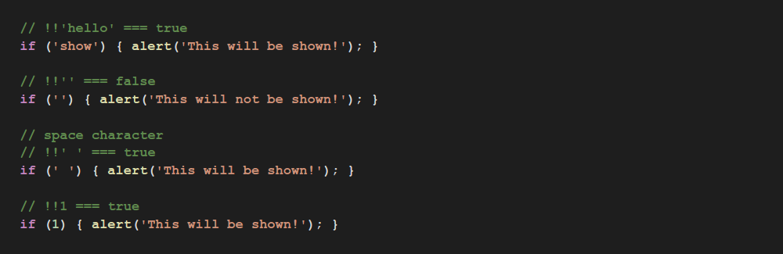
Not Explicit Type Conversion

Slide 9
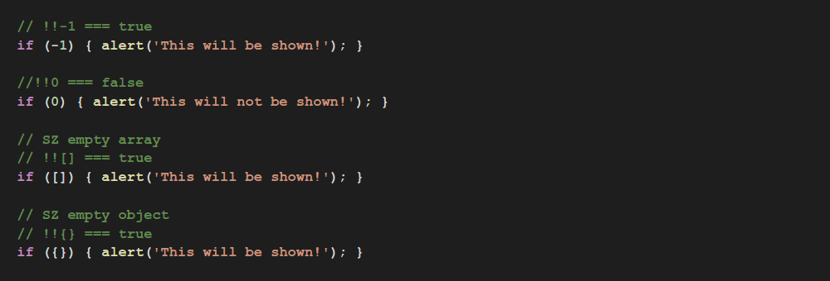
Not Explicit Type Conversion

Slide 10
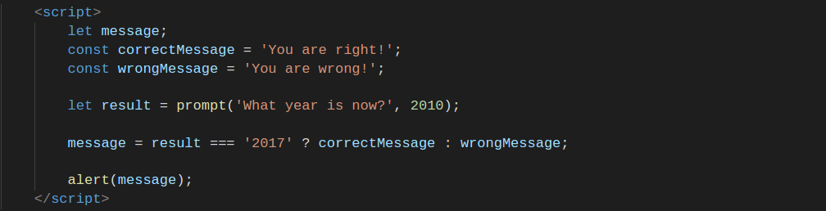
Conditional (ternary) Operator

Slide 11
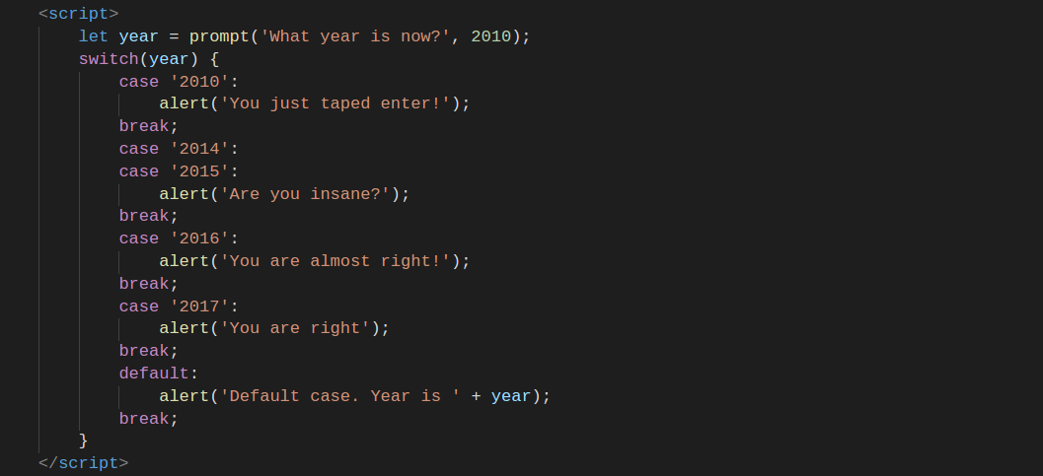
Switch Statement

Slide 12
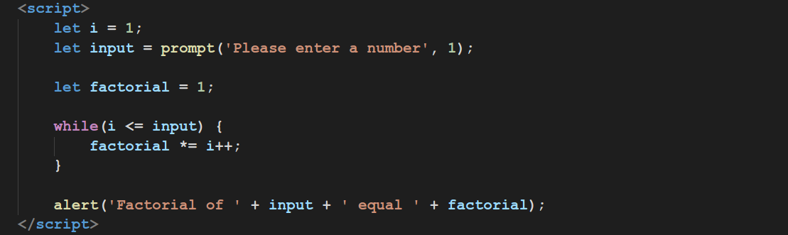
Loop While

Slide 13
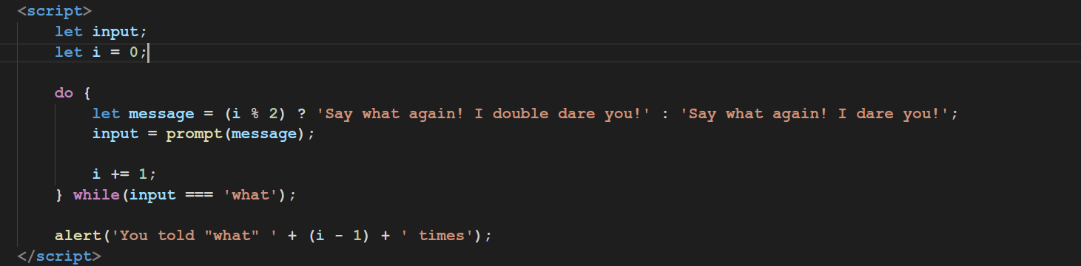
Loop Do While

Slide 14
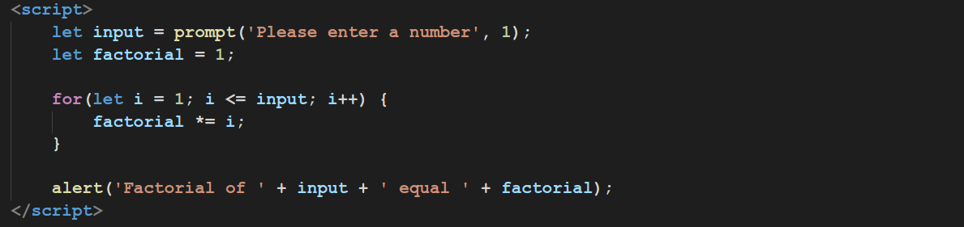
Loop For

Slide 15
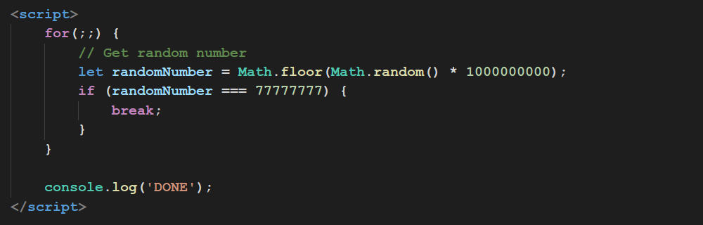
Loop For

Slide 16
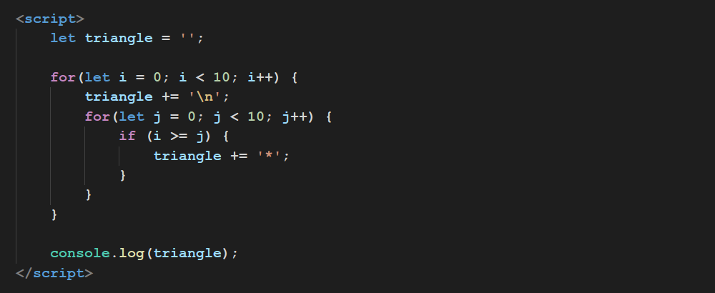
Nested Loops

Slide 17
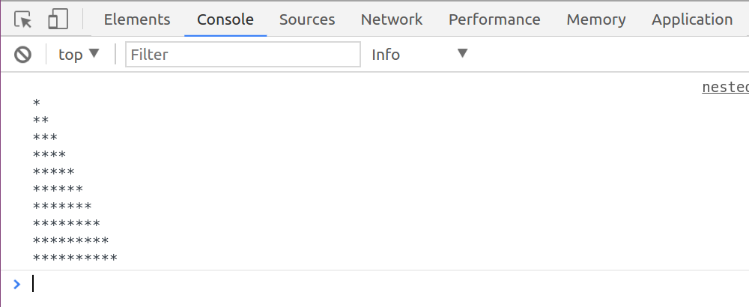
Nested Loops

Slide 18
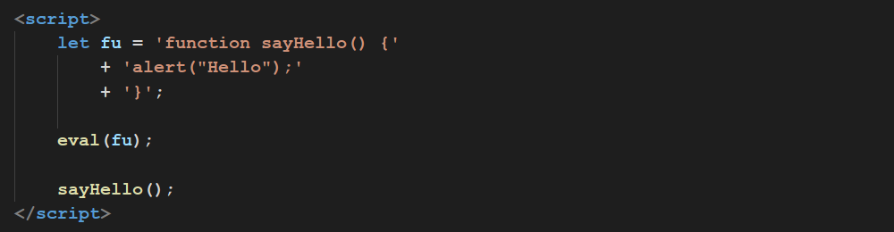
Eval
The eval() function evaluates JavaScript code represented as a string.

Slide 19
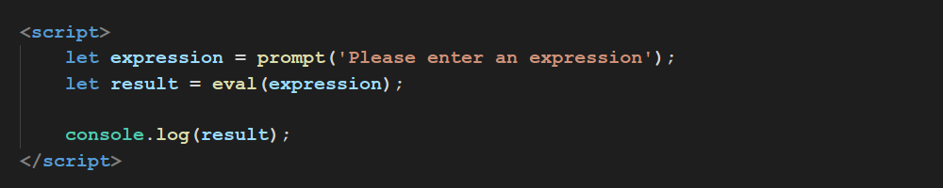
Eval

Slide 20
Eval
Don't use eval needlessly!

Slide 21
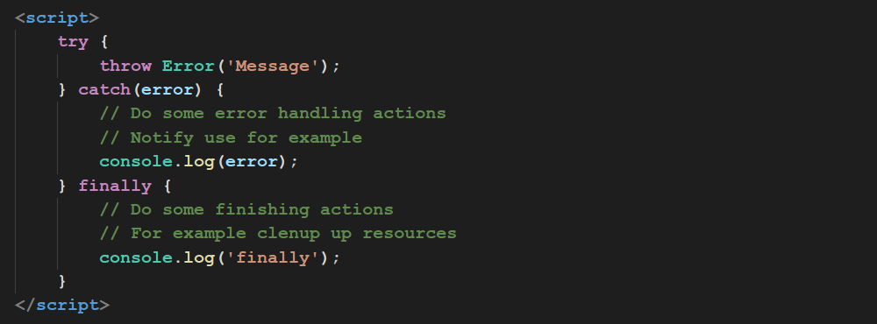
try catch

Slide 22
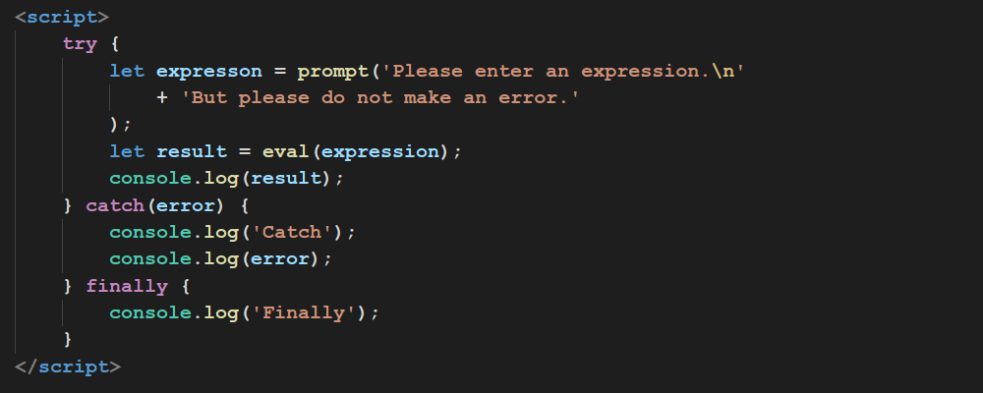
try catch

Slide 23
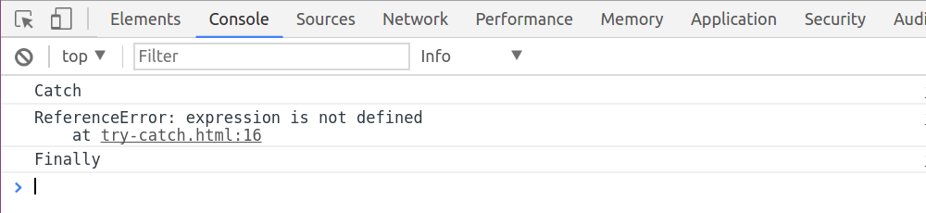
try catch

Slide 24
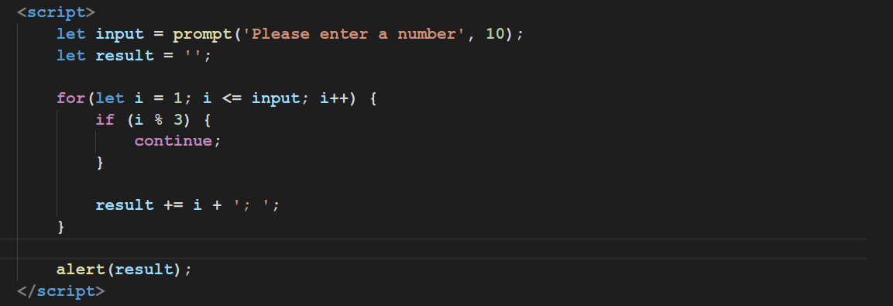
Break and Continue

Slide 25
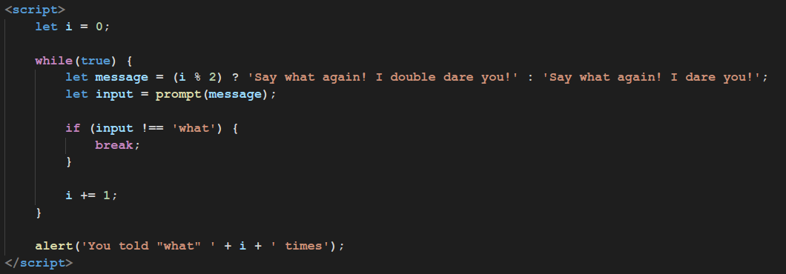
Break and Continue

Slide 26
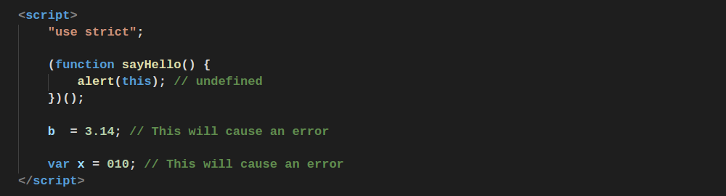
Strict Mode

Slide 27
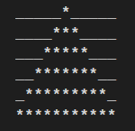
Home Work
Implement advanced calculator
Should be able to calculate expressions of this type (1 + 2) * 2 / (6 - 1) use eval;
Should handle error if input isn’t valid JavaScript expression;
Should work until it get “__STOP” command;
Display all dividers of a given number;
* Display new year tree in console, size of a tree base should be got from user;
** Implement script that calculates “amicable numbers” in given range https://en.wikipedia.org/wiki/Amicable_numbers.

Slide 28
Thanks for attention

