Slide 1
C# Coding Challenge: Call me Knight
Andrey Mishkinis
Senior Software Developer

Slide 2

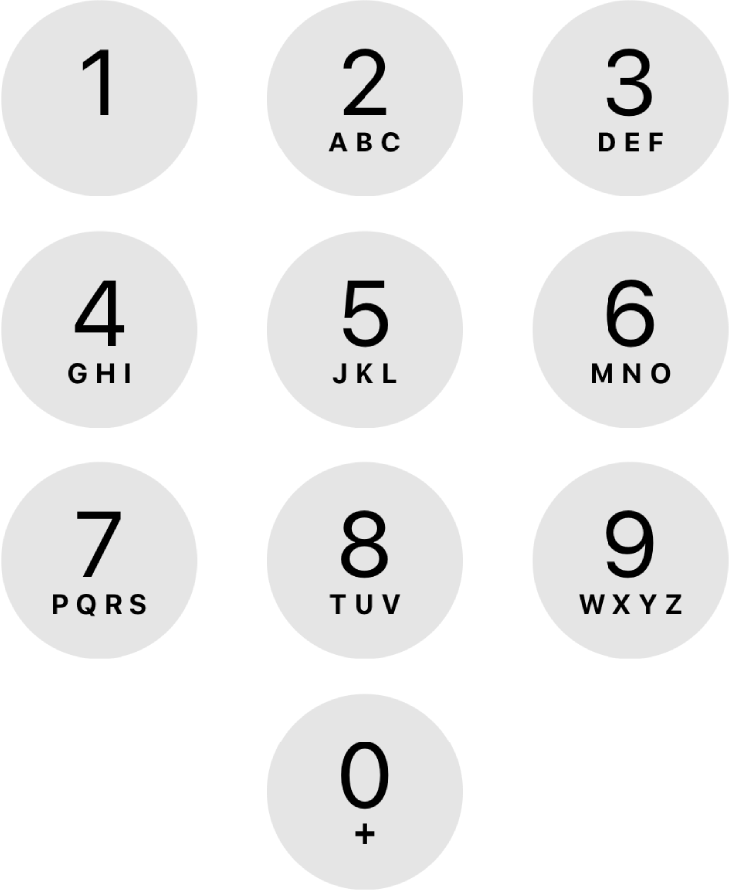
C# Coding Challenge: Call me Knight
Examples:
N is zero: 0 numbers
N is one: 10 numbers
N is two: 20 numbers
N is three: 46 numbers
Task:
Count the number of different numbers you can dial
Rules:
Classic dial pad
Start from any position
Move as a chess knight
Make exactly N hops

Slide 3
Getting the Next Hop
public static class Moves
{
public static readonly Dictionary<int, int[]> All = new() {
{ 1, [ 6, 8 ] },
{ 2, [ 7, 9 ] },
{ 3, [ 4, 8 ] },
{ 4, [ 3, 9, 0 ] },
{ 5, [] },
{ 6, [ 1, 7, 0 ] },
{ 7, [ 2, 6 ] },
{ 8, [ 1, 3 ] },
{ 9, [ 2, 4 ] },
{ 0, [ 4, 6 ] },
};
}

Slide 4
Level 0: Recursively Printing Numbers
public void Run(int N)
{
if (N <= 0) return;
for (var i = 0; i < 10; i++)
{
Count(N - 1, i, i.ToString());
}
}
private void Count(int hops, int start, string prefix)
{
if (hops == 0)
{
Console.WriteLine(prefix);
}
else
{
foreach (var next in Moves.All[start])
{
Count(hops - 1, next, prefix + next);
}
}
}
N: 20 Time: 9010ms

Slide 5
What value of N can we calculate in 10 seconds?

Slide 6
Level 1: Recursively Counting Numbers
public int Run(int N)
{
if (N <= 0) return 0;
var result = 0;
for (var i = 0; i < 10; i++)
{
result += Count(N - 1, i);
}
return result;
}
private int Count(int hops, int start)
{
if (hops == 0)
{
return 1;
}
var result = 0;
foreach (var next in Moves.All[start])
{
result += Count(hops - 1, next);
}
return result;
}
N: 20 Time: 780ms (11x faster)
N: 24 Time: 14594ms

Slide 7
Level 1: Recursively Counting Numbers
private int Count(int hops, int start)
{
if (hops == 0)
{
return 1;
}
var result = 0;
foreach (var next in Moves.All[start])
{
result += Count(hops - 1, next);
}
return result;
}
2 or 3 recursive calls, which leads us to exponential complexity of the algorithm

Slide 8
Algorithm Visualization
Count(4, 6)
Count(3, 1)
Count(3, 7)
Count(3, 0)

Slide 9
Algorithm Visualization
Count(4, 6)
Count(3, 1)
Count(3, 7)
Count(3, 0)
Count(2, 6)
Count(2, 8)
Count(2, 2)
Count(2, 6)
Count(2, 4)
Count(2, 6)

Slide 10
Algorithm Visualization
Count(4, 6)
Count(3, 1)
Count(3, 7)
Count(3, 0)
Count(2, 6)
Count(2, 8)
Count(2, 2)
Count(2, 6)
Count(2, 4)
Count(2, 6)
Count(1, 0)
Count(1, 3)
Count(1, 1)
Count(1, 9)
Count(1, 0)
Count(1, 1)
Count(1, 1)
Count(1, 0)
Count(1, 7)
Count(1, 0)
Count(1, 7)
Count(1, 7)
Count(1, 3)
Count(1, 1)
Count(1, 9)
Count(1, 7)

Slide 11
Algorithm Visualization
Count(4, 6)
Count(3, 1)
Count(3, 7)
Count(3, 0)
Count(2, 6)
Count(2, 8)
Count(2, 2)
Count(2, 6)
Count(2, 4)
Count(2, 6)
Count(1, 0)
Count(1, 3)
Count(1, 1)
Count(1, 9)
Count(1, 0)
Count(1, 1)
Count(1, 1)
Count(1, 0)
Count(1, 7)
Count(1, 0)
Count(1, 7)
Count(1, 7)
Count(1, 3)
Count(1, 1)
Count(1, 9)
Count(1, 7)

Slide 12
Level 2: Memoization
using TInt = int;
public TInt Run(int N)
{
if (N <= 0) return 0;
var memory = new Dictionary<(int, int), TInt>();
var result = default(TInt);
for (var i = 0; i < 10; i++)
{
result += Count(N - 1, i, memory);
}
return result;
}
Let's record results of function calls we’ve seen before and use those instead of redoing the work.
For a pair of arguments, we will remember the result of the calculations.

Slide 13
Level 2: Memoization
private TInt Count(int hops, int start, Dictionary<(int, int), TInt> memory)
{
if (hops == 0) return 1;
var result = default(TInt);
var key = (hops, start);
if (!memory.TryGetValue(key, out result))
{
foreach (var next in Moves.All[start])
{
result += Count(hops - 1, next, memory);
}
memory.Add(key, result);
}
return result;
}
Memoization allows us to significantly increase performance:
N: 24 Time: 2ms (7297x faster)
But…

Slide 14
Level 2: Memoization
private TInt Count(int hops, int start, Dictionary<(int, int), TInt> memory)
{
if (hops == 0) return 1;
var result = default(TInt);
var key = (hops, start);
if (!memory.TryGetValue(key, out result))
{
foreach (var next in Moves.All[start])
{
result += Count(hops - 1, next, memory);
}
memory.Add(key, result);
}
return result;
}
Memoization allows us to significantly increase performance:
N: 24 Time: 2ms (7297x faster)
But at N=25 we will encounter integer overflow. The number of variants grows rapidly, so we will use:
using TInt = BigInteger;
Now we can calculate results for much larger N:
N: 5000 Time: 72ms
But…

Slide 15
Level 2: Memoization
private TInt Count(int hops, int start, Dictionary<(int, int), TInt> memory)
{
if (hops == 0) return 1;
var result = default(TInt);
var key = (hops, start);
if (!memory.TryGetValue(key, out result))
{
foreach (var next in Moves.All[start])
{
result += Count(hops - 1, next, memory);
}
memory.Add(key, result);
}
return result;
}
Memoization allows us to significantly increase performance:
N: 24 Time: 2ms (7297x faster)
But at N=25 we will encounter integer overflow. The number of variants grows rapidly, so we will use:
using TInt = BigInteger;
Now we can calculate results for much larger N:
N: 5000 Time: 72ms
But at N=5500 we will encounter stack overflow.

Slide 16
Level 2: Memoization
var memory = new Dictionary<(int hops, int start), TInt>();
The key to memory is a pair of number of hops and the start position.
Start position can take only 10 values
Number of hops is limited by the value of N
This means that memory grows in direct proportion to the number of requested hops.
Once we have an entry in the memory for every combination of position and jump count, all calls will hit the cache rather than result in a new function call.
In other words, we got an algorithm that works in linear time.

Slide 17
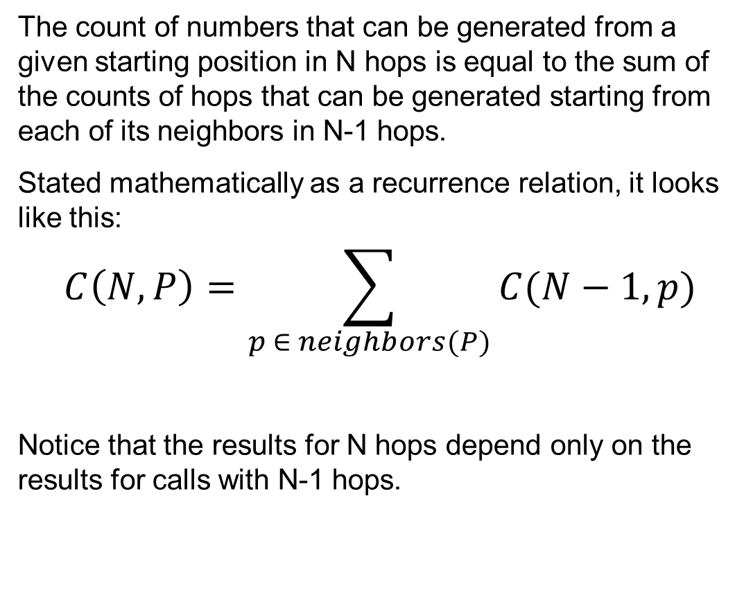
Different Perspective
The count of numbers that can be generated from a given starting position in N hops is equal to the sum of the counts of hops that can be generated starting from each of its neighbors in N-1 hops.
Stated mathematically as a recurrence relation, it looks like this:
$$C\left(N, P\right)=\sum_{p ∈ neighbors(P)}{C(N−1,p)}$$
Notice that the results for N hops depend only on the results for calls with N-1 hops.
private int Count(int hops, int start)
{
if (hops == 0)
{
return 1;
}
var result = 0;
foreach (var next in Moves.All[start])
{
result += Count(hops - 1, next);
}
return result;
}

Slide 18
Depth First Search
A
B
C
D
E
F
G
Depth First Search

Slide 19
Depth First Search vs Breadth First Search
A
A
B
C
B
C
D
E
F
G
D
E
F
G
Depth First Search
Breadth First Search

Slide 20

Level 3: Breadth First Search
public TInt Run(int N) {
if (N <= 0) return 0;
var prev = new TInt[10] { 1, 1, 1, 1, 1, 1, 1, 1, 1, 1 };
var next = new TInt[10];
for (var hop = 1; hop < N; hop++) {
for (var i = 0; i < prev.Length; i++) {
foreach (var j in Moves.All[i]) {
next[j] += prev[i];
}
}
(prev, next) = (next, prev);
Array.Clear(next, 0, next.Length);
} var result = default(TInt);
foreach (var value in prev) {
result += value;
}
return result;
}
We calculate the count in a loop using our recurrence relation:
$$C\left(N, P\right)=\sum_{p ∈ neighbors(P)}{C(N−1,p)}$$
Note that the outer loop has N iterations, while the inner loops have a constant number.
Thus, the overall time complexity is also linear.
N: 5000 Time: 34ms (2x faster) N: 250000 Time: 13459ms

Slide 21
Adjacency Matrix
Non-zero element $A_{ij}$indicates an edge from $i$ to $j$
 | 0 | 1 | 2 | 3 | 4 | 5 | 6 | 7 | 8 | 9
0 | 0 | 0 | 0 | 0 | 1 | 0 | 1 | 0 | 0 | 0
1 | 0 | 0 | 0 | 0 | 0 | 0 | 1 | 0 | 1 | 0
2 | 0 | 0 | 0 | 0 | 0 | 0 | 0 | 1 | 0 | 1
3 | 0 | 0 | 0 | 0 | 1 | 0 | 0 | 0 | 1 | 0
4 | 1 | 0 | 0 | 1 | 0 | 0 | 0 | 0 | 0 | 1
5 | 0 | 0 | 0 | 0 | 0 | 0 | 0 | 0 | 0 | 0
6 | 1 | 1 | 0 | 0 | 0 | 0 | 0 | 1 | 0 | 0
7 | 0 | 0 | 1 | 0 | 0 | 0 | 1 | 0 | 0 | 0
8 | 0 | 1 | 0 | 1 | 0 | 0 | 0 | 0 | 0 | 0
9 | 0 | 0 | 1 | 0 | 1 | 0 | 0 | 0 | 0 | 0

Slide 22

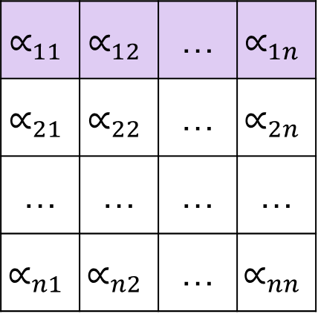



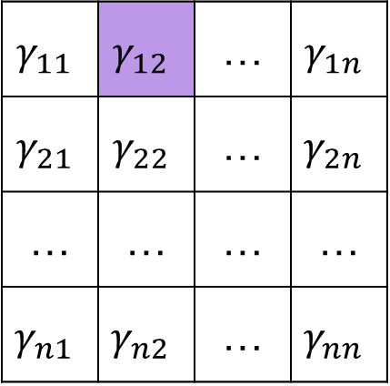

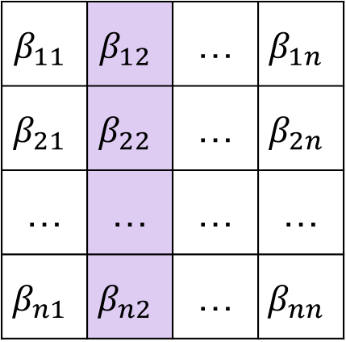

Matrix Multiplication
Notational conventions:
Matrices are represented by capital letters, e.g. $A, B, G$
Entries of a matrix are represented by Greek letters, e.g. $α, β, γ$
Matrix Multiplication:
The matrix product $G=AB$ is defined to be the matrix $G=γ_{ij}$ such that $γ_{ij}=\sum_{k=1}^{n}{α_{ik}β_{kj}}$
$$A=α_{ij}$$
$$B=β_{ij}$$
$$G=γ_{ij}$$
$$∝_{11}$$ | $$∝_{12}$$ | … | $$∝_{1n}$$
$$∝_{21}$$ | $$∝_{22}$$ | … | $$∝_{2n}$$
… | … | … | …
$$∝_{n1}$$ | $$∝_{n2}$$ | … | $$∝_{nn}$$
$$β_{11}$$ | $$β_{12}$$ | … | $$β_{1n}$$
$$β_{21}$$ | $$β_{22}$$ | … | $$β_{2n}$$
… | … | … | …
$$β_{n1}$$ | $$β_{n2}$$ | … | $$β_{nn}$$
$$γ_{11}$$ | $$γ_{12}$$ | … | $$γ_{1n}$$
$$γ_{21}$$ | $$γ_{22}$$ | … | $$γ_{2n}$$
… | … | … | …
$$γ_{n1}$$ | $$γ_{n2}$$ | … | $$γ_{nn}$$
$$×$$
$$=$$

Slide 23
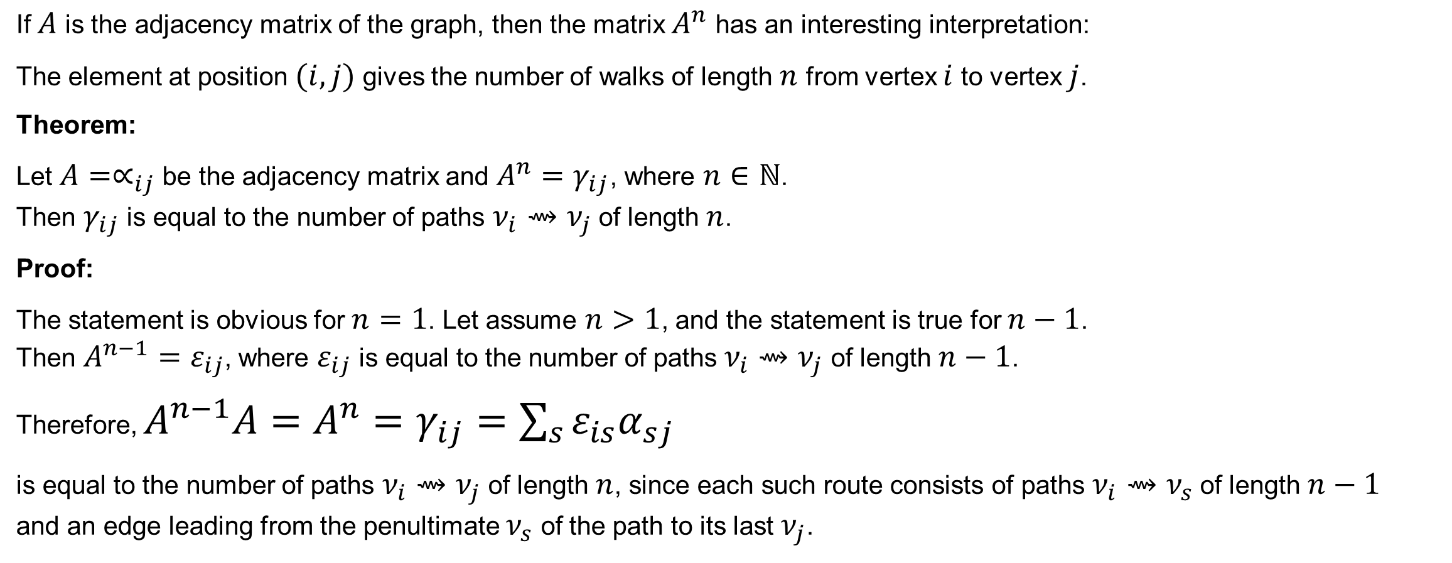
Adjacency Matrix Powers
If $A$ is the adjacency matrix of the graph, then the matrix $A^{n}$ has an interesting interpretation:
The element at position $(i,j)$ gives the number of walks of length $n$ from vertex $i$ to vertex $j$.
Theorem:
Let $A=∝_{ij}$ be the adjacency matrix and $A^{n}=γ_{ij}$, where $n∈ℕ$. Then $γ_{ij}$ is equal to the number of paths $ν_{i}⇝ν_{j}$ of length $n$.
Proof:
The statement is obvious for $n=1$. Let assume $n>1$, and the statement is true for $n−1$. Then $A^{n−1}=ε_{ij}$, where $ε_{ij}$ is equal to the number of paths $ν_{i}⇝ν_{j}$ of length $n−1$.
Therefore, $A^{n−1}A=A^{n}=γ_{ij}=\sum_{s}{ε_{is}α_{sj}}$
is equal to the number of paths $ν_{i}⇝ν_{j}$ of length $n$, since each such route consists of paths $ν_{i}⇝ν_{s}$ of length $n−1$ and an edge leading from the penultimate $ν_{s}$ of the path to its last $ν_{j}$.

Slide 24
Level 4: Linear Algebra
public TInt Run(int N) {
if (N <= 0) return 0;
var matrix = new Matrix10();
for (var i = 0; i < 10; i++) {
foreach (var j in Moves.All[i]) {
matrix[i, j] = 1;
}
}
var powered = Matrix10.Pow(matrix, N - 1);
var result = default(TInt);
foreach (var value in powered.data) {
result += value;
}
return result;
}
The algorithm remains that simple:
Initialize the adjacency matrix
Raise it to the required power
Sum up all the number of walks
N: 250 000 Time: 3:22.300 (15x slower)

Slide 25
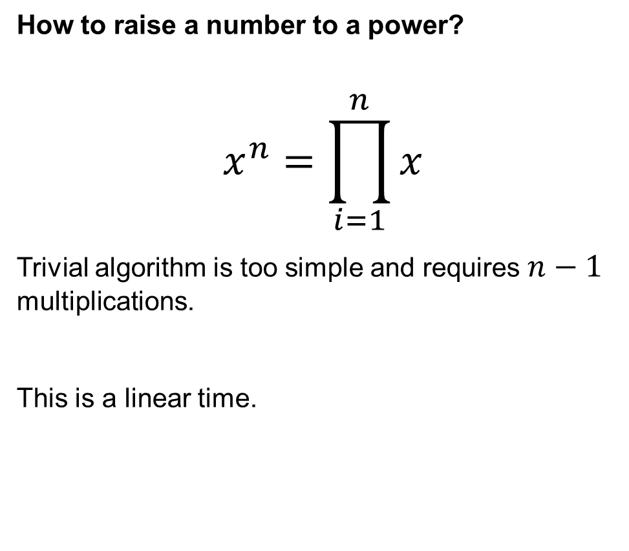
Exponentiation by Squaring
How to raise a number to a power?
$$x^{n}=\prod_{i=1}^{n}{x}$$
Trivial algorithm is too simple and requires $n−1$ multiplications.
This is a linear time.

Slide 26
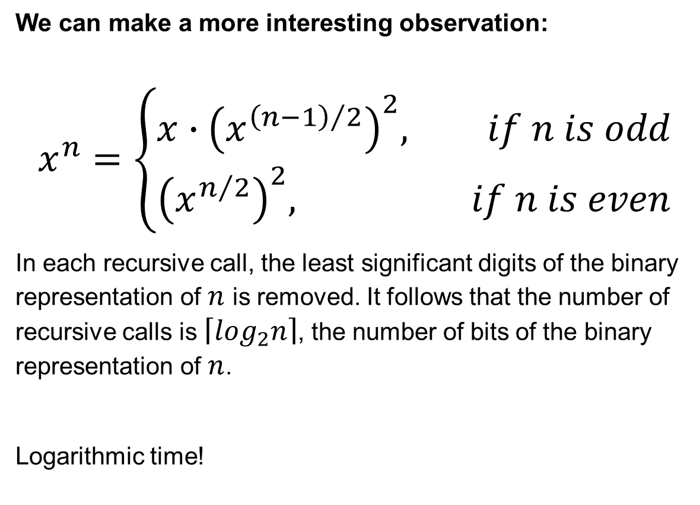
Exponentiation by Squaring
How to raise a number to a power?
$$x^{n}=\prod_{i=1}^{n}{x}$$
Trivial algorithm is too simple and requires $n−1$ multiplications.
This is a linear time.
We can make a more interesting observation:
$$x^{n}=\left\{\begin{aligned}x∙{\left(x^{{\left(n−1\right)}/2}\right)}^{2}, if n is odd \\ &{\left(x^{n/2}\right)}^{2}, if n is even\end{aligned}\right.$$
In each recursive call, the least significant digits of the binary representation of $n$ is removed. It follows that the number of recursive calls is $\left\lceil \log_{2}n\right\rceil$, the number of bits of the binary representation of $n$.
Logarithmic time!

Slide 27
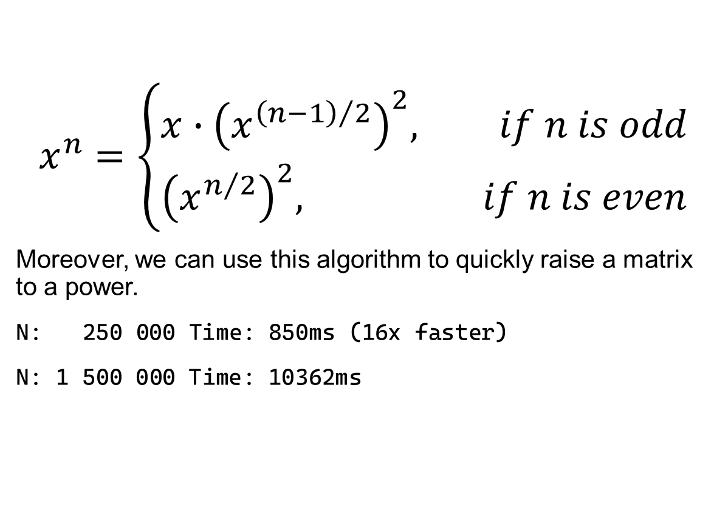
Level 4: Linear Algebra
public Matrix10 Pow(Matrix10 value, int power)
{
if (power == 0) {
return Identity();
}
if (power % 2 == 0) {
var tmp = Pow(value, power / 2);
return Mul(tmp, tmp);
}
else {
var tmp = Pow(value, power - 1);
return Mul(value, tmp);
}
}
$$x^{n}=\left\{\begin{aligned}x∙{\left(x^{{\left(n−1\right)}/2}\right)}^{2}, if n is odd \\ &{\left(x^{n/2}\right)}^{2}, if n is even\end{aligned}\right.$$
Moreover, we can use this algorithm to quickly raise a matrix to a power.
N: 250 000 Time: 850ms (16x faster)
N: 1 500 000 Time: 10362ms

Slide 28
Bonus Level: …
public Matrix10 Mul(Matrix10 m1, Matrix10 m2)
{
var result = new Matrix10();
for (var i = 0; i < 10; i++) {
for (var j = 0; j < 10; j++) {
var sum = default(TInt);
for (var k = 0; k < 10; k++) {
if (m1[i, k] != 0 && m2[k, j] != 0) {
sum += m1[i, k] * m2[k, j];
}
}
result[i, j] = sum;
}
}
return result;
}

Slide 29
Bonus Level: Multithreading
public Matrix10 Mul(Matrix10 m1, Matrix10 m2)
{
var result = new Matrix10();
Parallel.For(0, 10, i => {
for (var j = 0; j < 10; j++) {
var sum = default(TInt);
for (var k = 0; k < 10; k++) {
if (m1[i, k] != 0 && m2[k, j] != 0) {
sum += m1[i, k] * m2[k, j];
}
}
result[i, j] = sum;
}
});
return result;
}
Matrix multiplication can be easily parallelized.
N: 1 500 000 Time: 2629ms (4x faster)
N: 4 000 000 Time: 10004ms
The total count of dialable numbers is:
13515.........37504
1 438 012 digits

Slide 30


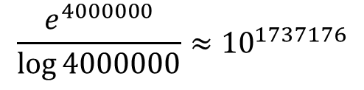

Summary
$$\frac{e^{4000000}}{\log{4000000}}≈{10}^{1737176}$$
Printed
Remove unnecessary computations
$$O\left(e^{N}\right)$$
Naive
Caching can significantly increase the speed of the algorithm
Memoized
$$O\left(N\right)$$
Sometimes the order in which a graph is traversed can be important
BFS
$$O\left(\log{N}\right)$$
There are different representations of graphs
Algorithms are the building blocks of your solution
Matrices

