Slide 1


Java SE Training

Slide 2
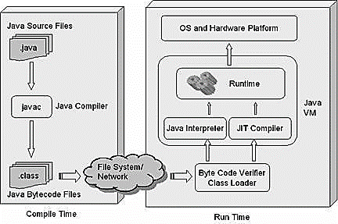
How it works

Slide 3
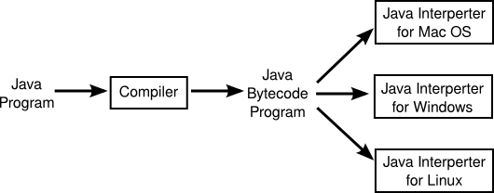
JVM and platform independence

Slide 4

Identifiers & JavaBeans
Questions?

Slide 5
I. Declarations and Access Control
Agenda:
Java Refresher
Identifiers & JavaBeans
Declare Classes
Declare Interfaces
Declare Class Members

Slide 6
Java Refresher
A Java program is mostly a collection of objects talking to other objects by invoking each other's methods. Every object is of a certain type, and that type is defined by a class or an interface. Most Java programs use a collection of objects of many different types.
Class A template that describes the kinds of state and behavior that objects of its type support.
Object At runtime, when the Java Virtual Machine (JVM) encounters the new keyword, it will use the appropriate class to make an object which is an instance of that class. That object will have its own state, and access to all of the behaviors defined by its class.
State (instance variables) Each object (instance of a class) will have its own unique set of instance variables as defined in the class. Collectively, the values assigned to an object's instance variables make up the object's state.
Behavior (methods) When a programmer creates a class, she creates methods for that class. Methods are where the class' logic is stored. Methods are where the real work gets done. They are where algorithms get executed, and data gets manipulated.

Slide 7
Java Refresher
Inheritance Central to Java and other object-oriented (OO) languages is the concept of inheritance, which allows code defined in one class to be reused in other classes. In Java, you can define a general (more abstract) superclass, and then extend it with more specific subclasses. The superclass knows nothing of the classes that inherit from it, but all of the subclasses that inherit from the superclass must explicitly declare the inheritance relationship. A subclass that inherits from a superclass is automatically given accessible instance variables and methods defined by the superclass, but is also free to override superclass methods to define more specific behavior.
Interfaces A powerful companion to inheritance is the use of interfaces. Interfaces are like a 100-percent abstract superclass that defines the methods a subclass must support, but not how they must be supported. In other words, an Animal interface might declare that all Animal implementation classes have an eat() method, but the Animal interface doesn't supply any logic for the eat() method.

Slide 8
Identifiers & JavaBeans
How do we give a names:
All the Java components we just talked about—classes, variables, and methods—need names. In Java these names are called identifiers, and, as you might expect, there are rules for what constitutes a legal Java identifier. Beyond what's legal though, Java programmers (and Sun) have created conventions for naming methods, variables, and classes.
Technically, legal identifiers must be composed of only Unicode characters, numbers, currency symbols, and connecting characters (like underscores).

Slide 9
Identifiers & JavaBeans
Here are the rules you do need to know:
Identifiers must start with a letter, a currency character ($), or a connecting character such as the underscore ( _ ). Identifiers cannot start with a number!
After the first character, identifiers can contain any combination of letters, currency characters, connecting characters, or numbers.
In practice, there is no limit to the number of characters an identifier can contain.
You can't use a Java keyword as an identifier.
Identifiers in Java are case-sensitive; foo and FOO are two different identifiers.

Slide 10


Identifiers & JavaBeans
Examples of legal identifiers:
The following are illegal:

Slide 11
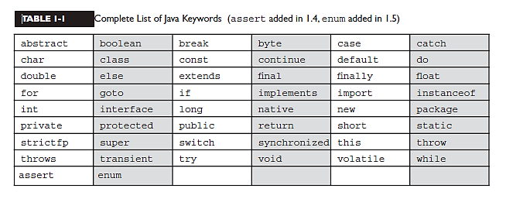
Identifiers & JavaBeans
Complete List of Java Keywords:

Slide 12
Identifiers & JavaBeans
Sun's Java Code Conventions:
Classes and interfaces The first letter should be capitalized, and if several words are linked together to form the name, the first letter of the inner words should be uppercase (a format that's sometimes called "camelCase"):
Dog, Runnable
Methods The first letter should be lowercase, and then normal camelCase rules should be used:
getBalance, doCalculation
Variables Like methods, the camelCase format should be used, starting with a lowercase letter. Sun recommends short, meaningful names, which sounds good to us:
buttonWidth, accountBalance
Constants Java constants are created by marking variables static and final. They should be named using uppercase letters with underscore characters as separators:
MIN_HEIGHT

Slide 13
Identifiers & JavaBeans
JavaBeans Standards
The JavaBeans spec is intended to help Java developers create Java components that can be easily used by other Java developers in a visual Integrated Development Environment (IDE) tool (like Eclipse or NetBeans).
By using naming rules, the JavaBeans spec helpsguarantee that tools can recognize and use components built by different developers.

Slide 14
Identifiers & JavaBeans
JavaBean Property Naming Rules:
If the property is not a boolean, the getter method's prefix must be get. For example, getSize()is a valid JavaBeans getter name for a property named "size.“
If the property is a boolean, the getter method's prefix is either get or is. For example, getStopped() or isStopped() are both valid JavaBeans names for a boolean property
The setter method's prefix must be set. For example, setSize() is the valid JavaBean name for a property named size.
Setter method signatures must be marked public, with a void return type and an argument that represents the property type.
Getter method signatures must be marked public, take no arguments, and have a return type that matches the argument type of the setter method for that property.

Slide 15


Identifiers & JavaBeans
Examples of valid JavaBean method signatures are:
Examples of invalid JavaBean method signatures are:

Slide 16
Identifiers & JavaBeans
Questions?

Slide 17
Declare Classes
Before we dig into class declarations, let's do a quick review of the rules associated with declaring classes, import statements, and package statements in a source file:
There can be only one public class per source code file.
Comments can appear at the beginning or end of any line in the source code file; they are independent of any of the positioning rules discussed here.
If there is a public class in a file, the name of the file must match the name of the public class. For example, a class declared as public class Dog { } must be in a source code file named Dog.java.
If the class is part of a package, the package statement must be the first line in the source code file, before any import statements that may be present.
If there are import statements, they must go between the package statement (if there is one) and the class declaration. If there isn't a package statement, then the import statement(s) must be the first line(s) in the source code file. If there are no package or import statements, the class declaration must be the first line in the source code file.
import and package statements apply to all classes within a source code file.
In other words, there's no way to declare multiple classes in a file and have them in different packages, or use different imports.
A file can have more than one nonpublic class.
Files with no public classes can have a name that does not match any of the classes in the file.

Slide 18
Declare Classes
Class Declarations and Modifiers:
class MyClass {
…
}
Modifiers fall into two categories:
Access modifiers: public, protected, package, private.
Non-access modifiers (including strictfp, final, and abstract).

Slide 19
Declare Classes
Class Access
What does it mean to access a class? When we say code from one class (class A) has access to another class (class B), it means class A can do one of three things:
Create an instance of class B.
Extend class B (in other words, become a subclass of class B).
Access certain methods and variables within class B, depending on the access control of those methods and variables.

Slide 20


Declare Classes
Default Access
Think of default access as package-level access, because a class with default access can be seen only by classes within the same package.
Look at the following source file:
Now look at the second source file:
The Beverage file compiles fine, but when we try to compile the Tea file we get something like:
Can't access class cert.Beverage. Class or interface must be public, in same package, or an accessible member class. import cert.Beverage;

Slide 21

Declare Classes
Public Access
A class declaration with the public keyword gives all classes from all packages access to the public class. In other words, all classes in the Java Universe (JU) have access to a public class. Don't forget, though, that if a public class you're trying to use is in a different package from the class you're writing, you'll still need to import the public class.
Look at the following source file:
Now look at the second source file:
The Beverage and Tea file compiles fine.

Slide 22
Declare Classes
Other (Nonaccess) Class Modifiers
You can modify a class declaration using the keyword final, abstract, or strictfp. These modifiers are in addition to whatever access control is on the class, so you could, for example, declare a class as both public and final. But you can't always mix nonaccess modifiers. You're free to use strictfp in combination with final, for example, but you must never, ever, ever mark a class as both final and abstract.

Slide 23


Declare Classes
Final Classes
When used in a class declaration, the final keyword means the class can't be subclassed.
So why would you ever mark a class final? After all, doesn't that violate the whole object-oriented (OO) notion of inheritance? You should make a final class only if you need an absolute guarantee that none of the methods in that class will ever be overridden.
Let's modify our Beverage example by placing the keyword final in the declaration:
Now, if we try to compile the Tea subclass:
We get an error something like
Can't subclass final classes: class cert.Beverage class Tea extends Beverage {}1 error.

Slide 24
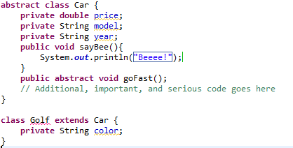
Declare Classes
Abstract
An abstract class can never be instantiated. Remember that if even a single method is abstract, the whole class must be declared abstract.

Slide 25
Declare Classes
Questions?

Slide 26
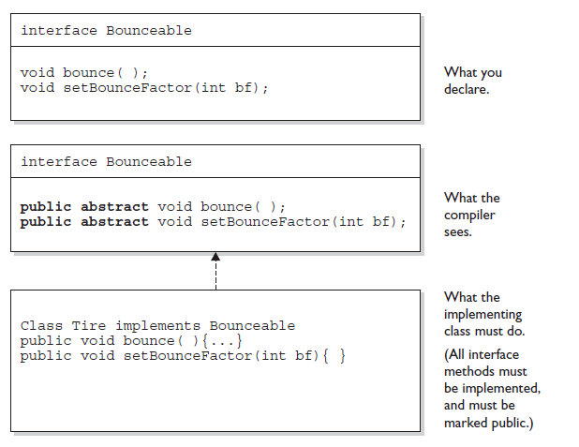
Declare Interfaces
When you create an interface, you're defining a contract for what a class can do, without saying anything about how the class will do it. An interface is a contract.
Interfaces can be implemented by any class, from any inheritance tree
Think of an interface as a 100-percent abstract class.

Slide 27
Declare Interfaces
These rules are strict for Interfaces:
All interface methods are implicitly public and abstract. In other words, you do not need to actually type the public or abstract.
All variables defined in an interface must be public, static, and final - in other words, interfaces can declare only constants, not instance variables.
Interface methods must not be static.
Because interface methods are abstract, they cannot be marked final, strictfp, or native.
An interface can extend one or more other interfaces.
An interface cannot extend anything but another interface.
An interface cannot implement another interface or class.
Interface types can be used polymorphically.

Slide 28
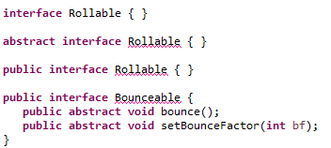
Declare Interfaces
The following is a legal interface declaration:

Slide 29
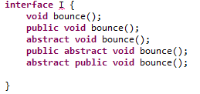
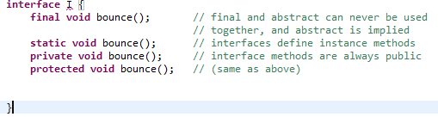
Declare Interfaces
You must remember that all interface methods are public and abstract regardless of what you see in the interface:
The following interface method legal:
The following interface method declarations won't compile:

Slide 30
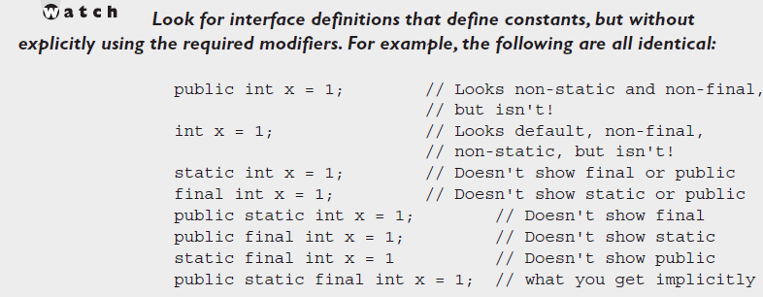
Declare Interfaces
Declaring Interface Constants
You need to remember one key rule for interface constants. They must always be public static final.

Slide 31
Declare Interfaces
Questions?

Slide 32
Declare Class Members
Access Modifiers
Whereas a class can use just two of the four access control levels (default or public), members can use all four:
public
protected
default
Private
You need to understand two different access issues:
Whether method code in one class can access a member of another class
Whether a subclass can inherit a member of its superclass

Slide 33
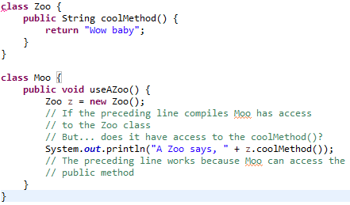
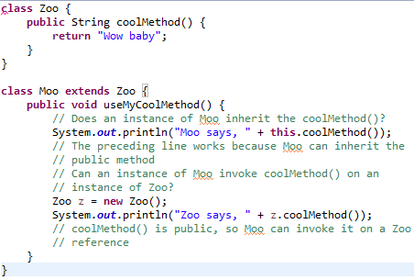
Declare Class Members
Access Modifiers

Slide 34
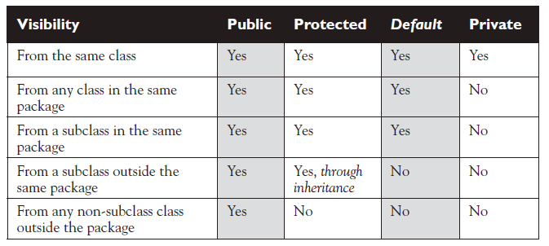
Declare Class Members
Access Modifiers
Determining Access to Class Members

Slide 35

Declare Class Members
Nonaccess Member Modifirs
We've discussed member access, which refers to whether code from one class can invoke a method (or access an instance variable) from another class. That still leaves a boatload of other modifiers you can use on member declarations. Two you're already familiar with—final and abstract—because we applied them to class declarations earlier. But we still have to take a quick look at transient, synchronized, native, strictfp, and then a long look at the Big One—static.
Final Methods
The final keyword prevents a method from being overridden in a subclass, and is often used to enforce the API functionality of a method.
A typical final method declaration looks like this:

Slide 36

Declare Class Members
Nonaccess Member Modifirs
Final Arguments
This means they can also have the modifier final:
In this example, the variable recNumber is declared as final, which of course means it can't be modified within the method. In this case, "modified" means reassigning a new value to the variable. In other words, a final argument must keep the same value that the parameter had when it was passed into the method.
Abstract Methods
An abstract method is a method that's been declared (as abstract) but not implemented. In other words, the method contains no functional code.

Slide 37

Declare Class Members
Nonaccess Member Modifiers
Synchronized Methods
The synchronized keyword indicates that a method can be accessed by only one thread at a time. We'll discuss this latter, but for now all we're concerned with is knowing that the synchronized modifier can be applied only to methods—not variables, not classes, just methods. A typical synchronized declaration looks like this:
Native Methods
The native modifier indicates that a method is implemented in platform-dependent code, often in C. You don't need to know how to use native methods for the exam, other than knowing that native is a modifier (thus a reserved keyword) and that native can be applied only to methods—not classes, not variables, just methods.
Strictfp Methods
We looked earlier at using strictfp as a class modifier, but even if you don't declare a class as strictfp, you can still declare an individual method as strictfp. Remember, strictfp forces floating points (and any floating-point operations) to adhere to the IEEE 754 standard. With strictfp, you can predict how your floating points will behave regardless of the underlying platform the JVM is running on.

Slide 38
Declare Class Members
Nonaccess Member Modifiers
Methods with Variable Argument Lists (var-args)
As of 5.0, Java allows you to create methods that can take a variable number of arguments. We'll cover using var-arg methods more latter, for now let's review the declaration rules for var-args:
Var-arg type When you declare a var-arg parameter, you must specify the type of the argument(s) this parameter of your method can receive. (This can be a primitive type or an object type.)
Basic syntax To declare a method using a var-arg parameter, you follow the type with an ellipsis (...), a space, and then the name of the array that will hold the parameters received.
Other parameters It's legal to have other parameters in a method that uses a var-arg.
Var-args limits The var-arg must be the last parameter in the method's signature, and you can have only one var-arg in a method.

Slide 39
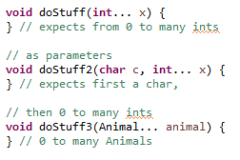

Declare Class Members
Nonaccess Member Modifiers
Methods with Variable Argument Lists (var-args)
Let's look at some legal and illegal var-arg declarations:
Legal:
Illegal:

Slide 40
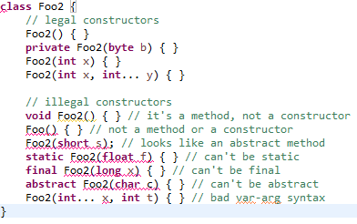
Declare Class Members
Constructor Declarations
In Java, objects are constructed. Every time you make a new object, at least one constructor is invoked. Every class has a constructor, although if you don't create one explicitly, the compiler will build one for you.
The first thing to notice is that constructors look an awful lot like methods. A key difference is that a constructor can't ever, ever, ever, have a return type…ever!
Constructor declarations can however have all of the normal access modifiers, and they can take arguments (including var-args), just like methods. The other BIG RULE, to understand about constructors is that they must have the same name as the class in which they are declared. Constructors can't be marked static (they are after all associated with object instantiation), they can't be marked final or abstract (because they can't be overridden).
Here are some legal and illegal constructor declarations:

Slide 41

Declare Class Members
Variable Declarations
There are two types of variables in Java:
Primitives A primitive can be one of eight types: char, boolean, byte, short, int, long, double, or float. Once a primitive has been declared, its primitive type can never change, although in most cases its value can change.
Reference variables A reference variable is used to refer to (or access) an object. A reference variable is declared to be of a specific type and that type can never be changed. A reference variable can be used to refer to any object of the declared type, or of a subtype of the declared type (a compatible type).
We'll talk a lot more about using a reference variable to refer to a subtype later, when we discuss polymorphism.
Declaring Primitives and Primitive Ranges
Primitive variables can be declared as class variables (statics), instance variables,
method parameters, or local variables.

Slide 42
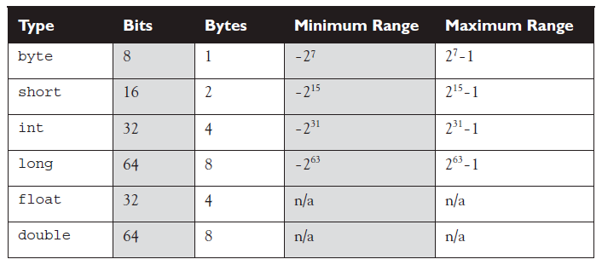
Declare Class Members
Variable Declarations
Ranges of Numeric Primitives:
For boolean types there is not a range; a boolean can be only true or false.
The char type (a character) contains a single, 16-bit Unicode character. Although the extended ASCII set known as ISO Latin-1 needs only 8 bits (256 different characters), a larger range is needed to represent characters found in languages other than English.

Slide 43
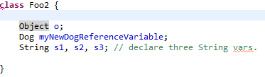
Declare Class Members
Variable Declarations
Declaring Reference Variables
Reference variables can be declared as static variables, instance variables, method parameters, or local variables.
Instance variables are defined inside the class, but outside of any method, and are only initialized when the class is instantiated. Instance variables are the fields that belong to each unique object.
For the exam, you need to know that instance variables:
Can use any of the four access levels (which means they can be marked with any of the three access modifiers)
Can be marked final
Can be marked transient (talk latter)
Cannot be marked abstract
Cannot be marked synchronized (talk latter)
Cannot be marked strictfp
Cannot be marked native
Cannot be marked static, because then they'd become class variables.

Slide 44
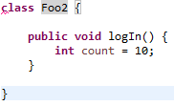
Declare Class Members
Variable Declarations
Local (Automatic/Stack/Method) Variables
Local variables are variables declared within a method. That means the variable is not just initialized within the method, but also declared within the method. Just as the local variable starts its life inside the method, it's also destroyed when the method has completed. Local variables are always on the stack, not the heap. (We'll talk more about the stack and the heap later).
Remember, before a local variable can be used, it must be initialized with a value.

Slide 45
Declare Class Members
Variable Declarations
Final Variables
Declaring a variable with the final keyword makes it impossible to reinitialize that variable once it has been initialized with an explicit value.
For primitives, this means that once the variable is assigned a value, the value can't be altered. For example, if you assign 10 to the int variable x, then x is going to stay 10, forever.
A reference variable marked final can't ever be reassigned to refer to a different object. The data within the object can be modified, but the reference variable cannot be changed.
Burn this in: there are no final objects, only final references.

Slide 46
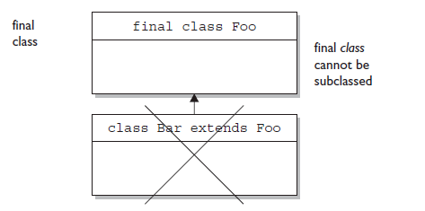
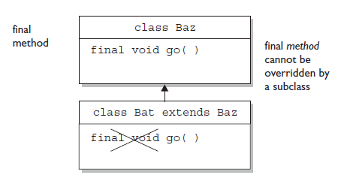
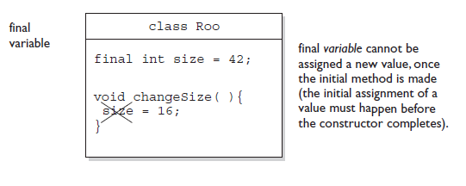
Declare Class Members
Variable Declarations
We've now covered how the final modifier can be applied to classes, methods, and variables.

Slide 47
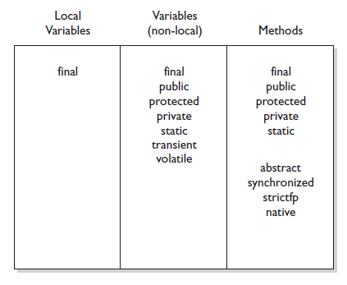
Declare Class Members
Comparison of modifiers on variables vs. methods

Slide 48
Declare Class Members
Static Variables and Methods
The static modifier is used to create variables and methods that will exist independently of any instances created for the class. All static members exist before you ever make a new instance of a class, and there will be only one copy of a static member regardless of the number of instances of that class.
We'll cover static members in great detail later.
Things you can mark as static:
Methods
Variables
A class nested within another class, but not within a method (talk later).
Initialization blocks
Things you can't mark as static:
Constructors (makes no sense; a constructor is used only to create instances)
Classes (unless they are nested)
Interfaces
Method local inner classes (talk later)
Inner class methods and instance variables
Local variables

Slide 49
Declare Class Members
Questions?

Slide 50
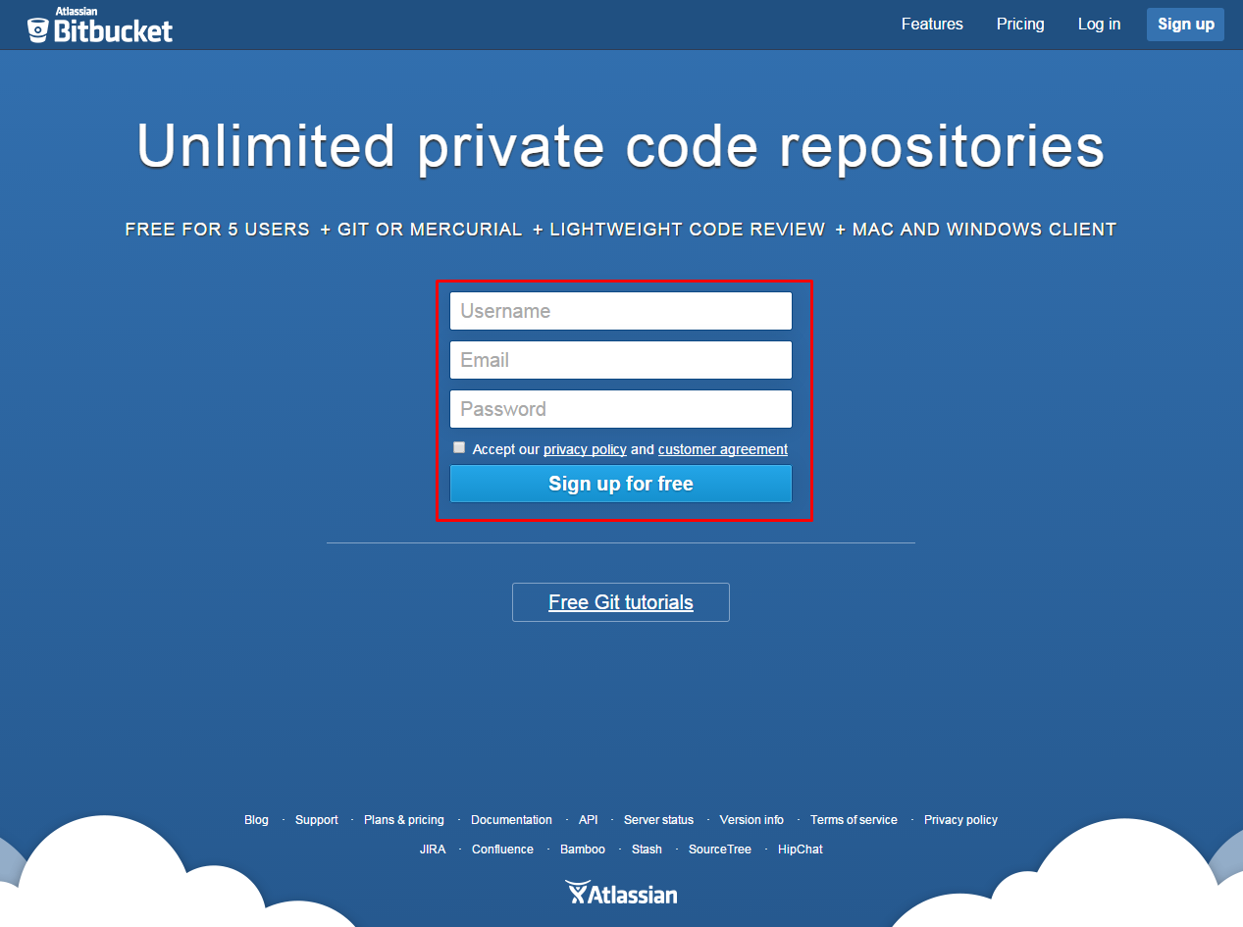
https://bitbucket.org/
Please, Sign up!

Slide 51
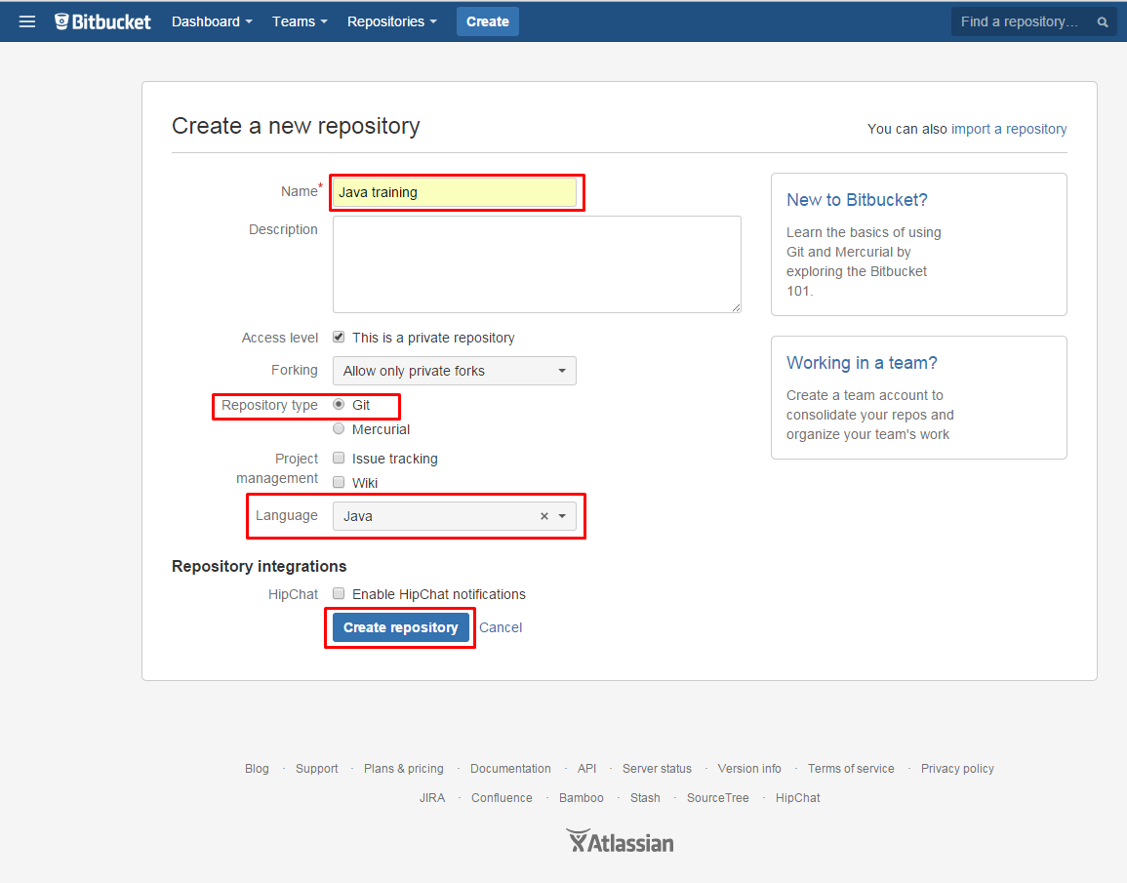
https://bitbucket.org/
Create your repository

Slide 52
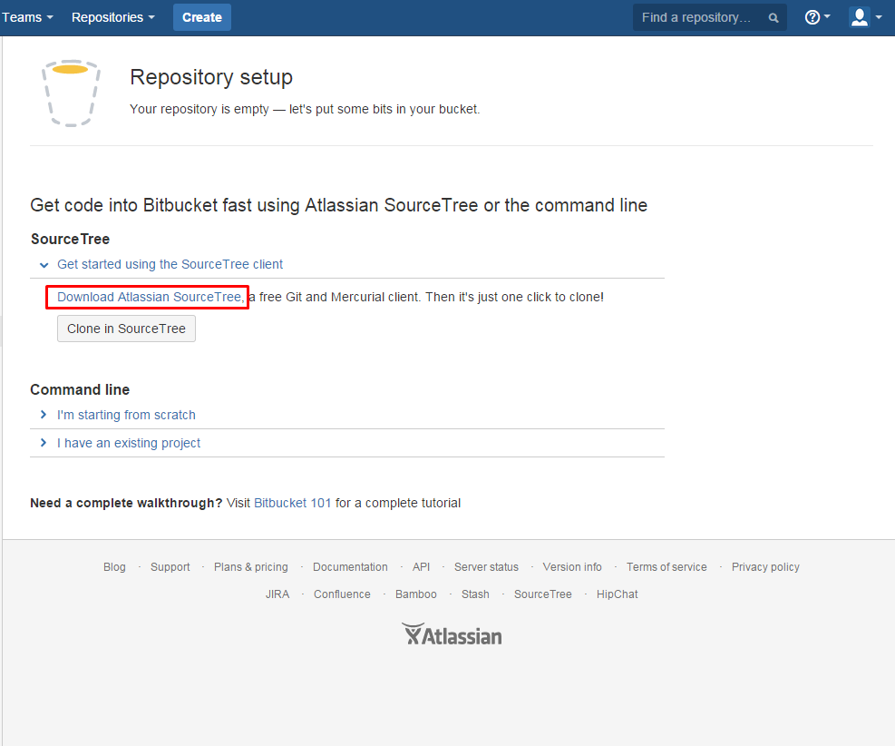
https://bitbucket.org/
Next, download and install the client.
Then, run client, login and clone your repo to local machine.

Slide 53
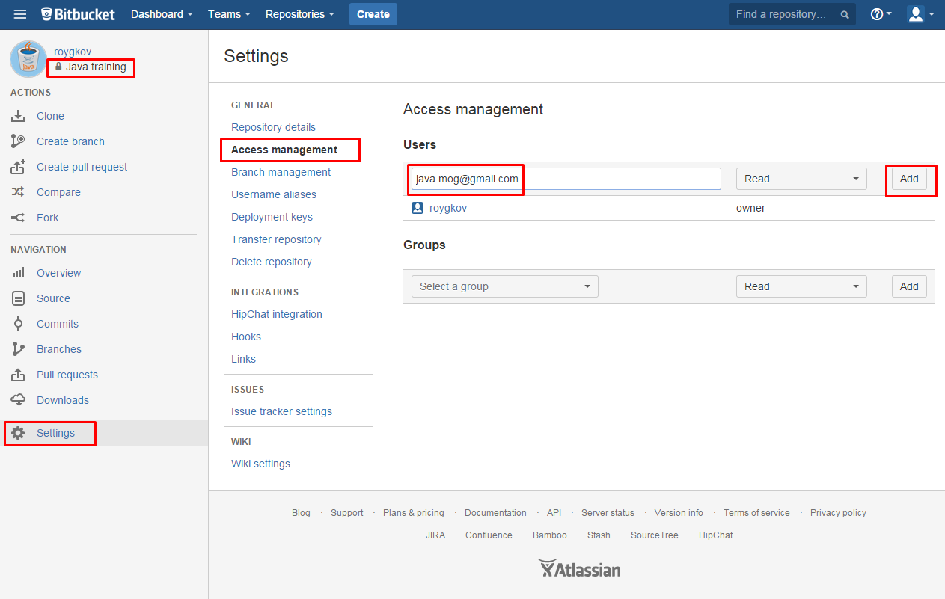
https://bitbucket.org/
Share your repo with java.mog@gmail.com user

Slide 54
https://bitbucket.org/
Questions?

Slide 55
User data
Mail: java.mog@gmail.com
Yauheni_Razhkou@epam.com
Progress: http://goo.gl/Tsk493
Listener Env: Login: training
Password: Courses2014

Slide 56
II. Object Orientation
Agenda:
Encapsulation
Inheritance, Is-A, Has-A
Polymorphism
Overriding / Overloading
Reference Variable Casting
Constructors and Instantiation
Statics

Slide 57
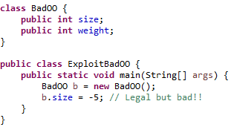
Encapsulation
Imagine you wrote the code for a class, and another dozen programmers from your company all wrote programs that used your class. Now imagine that later on, you didn't like the way the class behaved, because some of its instance variables were being set (by the other programmers from within their code) to values you hadn't anticipated.
If you want maintainability, flexibility, and extensibility (and of course, you do), your design must include encapsulation. How do you do that?
Keep instance variables protected (with an access modifier, often private).
Make public accessor methods, and force calling code to use those methods rather than directly accessing the instance variable.
For the methods, use the JavaBeans naming convention of set<someProperty> and get<someProperty>.

Slide 58
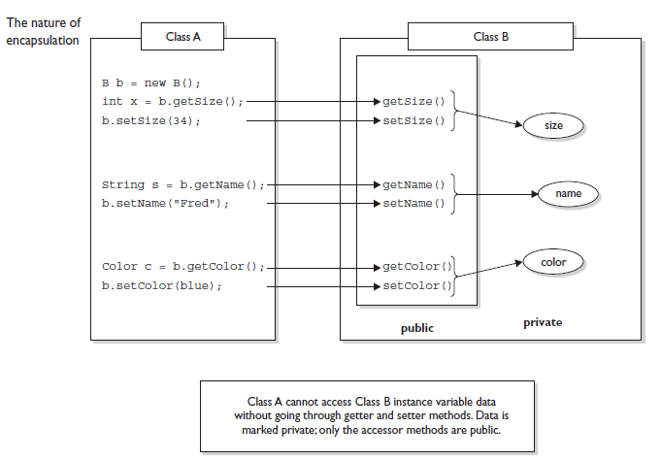
Encapsulation

Slide 59
Encapsulation
Questions?

Slide 60
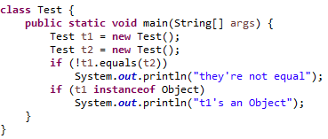
Inheritance, Is-A, Has-A
Inheritance is everywhere in Java. It's safe to say that it's almost (almost?) impossible to write even the tiniest Java program without using inheritance. Every class you'll ever use or ever write will inherit from class Object. You'll always have an equals method, a clone method, notify, wait, and others, available to use. Whenever you create a class, you automatically inherit all of class Object's methods.
Produces the output:
they're not equal
t1's an Object
Where did that equals method come from?
For now, just remember that instanceof returns true if the reference variable being tested is of the type being compared to.

Slide 61
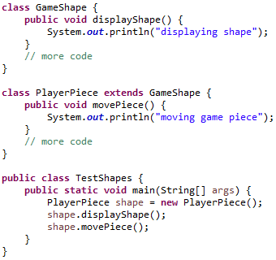
Inheritance, Is-A, Has-A
You'll need to know that you can create inheritance relationships in Java by extending a class. It's also important to understand that the two most common reasons to use inheritance are:
To promote code reuse
To use polymorphism
Let's start with reuse:

Slide 62
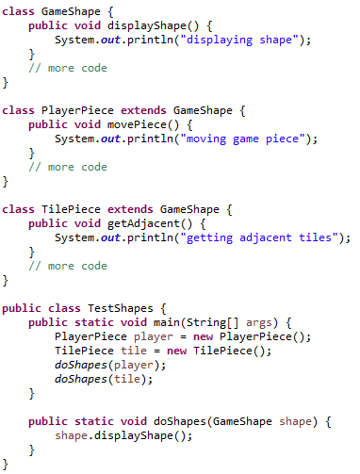
Inheritance, Is-A, Has-A
The second (and related) use of inheritance is to allow your classes to be accessed polymorphically - a capability provided by interfaces as well. Let's say that you have a GameLauncher class that wants to loop through a list of different kinds of GameShape objects, and invoke display() on each of them. At the time you write this class, you don't know every possible kind of GameShape subclass that anyone else will ever write. And you sure don't want to have to redo your code just because somebody decided to build a Dice shape six months later.
You can write code in your GameLauncher class that says, "I don't care what kind of object you are as long as you inherit from (extend) GameShape. And as far as I'm concerned, if you extend GameShape then you've definitely got a display() method, so I know I can call it.“

Slide 63
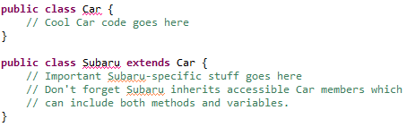
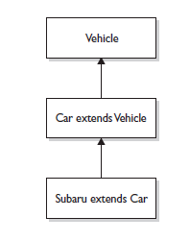


Inheritance, Is-A, Has-A
IS-A
In OO, the concept of IS-A is based on class inheritance or interface implementation. IS-A is a way of saying, "this thing is a type of that thing." For example, a Mustang is a type of horse, so in OO terms we can say, "Mustang IS-A Horse." Subaru IS-A Car.
Important: java has no multiple inheritance, but you can implement
a lot of interfaces:

Slide 64

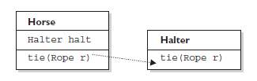
Inheritance, Is-A, Has-A
HAS-A
HAS-A relationships are based on usage, rather than inheritance. In other words, class A HAS-A B if code in class A has a reference to an instance of class B. For example, you can say the following,
A Horse IS-A Animal. A Horse HAS-A Halter.
The code might look like this:
HAS-A relationships allow you to design classes that follow good OO practices by not having monolithic classes that do a gazillion different things.

Slide 65
Inheritance, Is-A, Has-A
Questions?

Slide 66
Polymorphism
Remember, any Java object that can pass more than one IS-A test can be considered polymorphic.
Remember that the only way to access an object is through a reference variable, and there are a few key things to remember about references:
  A reference variable can be of only one type, and once declared, that type can never be changed (although the object it references can change).
  A reference is a variable, so it can be reassigned to other objects, (unless the reference is declared final).
  A reference variable's type determines the methods that can be invoked on the object the variable is referencing.
  A reference variable can refer to any object of the same type as the declared reference, or - this is the big one - it can refer to any subtype of the declared type!
  A reference variable can be declared as a class type or an interface type. If the variable is declared as an interface type, it can reference any object of any class that implements the interface.

Slide 67
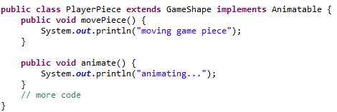

Polymorphism
So now we have a PlayerPiece that passes the IS-A test for both the GameShape class and the Animatable interface. That means a PlayerPiece can be treated polymorphically as one of four things at any given time, depending on the declared type of the reference variable:
An Object (since any object inherits from Object)
A GameShape (since PlayerPiece extends GameShape)
A PlayerPiece (since that's what it really is)
An Animatable (since PlayerPiece implements Animatable)
The following are all legal declarations. Look closely:

Slide 68
Polymorphism
Remember!!!
Polymorphic method invocations apply only to instance methods. You can always refer to an object with a more general reference variable type (a superclass or interface), but at runtime, the ONLY things that are dynamically selected based on the actual object (rather than the reference type) are instance methods. Not static methods. Not variables. Only overridden instance methods are dynamically invoked based on the real object's type.

Slide 69
Polymorphism
Questions?

Slide 70
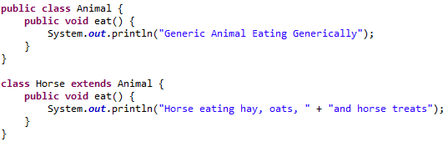
Overriding / Overloading
Overridden Methods
Any time you have a class that inherits a method from a superclass, you have the opportunity to override the method (unless, as you learned earlier, the method is marked final). The key benefit of overriding is the ability to define behavior that's specific to a particular subclass type.

Slide 71
Overriding / Overloading
The rules for overriding a method are as follows:
The argument list must exactly match that of the overridden method. If they don't match, you can end up with an overloaded method you didn't intend.
The return type must be the same as, or a subtype of, the return type declared in the original overridden method in the superclass.
The access level can't be more restrictive than the overridden method's.
The access level CAN be less restrictive than that of the overridden method.
Instance methods can be overridden only if they are inherited by the subclass. A subclass within the same package as the instance's superclass can override any superclass method that is not marked private or final. A subclass in a different package can override only those non-final methods marked public or protected (since protected methods are inherited by the subclass).
The overriding method CAN throw any unchecked (runtime) exception, regardless of whether the overridden method declares the exception.
The overriding method must NOT throw checked exceptions that are new or broader than those declared by the overridden method. For example, a method that declares a FileNotFoundException cannot be overridden by a method that declares a SQLException, Exception, or any other non-runtime exception unless it's a subclass of FileNotFoundException.
The overriding method can throw narrower or fewer exceptions. Just because an overridden method "takes risks" doesn't mean that the overriding subclass‘ exception takes the same risks. Bottom line: an overriding method doesn't have to declare any exceptions that it will never throw, regardless of what the overridden method declares.
You cannot override a method marked final.
You cannot override a method marked static.
If a method can't be inherited, you cannot override it.

Slide 72
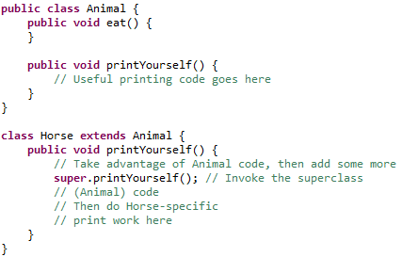
Overriding / Overloading
Invoking a Superclass Version of an Overridden Method

Slide 73

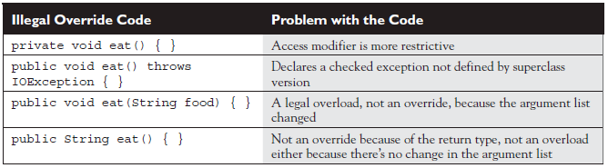
Overriding / Overloading
Examples of Legal and Illegal Method Overrides

Slide 74

Overloaded Methods
Overloaded Methods
Method Overloading is a feature that allows a class to have two or more methods having same name, if their argument lists are different.
The rules:
Overloaded methods MUST change the argument list.
Overloaded methods CAN change the return type.
Overloaded methods CAN change the access modifier.
Overloaded methods CAN declare new or broader checked exceptions.
A method can be overloaded in the same class or in a subclass.

Slide 75
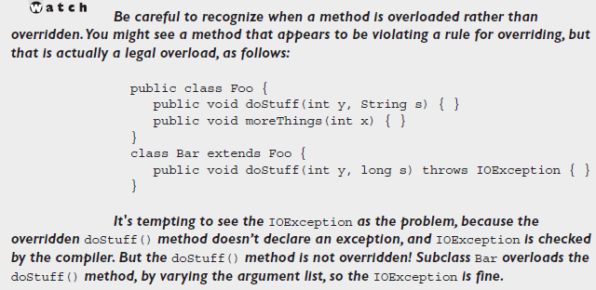
Overloaded Methods
Overloaded Methods

Slide 76
Overriding / Overloading
Questions?

Slide 77
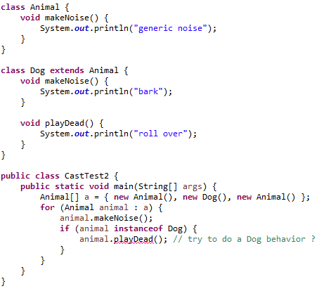
Reference Variable Casting
We've seen how it's both possible and common to use generic reference variable types to refer to more specific object types. It's at the heart of polymorphism. For example, this line of code should be second nature by now: Animal animal = new Dog();
But what happens when you want to use that animal reference variable to invoke a method that only class Dog has?

Slide 78

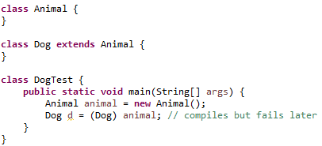
Reference Variable Casting
When we try to compile previous code, the compiler says something like this: cannot find symbol
The compiler is saying, "Hey, class Animal doesn't have a playDead() method". Let's modify the if code block:
The new and improved code block contains a cast, which in this case is sometimes called a downcast. In this case we're safe because before we ever try the cast, we do an instanceof test to make sure.
It's important to know that the compiler is forced to trust us when we do a downcast, even when we screw up:
It can be maddening! This code compiles! When we try to run it, we'll get an exception something like this: java.lang.ClassCastException.

Slide 79
Reference Variable Casting
Questions?

Slide 80
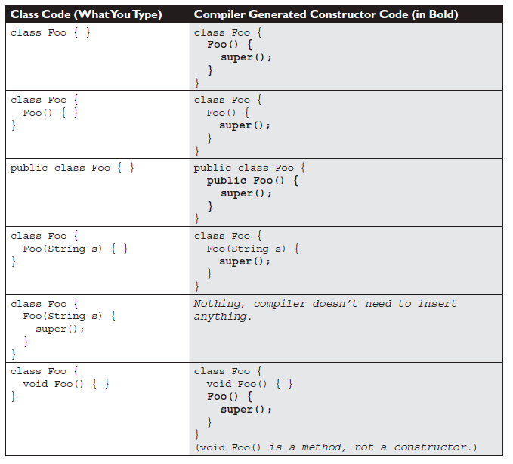


Constructors and Instantiation
Objects are constructed. You can't make a new object without invoking a constructor.
Constructor Basics
Every class, including abstract classes, MUST have a constructor. A constructor looks like this:

Slide 81
Constructors and Instantiation
Rules for Constructors
Constructors can use any access modifier, including private.
The constructor name must match the name of the class.
Constructors must not have a return type.
It's legal (but stupid) to have a method with the same name as the class, but that doesn't make it a constructor.
If you don't type a constructor into your class code, a default constructor will
be automatically generated by the compiler.
The default constructor is ALWAYS a no-arg constructor.
Every constructor has, as its first statement, either a call to an overloaded constructor (this()) or a call to the superclass constructor (super()), although remember that this call can be inserted by the compiler.
You cannot make a call to an instance method, or access an instance variable, until after the super constructor runs.
Only static variables and methods can be accessed as part of the call to super() or this().
Abstract classes have constructors, and those constructors are always called when a concrete subclass is instantiated.
Interfaces do not have constructors. Interfaces are not part of an object's inheritance tree.

Slide 82
Constructors and Instantiation
Questions?

Slide 83
Statics
Static Variables and Methods
To understand the way a static member using, we'll look first at a reason for using one. Imagine you've got a utility class with a method that always runs the same way; its sole function is to return, say, a random number. It wouldn't matter which instance of the class performed the method—it would always behave exactly the same way. In other words, the method's behavior has no dependency on the state (instance variable values) of an object.
Use static methods to implement behaviors that are not affected by the state of any instances.
Use static variables to hold data that is class specific as opposed to instance specific—there will be only one copy of a static variable.
All static members belong to the class, not to any instance.
A static method can't access an instance variable directly.
Use the dot operator to access static members, but remember that using a reference variable with the dot operator is really a syntax trick, and the compiler will substitute the class name for the reference variable, for instance:
  d.doStuff();
  becomes:
  Dog.doStuff();
static methods can't be overridden, but they can be redefined.

Slide 84
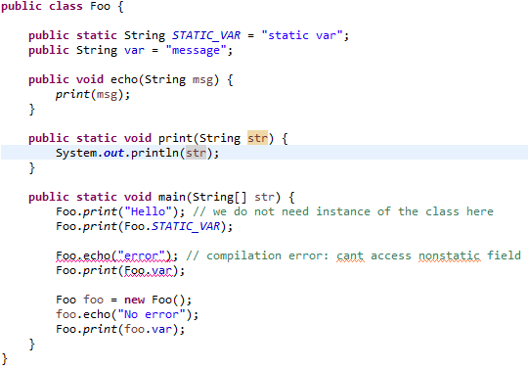
Statics

Slide 85
Statics
Questions?

Slide 86
III. Operators, Flow Control, Exceptions
Agenda:

