Slide 1


November 21, 2019

Slide 2
IN PREVIOUS PART
Foundations of Querying
Understanding the Foundations of T-SQL
Understanding Logical Query Processing
Getting Started with the SELECT Statement
Using the FROM and SELECT Clauses
Working with Data Types and Built-in Functions
Library OLTP Database (Homework assignment)

Slide 3
MSBI.Dev.E03 AGENDA
Choosing a Data Type for Keys
Getting Started with the SELECT Statement
Filtering and Sorting Data
Combining Sets
Working with Git
Design for OLTP Database (Web Store)

Slide 4
Choosing a Data Type for Keys
Choosing a Data Type for Keys
The identity column property
The sequence object
Nonsequential GUIDs
Sequential GUIDs
Custom solutions

Slide 5
Getting Started with the SELECT Statement
CASE Expression and Related Functions
SELECT productid,
productname,
unitprice,
discontinued,
CASE discontinued
WHEN 0 THEN 'No'
WHEN 1 THEN 'Yes'
ELSE 'Unknown'
END AS discontinued_desc
FROM Production.Products;
COALESCE
ISNULL
CHOOSE
IIF

Slide 6
Filtering and Sorting Data
Filtering and Sorting Data

Slide 7
Filtering and Sorting Data
Filtering Data with Predicates
Predicates
ON
WHERE
HAVING
Predicates, Three-Valued Logic, and Search Arguments

Slide 8
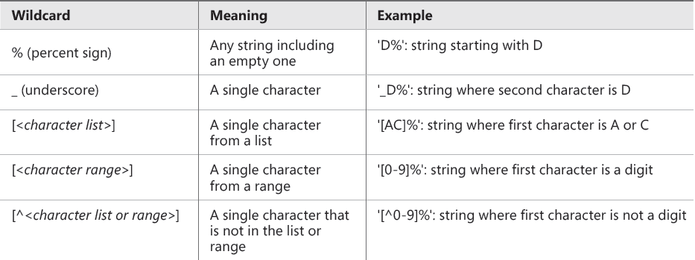
Filtering and Sorting Data
Filtering Character Data
LIKE

Slide 9
Filtering and Sorting Data
Search Arguments

Slide 10
Filtering and Sorting Data
Search Arguments
Non-SARG
SARG
WHERE [Column] - 1 = @var
WHERE ABS([Column]) = 1
WHERE ISNULL([Column], 1) = 1
WHERE DATEADD(DAY, 7, [Column]) > GETDATE()
WHERE SUBSTRING([Column], 4) = 'ABCD'
WHERE [Column] LIKE '%ABC%'
WHERE [Column] = @var + 1
WHERE [Column] IN (-1, 1)
WHERE (([Column] = 1) OR ([Column] IS NULL))
WHERE [Column] > DATEADD(DAY, -7, GETDATE())
WHERE [Column] LIKE 'ABCD%'

Slide 11
Filtering and Sorting Data
Search Arguments
DEMO

Slide 12
Filtering and Sorting Data
Filtering Date and Time Data
USE YYYYMDD FORMAT
Be careful when you filter column with data and time
SELECT orderid, orderdate, empid, custid
FROM Sales.Orders
WHERE orderdate = '02/12/07';
SELECT orderid, orderdate, empid, custid
FROM Sales.Orders
WHERE orderdate = '20070212';

Slide 13
Filtering and Sorting Data
Filtering Data with TOP and OFFSET -FETCH
Filtering Data with TOP
Filtering Data with OFFSET-FETCH
deterministic results of sorting
OFFSET-FETCH is standard and TOP isn’t; also, OFFSET-FETCH supports a skipping
capability that TOP doesn’t

Slide 14
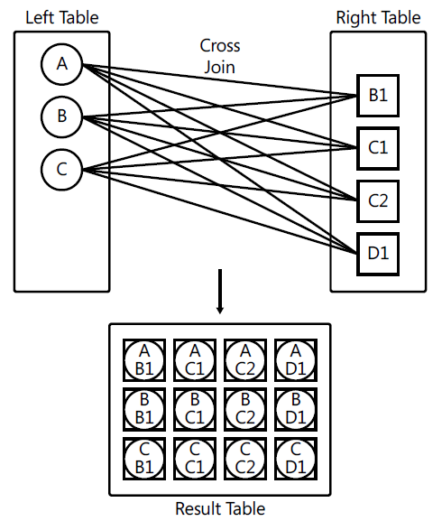
Combining Sets
Using Joins
Cross Joins

Slide 15
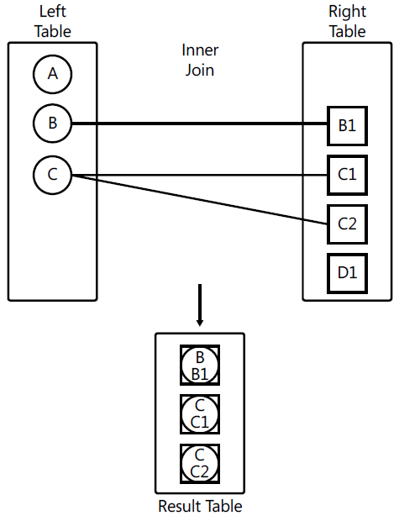
Combining Sets
Using Joins
Inner Joins

Slide 16
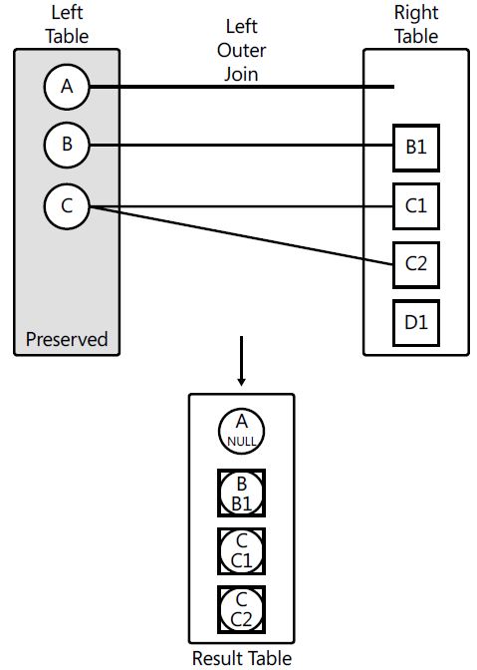
Combining Sets
Using Joins
Outer Joins

Slide 17
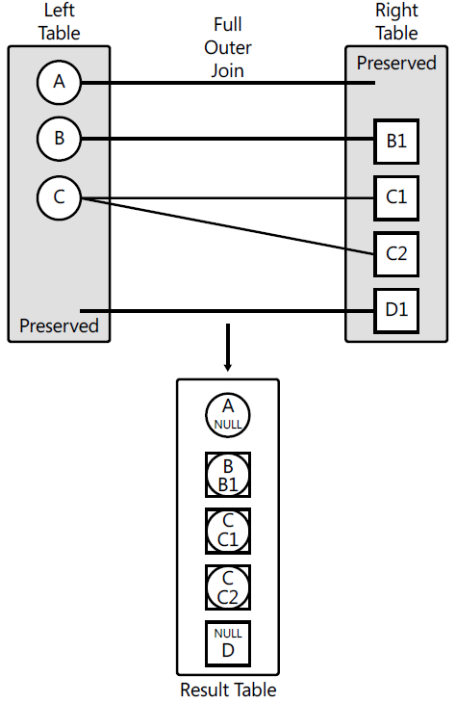
Combining Sets
Using Joins
FULL OUTER JOIN

Slide 18
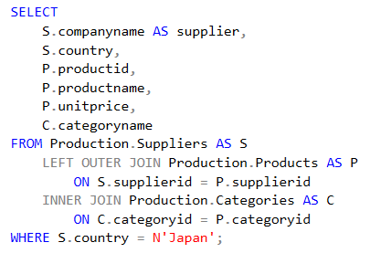
Combining Sets
Using Joins
Multi-Join Queries

Slide 19
Combining Sets
Combining Sets
DEMO

Slide 20
Working with Git
Working with Git
DEMO

Slide 21
Design for OLTP Database (Web Store)
Design for OLTP Database (Web Store)

