Slide 1


November 18, 2019

Slide 2
IN PREVIOUS PART
Database evolution
MS SQL Server overview
Course workflow and resources
POC of a database

Slide 3
S20E02 AGENDA
Data Storage Internals
Tables and Indexes
Foundations of Querying
Getting Started with the SELECT Statement
Working with Git, Jira, Draw.io
Library OLTP Database (Homework assignment)

Slide 4
S20E02
Data Storage Internals

Slide 5
Data Storage Internals
1
Database Files and Filegroups
2
Data Pages and Data Rows
3
Large Objects Storage
4
LOB Storage
5
Extents and Allocation Map Pages
5
Data Modifications

Slide 6
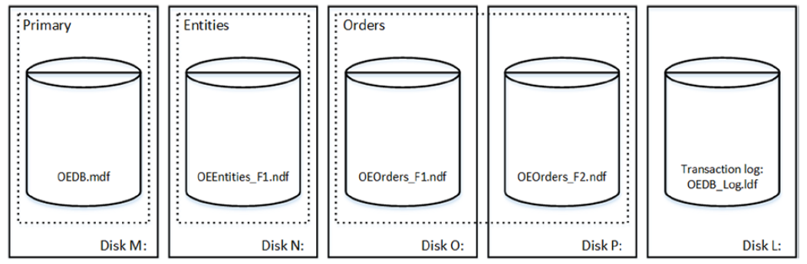
Data Storage Internals
Database Files and Filegroups

Slide 7
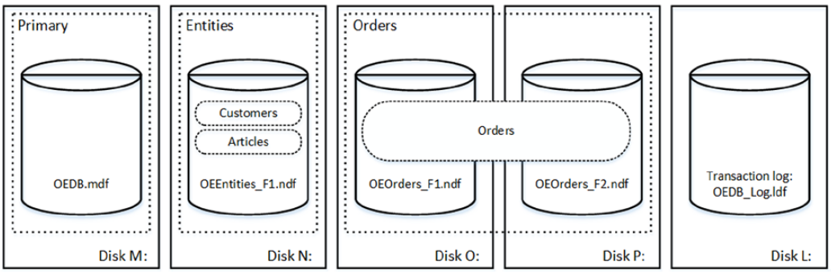
Data Storage Internals
Database Files and Filegroups

Slide 8
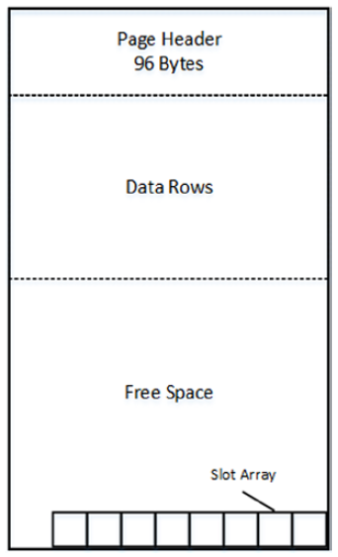
Data Storage Internals
Data Pages and Data Rows
The space in the database is divided into logical 8KB pages

Slide 9
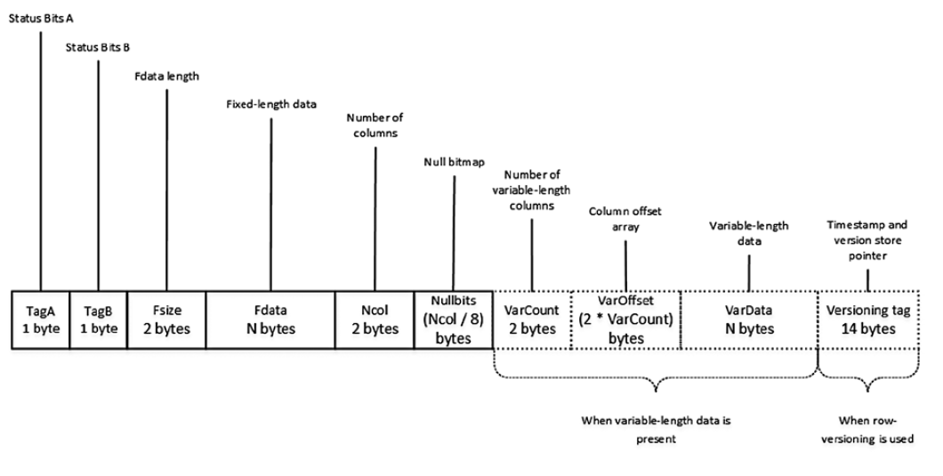
Data Storage Internals
Data Pages and Data Rows

Slide 10
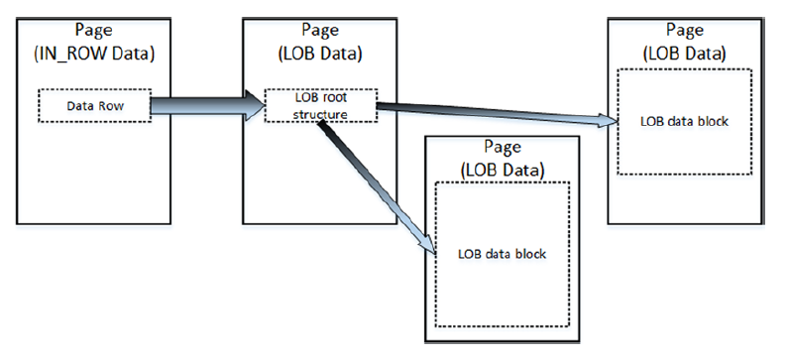
Data Storage Internals
Large Objects Storage
Row-Overflow Storage
LOB Storage

Slide 11
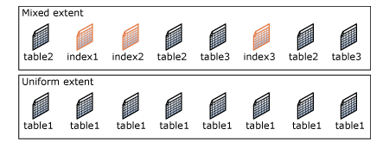
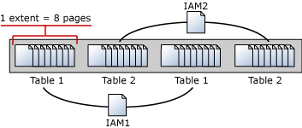
Data Storage Internals
Extents and Allocation Map Pages

Slide 12
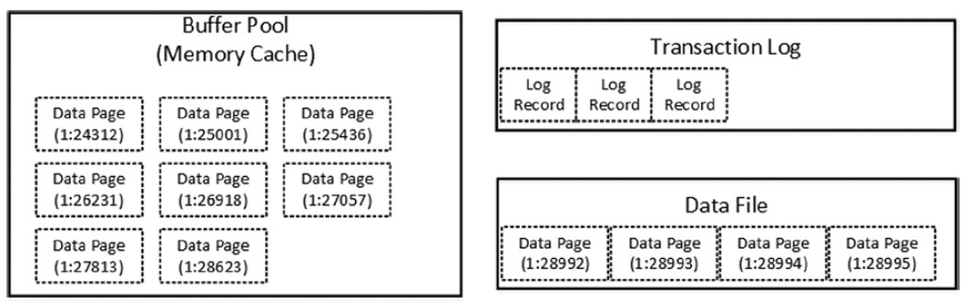
Data Storage Internals
Data Modifications
Initial stage

Slide 13
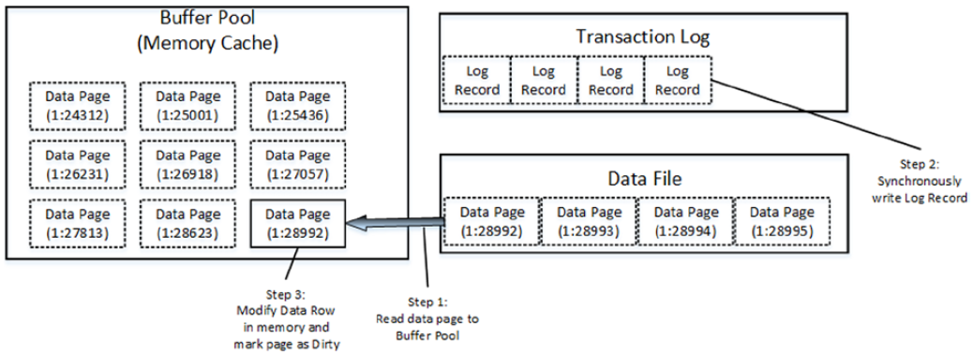
Data Storage Internals
Data Modifications
Modifying data

Slide 14
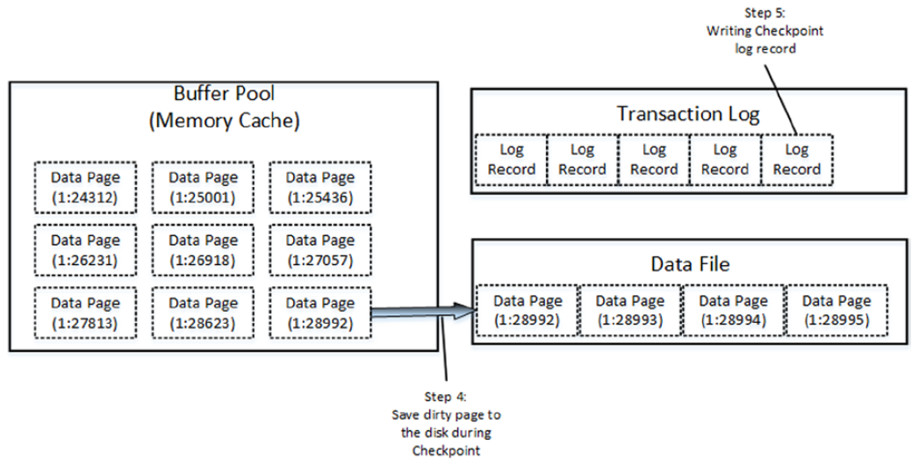
Data Storage Internals
Data Modifications
Checkpoint

Slide 15
S20E02
Tables and Indexes

Slide 16
Tables and Indexes: Internal Structure and Access Methods
1
Heap Tables
2
Clustered Indexes
3
Composite Indexes
4
Nonclustered Indexes

Slide 17

Tables and Indexes: Internal Structure and Access Methods
Heap Tables
Heap tables are tables without a clustered index.
The data in heap tables is unsorted.
SQL Server does not guarantee, nor does it maintain, a sorting order of the data in the heap tables.

Slide 18
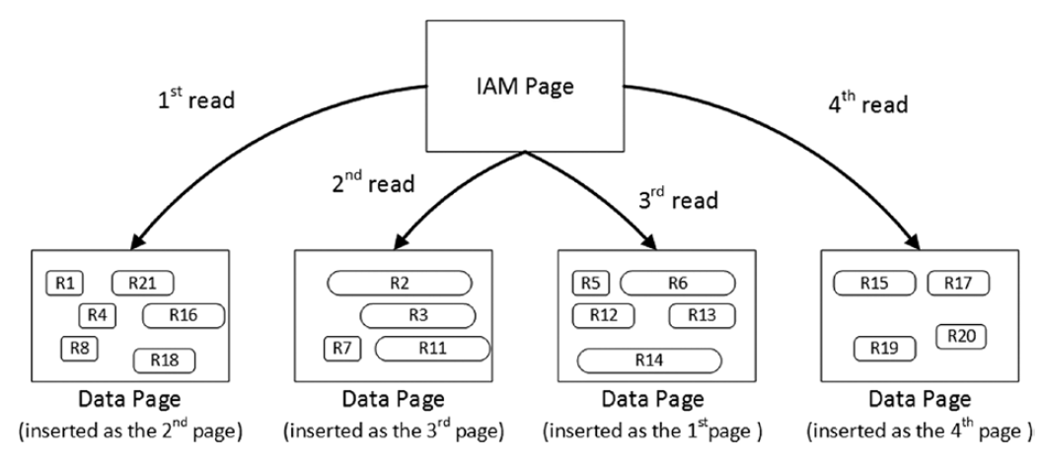
Tables and Indexes: Internal Structure and Access Methods
Heap Tables
Heap tables are tables without a clustered index.
The data in heap tables is unsorted.
SQL Server does not guarantee,nor does it maintain, a sorting order of the data in the heap tables.

Slide 19
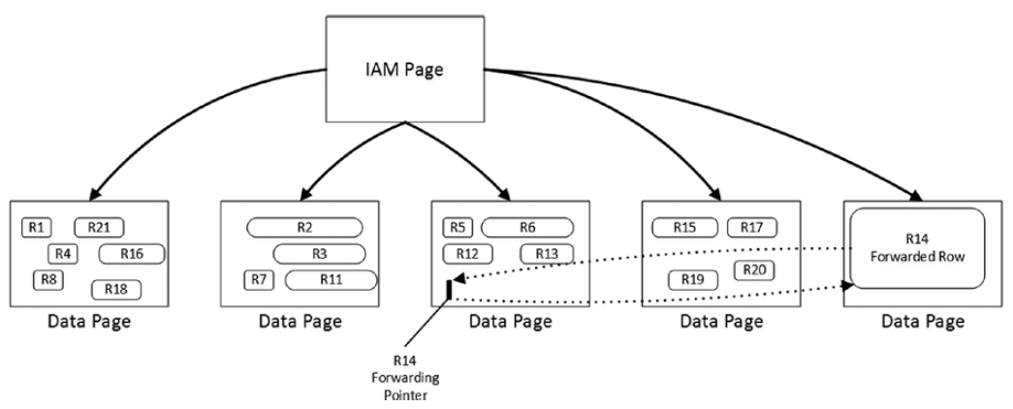
Tables and Indexes: Internal Structure and Access Methods
Heap Tables
Forwarding pointers

Slide 20
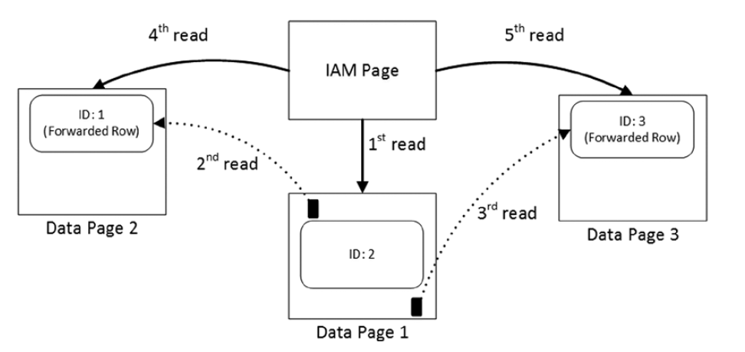
Tables and Indexes: Internal Structure and Access Methods
Heap Tables
Reading data when the forwarding pointers exist

Slide 21

Tables and Indexes: Internal Structure and Access Methods
Clustered Indexes
A clustered index dictates the physical order of the data in a table, which is sorted according to the clustered index key.
The table can have only one clustered index defined.

Slide 22
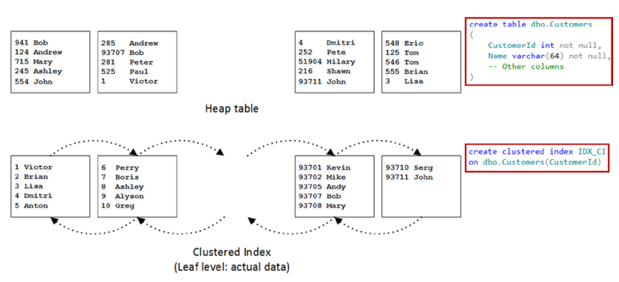
Tables and Indexes: Internal Structure and Access Methods
Clustered Indexes

Slide 23
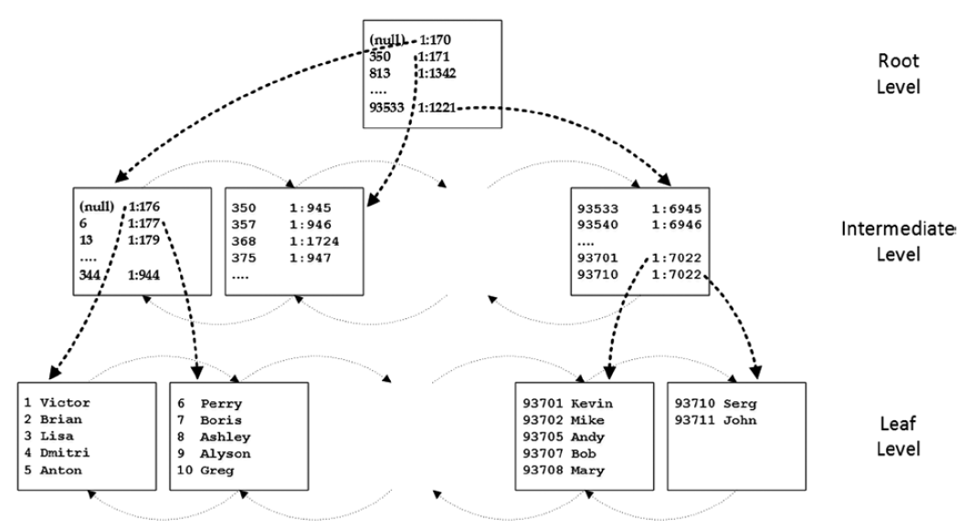
Tables and Indexes: Internal Structure and Access Methods
Clustered Indexes

Slide 24
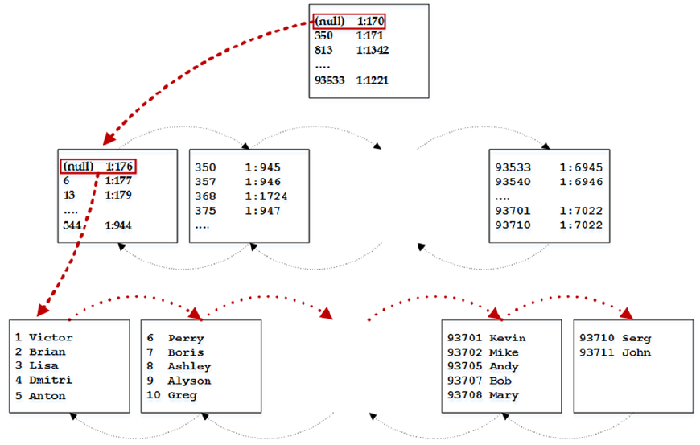
Tables and Indexes: Internal Structure and Access Methods
Clustered Indexes
Ordered index scan

Slide 25
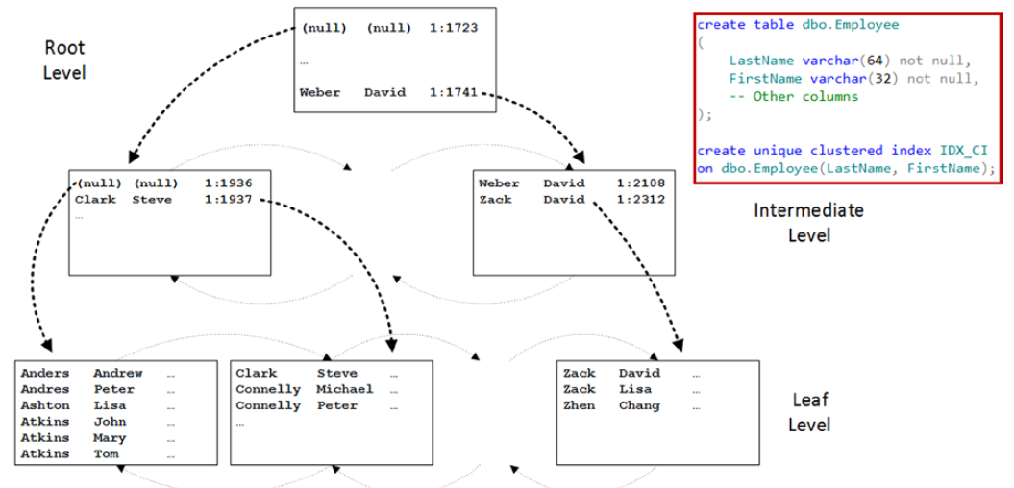
Tables and Indexes: Internal Structure and Access Methods
Composite Indexes

Slide 26
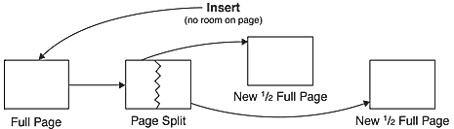
Tables and Indexes: Internal Structure and Access Methods
Page split

Slide 27
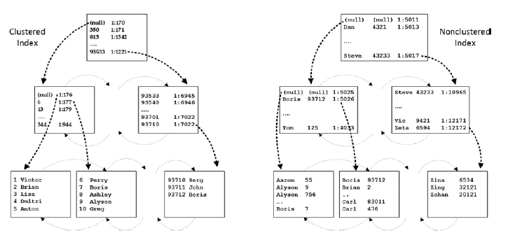
Tables and Indexes: Internal Structure and Access Methods
Nonclustered Indexes

Slide 28
S20E02
Foundations of T-SQL

Slide 29
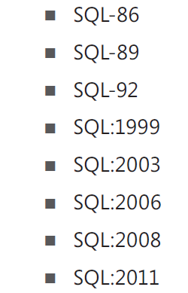
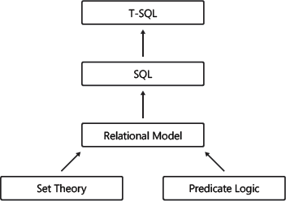
Understanding the Foundations of T-SQL
Evolution of T-SQL
International Organization for Standards (ISO) American National Standards Institute (ANSI)
Dialect of SQL
SEQUEL; an acronym for “structured English query language.”

Slide 30
Understanding the Foundations of T-SQL
Evolution of T-SQL
@Variable1 <> @Variable2
@Variable1 != @Variable2
CAST
CONVERT
Standard
Is not a standard
Standard
Is not a standard

Slide 31
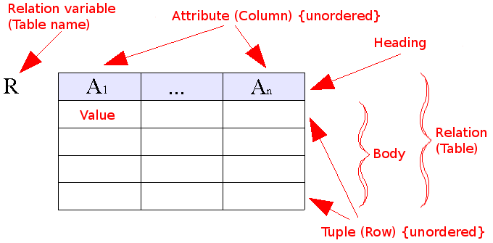
Understanding the Foundations of T-SQL
Evolution of T-SQL

Slide 32

Understanding the Foundations of T-SQL
Evolution of T-SQL
Set theory and predicate logic
SELECT [empid]
,[lastname]
,[region]
FROM [TSQL2012].[HR].[Employees]
WHERE [region]='WA'
NULL
Mark
third logical value—
unknown

Slide 33
Understanding the Foundations of T-SQL
Using T-SQL in a Relational Way
DEMO

Slide 34
Understanding Logical Query Processing
T-SQL As a Declarative English-Like Language
declarative means you define what you want
imperative languages define how to achieve what you want
“Bring me a soda from the refrigerator.”
SELECT shipperid, phone, companyname
FROM Sales.Shippers;
DEMO
“Go to the refrigerator; open the door; get a soda; bring it to me.”

Slide 35
Understanding Logical Query Processing
T-SQL As a Declarative English-Like Language
For human
For robot
“Bring me a soda from the refrigerator.”
SELECT shipperid, phone, companyname
FROM Sales.Shippers;
DEMO
“Go to the refrigerator; open the door; get a soda; bring it to me.”
FROM Sales.Shippers
SELECT shipperid, phone, companyname;

Slide 36
Understanding Logical Query Processing
Logical Query Processing Phases
In T-SQL Query
logical query processing order
1. FROM
2. WHERE
3. GROUP BY
4. HAVING
5. SELECT
6. ORDER BY
1. SELECT
2. FROM
3. WHERE
4. GROUP BY
5. HAVING
6. ORDER BY

Slide 37
Getting Started with the SELECT Statement
Using the FROM and SELECT Clauses
DEMO
<expression> AS <alias>
<expression> <alias>
<alias> = <expression>

Slide 38
Getting Started with the SELECT Statement
Working with Data Types and
Built-in Functions
DEMO
Data Types (Transact-SQL)” at http://msdn.microsoft.com/en-us/library/ms187752(v=SQL.110).aspx
Built-in Functions (Transact-SQL)” at http://msdn.microsoft.com/en-us/library/ms174318(v=SQL.110).aspx

Slide 39
S20E02
Working with Git

Slide 40
S20E02
Working with Jira

Slide 41
S20E02
Working with Draw.io

Slide 42
S20E02
Homework Assignment

