Slide 1



March 17, 2019
3

Slide 2
Agenda: MSBI.Dev.S19E15
---
topics:
- topicname: Designing and Implementing Control Flow
subtopics:
- subtopicname: Control Flow Tasks and Containers
- subtopicname: Precedence Constraints
- topicname: Designing and Implementing Data Flow
subtopics:
- subtopicname: Data Flow Task
- subtopicname: Data Flow Source Adapters
- subtopicname:
- topicname: CrimeStatistic Project
subtopics:
- subtopicname: CrimeStat.DWH
- subtopicname: CrimeStat.SSIS
- subtopicname: CrimeStat Tasks
3
Notes:
Appendix includes recent awards, please visit elements.epam.com for all 2016-2017 awards

Slide 3
Containers
3
Notes:
Appendix includes recent awards, please visit elements.epam.com for all 2016-2017 awards

Slide 4
- subtopicname: Control Flow Tasks and Containers
Containers
For Loop container
Foreach Loop container
Sequence container

Slide 5
Precedence Constraints
3
Notes:
Appendix includes recent awards, please visit elements.epam.com for all 2016-2017 awards

Slide 6
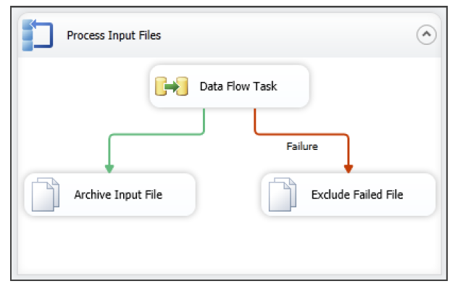
Designing and Implementing Control Flow
Precedence Constraints

Slide 7
Designing and Implementing Data Flow
Defining Data Sources and Destinations
Creating a Data Flow Task
Defining Data Flow Source Adapters
Defining Data Flow Destination Adapters
SSIS Data Types
Data Flow Transformations

Slide 8
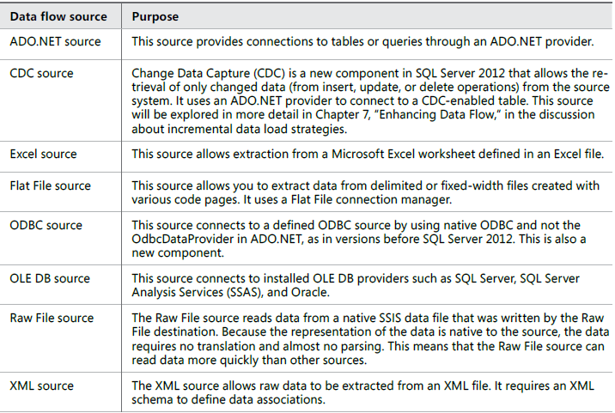
Designing and Implementing Data Flow
Defining Data Flow Source Adapters

Slide 9
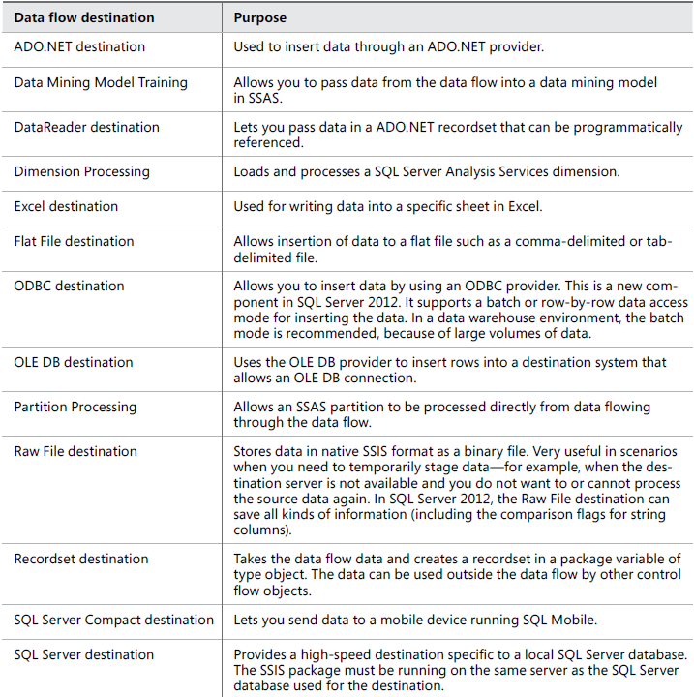
Designing and Implementing Data Flow
Defining Data Flow Destination Adapters

Slide 10
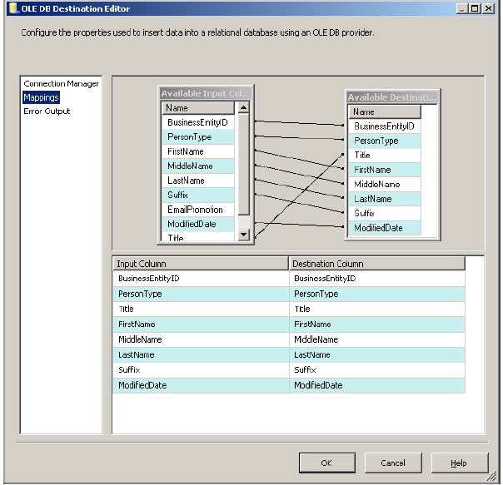
Designing and Implementing Data Flow
Columns mapping

Slide 11
Designing and Implementing Data Flow
Designing and Implementing Data Flow

Slide 12
Designing and Implementing Data Flow
Defining Data Sources and Destinations
Creating a Data Flow Task
Defining Data Flow Source Adapters
Defining Data Flow Destination Adapters
SSIS Data Types

Slide 13
Designing and Implementing Data Flow
Defining Data Flow Source Adapters

Slide 14
Designing and Implementing Data Flow
Defining Data Flow Destination Adapters

Slide 15
Designing and Implementing Data Flow
Columns mapping

Slide 16
Designing and Implementing Data Flow
Defining Data Sources and Destinations
Creating a Data Flow Task
Defining Data Flow Source Adapters
Defining Data Flow Destination Adapters
SSIS Data Types

Slide 17
Designing and Implementing Data Flow
SSIS Data Types

Slide 18

Designing and Implementing Data Flow
Using a Lookup Transformation
Lookup Transformation Case Sensitivity and others

Slide 19
Designing and Implementing Data Flow
Using the Cache Transform Transformation with the Lookup
Transformation

Slide 20
Designing and Implementing Data Flow
Sorting the Data
Set based update

Slide 21
Designing and Implementing Data Flow
Working with Data Flow Transformations
Selecting Transformations
non-blocking transformations
partial-blocking transformation
blocking transformation

Slide 22
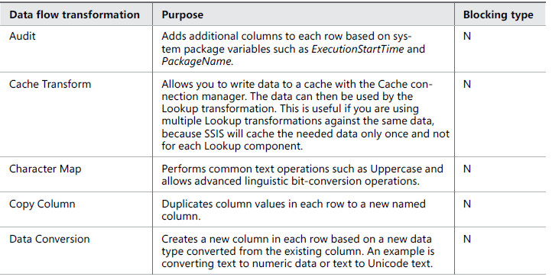
Designing and Implementing Data Flow
Logical Row-Level Transformations

Slide 23
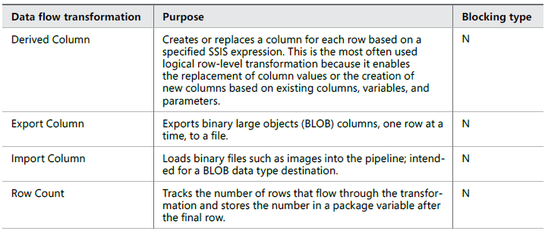
Designing and Implementing Data Flow
Logical Row-Level Transformations

Slide 24
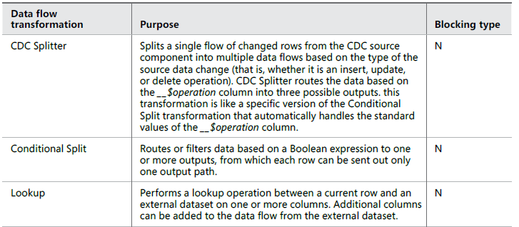
Designing and Implementing Data Flow
Multi-Input and Multi-Output Transformations

Slide 25
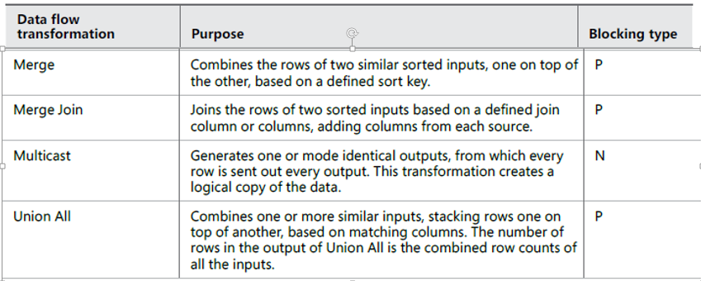
Designing and Implementing Data Flow
Multi-Input and Multi-Output Transformations

Slide 26
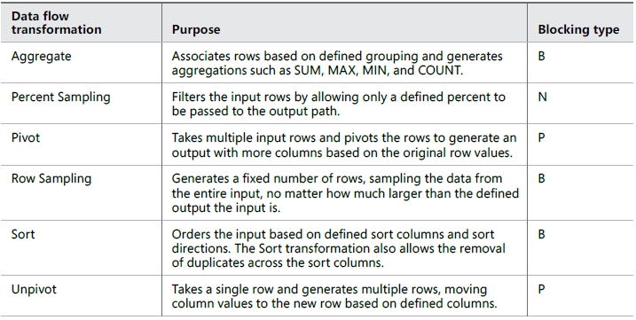
Designing and Implementing Data Flow
Multi-Row Transformations

Slide 27
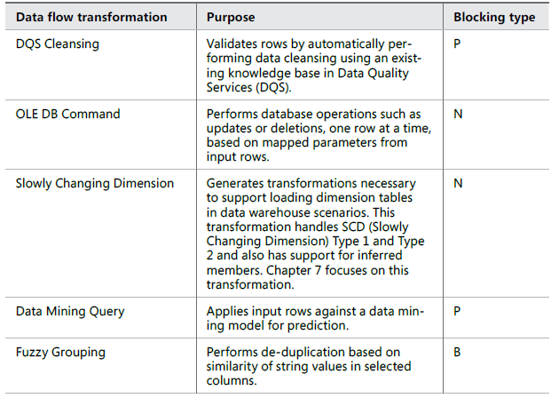
Designing and Implementing Data Flow
Advanced Data-Preparation Transformations

Slide 28
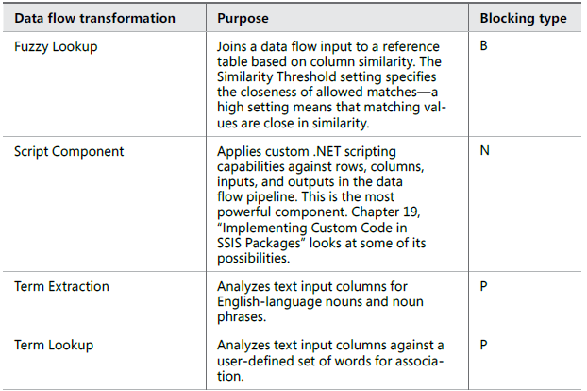
Designing and Implementing Data Flow
Advanced Data-Preparation Transformations

Slide 29
DWH
CrimeStat BI solution case scenario

Slide 30
Determining Appropriate ETL Strategy and Tools
ETL Strategy
Defining the architecture for ETL
Deciding what to do in the SSIS and what to push down to the database layer
Managing the whole ETL process

Slide 31
Determining Appropriate ETL Strategy and Tools
ETL Architecture
Extract the data (process)
Initial Staging (landing zone)
Data Quality (process)
Clean Staging (landing zone)
Transformation (process)
Load-ready Publish (landing zone)
Load Enterprise Data Warehouse (process)
Enterprise Data Warehouse (landing zone)
Load Data Marts (process)
Data Marts (landing zone)

