Slide 1



3
Notes:
Appendix includes recent awards, please visit elements.epam.com for all 2016-2017 awards

Slide 2
IN PREVIOUS PART: S18E05
1
Using Window Functions
2
Creating and Altering Tables
3
Enforcing Data Integrity
4
SSDT How to manage database as a source code
5
Jira
3
Notes:
Appendix includes recent awards, please visit elements.epam.com for all 2016-2017 awards

Slide 3
Agenda: MSBI.Dev.S19E06
1
Querying and Managing XML Data
-
Returning Results As XML with FOR XML
-
Querying XML Data with XQuery
-
Using the XML Data Type
3
Notes:
Appendix includes recent awards, please visit elements.epam.com for all 2016-2017 awards

Slide 4
Agenda: MSBI.Dev.S19E06
2
JSON data in SQL Server
-
Key JSON capabilities of SQL Server and SQL Database
-
Extract values from JSON text and use them in queries
-
Change JSON values
-
Convert JSON collections to a rowset
-
Convert SQL Server data to JSON or export JSON
3
Notes:
Appendix includes recent awards, please visit elements.epam.com for all 2016-2017 awards

Slide 5
Querying and Managing XML Data

Slide 6
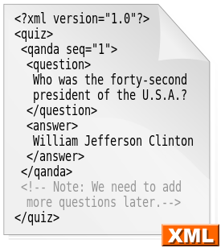
XML
Extensible Markup Language (XML)
is a markup language that defines a set of rules for encoding documents in a format which is both human-readable and machine-readable

Slide 7
Querying and Managing XML Data
MS SQL SERVER XML FEATURES
Creating XML from relational data
Shredding XML into relational tabular format
Native XML data type
XML Query Language (XQuery)

Slide 8
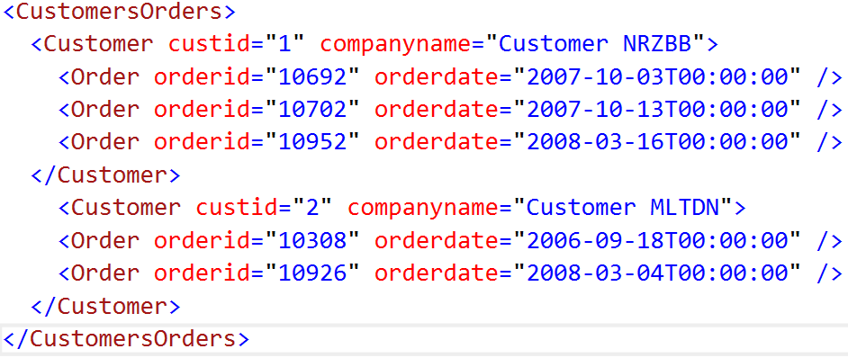
Querying and Managing XML Data
Introduction to XML
Creating XML from relational data
Shredding XML into relational tabular format
Native XML data type
XML Query Language (XQuery)

Slide 9
Querying and Managing XML Data
Introduction to XML
TAGS
Creating XML from relational data
Shredding XML into relational tabular format
Native XML data type
XML Query Language (XQuery)

Slide 10
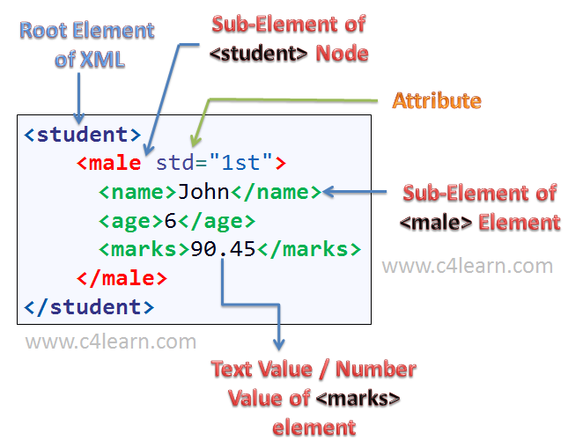
Querying and Managing XML Data
Introduction to XML

Slide 11
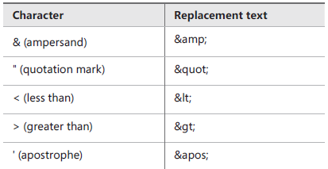
Querying and Managing XML Data
Characters with special values in XML documents

Slide 12
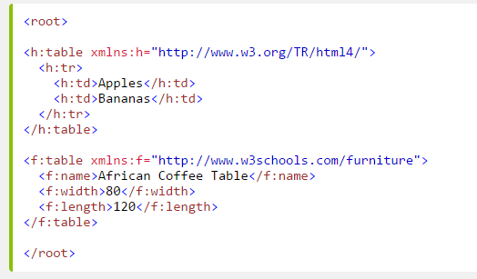
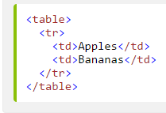
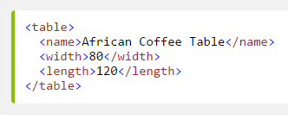
Querying and Managing XML Data
NAMESPACES
Name Conflicts

Slide 13
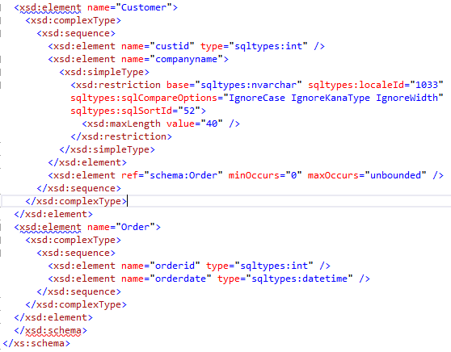
Querying and Managing XML Data
XML Schema Description (XSD)

Slide 14
Querying and Managing XML Data
Producing XML from Relational Data
FOR XML RAW
FOR XML AUTO
FOR XML PATH

Slide 15
Querying and Managing XML Data
Shredding XML to Tables
OPENXML

Slide 16
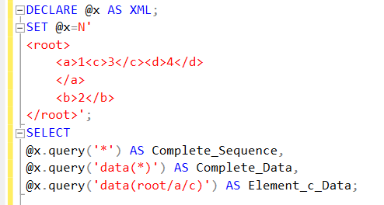
Querying and Managing XML Data
Querying XML Data with XQuery
XQuery Basics

Slide 17
Querying and Managing XML Data
XQuery Functions
Querying XML Data with XQuery
Numeric functions ceiling(), floor(), and round()
String functions concat(), contains(), substring(), string-length(), lower-case(), and upper-case()
Boolean and Boolean constructor functions not(), true(), and false()
Nodes functions local-name() and namespace-uri()
Aggregate functions count(), min(), max(), avg(), and sum()
Data accessor functions data() and string()
SQL Server extension functions sql:column() and sql:variable()

Slide 18
Querying and Managing XML Data
Navigation
Querying XML Data with XQuery
ode-name/child::element-name[@attribute-name=value]
Axis Specifies the direction of travel. In the example, the axis is child::, which specifies child nodes of the node from the previous step.
Axis Specifies the direction of travel. In the example, the axis is child::, which specifies child nodes of the node from the previous step.
Predicate Further narrows down the search. In the example, there is one predicate: [@attribute-name=value], which selects only nodes that have an attribute named attribute-name with value value, such as [@orderid=10952].

Slide 19
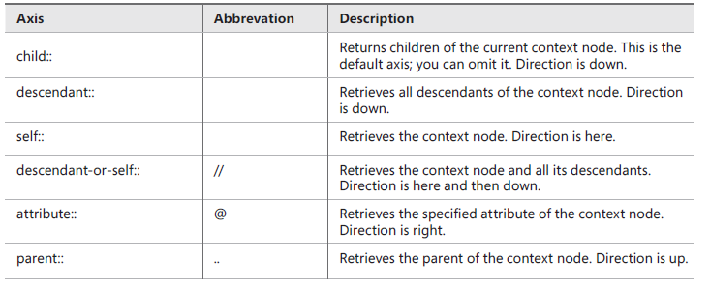
Querying and Managing XML Data
Querying XML Data with XQuery
Axes supported in SQL Server

Slide 20
Querying and Managing XML Data
Using the XML Data Type
Using the XML Data Type for Dynamic Schema
Skip it for S18

Slide 21
JSON data in SQL Server

Slide 22

JSON
JSON
JavaScript Object Notation

Slide 23
JSON
JSON's basic data types
Number: a signed decimal number that may contain a fractional part and may use exponential E notation, but cannot include non-numbers such as NaN.
String: a sequence of zero or more Unicode characters. Strings are delimited with double-quotation marks and support a backslash escaping syntax.
Boolean : true or False
Array: an ordered list of zero or more values, each of which may be of any type. Arrays use square bracket notation and elements are comma-separated.
Object: an unordered collection of name–value pairs where the names (also called keys) are strings.

Slide 24
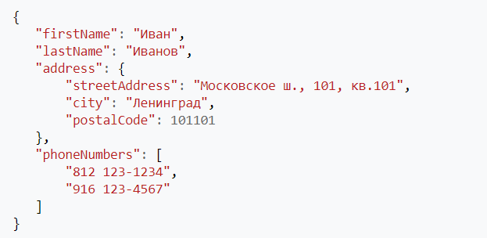
JSON
JSON

Slide 25
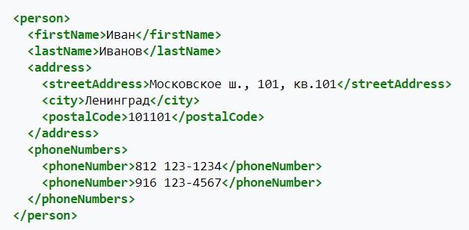
JSON
XML

Slide 26
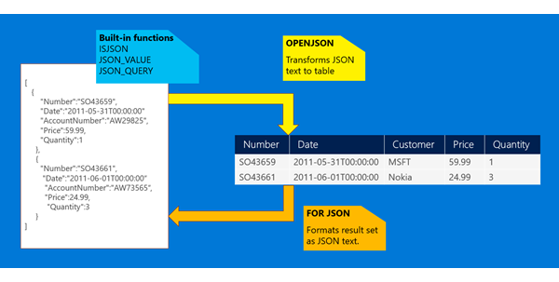
JSON
JSON data in SQL Server

Slide 27
JSON
Base operation
Convert JSON collections to a rowset
Convert SQL Server data to JSON or export JSON
Extract values from JSON text and use them in queries
JSON_VALUE extracts a scalar value from a JSON string.
JSON_QUERY extracts an object or an array from a JSON string.
ISJSON tests whether a string contains valid JSON.
JSON_MODIFY changes a value in a JSON string.
Modify JSON

