Slide 1



March 17, 2019
3

Slide 2
IN PREVIOUS PART: MSBI.Dev.S19E13
---
topics:
- topicname: Managing the Performance of a Data Warehouse
subtopics:
- subtopicname: Database settings and DWH creation steps
- subtopicname: Indexing Dimensions and Fact Tables
- subtopicname: Indexed Views
- subtopicname: Compression
- subtopicname: Columnstore Indexes and Batch Processing
- subtopicname: Using Partitions
- subtopicname: Data Lineage
- topicname: DWH documentation
subtopics:
- subtopicname: Data mapping
- subtopicname: Dimensional model
3
Notes:
Appendix includes recent awards, please visit elements.epam.com for all 2016-2017 awards

Slide 3
IN PREVIOUS PART : MSBI.Dev.S19E13
- topicname: Developing SSIS Packages
subtopics:
- subtopicname: ETL
- topicname: Creating SSIS Packages
subtopics:
- subtopicname: Using the SQL Server Import and Export Wizard
- subtopicname: Developing SSIS Packages in SSDT
- subtopicname: Introducing Control Flow, Data Flow, and Connection Managers
- topicname: Designing and Implementing Control Flow
subtopics:
- subtopicname: Connection Managers
- subtopicname: Control Flow Tasks and Containers
- subtopicname: Precedence Constraints
- topicname: UN Statistic Project
subtopics:
- subtopicname: Review
- subtopicname: First step
---
3
Notes:
Appendix includes recent awards, please visit elements.epam.com for all 2016-2017 awards

Slide 4
Agenda: MSBI.Dev.S19E14
---
topics:
- topicname: Designing and Implementing Control Flow
subtopics:
- subtopicname: Connection Managers
- subtopicname: Control Flow Tasks and Containers
- subtopicname: Precedence Constraints
- topicname: Designing and Implementing Data Flow
subtopics:
- subtopicname: Data Flow Task
- subtopicname: Data Flow Source Adapters
- subtopicname:
- topicname: CrimeStatistic Project
subtopics:
- subtopicname: CrimeStat.DWH
- subtopicname: CrimeStat.SSIS
- subtopicname: CrimeStat Tasks
3
Notes:
Appendix includes recent awards, please visit elements.epam.com for all 2016-2017 awards

Slide 5
Designing and Implementing Control Flow

Slide 6
Connection Managers
3
Notes:
Appendix includes recent awards, please visit elements.epam.com for all 2016-2017 awards

Slide 7
Designing and Implementing Control Flow
Connection
Managers
Type | Description
ADO | Connects to ActiveX Data Objects (ADO) objects.
ADO.NET | Connects to a data source by using a .NET provider.
CACHE | Reads data from the data flow or from a cache file (.caw), and can save data to the cache file.
DQS | Connects to a Data Quality Services server and a Data Quality Services database on the server.
EXCEL | Connects to an Excel workbook file.
FILE | Connects to a file or a folder.
FLATFILE | Connect to data in a single flat file.
FTP | Connect to an FTP server.
HTTP | Connects to a webserver.
MSMQ | Connects to a message queue.
MSOLAP100 | Connects to an instance of SQL Server Analysis Services or an Analysis Services project.
MULTIFILE | Connects to multiple files and folders.
MULTIFLATFILE | Connects to multiple data files and folders.
OLEDB | Connects to a data source by using an OLE DB provider.
ODBC | Connects to a data source by using ODBC.
SMOServer | Connects to a SQL Server Management Objects (SMO) server.
SMTP | Connects to an SMTP mail server.
WMI | Connects to a server and specifies the scope of Windows Management Instrumentation (WMI) management on the server.
https://msdn.microsoft.com/en-us/ms140203.aspx

Slide 8
Designing and Implementing Control Flow
Connection Managers
ADO.NET
OLE DB
ODBC
https://datatellblog.wordpress.com/2015/01/13/ssis-data-flows-ado-net-vs-ole-db-vs-odbc/

Slide 9
Designing and Implementing Control Flow
Connection Manager Scope
Package-scoped connection managers
Project-scoped connection managers
https://msdn.microsoft.com/en-us/ms140203.aspx

Slide 10
Designing and Implementing Control Flow
32-Bit and 64-Bit Data Providers
SSIS development environment is a 32-bit environment
SSIS execution environment is dictated by the underlying operating system
https://msdn.microsoft.com/en-us/ms140203.aspx

Slide 11
Containers
3
Notes:
Appendix includes recent awards, please visit elements.epam.com for all 2016-2017 awards

Slide 12
- subtopicname: Control Flow Tasks and Containers
Containers
For Loop container
Foreach Loop container
Sequence container

Slide 13
Precedence Constraints
3
Notes:
Appendix includes recent awards, please visit elements.epam.com for all 2016-2017 awards

Slide 14
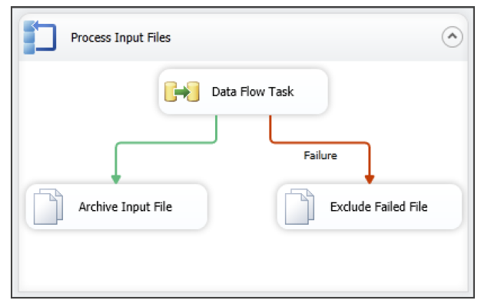
Designing and Implementing Control Flow
Precedence Constraints

Slide 15
Designing and Implementing Data Flow
Defining Data Sources and Destinations
Creating a Data Flow Task
Defining Data Flow Source Adapters
Defining Data Flow Destination Adapters
SSIS Data Types
Data Flow Transformations

Slide 16
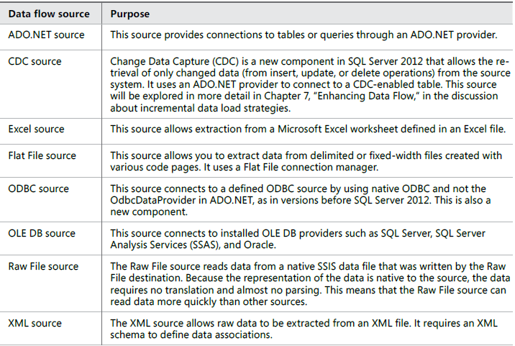
Designing and Implementing Data Flow
Defining Data Flow Source Adapters

Slide 17
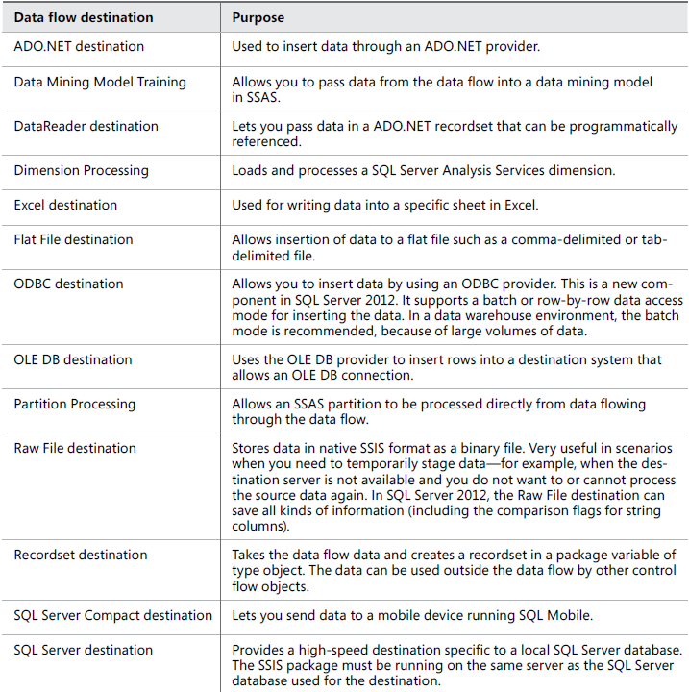
Designing and Implementing Data Flow
Defining Data Flow Destination Adapters

Slide 18
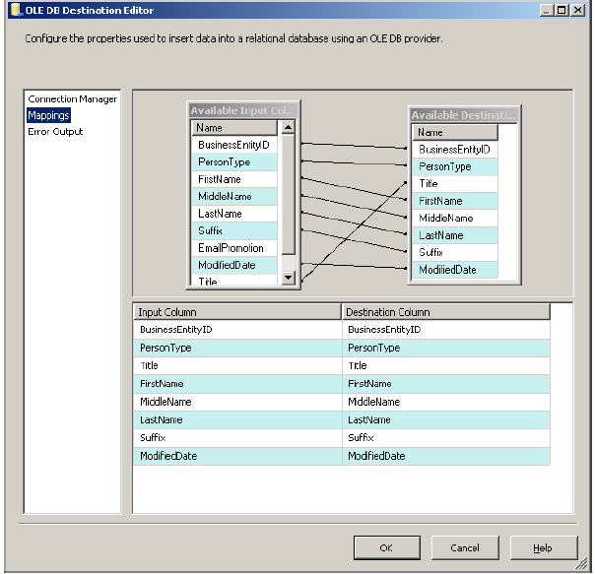
Designing and Implementing Data Flow
Columns mapping

Slide 19
CrimeStatistic Project

Slide 20
CrimeStat.DWH
3
Notes:
Appendix includes recent awards, please visit elements.epam.com for all 2016-2017 awards

Slide 21
CrimeStat.SSIS
3
Notes:
Appendix includes recent awards, please visit elements.epam.com for all 2016-2017 awards

