Slide 1



March 7, 2019
3
Notes:
Appendix includes recent awards, please visit elements.epam.com for all 2016-2017 awards

Slide 2
IN PREVIOUS PART: MSBI.Dev.S19E10
- topicname: Using Dynamic SQL
subtopics:
- subtopicname: Dynamic SQL Overview
- subtopicname: Uses for Dynamic SQL
- subtopicname: The EXECUTE Command
- subtopicname: SQL Injection
- subtopicname: Using sp_executesql
- subtopicname: Use case scenarios
- topicname: Designing and Implementing Stored Procedures
subtopics:
- subtopicname: Understanding Stored Procedures
keywords: [SET NOCOUNT ON, RETURN and Return Codes,Input Parameters,Output Parameters]
- subtopicname: Branching Logic
keywords: [IF/ELSE, WHILE,WAITFOR,GOTO]
- subtopicname: Developing Stored Procedures
keywords: [Stored Procedures and Error Handling, Dynamic SQL in Stored Procedures]
3
Notes:
Appendix includes recent awards, please visit elements.epam.com for all 2016-2017 awards

Slide 3
IN PREVIOUS PART: MSBI.Dev.S19E10
- topicname: Implementing Triggers
subtopics:
- subtopicname: DML Triggers
- subtopicname: AFTER Triggers
keywords: [Nested AFTER Triggers]
- subtopicname: INSTEAD OF Triggers
- subtopicname: DML Trigger Functions
keywords: [UP DATE (),COLUMNS _UPDATED()]
- topicname: Implementing User-Defined Functions
subtopics:
- subtopicname: Scalar UDFs
- subtopicname: Inline Table-Valued UDF
- subtopicname: Multistatement Table-Valued UDF
- subtopicname: Limitations on UDFs
3
Notes:
Appendix includes recent awards, please visit elements.epam.com for all 2016-2017 awards

Slide 4
Agenda: MSBI.Dev.S19E11
---
topics:
- topicname: Implementing Indexes and Statistics
subtopics:
- subtopicname: Heap Tables
- subtopicname: Clustered Indexes
- subtopicname: Supporting Queries with Indexes
- topicname: Using Tools to Analyze Query Performance
subtopics:
- subtopicname: Query Optimization Problems and the Query Optimizer
- subtopicname: SQL Server Extended Events, SQL Trace, and SQL Server Profiler
- subtopicname: Using SET Session Options and Analyzing Query Plans
- subtopicname: Using Dynamic Management Objects
- topicname: Understanding Cursors, Sets, and Temporary Tables
subtopics:
- subtopicname: Cursors
- subtopicname: Temporary Tables
---
3
Notes:
Appendix includes recent awards, please visit elements.epam.com for all 2016-2017 awards

Slide 5
Implementing Indexes and Statistics

Slide 6

Tables and Indexes: Internal Structure and Access Methods
Heap Tables
Heap tables are tables without a clustered index.
The data in heap tables is unsorted.
SQL Server does not guarantee, nor does it maintain, a sorting order of the data in the heap tables.

Slide 7
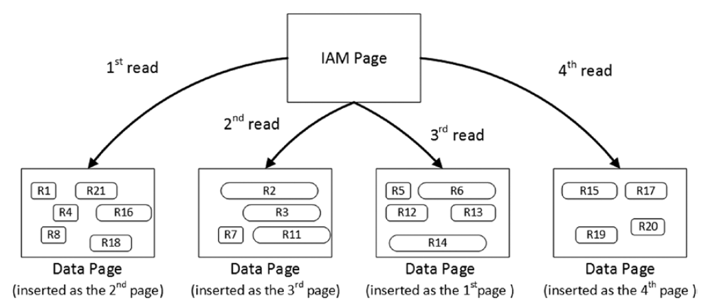
Tables and Indexes: Internal Structure and Access Methods
Heap Tables
Heap tables are tables without a clustered index.
The data in heap tables is unsorted.
SQL Server does not guarantee,nor does it maintain, a sorting order of the data in the heap tables.

Slide 8
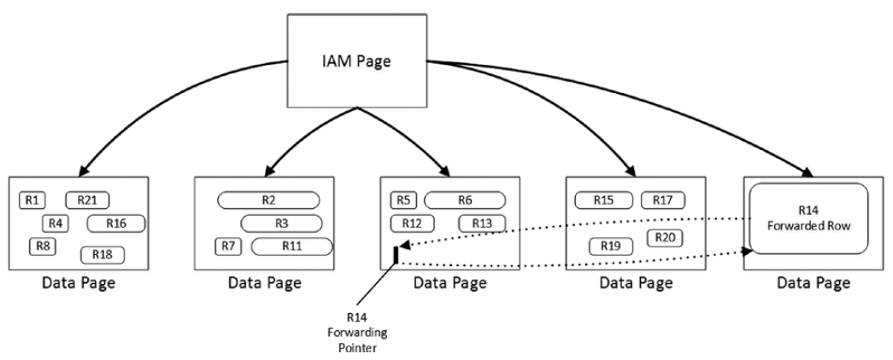
Tables and Indexes: Internal Structure and Access Methods
Heap Tables
Forwarding pointers

Slide 9
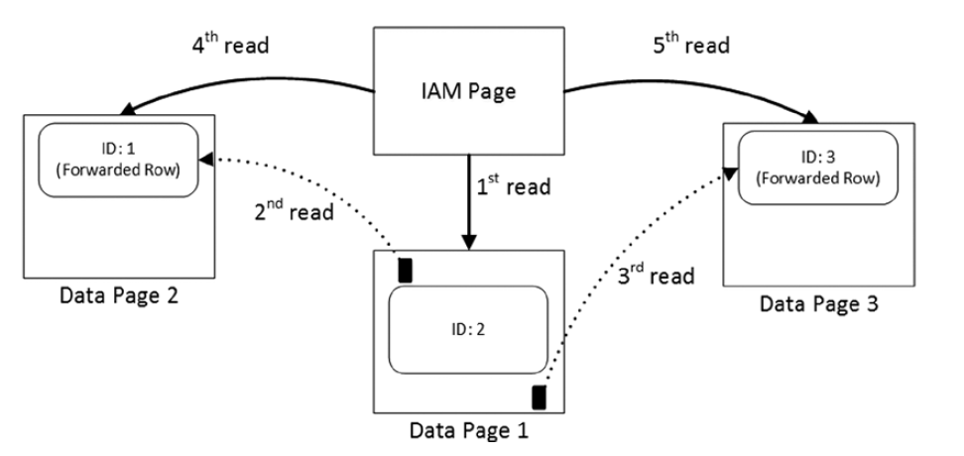
Tables and Indexes: Internal Structure and Access Methods
Heap Tables
Reading data when the forwarding pointers exist

Slide 10

Tables and Indexes: Internal Structure and Access Methods
Clustered Indexes
A clustered index dictates the physical order of the data in a table, which is sorted according to the clustered index key.
The table can have only one clustered index defined.

Slide 11
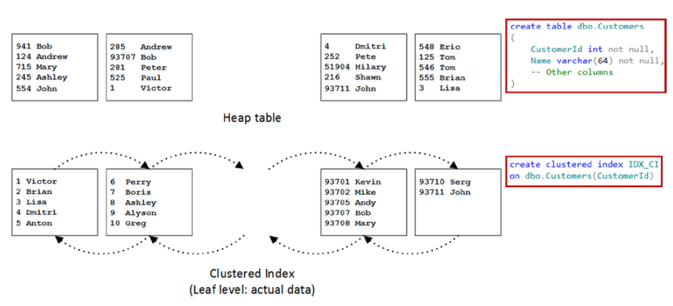
Tables and Indexes: Internal Structure and Access Methods
Clustered Indexes

Slide 12
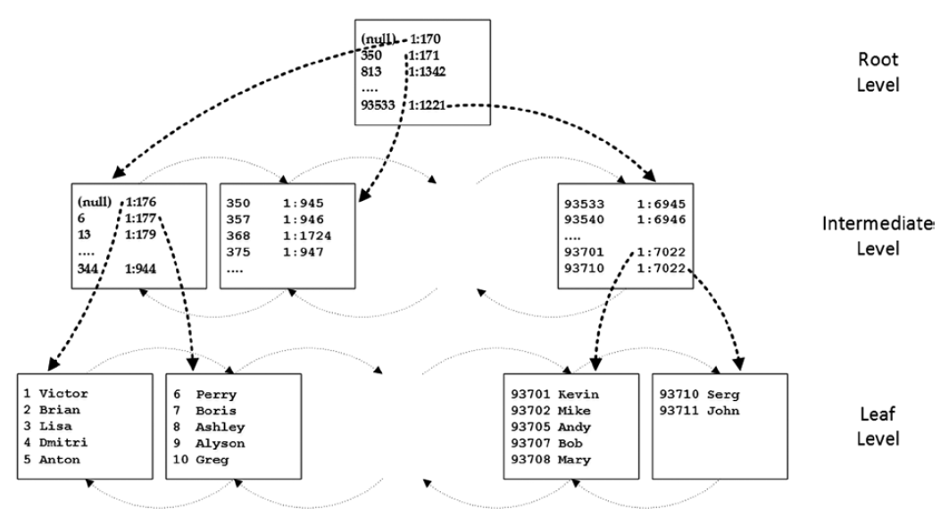
Tables and Indexes: Internal Structure and Access Methods
Clustered Indexes

Slide 13
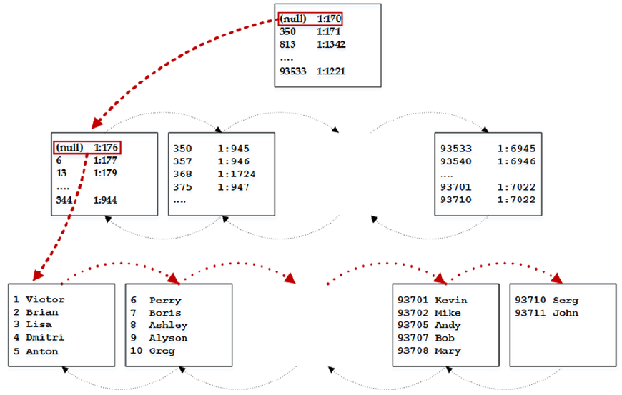
Tables and Indexes: Internal Structure and Access Methods
Clustered Indexes
Ordered index scan

Slide 14
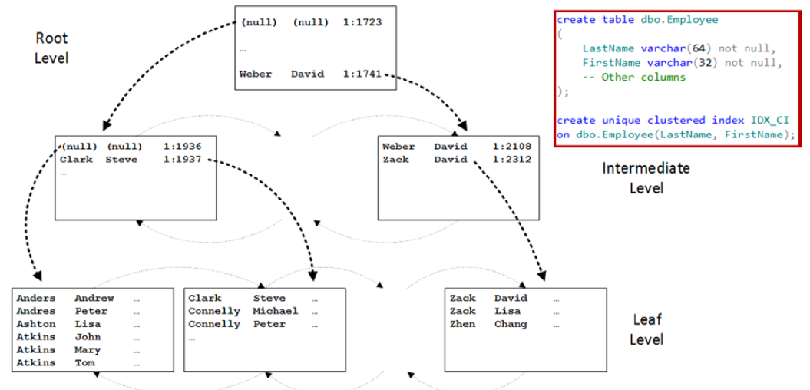
Tables and Indexes: Internal Structure and Access Methods
Composite Indexes

Slide 15
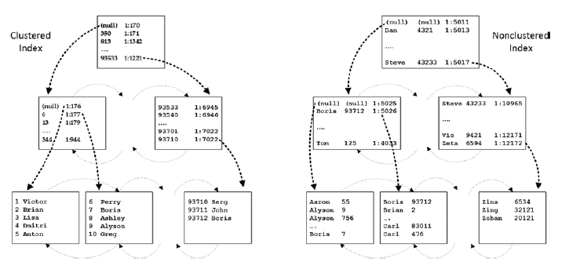
Tables and Indexes: Internal Structure and Access Methods
Nonclustered Indexes

Slide 16


Tables and Indexes: Internal Structure and Access Methods
Indexes with Included Columns
Filtered Indexes

Slide 17
Tables and Indexes: Internal Structure and Access Methods
Supporting Queries with Indexes
JOIN
WHERE (Search Arguments)
ORDER

Slide 18
Using Tools to Analyze Query Performance

Slide 19
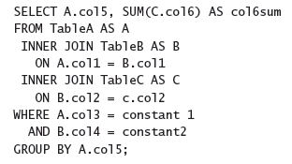
Using Tools to Analyze Query Performance
Query Optimization Problems and the Query Optimizer

Slide 20
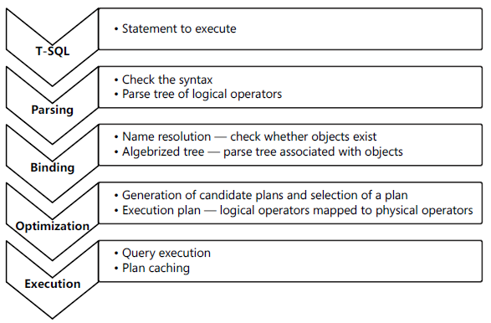
Using Tools to Analyze Query Performance
Query execution phases

Slide 21
Using Tools to Analyze Query Performance
parameter sniffing

Slide 22
Using Tools to Analyze Query Performance
SQL Server Extended Events
■ Events These are your points of interest for monitoring. You can use events for monitoring
or to trigger synchronous or asynchronous actions.
■ Targets These are event consumers. You can use targets that write to a file, store
event data in a memory buffer, or aggregate event data. Targets can process data
synchronously or asynchronously.
■ Actions These are responses to an event. They are bound to an event. Actions can
capture a stack dump and inspect data, store information in a local variable, aggregate
event data, or even append data to event data. For example, in SQL Server, you can use
the execution plan detection action to detect execution plans.
■ Predicates These are sets of logical rules to filter captured events. In order to
minimize the impact of a monitoring session on your system, it is important that you
capture only events you need.
■ Types These help interpret the data collected. The data is actually a collection of
bytes, and types give this data context. A type is provided for events, actions, targets,
predicates, and types themselves.
■ Maps These are SQL Server internal tables that map internal numeric values to
meaningful strings.

Slide 23
Using Tools to Analyze Query Performance
SQL Server Profiler
Event An event is an action within SQL Server. For example, an action can be a logon
failure, T-SQL batch, start of a stored procedure, and more.
EventClass This is the type of an event. The event class defines the data that an event
can report.
EventCategory Event categories define groupings of events
DataColumn A data column is an attribute of an event. If you save a trace to a table,
an event is represented by a row in the table, and attributes of events are columns in
the table.
Template A template is a saved trace definition. SQL Server Profiler comes with a
couple of predefined templates that can speed up the creation of a trace.
Filter Filters limit the events traced. You can put a filter on any event column. In
order to minimize the impact of monitoring on your SQL Server instance, you should
filter out any event you do not need in your current trace.
Trace A trace is a collection of events, columns, filters, and data returned

Slide 24
Using Tools to Analyze Query Performance
SQL Trace
Notes:
SQL Trace is an internal SQL Server mechanism for capturing events. SQL Trace is deprecated
in future versions. This means that it will still be available in the life cycle of SQL Server
2012 and the next version of SQL Server; however, after the next version, SQL Trace might be
discontinued.

Slide 25
Using Tools to Analyze Query Performance
Query Store
Notes:
SQL Trace is an internal SQL Server mechanism for capturing events. SQL Trace is deprecated
in future versions. This means that it will still be available in the life cycle of SQL Server
2012 and the next version of SQL Server; however, after the next version, SQL Trace might be
discontinued.

Slide 26
Using Tools to Analyze Query Performance
SET STATISTICS IO ON;
Scan count
Logical reads
Physical reads
Read-ahead reads
Lob logical reads
Lob physical reads
Lob read-ahead reads

Slide 27
Using Tools to Analyze Query Performance
SET STATISTICS TIME ON;
Parse and compile time
Execution time

Slide 28
Using Dynamic Management Objects
The Most Important DMOs for Query Tuning
SQL Server Operating System (SQLOS)–related DMOs
sys.dm_os_waiting_tasks
sys.dm_exec_sessions
Execution-related DMOs
sys.dm_exec_requests
sys.dm_exec_sql_text
sys.dm_exec_query_stats
Index-related DMOs
sys.dm_db_missing_index_details

Slide 29
Using Tools to Analyze Query Performance
Execution Plans
SET SHOWPLAN_TEXT and SET SHOWPLAN_ALL for estimated plans
SET STATISTICS PROFILE for actual plans
SET SHOWPLAN_XML for estimated plans
SET STATISTICS XML for actual plan

Slide 30
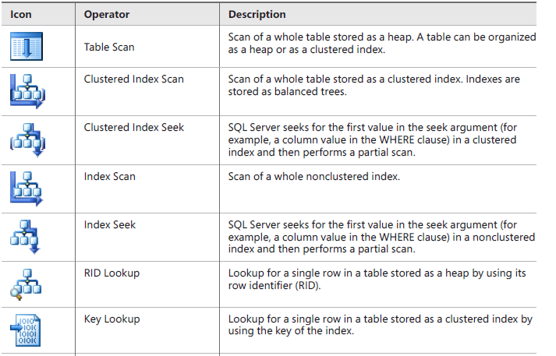
Using Tools to Analyze Query Performance
Execution Plans

Slide 31
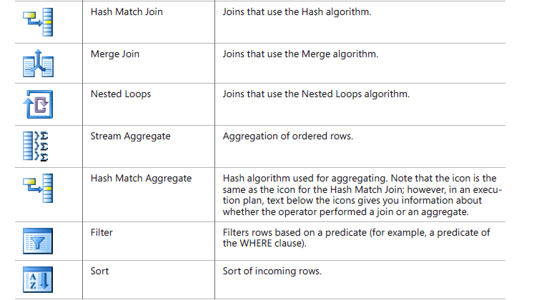
Using Tools to Analyze Query Performance
Execution Plans

Slide 32
Using Tools to Analyze Query Performance
Execution Plans
Nested Loops
Merge
Hash
Bitmap Filtering Optimized Hash (also called Star join optimization)
Adaptive join (SQL 2017)

Slide 33
Understanding Cursors, Sets, and Temporary Tables

Slide 34
Cursors
DEMO

Slide 35
using temporary tables vs. table variables
DEMO

