Slide 1



March 24, 2019
3

Slide 2
Agenda: MSBI.Dev.S19E16
---
topics:
- topicname: CrimeStatistic Project
subtopics:
- subtopicname: CrimeStat.DWH
- subtopicname: CrimeStat.SSIS
- subtopicname: CrimeStat Tasks
- topicname: Designing and Implementing Control Flow
subtopics:
- subtopicname: Transformations
3
Notes:
Appendix includes recent awards, please visit elements.epam.com for all 2016-2017 awards

Slide 3
CrimeStat.SSIS

Slide 4
DWH
CrimeStat BI solution case scenario

Slide 5
Determining Appropriate ETL Strategy and Tools
ETL Strategy
Defining the architecture for ETL
Deciding what to do in the SSIS and what to push down to the database layer
Managing the whole ETL process

Slide 6
Determining Appropriate ETL Strategy and Tools
ETL Architecture
Extract the data (process)
Initial Staging (landing zone)
Data Quality (process)
Clean Staging (landing zone)
Transformation (process)
Load-ready Publish (landing zone)
Load Enterprise Data Warehouse (process)
Enterprise Data Warehouse (landing zone)
Load Data Marts (process)
Data Marts (landing zone)

Slide 7
Transformations

Slide 8
Designing and Implementing Data Flow
Designing and Implementing Data Flow

Slide 9
Designing and Implementing Data Flow
Defining Data Sources and Destinations
Creating a Data Flow Task
Defining Data Flow Source Adapters
Defining Data Flow Destination Adapters
SSIS Data Types

Slide 10

Designing and Implementing Data Flow
Using a Lookup Transformation
Lookup Transformation Case Sensitivity and others

Slide 11
Designing and Implementing Data Flow
Using the Cache Transform Transformation with the Lookup
Transformation

Slide 12
Designing and Implementing Data Flow
Sorting the Data
Set based update

Slide 13
Designing and Implementing Data Flow
Working with Data Flow Transformations
Selecting Transformations
non-blocking transformations
partial-blocking transformation
blocking transformation

Slide 14
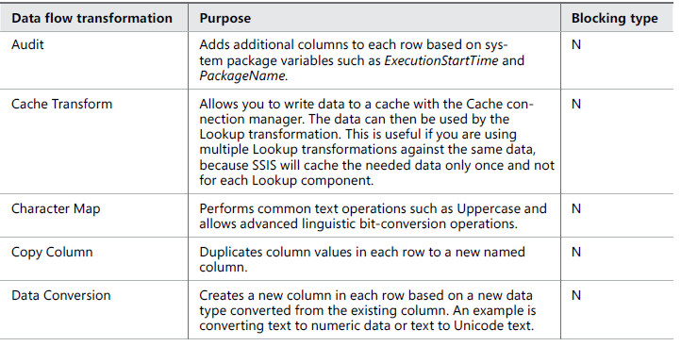
Designing and Implementing Data Flow
Logical Row-Level Transformations

Slide 15
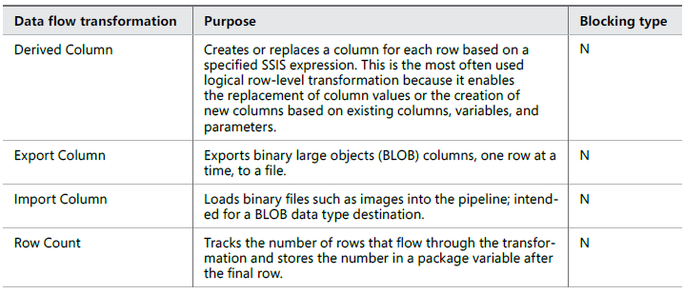
Designing and Implementing Data Flow
Logical Row-Level Transformations

Slide 16
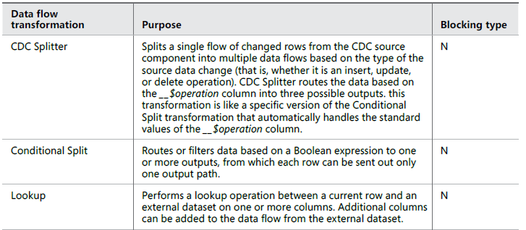
Designing and Implementing Data Flow
Multi-Input and Multi-Output Transformations

Slide 17
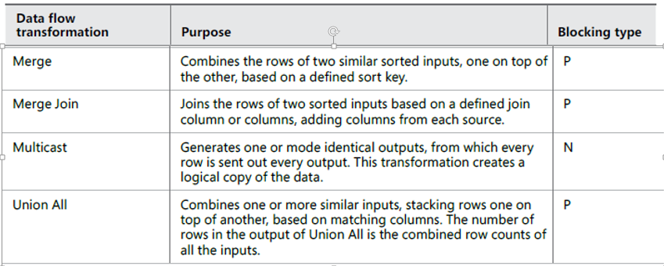
Designing and Implementing Data Flow
Multi-Input and Multi-Output Transformations

Slide 18
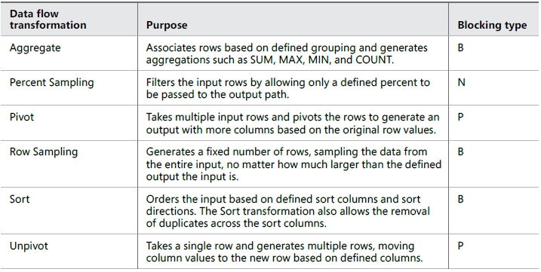
Designing and Implementing Data Flow
Multi-Row Transformations

Slide 19
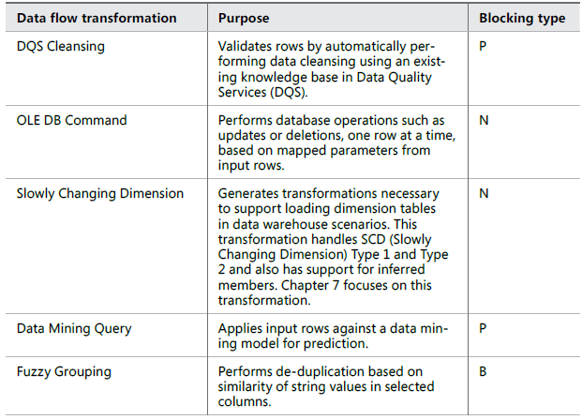
Designing and Implementing Data Flow
Advanced Data-Preparation Transformations

Slide 20
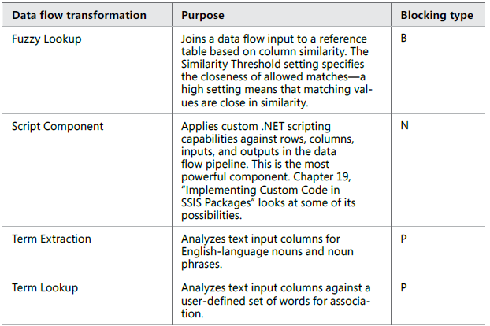
Designing and Implementing Data Flow
Advanced Data-Preparation Transformations

