Slide 1

November 23, 2021
CONFIDENTIAL | © 2021 EPAM Systems, Inc.

Slide 2

Agenda
1
Using Subqueries AND Table Expressions
2
USING APPLY Operator
3
Grouping
4
Pivoting and Unpivoting Data
5
Using Window Functions

Slide 3
Using Subqueries AND Table Expressions

Slide 4
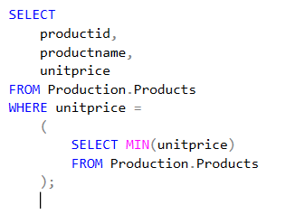
Using Subqueries and Table Expressions
Self-Contained Subqueries
Self-contained subqueries are subqueries that have no dependency on the outer query.
Notes:
Note that if what’s supposed to be a scalar subquery returns in practice more than one
value, the code fails at run time. If the scalar subquery returns an empty set, it is converted to
a NULL.

Slide 5
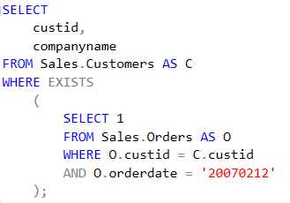
Using Subqueries and Table Expressions
Correlated Subqueries
Correlated subqueries are subqueries where the inner query has a reference to a column from the table in the outer query.

Slide 6
Using Subqueries and Table Expressions
Table Expressions
Table expressions are named queries.
Derived tables
Common table expressions (CTEs)
Views
Inline table-valued functions

Slide 7
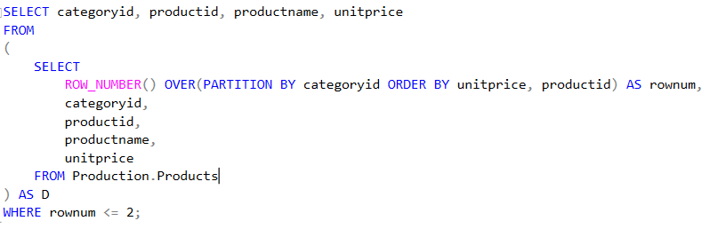
Using Subqueries and Table Expressions
Derived Tables

Slide 8
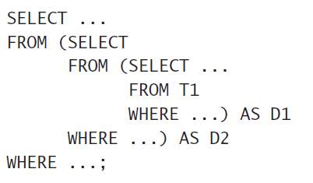
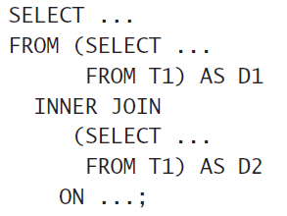
Using Subqueries and Table Expressions
Derived Tables

Slide 9
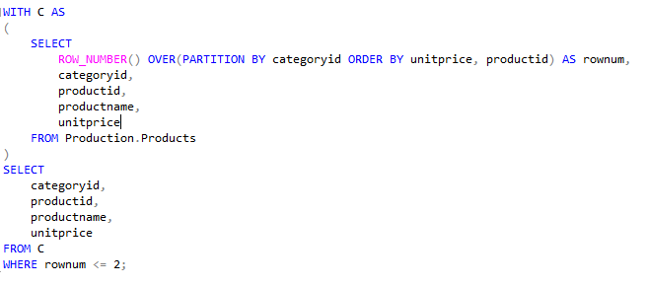
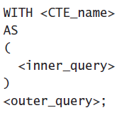
Using Subqueries and Table Expressions
CTE
common table expression (CTE)

Slide 10
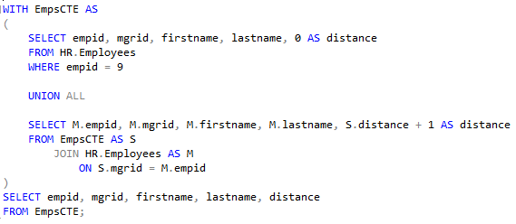
Using Subqueries and Table Expressions
CTE recursive form
common table expression (CTE) recursive form

Slide 11
Using Subqueries and Table Expressions
DEMO

Slide 12
Using APPLY Operator

Slide 13
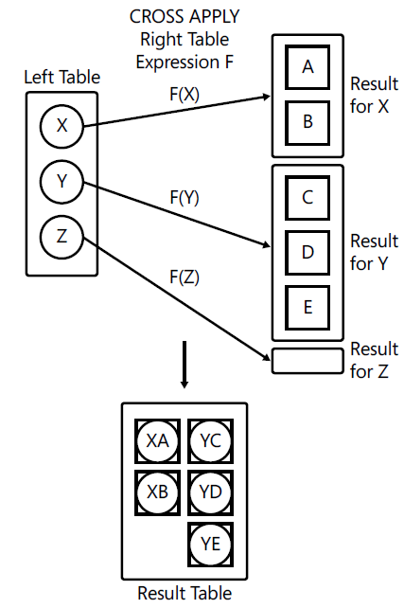
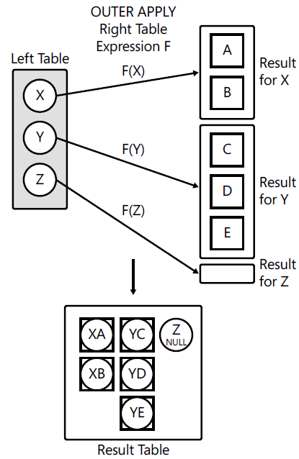
Using APPLY Operator
CROSS APPLY
OUTER APPLY

Slide 14
Using APPLY Operator
DEMO

Slide 15
Grouping

Slide 16
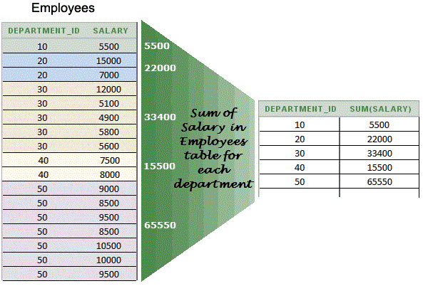
Grouping
SUM, COUNT, AVG, MIN, MAX

Slide 17
Grouping
Aggregate Functions
APPROX_COUNT_DISTINCT
AVG
CHECKSUM_AGG
COUNT
COUNT_BIG
GROUPING
GROUPING_ID
MAX
MIN
STDEV
STDEVP
STRING_AGG
SUM
VAR
VARP
https://docs.microsoft.com/en-us/sql/t-sql/functions/aggregate-functions-transact-sql

Slide 18
Grouping
SINGLE Grouping Sets
SELECT
shipperid,
YEAR(shippeddate) AS shippedyear,
COUNT(*) AS numorders
FROM Sales.Orders
GROUP BY shipperid, YEAR(shippeddate)
ORDER BY shipperid;

Slide 19
Grouping
Multiple Grouping Sets
SELECT shipperid, YEAR(shippeddate) AS shipyear, COUNT(*) AS numorders
FROM Sales.Orders
GROUP BY GROUPING SETS
(
( shipperid, YEAR(shippeddate) ),
( YEAR(shippeddate) ),
( )
)

Slide 20
Grouping
DEMO

Slide 21
Pivoting and Unpivoting Data

Slide 22
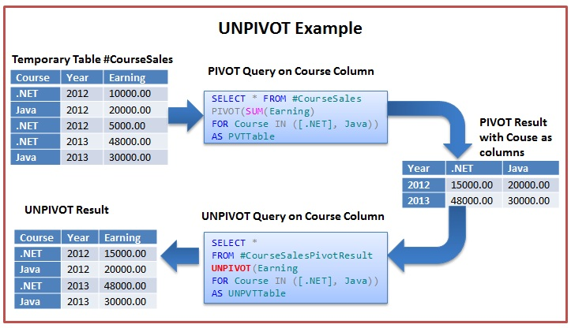
Pivoting and Unpivoting Data

Slide 23
Pivoting and Unpivoting Data
DEMO

Slide 24
Using Window Functions

Slide 25
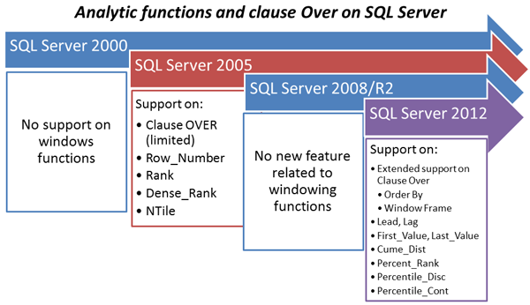
Using Window Functions

Slide 26
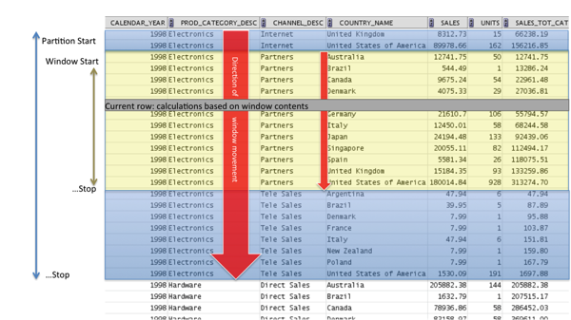
Using Window Functions
<window function>
OVER (
[PARTITION BY … ]
[ORDER BY…]
[{ ROWS | RANGE } ]
)

Slide 27
Using Window Functions
Window Aggregate Functions
APPROX_COUNT_DISTINCT
AVG
CHECKSUM_AGG
COUNT
COUNT_BIG
GROUPING
GROUPING_ID
MAX
MIN
STDEV
STDEVP
STRING_AGG
SUM
VAR
VARP
https://docs.microsoft.com/en-us/sql/t-sql/functions/aggregate-functions-transact-sql

Slide 28
Using Window Functions
Window Ranking Functions
RANK
DENSE_RANK
NTILE
ROW_NUMBER
https://docs.microsoft.com/en-us/sql/t-sql/functions/ranking-functions-transact-sql

Slide 29
Using Window Functions
Window Analytic Functions
CUME_DIST
FIRST_VALUE
LAG
LAST_VALUE
LEAD
PERCENT_RANK
PERCENTILE_CONT
PERCENTILE_DISC
https://docs.microsoft.com/en-us/sql/t-sql/functions/analytic-functions-transact-sql

Slide 30
Using Window Functions
Window Frames
UNBOUNDED PRECEDING or FOLLOWING, meaning the beginning or end of the partition, respectively
CURRENT ROW, obviously representing the current row
<n> ROWS PRECEDING or FOLLOWING, meaning n rows before or after the current, respectively
RANGE UNBOUNDED PRECEDING AND UNBOUNDED FOLLOWING is used as default for window frame when ORDER BY is not provided
RANGE UNBOUNDED PRECEDING AND CURRENT ROW is used as default for window frame when ORDER BY is provided
{ ROWS | RANGE }

Slide 31
Using Window Functions
DEMO

Slide 32
Q&A Session

