Slide 1

November 30, 2021
CONFIDENTIAL | © 2021 EPAM Systems, Inc.

Slide 2

Agenda
1
Creating and Altering Tables
2
Enforcing Data Integrity
3
Designing and Implementing Views
4
Implementing User-Defined Functions
5
SSDT: How to manage database as a source code

Slide 3
Creating and Altering Tables

Slide 4
Creating and Altering Tables
Creating and Altering Tables
Base tables
Temporary tables
Table variables
Views
Indexed views
Derived tables and table expressions

Slide 5
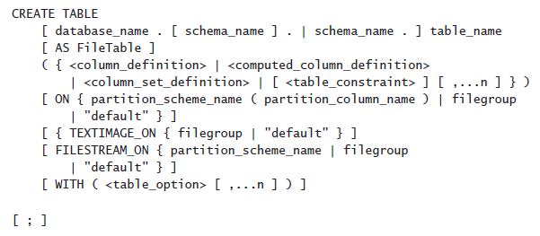
Creating and Altering Tables
Creating and Altering Tables
CREATE TABLE statement
SELECT INTO statement

Slide 6
Creating and Altering Tables
Creating and Altering Tables
Specifying a Database Schema
Naming Tables and Columns
Sys (Lineage) Columns
Choosing Column Data Types
NULL and Default Values
Computed Columns
Table Compression

Slide 7
Creating and Altering Tables
Naming Tables and Columns
Regular
Delimited
CREATE TABLE Production.CategoriesTest1
CREATE TABLE Production.[Yesterday's News]
CREATE TABLE Production."Tomorrow's Schedule"

Slide 8
Creating and Altering Tables
Choosing Column Data Types
Size is important
NVARCHAR or VARCHAR vs NCHAR or CHAR
DATE, TIME, and DATETIME2 vs DATETIME and SMALLDATETIME
VARCHAR(MAX), NVARCHAR(MAX), and VARBINARY(MAX) instead of the deprecated TEXT, NTEXT, and IMAGE
Use DECIMAL and NUMERIC instead of FLOAT or REAL

Slide 9
Choosing a Data Type for Keys
Choosing a Data Type for Keys
The identity column property
The sequence object
Nonsequential GUIDs
Sequential GUIDs
Custom solutions

Slide 10
Creating and Altering Tables
Column
NULL and Default Values
The Identity Property and Sequence Numbers
Computed Columns (non deterministic function GETDATE() or CURRENT_TIMESTAMP)

Slide 11
Creating and Altering Tables
DEMO

Slide 12
Enforcing Data Integrity

Slide 13
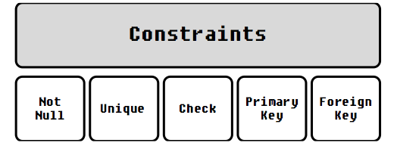

Enforcing Data Integrity
Constraints
NOT NULL
Primary Key Constraint
Unique Constraint
Foreign Key Constraint
Check Constraint
Default Constraint

Slide 14
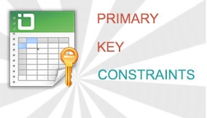
Enforcing Data Integrity
Primary Key Constraints

Slide 15
Enforcing Data Integrity
Unique Constraints

Slide 16
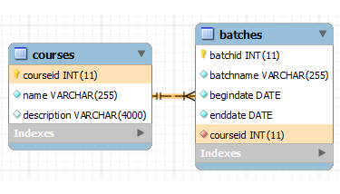

Enforcing Data Integrity
Foreign Key Constraints

Slide 17

Enforcing Data Integrity
Check Constraints

Slide 18
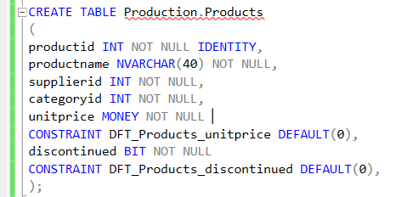
Enforcing Data Integrity
Default Constraints

Slide 19
Enforcing Data Integrity
Naming
PK_<TableName>_<ColNames>
UQ_<TableName>_<ColNames>
FK_<ReferencingTable>_<ReferencedTable>_<ColNames>
DF_<Table>_<Column>
CK_<Table>_<Column_Or_Description>

Slide 20
Designing and Implementing Views

Slide 21
Designing and Implementing Views
Views case scenario
Notes:
Restrictions on Views
Views have a number of restrictions, such as the following:
■■ You cannot add an ORDER BY to the SELECT statement in a view. A view must appear
just like a table, and tables in a relational database contain sets of rows. Sets by themselves
are not ordered, although you can apply an order to a result set using ORDER
BY. Similarly, tables and views in SQL Server do not have a logical order to their rows,
though you can apply one by adding an ORDER BY to the outermost SELECT statement
when you access the view.
■■ You cannot pass parameters to views.
■■ Similarly, a view cannot reference a variable inside the SELECT statement. See the
section “Inline Functions” for information on how to use functions to simulate passing
parameters to a view.
■■ A view cannot create a table, whether permanent or temporary. In other words, you
cannot use the SELECT/INTO syntax in a view.
■■ A view can reference only permanent tables; a view cannot reference a temporary
table.

Slide 22

Designing and Implementing Views
Creating Views
WITH ENCRYPTION
WITH SCHEMABINDING
WITH VIEW_METADATA
WITH CHECK OPTION
Notes:
Restrictions on Views
Views have a number of restrictions, such as the following:
■■ You cannot add an ORDER BY to the SELECT statement in a view. A view must appear
just like a table, and tables in a relational database contain sets of rows. Sets by themselves
are not ordered, although you can apply an order to a result set using ORDER
BY. Similarly, tables and views in SQL Server do not have a logical order to their rows,
though you can apply one by adding an ORDER BY to the outermost SELECT statement
when you access the view.
■■ You cannot pass parameters to views.
■■ Similarly, a view cannot reference a variable inside the SELECT statement. See the
section “Inline Functions” for information on how to use functions to simulate passing
parameters to a view.
■■ A view cannot create a table, whether permanent or temporary. In other words, you
cannot use the SELECT/INTO syntax in a view.
■■ A view can reference only permanent tables; a view cannot reference a temporary
table.

Slide 23
Designing and Implementing Views
Views Restrictions
NO ORDER BY (unless there is also a TOP clause)
NO PARAMETERS
NO DDL (CREATE, ALTER etc)
NO TEMP TABLE
Notes:
However, it is possible to create a unique clustered index on a view and materialize the
data. In that case, more than the view definition is stored. The actual results of the view query
are stored on disk, in the clustered index structure. To be indexed, a view must satisfy a number
of important restrictions. For more information about indexed views, see "Implementing
Indexed Views" in Chapter 15, “Implementing Indexes and Statistics.”

Slide 24
Designing and Implementing Views
Indexed Views
Notes:
However, it is possible to create a unique clustered index on a view and materialize the
data. In that case, more than the view definition is stored. The actual results of the view query
are stored on disk, in the clustered index structure. To be indexed, a view must satisfy a number
of important restrictions. For more information about indexed views, see "Implementing
Indexed Views" in Chapter 15, “Implementing Indexes and Statistics.”

Slide 25
Designing and Implementing Views
Modifying Data Through a View
Only with direct reference to column
WITH CHECK OPTION
Notes:
However, it is possible to create a unique clustered index on a view and materialize the
data. In that case, more than the view definition is stored. The actual results of the view query
are stored on disk, in the clustered index structure. To be indexed, a view must satisfy a number
of important restrictions. For more information about indexed views, see "Implementing
Indexed Views" in Chapter 15, “Implementing Indexes and Statistics.”

Slide 26
Designing and Implementing Views
DEMO

Slide 27
Implementing User-Defined Functions

Slide 28
Implementing User-Defined Functions
User-Defined Function Types
Scalar
inline (starting with SQL Server 2019)
Table-valued
inline table-valued UDF
multistatement table-valued UDF

Slide 29
Implementing User-Defined Functions
Understanding User-Defined Functions
Can
accept parameters
embedded in T-SQL statements
access SQL Server data

Slide 30
Implementing User-Defined Functions
OBJECT_ID()
FN = SQL scalar function
IF = SQL inline table-valued function
TF = SQL multistatement table-valued function

Slide 31
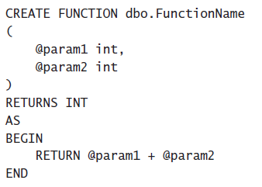
Implementing User-Defined Functions
Scalar UDFs

Slide 32
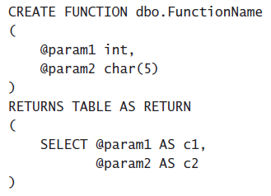
Implementing User-Defined Functions
Inline Table-Valued UDF

Slide 33
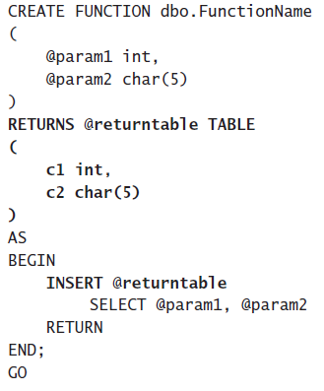
Implementing User-Defined Functions
Multistatement Table-Valued UDF

Slide 34
Implementing User-Defined Functions
DEMO

Slide 35
Implementing User-Defined Functions
UDF Options
You can specify five options with UDFs:
ENCRYPTION
SCHEMABINDING
RETURN NULL ON NULL INPUT / CALLED ON NULL INPUT
EXECUTE AS
INLINE = ON / OFF (Starting with SQL Server 2019)

Slide 36
Implementing User-Defined Functions
Limitations on UDFs
UDFs cannot do the following:
Apply any schema or data changes in the database.
Change the state of a database or SQL Server instance.
Create or access temporary tables.
Call stored procedures.
Execute dynamic SQL.
Produce side effects. For example, both the RAND() and NEWID()

Slide 37
Implementing User-Defined Functions
UDF Performance Considerations

Slide 38
SSDT: How to manage database as a source code

Slide 39
SSDT How to manage database as a source code
Create new project.
Sync project to actual state of database
Deploy changes to DEV , TST and PRD
Teamwork

Slide 40
Q&A Session

