Slide 1



April 24, 2019
3

Slide 2


MSBI DEVELOPER
Course
S16E25
May 11, 2016 by Andrey Potapov

Slide 3
In Previous part: S16E24 AGENDA
Creating Calculations and Queries by Using MDX
Understanding MDX syntax
Applying MDX Functions
Creating Calculated Members
Defining Named Sets
Parent child user hierarchies

Slide 4
S16E25 AGENDA
​Managing SSAS Storage, Processing, and Deployment
Defining Measure Group Partitions and Aggregations
Deploying SSAS Objects
Processing SSAS Objects

Slide 5
S16E24 AGENDA
Setting Up SSAS Server Security
Understanding SSAS Security
Creating Roles and Applying User Security to Cubes
Defining Advanced Cell Security
Setting Drill-Through Security
Testing Database Role Security

Slide 6
​Managing SSAS Storage, Processing, and Deployment
Defining Measure Group Partitions and Aggregations

Slide 7
​Managing SSAS Storage, Processing, and Deployment
Defining Measure Group Partitions and Aggregations
Reason for partitioning
Improved performance
No need to scan whole partition
Improved manageability
Different partitions modes
Processing

Slide 8
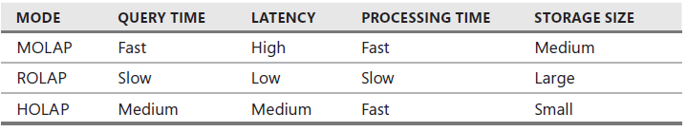
​Managing SSAS Storage, Processing, and Deployment
Defining Measure Group Partitions and Aggregations
Storage Modes
Multidimensional OLAP
Relational OLAP
Hybrid OLAP

Slide 9
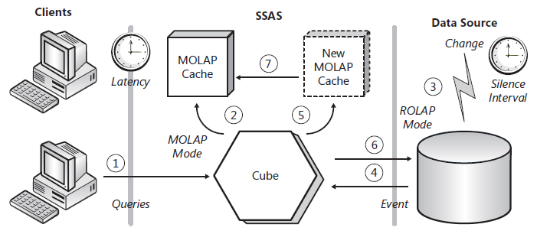
​Managing SSAS Storage, Processing, and Deployment
Defining Measure Group Partitions and Aggregations
Proactive Caching
Multidimensional OLAP
Relational OLAP
Hybrid OLAP

Slide 10
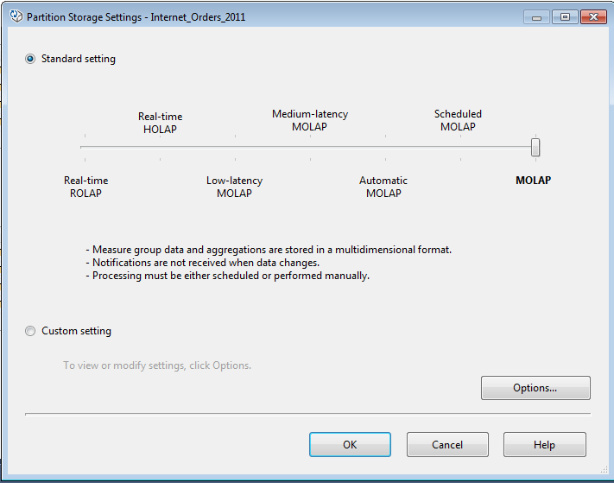
​Managing SSAS Storage, Processing, and Deployment
Defining Measure Group Partitions and Aggregations
Proactive Caching Modes

Slide 11
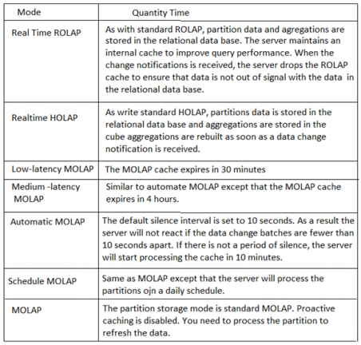
​Managing SSAS Storage, Processing, and Deployment
Defining Measure Group Partitions and Aggregations
Proactive Caching Modes

Slide 12
​Managing SSAS Storage, Processing, and Deployment
Defining Measure Group Partitions and Aggregations
Demo
Show project with several partitions
Show Adventure work
Show ROLAP
Show Proactive Caching

Slide 13
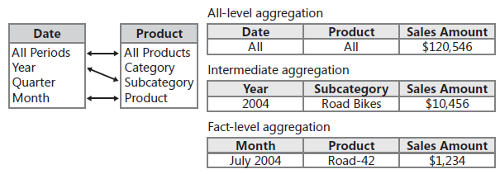
​Managing SSAS Storage, Processing, and Deployment
Defining Measure Group Partitions and Aggregations
Aggregations
Show project with several partitions
Show Adventure work
Show ROLAP
Show Proactive Caching

Slide 14
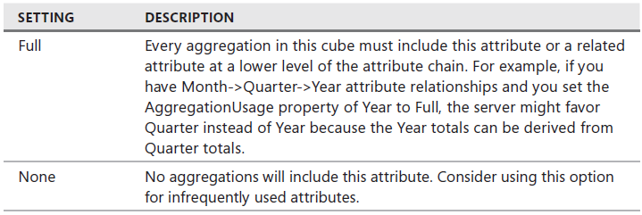
​Managing SSAS Storage, Processing, and Deployment
Defining Measure Group Partitions and Aggregations
AggregationsUsage property
Show project with several partitions
Show Adventure work
Show ROLAP
Adventure Works Cube has up to 2^50 aggregations

Slide 15
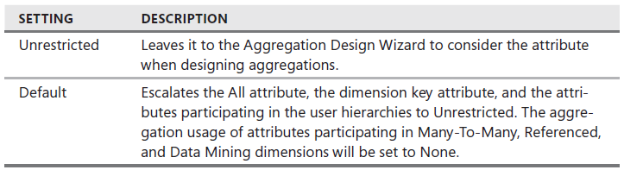
​Managing SSAS Storage, Processing, and Deployment
Defining Measure Group Partitions and Aggregations
AggregationsUsage property
Show project with several partitions
Show Adventure work
Show ROLAP
Adventure Works Cube has up to 2^50 aggregations

Slide 16
​Managing SSAS Storage, Processing, and Deployment
Deploying and Processing SSAS Objects

Slide 17
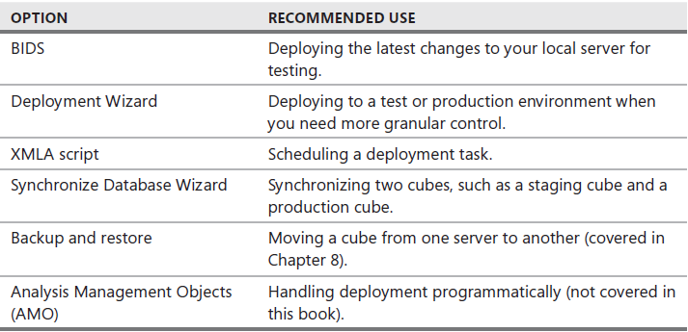
​Managing SSAS Storage, Processing, and Deployment
Deploying SSAS Objects
Deployment options

Slide 18
​Managing SSAS Storage, Processing, and Deployment
Deploying SSAS Objects
BIDS Design Modes (SQL Server Data Tools )
Connected mode
Project mode

Slide 19
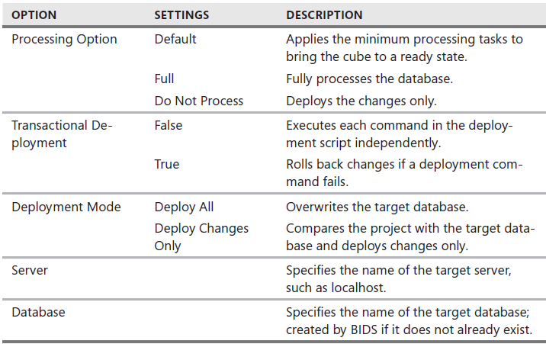
​Managing SSAS Storage, Processing, and Deployment
Deploying SSAS Objects
Deployment settings

Slide 20
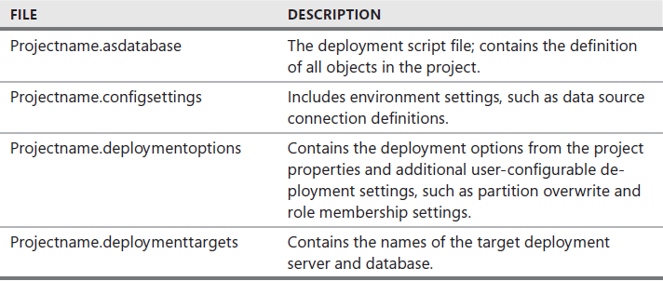
​Managing SSAS Storage, Processing, and Deployment
Deploying SSAS Objects
Deployment Wizard (help to keep management settings)

Slide 21
​Managing SSAS Storage, Processing, and Deployment
Deploying SSAS Objects
Deployment Wizard (help to keep management settings)

Slide 22
​Managing SSAS Storage, Processing, and Deployment
Deploying SSAS Objects
Running XMLA script
Synchronize

Slide 23
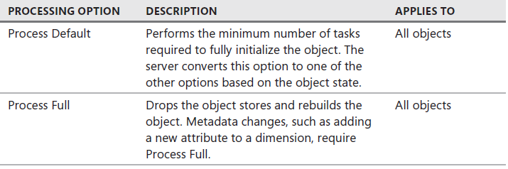
​Managing SSAS Storage, Processing, and Deployment
Processing SSAS Objects
Processing options

Slide 24
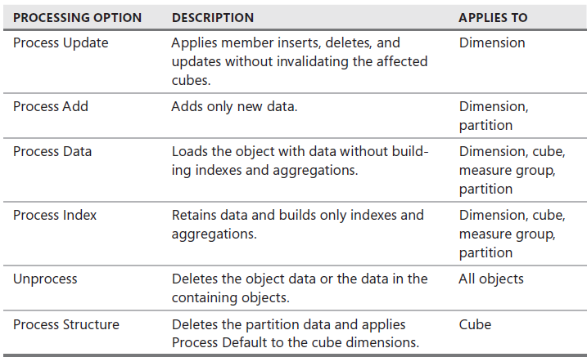
​Managing SSAS Storage, Processing, and Deployment
Processing SSAS Objects
Processing options

Slide 25
​Managing SSAS Storage, Processing, and Deployment
Processing SSAS Objects
BIDS (SQL Server Data Tools )
SSMS
SSIS
XMLA

Slide 26
Setting Up SSAS Server Security
Understanding SSAS Security

Slide 27
Setting Up SSAS Server Security
Understanding SSAS Security
DEMO

Slide 28
Setting Up SSAS Server Security
Creating Roles and Applying User Security to Cubes

Slide 29
Setting Up SSAS Server Security
Creating Roles and Applying User Security to Cubes
Roles
Administrator Role
Database Role

Slide 30
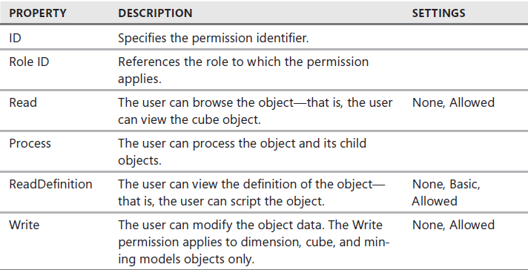
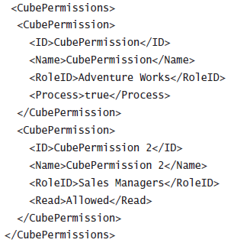
Setting Up SSAS Server Security
Creating Roles and Applying User Security to Cubes
Permission property

Slide 31

Setting Up SSAS Server Security
Creating Roles and Applying User Security to Cubes
DEMO
Creating a Database Role
Working with Dimension Data Security
Enable Visual Totals
Dynamic Security

Slide 32
Setting Up SSAS Server Security
Defining Advanced Cell Security

Slide 33
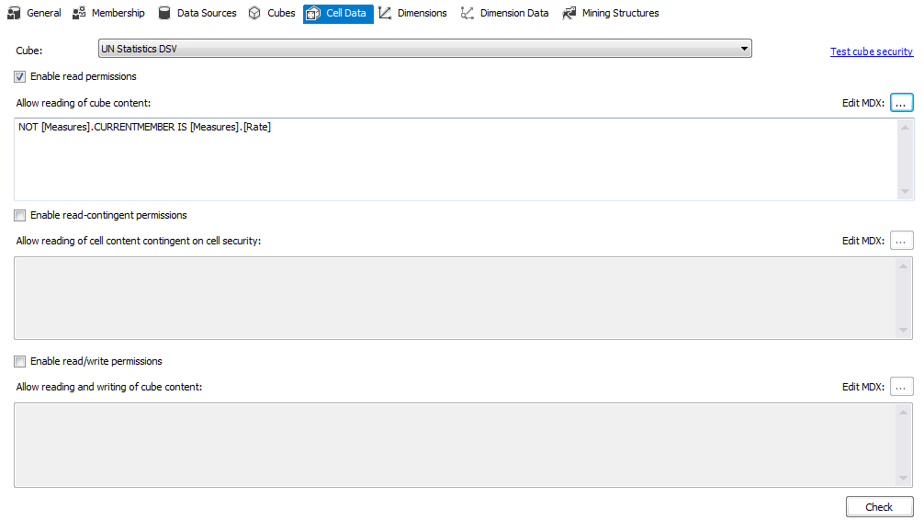
Setting Up SSAS Server Security
Defining Advanced Cell Security
Cell permissions types
Read
Read-contingent
Read-Write

Slide 34
Setting Up SSAS Server Security
Setting Drill-Through Security

Slide 35
Setting Up SSAS Server Security
Setting Drill-Through Security
Related to Drill through Action
By default this permission is disabled

Slide 36
Setting Up SSAS Server Security
Testing Database Role Security

Slide 37
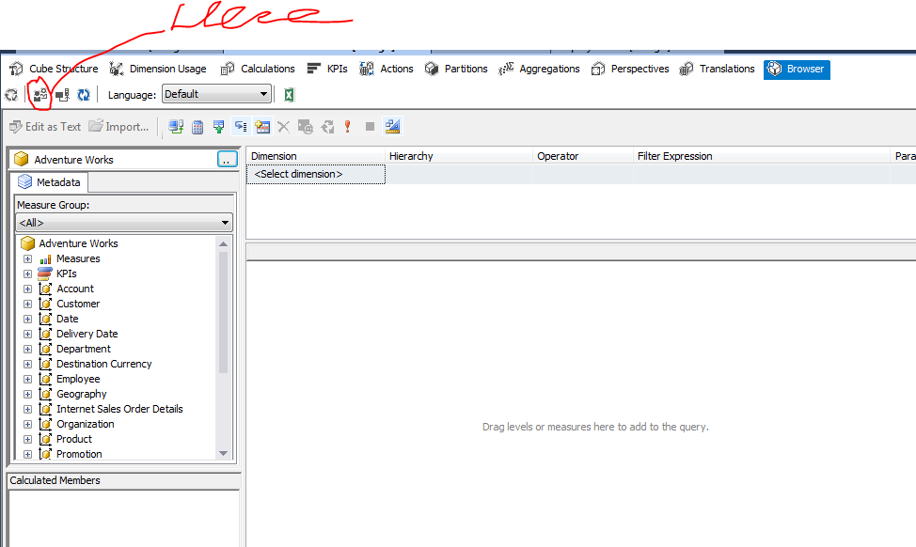
Setting Up SSAS Server Security
Testing Database Role Security
DEMO

Slide 38
S16E24
Thank You!

